Slide 1
HyperText Transfer Protocol (HTTP)
A General Definition

Slide 2
Introduction
HTTP is a protocol for fetching resources such as HTML documents.
It is a Client-Server protocol.
It is ubiquitous. Whenever one visits a page on the web, their device uses HTTP to download that page from somewhere on the Internet

Slide 3
Before we start: Protocols
System of rules
Defines how data is exchanged (the format)

Slide 4
HTTP: A definition
Clients and servers communicate by exchanging individual messages.
Messages sent by the client (usually Web browsers) are called requests.
Messages sent by the server as an answer are called responses

Slide 5
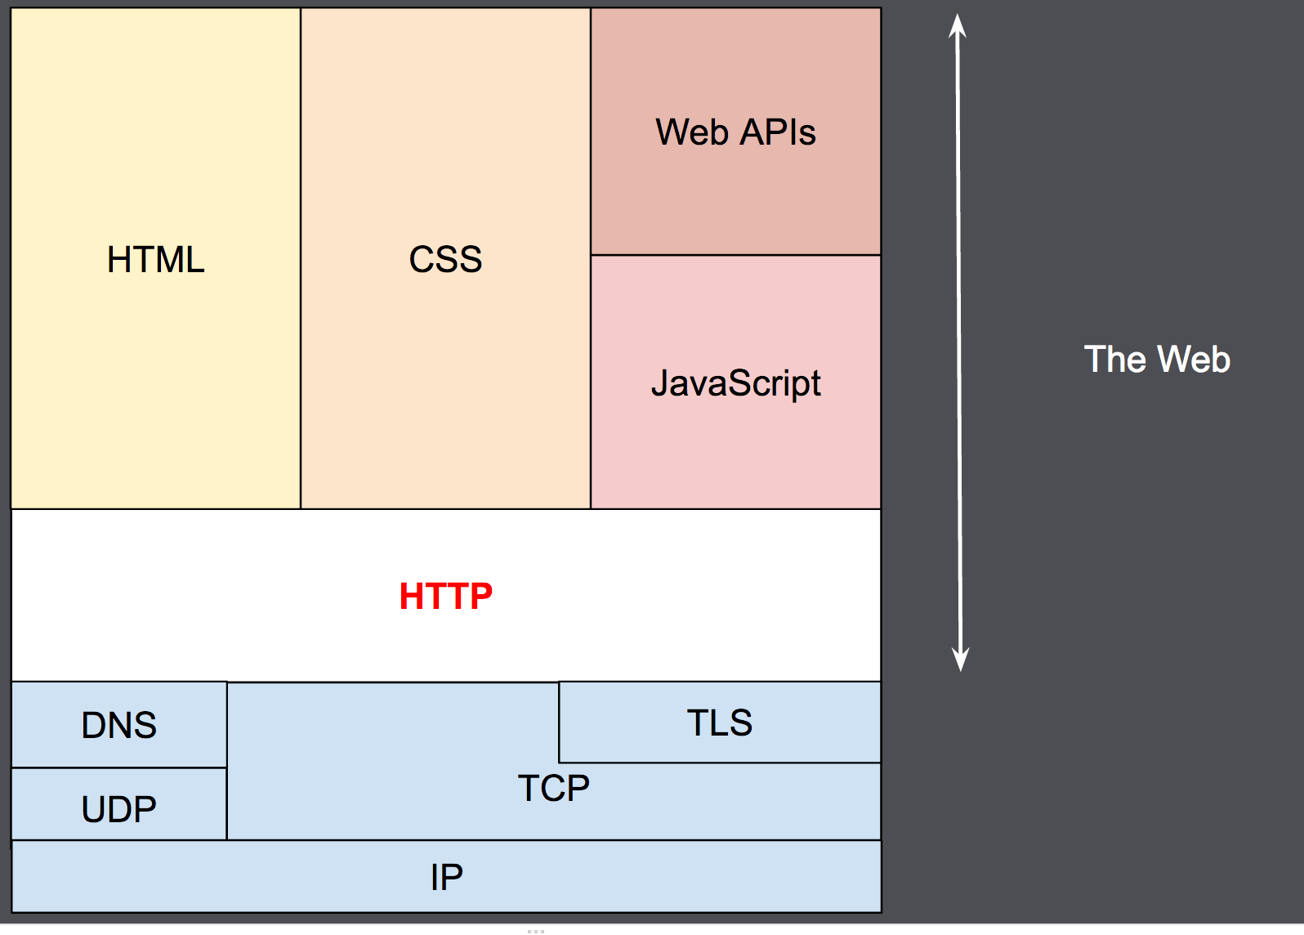
Architecture of the Web
HTTP is an application layer protocol.
It is sent of TCP (or TLS-encrypted TCP connection)

Slide 6
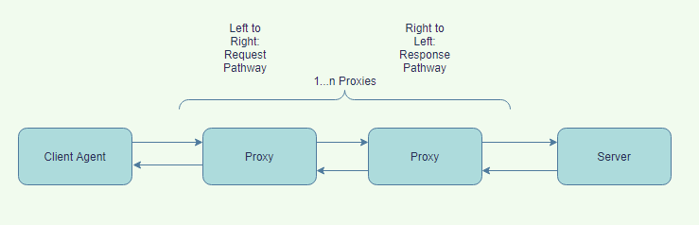
HTTP Components: Overview
Note: There are more between client and server (routers, modems…). While important in diagnosing network problems, they are irrelevant to describing HTTP.

Slide 7
HTTP Components: Client (User –Agent)
Definition: Any tool that acts on behalf of the user.
Is primarily the Web browser, but can also be programs used for debugging.
The client is always the entity initiating the request. The server never initiates a request (it is possible to simulate server-initiated messages though)

Slide 8
HTTP Components: Server
Serves client requests
Virtually a single machine, but can be distributed.
While not necessarily a single machine, several instances can be hosted on one, and they can share the same IP

Slide 9
HTTP Components: Proxies
Multiple devices that relay HTTP messages between Client and Server
Can be transparent (just forwarding the request. Can also…

Slide 10
HTTP Components: Proxies
Caching (public or private)
Filtering (Antivirus scan or Parental Control)
Logging (Storage of historical information)
Load balancing (Allows multiple servers to server multiple requests)
Authenticating (Access control to resources)

Slide 11
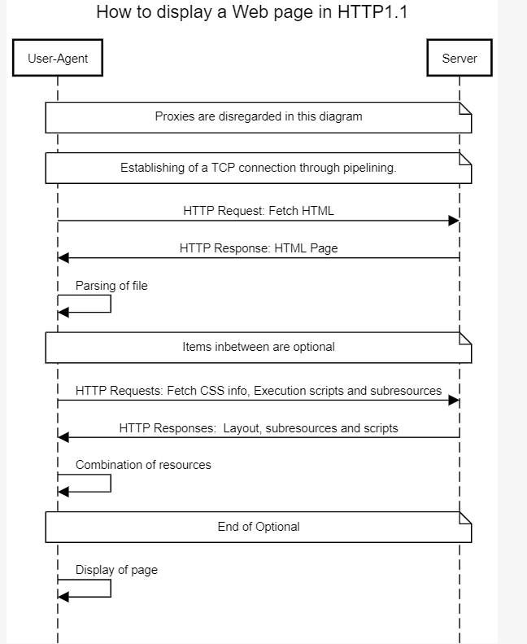
Typical HTTP application
Before HTTP1.1, a TCP connection was to be established before each request-response
More on this later on

Slide 12
Basic Aspects of HTML: Simplicity
Can be read and understood by humans
Makes for easier testing for developers
Reduces complexity for newcomers

Slide 13
Basic Aspects of HTML: Extensibility
HTTP headers make it easy to extend
New functionalities can be introduced as long as the client and server agree about the semantics.

Slide 14
Basic Aspects of HTML: Stateless…
No link between 2 requests on the same connection
This is problematic for coherent page interaction (e.g. e-commerce shopping carts)

Slide 15
Basic Aspects of HTML: Not sessionless
Cookies allow the use of stateful sessions.
Allows for session creation on each request.
Useful to share context/state on each request.

Slide 16
Control Scope of HTTP (1)
Caching
Controls how docs are cached
How to cache and for how long
Can also ignore
Authentication
Access right controls
Using WWW-Authenticate
Or sessions through Cookies

Slide 17
Control Scope of HTTP (2)
Sessions
Link requests with server state
Even though HTTP is stateless
Useful for sites with user config of output
Proxy and Tunneling
Components on Intranet often hide their true IP
Requests go through proxies
Not all are HTTP proxies though

Slide 18
Control Scope of HTTP: Origin constraints
By default, browsers enforce strict separation between Web sites/
To prevent snooping and privacy breaches.
=> Only page from same origin can access all info

Slide 19
Control Scope of HTTP: Origin constraints
HTTP headers can relax this on server side.
Allows a document to be sourced from different domains
Could even be security reasons to do so/

Slide 20
HTTP Flow
TCP Connection
Used to send requests and receive responses.
Send HTTP message
Read server response
New, reuse or multiple
Before HTTP2: Human-readable
Similar to HTTP messages

Slide 21
The Connection (usually TCP)
Established by the client on the transport layer
By default the port is 80 for HTTP.
URL = domain name + port number (port optional if 80)

Slide 22
The Connection
Client-Server does not allow the server to send data to client
Unless explicit requests
Circumvented through XMLHTTPRequest, fetch() APIs, etc…

Slide 23
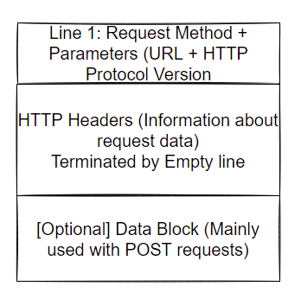
The Client Request

Slide 24
Main HTTP Request Types
GET
POST
Requests a data representation.
SHOULD ONLY RETRIEVE DATA
Sends data to a server to change its state.
Often used for HTML Forms

Slide 25

Example of HTTP GET Request

Slide 26
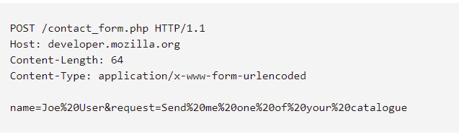
Example of HTTP POST Request

Slide 27
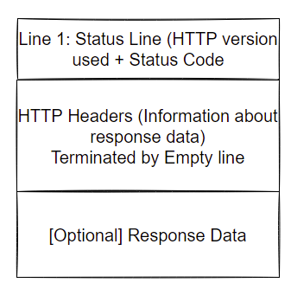
The Server Response

Slide 28
HTTP Response Status Codes
Code Type | Code Pattern | Code Range
Informational | 1xx | 100-199
Success | 2xx | 200-299
Redirection | 3xx | 300-399
Client Error | 4xx | 400-499
Server Error | 5xx | 500-599
More information about codes under RFC 7231

Slide 29
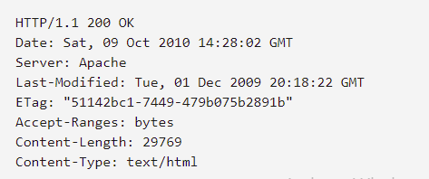
Example of HTTP Responses

