Slide 1


custom Components
V21 - 5 Project

Slide 2
V21-5 Valoores Components
V-INPUT
V-LABEL
V-FIELD-ERROR
V-AUTOCOMPLETE
V-BUTTON
PAGENOTFOUND
V-DROPDOWN
V-GRID

Slide 3
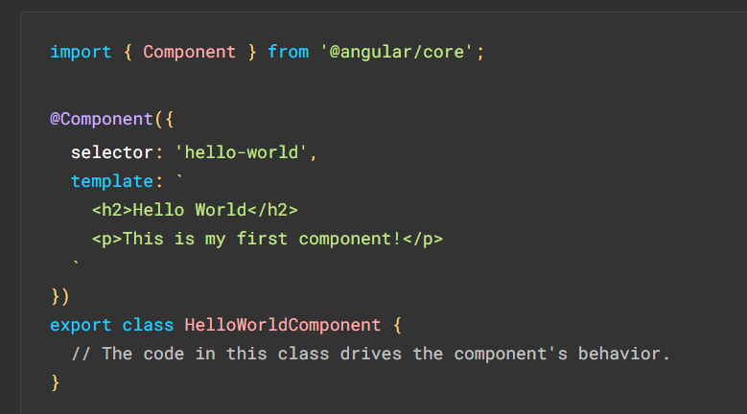
Components
Components are the building blocks that compose an application.
A component includes a TypeScript class with a @Component() decorator, an HTML template, and styles. The @Component() decorator specifies the following

Slide 4
Creating a component using the Angular CLI
To create a component using Angular CLI:
From a terminal window, navigate to the directory containing your application.
Run ng g c <component-name> command
By default 4 files will be automatically generated under src/app/<componentName> as following
<componentName>.component.ts
<componentName>.component.html
<componentName>.component.css
<componentName>.component.spec.ts
In addition you can create a component by simply creating the files manually without using the ng g c command

Slide 5
V-Input
type allows the developer to add the input type
placeholder allows the developer to add a placeholder for the input field
label allows the developer to add a label for the input, in addition once the field is required so the label will show up as bold + red asterisk
floatLabel allows the developer to specify how the label is shown, options available (always, never, auto)
required allows the developer to specify if the input is required or no, in addition this will affect the label component inside the input
parentForm add parentForm similar to formGroup in order to be synchronized with the fieldname for validation
fieldName add fieldName similar to declared formControlName to be synced with the parentForm element for validation
matAppearance allow the developer to set the preferred material design (legacy, standard, outline, fill)
textareaCols used to set preferred textarea cols attribute if type of v-input is textarea
textareaRows used to set preferred textarea rows attribute if the type of v-input is textarea

Slide 6
V-label
text allow the developer to add the label text
required allow the developer to specify if the label in required state or no

Slide 7
V-Field-Error
errorMessage allow the developer to set error messages on fields

Slide 8
V-Autocomplete
dataList allow the developer to add the data that will show in the autocomplete dropdown
placeholder allows the developer to add a placeholder for the autocomplete input field
required allows the developer to specify if the input is required or no, in addition this will affect the label component inside the input
label allows the developer to add a label for the input, in addition once the field is required so the label will show up as bold + red asterisk
parentForm add parentForm similar to formGroup in order to be synchronized with the fieldname for validation
fieldname add fieldName similar to declared formControlName to be synced with the parentForm element for validation
matAppearance allow the developer to set the preferred material design (legacy, standard, outline, fill)
floatLabel allows the developer to specify how the label is shown, options available (always, never, auto)

Slide 9
V-Button
value allow the developer to add a value to the button
btnActionType allow the developer to specify for the button will be used (as submit or normal button)
customStyle allow the developer to set custom styles for the button
btnType allow the developer to specify the button’s purpose if it’s for a form or it’s for the login
class allow the developer add a class to the button
parentForm allow the developer to specify that form the button is used in for submit validation

Slide 10
pagenotfound
This is a page not found component used to be redirected to when an unknown path is used

Slide 11
V-DropDown
placeholder allow the developer to add a placeholder for the dropdown
label allows the developer to add a label for the input, in addition once the field is required so the label will show up as bold + red asterisk
floatLabel allows the developer to specify how the label is shown, options available (always, never, auto)
parentForm allow the developer to add parentForm similar to formGroup in order to be synchronized with the fieldname for validation
fieldName allow the developer to add fieldName similar to declared formControlName to be synced with the parentForm element for validation
comboDatasource allow the developer to set the JSON data to be shown in the dropdown
matAppearance allow the developer to set the preferred material design (legacy, standard, outline, fill)
multiple allow the developer to set if it’s a multi combo or no

Slide 12
V-grid
dataApi allow the developer to add the API that will be used for data fetching in the grid as shown in the next slide
agColumns allow the developer to specify the columns that will be used in the grid as shown in the next slide
allowSideBar allow the developer to specify if the sidebar is visible or no in the grid
sizeColumnsToFit allow the developer to specify how the columns fitting will be handled
pagination allow the developer to specify if the pagination is needed in the grid
paginationPageSize allow the developer to specify the size of pagination in each page if the pagination is shown
agStyle allow the developer add custom styling to the grid

Slide 13
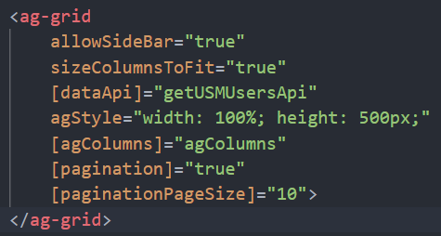
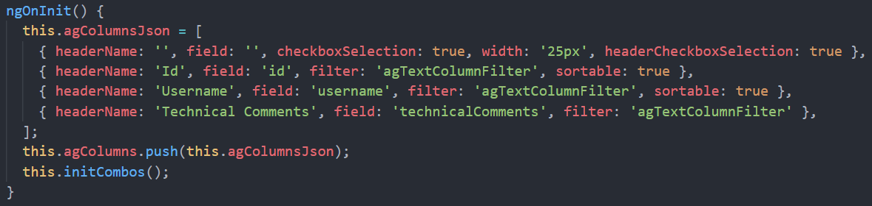
V-grid

Slide 14
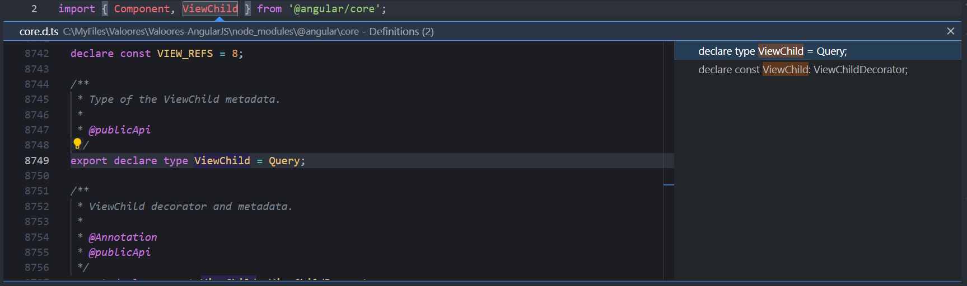
Tips
To view any details related to an import in typescript control click on any

Slide 15

Thank You

