Slide 1
Panduan Pengguna - Kasir
SIMKlinik Elrhea Clinic
Daftar Isi
1. login
2. kasir-list-invoice
3. kasir-invoice-detail
4. kasir-struk-invoice
5. kasir-print-pembayaran

Slide 2
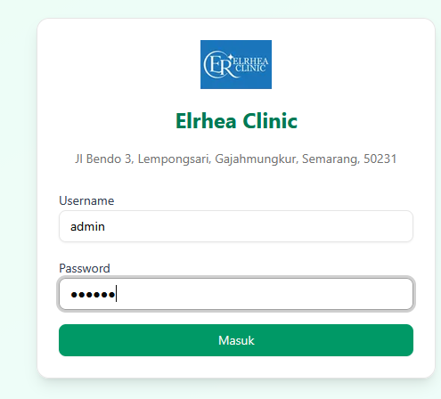
1. login
1 / 5

Slide 3
1. login
No description available.
Penjelasan
Source: login.png

Slide 4
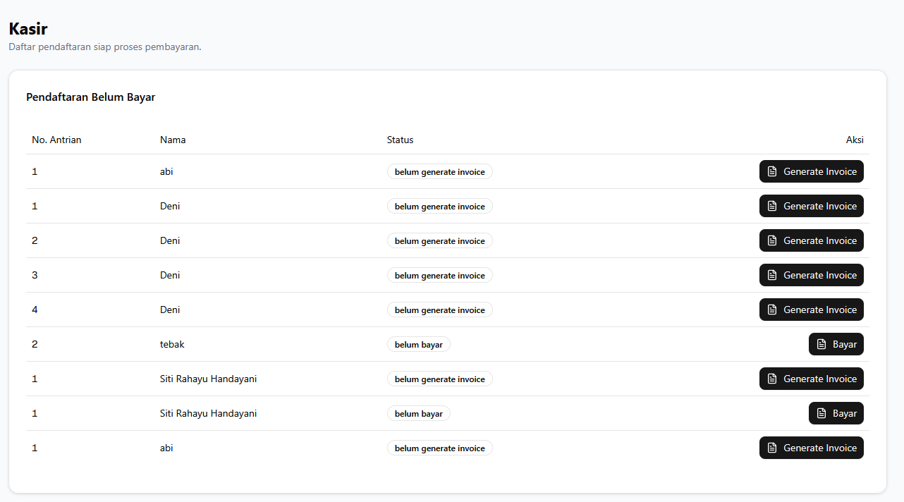
2. kasir-list-invoice
2 / 5

Slide 5
2. kasir-list-invoice
No description available.
Penjelasan
Source: kasir-list-invoice.png

Slide 6
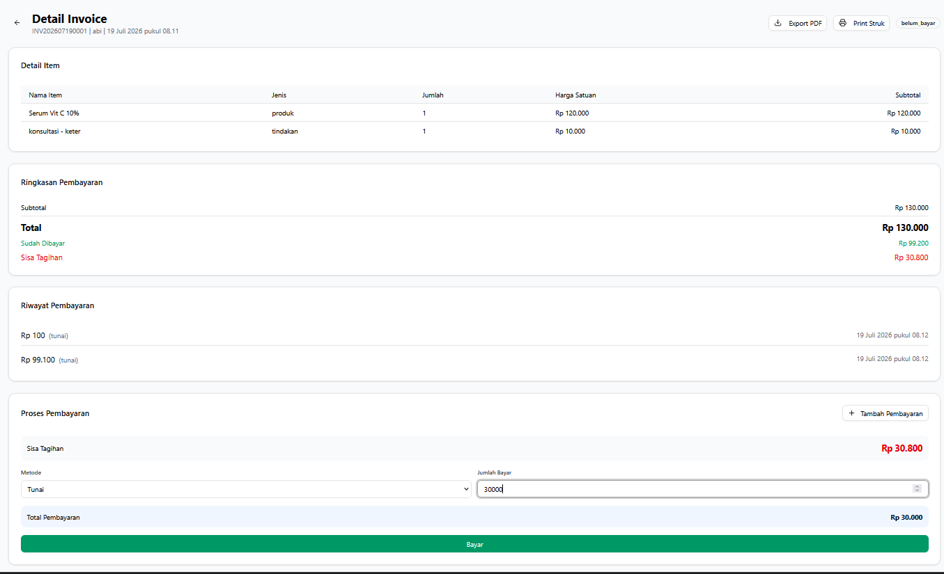
3. kasir-invoice-detail
3 / 5

Slide 7
3. kasir-invoice-detail
No description available.
Penjelasan
Source: kasir-invoice-detail.png

Slide 8
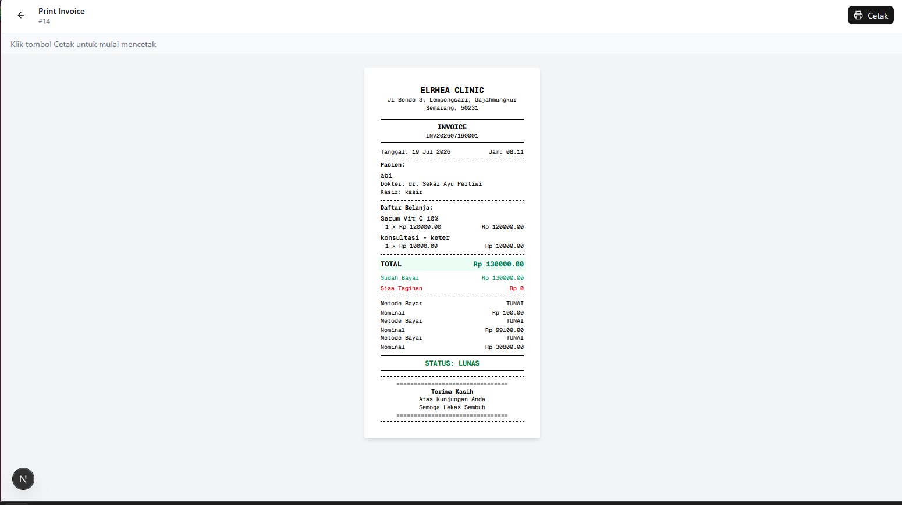
4. kasir-struk-invoice
4 / 5

Slide 9
4. kasir-struk-invoice
No description available.
Penjelasan
Source: kasir-struk-invoice.png

Slide 10
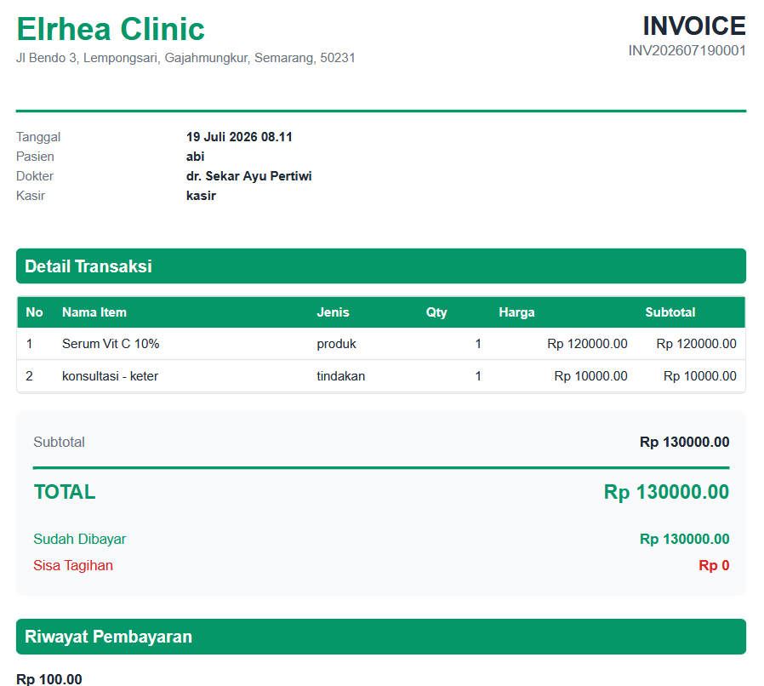
5. kasir-print-pembayaran
5 / 5

Slide 11
5. kasir-print-pembayaran
No description available.
Penjelasan
Source: kasir-print-pembayaran.png

Slide 12
~ Akhir Panduan ~
Panduan Pengguna - Kasir
5 halaman tutorial

