Slide 1

Partnership Working
Why
Who
How
PGDE Design and Technology

Slide 2

Why engage in Partnership working?
Inter-connection with experts in their fields
Link to variety of agencies interested in education and Craft, Design, Engineering, Technology, Graphics
Authenticity and relevance
Motivation and sustainable interest
Deliverable outcome required
Exploitation of potential
Creativity of interpretation
Curriculum development experience
Offer something to experts agencies and school partners
Capitalise of expertise of students prior experience and learning
Curriculum development experience
Raise profile of DT education in Moray House School of Education and elsewhere?

Slide 3

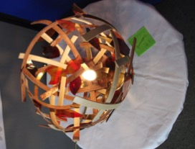
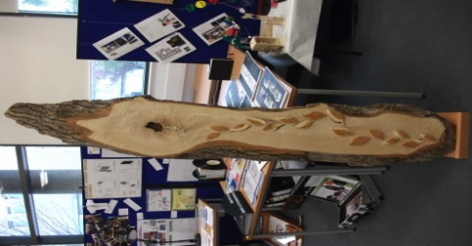
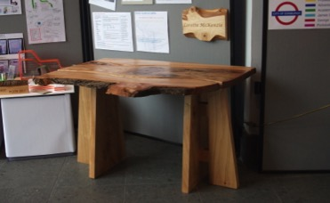


Who -----Masterclass
From School Partners
Global Science STEM ambassadors
Institute of Mining, Minerals and Materials

Slide 4
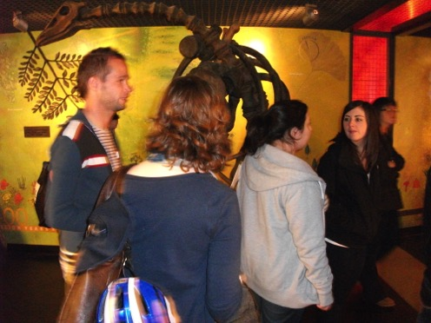

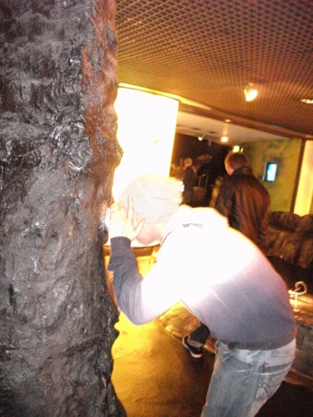
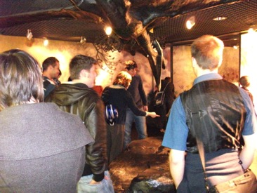

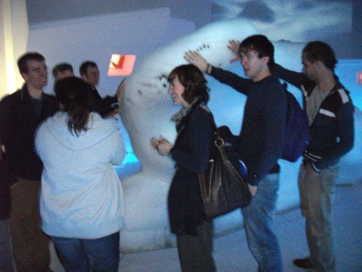
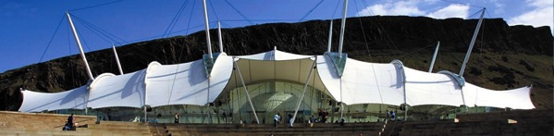
Who
Also
With Art & Design students
STEM students

Slide 5
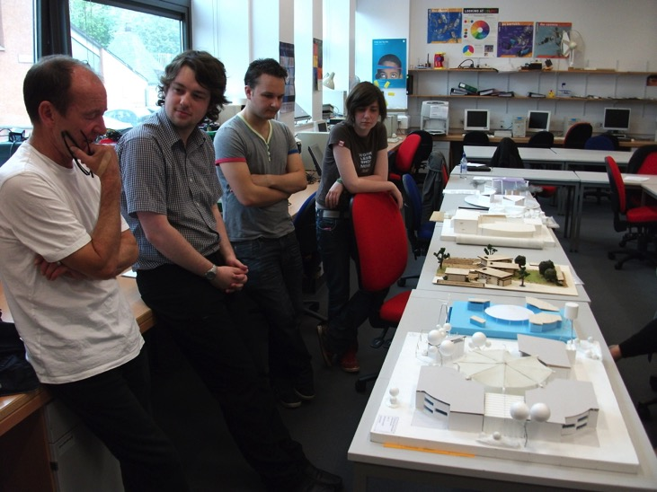

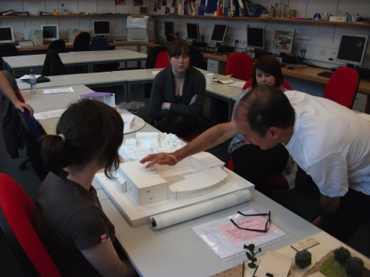
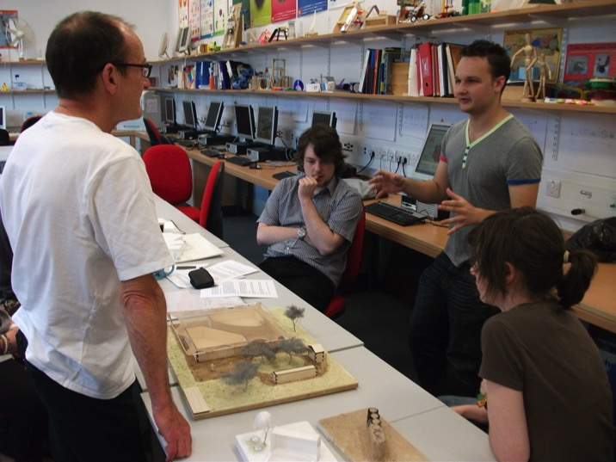
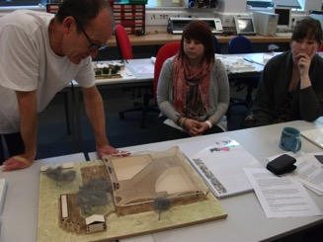
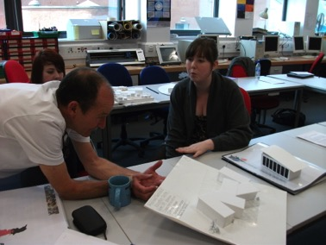
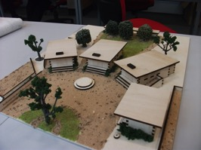
Who

Slide 6
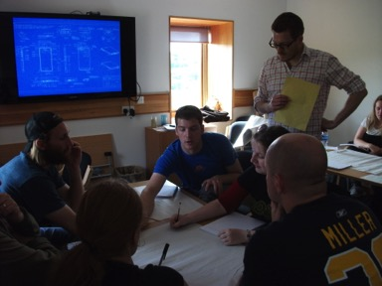
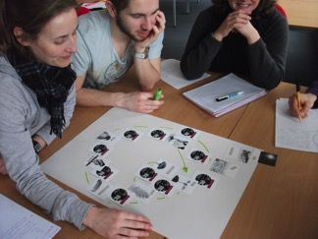
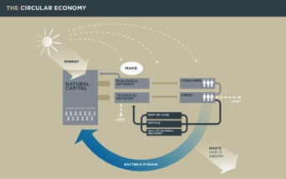
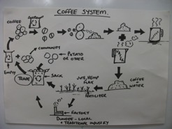



Who

Slide 7
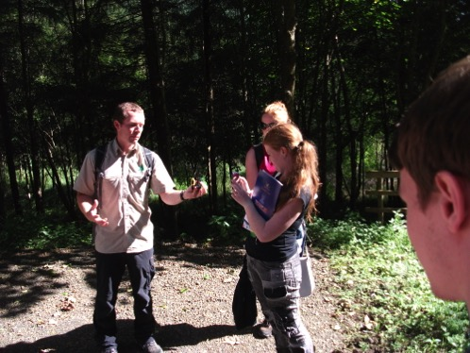
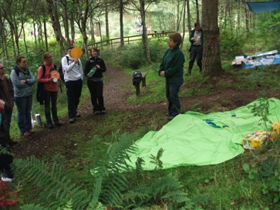
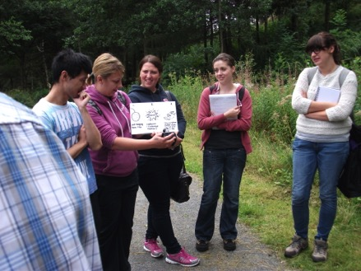
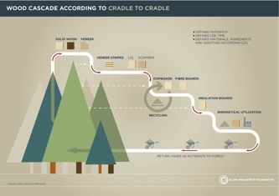
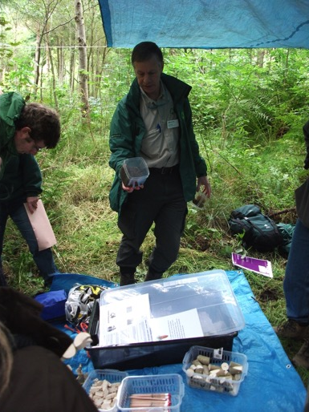
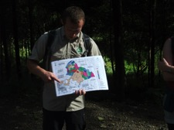
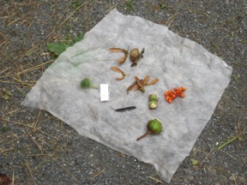
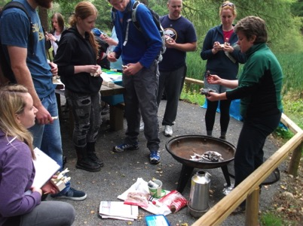



How - an illustration in action
Stimulus Fieldtrip to Glentress Forest Park STEG not STEM
Workshops to learn content
Workshops spark ideas
Illustrate potential

Slide 8
How - an illustration in action : Natural Partners
partnership working
Identify a focus through major learning area with IDL potential
Devise unit of work
Feed-forward interim crits with expert input from various agencies and experts and initial ‘clients’
Development and trials (in schools) evaluate and review
Real Life Science Lab Drop-in @ RBGE
This year:
7th/8th Dec 2013

Slide 9
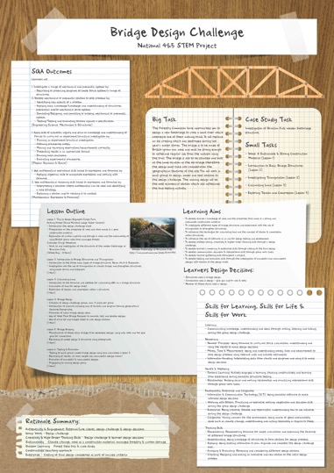
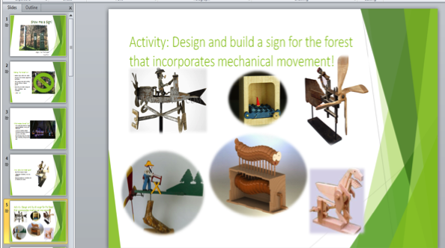
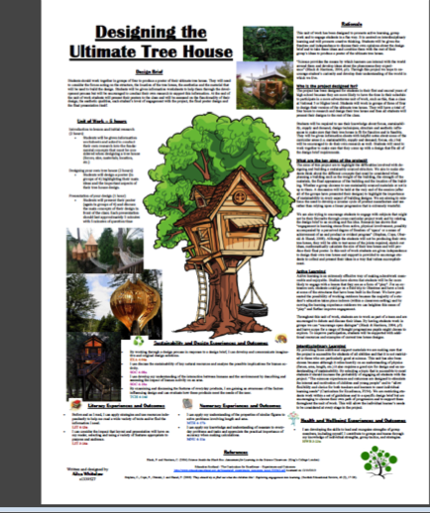
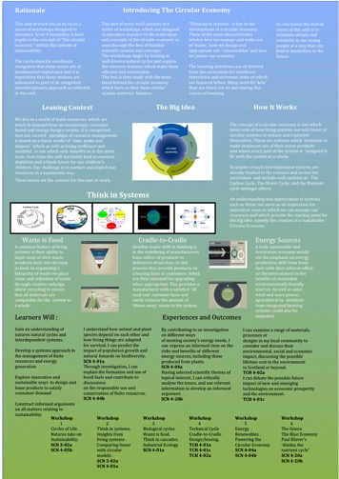
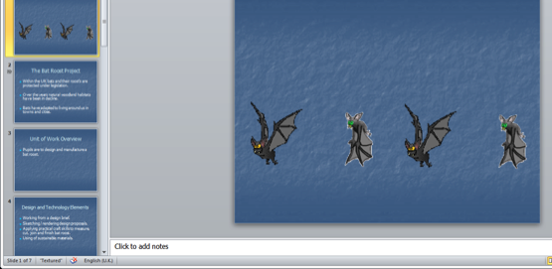
How - an illustration in action- work in progress
partnership working

Slide 10
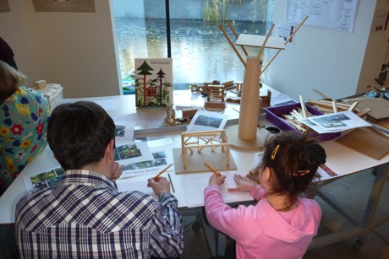
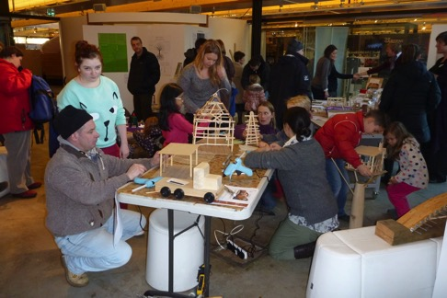
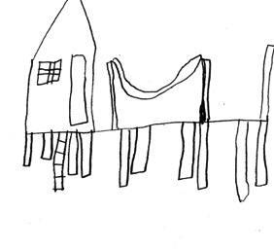
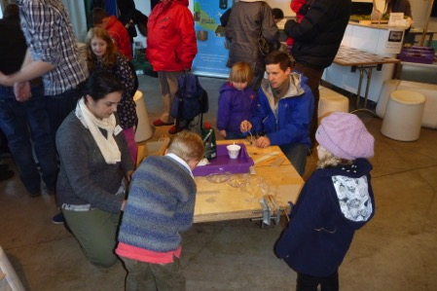
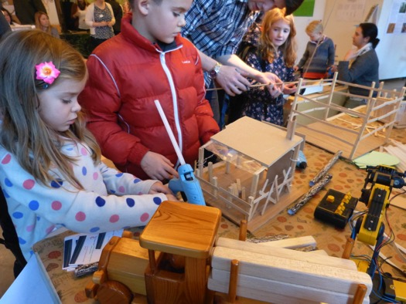
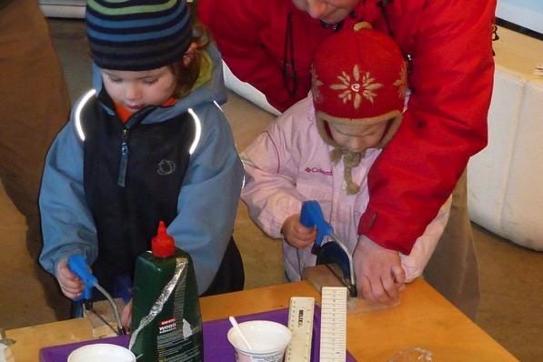
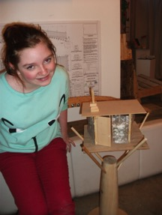
Real Life Science Lab: Drop-in sessions
1st/2nd Dec 2012
Treehouse designing and building

Slide 11
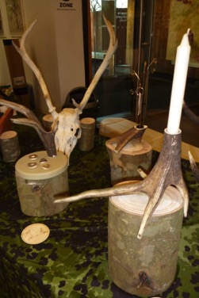
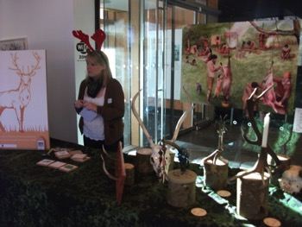
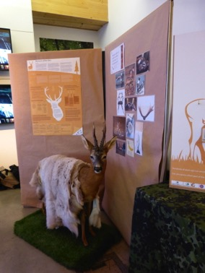

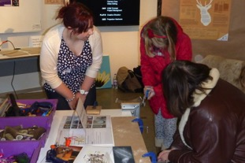
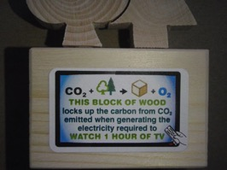
Real Life Science Lab: Drop-in sessions
1st/2nd Dec 2012
Monarch of the Glen- Antlers as a medium for design tasks, closed loop cycles, food chains, deer culling and much more
A pallet’s pilgrimage - reuse material cascade and closed loop forestry
Lighting the Forest – design and control
Wood is Good as a carbon store

Slide 12

Thank you
Questions?

