Slide 1
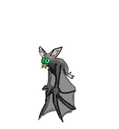
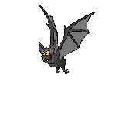

Slide 2
The Bat Roost Project
Within the UK bats and their roost’s are protected under legislation.
Over the years natural woodland habitats have been in decline.
Bats have adapted to living around us in towns and cities.

Slide 3
Unit of Work Overview
Pupils are to design and manufacture a bat roost.

Slide 4
Design and Technology Elements
Working from a design brief.
Sketching / rendering design proposals.
Applying practical craft skills to measure, cut, join and finish bat roost.
Using of sustainable materials.

Slide 5
Science Elements
17 Different types of bat in the UK (9 in Scotland).
Natural habitat analysis / Conservation area identification, incorporating:
  Woodlands
  Age of woodland, older increases chance of bat presence
  Food source – Primarily insects
  Lakes, ponds, rivers (Supporting large numbers of insects)
  Roost located for optimal warmth and insulated from sun, wind & rain
Bats can be carriers of diseases – Rabies (although rare).
Hunt insects of using echo-location

Slide 6
Outdoor Learning
Organise a field trip, in partnership with The Forestry Commission
Pupil’s boxes to be mounted in forest.
Pupils to be given opportunity to see/handle bats first hand and learn from the experts.

Slide 7
Responsible Citizens
The unit of work is designed to contribute to Learners’ becoming responsible citizens:
  Promote greater awareness of bats in Scotland.
  Enable more people in Scotland to appreciate and enjoy bats and get involved in bat conservation.
  Identify local bat conservation areas / natural habitats in Scotland.

