Slide 1
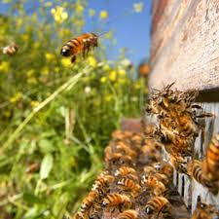
Feed Forward Event 8/11/2013
PGDE (Secondary) 2013 / 14
Design and Technology.
Natural Partners Project.
Sean Annan

Slide 2
The Benefits of Bees
Bees pollinate about one-sixth of the world's flowering plant species and some 400 of its agricultural plants. Poorly pollinated plants produce fewer, often misshapen, fruits and lower yields of seed with inevitable consequences upon quality, availability and price of food. No human activity or ingenuity could ever replace the work of bees and yet it is largely taken for granted. One of the few farm activities that can actually increase yields, rather than simply protect existing yields from losses, is to manage bees to encourage good pollination. (www.heatherhills.co.uk )

Slide 3
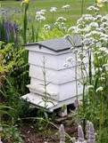
Learning Opportunities
Managed Bee Hives within
a Forest Environment.

Slide 4
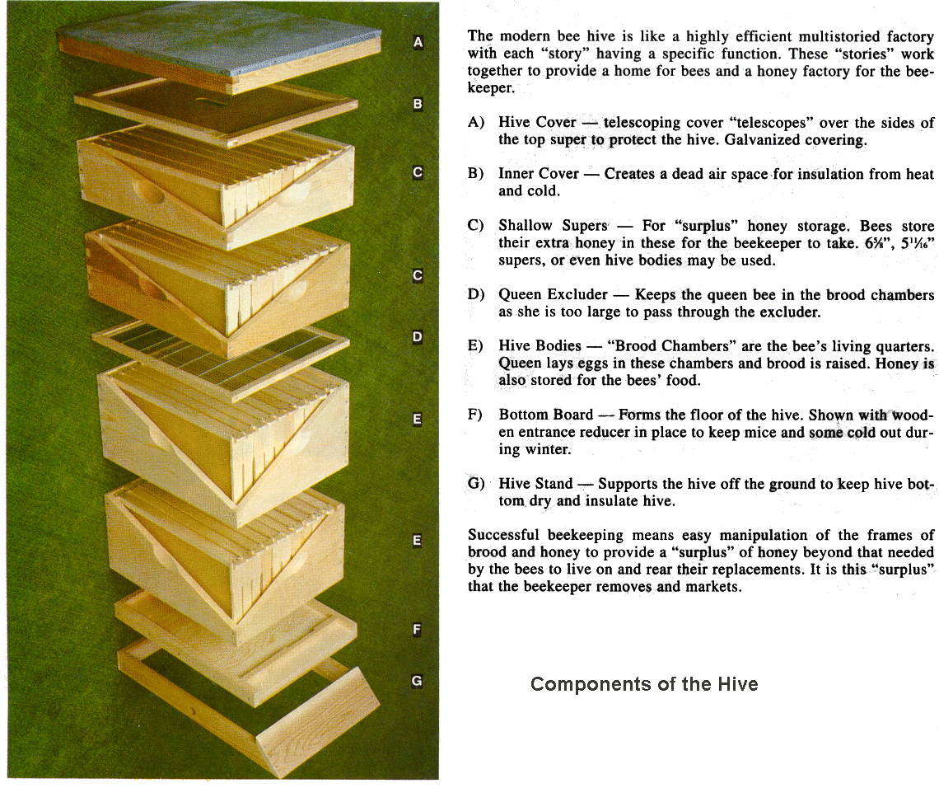
Man Made Bee Hives
The design and manufacture of the bee hives is an activity that could be incorporated within a Forth Level Craft, design and Graphics unit of work. It can meet many of the E’s and O’s for this level, including;
I can confidently apply preparation techniques and processes to manufacture items using specialist skills, materials, tools and software in my place of learning, at home or in the world of work.
TCH 4-13a

Slide 5
Technologies E’s and O’s
Showing creativity and innovation, I can design, plan and produce increasingly complex items which satisfy the needs of the user, at home or in the world of work.
TCH 4-14a
I can explore the properties and functionality of materials, tools, software or control technology to establish their suitability for a task at home or in the world of work.
TCH 4-14c
Having sketched or drawn a series of everyday objects pictorially and orthographically, I have become proficient in third angle projection and can apply this knowledge when producing 2D or 3D images when using software.
TCH 4-15a
I can apply skills of critical thinking when evaluating the quality and effectiveness of my own or others’ products or systems.
TCH 4-14b

Slide 6
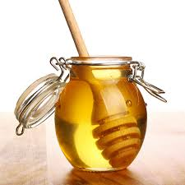
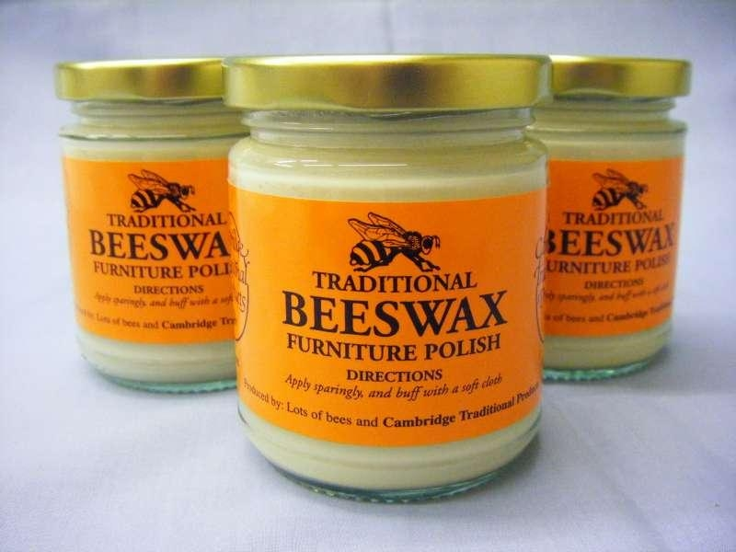
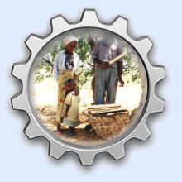
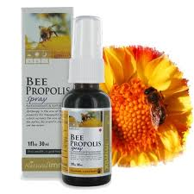
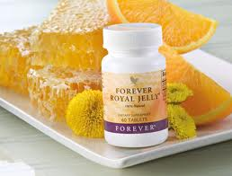
Bee’s and Enterprise
Chimanimani in Zimbabwe

Slide 7
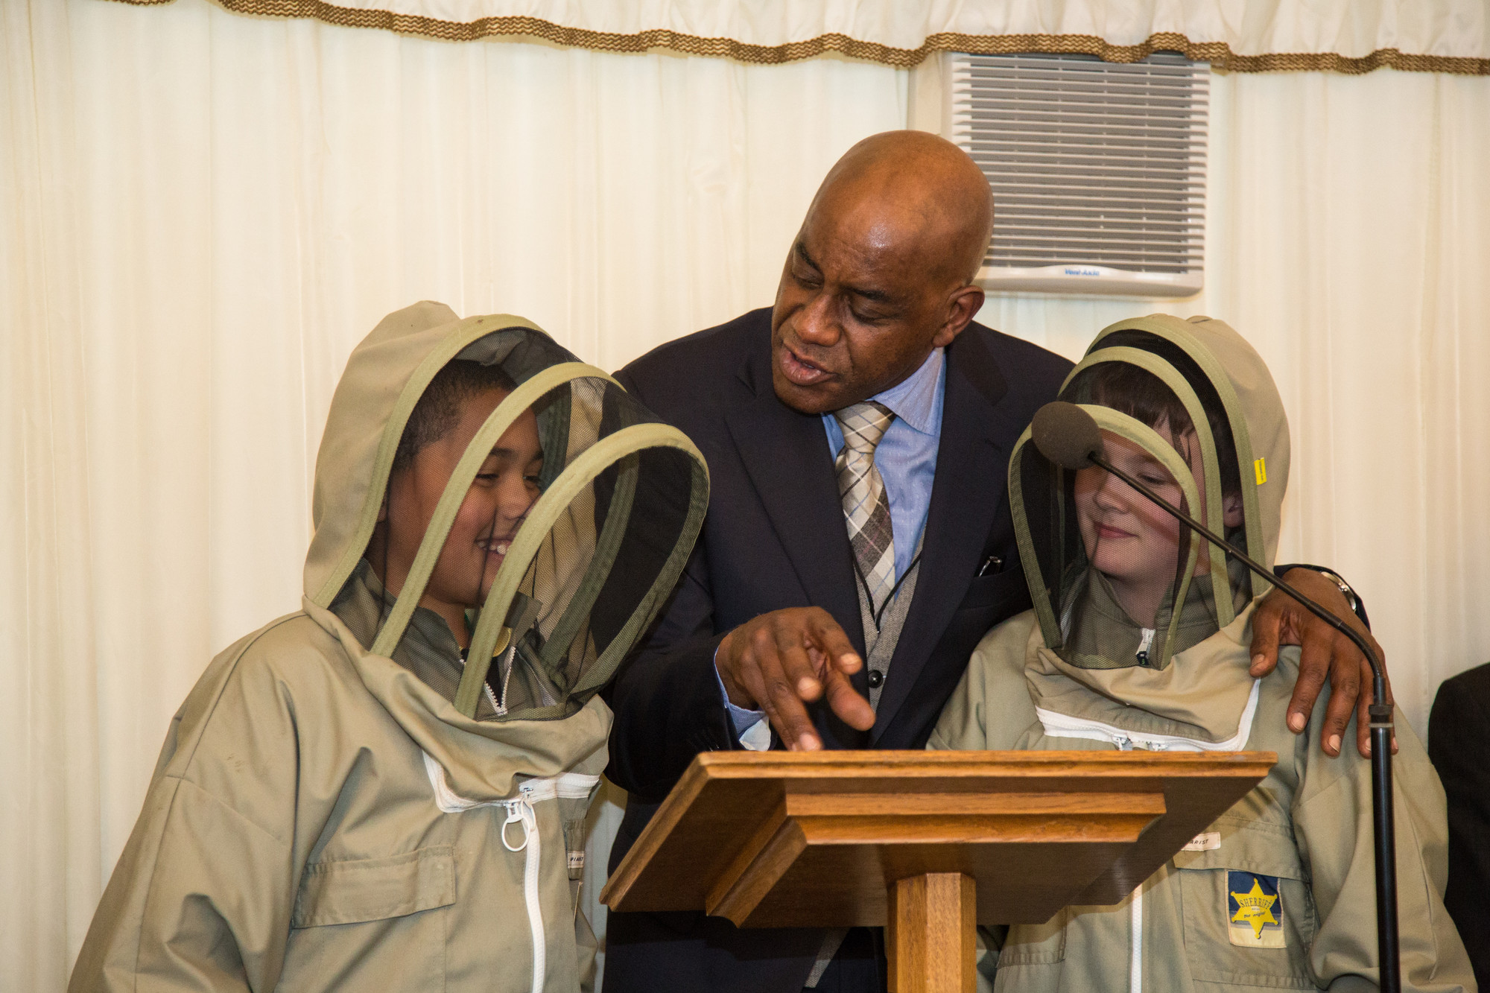
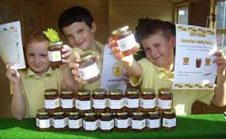
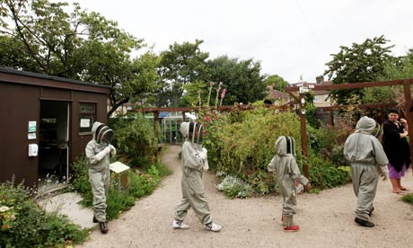
Example of Work in Progress
Charlton Manor Primary School Beekeeping

Slide 8

THE HONEY BEE
HEALTH STRATEGY
June 2010
Overview of the strategy
AIM: To achieve a sustainable and healthy population of honey bees for pollination
and honey production in Scotland through strengthened partnership working
between stakeholders with interests in honey bees

Slide 9
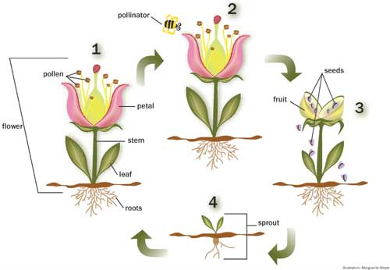
Bees and Pollination
How Bees Pollinate
Pollination begins when a bees stops to gather food from a flower.
Sticky pollen gets caught in the small hairs that are on the bee's body.
Still foraging for food, the bee travels to another flower. Some of the pollen on the bee's body falls onto this new blossom.
When pollen is transferred from one plant to another of the same species, it becomes possible for the blossom to produce fruit or vegetables.
http://lifecyclesproject.ca/resources/bee_average/pollination.php

