Slide 1


The Hedgehog House Project
Jodie Anderson
Design and Technology

Slide 2


Why?
Secondary Education – CfE 3rd/4th level broad general education.
Interdisciplinary project.
Authentic learning.
Meaningful and purposeful.
Enjoyable.

Slide 3
Project Context
The hedgehog population is in dramatic decline.
Hedgehog numbers have declined by over a third between 2003 and 2012.
Loss of habitats (fragmentation).
Poor management of hedgerows.

Slide 4
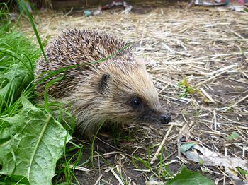

Slide 5


Natural Partners
Forestry Commission Scotland
British Hedgehog Preservation Society

Slide 6
Unit of Work Overview
Learners will learn about the natural environment for a hedgehog and the importance of protecting the hedgehog species.
Learners will design and manufacture a hedgehog house.

Slide 7
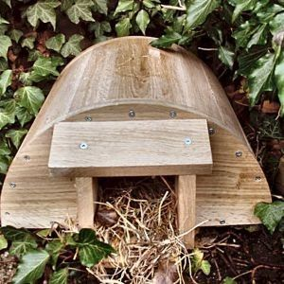
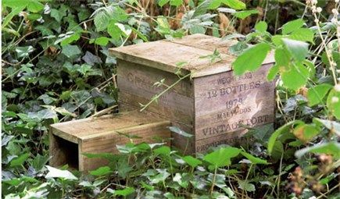
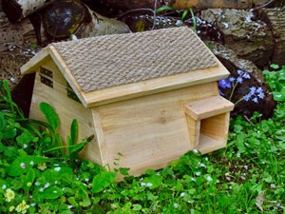
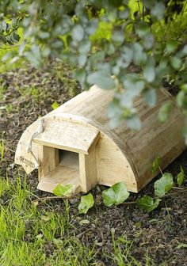
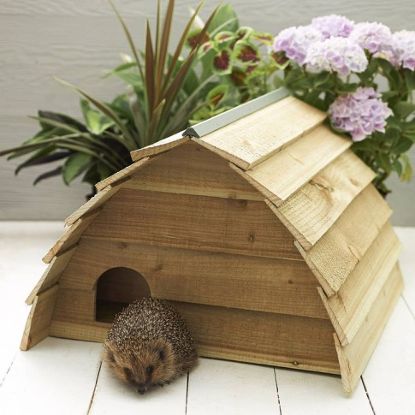
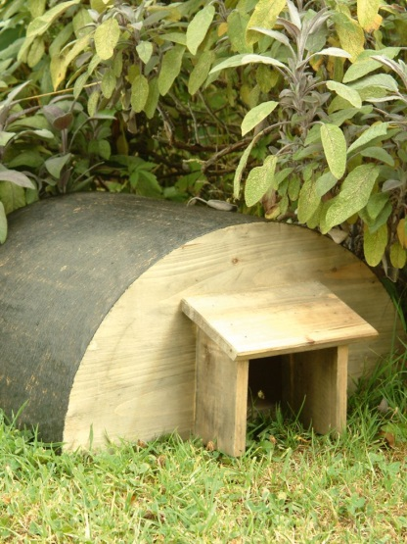
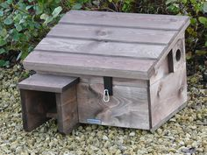
Examples

Slide 8
Interdisciplinary Learning
Biology
Geography
Craft, Design and Technology

Slide 9
CfE Experiences & Outcomes
LIT 4-02a
HWB 3-01a/4-01a HWB 3-02a/4-02a
MNU 4-01a MNU 4-11a
TCH 3-13a/3-13b TCH 3-14a/4-14a
SCN 4-01a
SOC 4-08a SOC 4-10a

Slide 10
Biology
Hedgehog protection.
Talk from British Hedgehog Preservation Society.
Habitats – natural environment.
Food source
Location
Shelter

Slide 11
Geography
Importance of forest – providing timbre as a sustainable material for manufacture.
Impact of human activity on the environment.

Slide 12
Design and Technology
Working from a design brief
Using sustainable timber/materials from the forest
Idea generation
Application of practical craft skills to measure, cut, join and finish their hedgehog house

Slide 13
Outdoor Learning
Initial field trip to observe the environment they have to design for.
British Hedgehog Preservation Society – encouraging children to respect our natural wildlife.
Field trip to place their finished hedgehog houses into the outdoor environment – a sense of pride, joy and achievement.

Slide 14
The Hedgehog House Project
-Planning -Making
-Creativity -Joining
-Problem solving -Finishing
-Challenging -Enjoyable
-Decision making -Collaborating
-Measuring

