Slide 1
Pallet Transformation
Eco-friendly habitats created from old pallets.

Slide 2
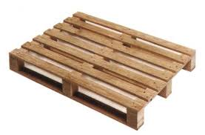
The problem with pallets
There are currently millions of pallets in circulation across the UK.
The industry itself is worth over £260 million per year.
After their initial use a variety of things can happen to a pallet
It is discarded and put to landfill.
It is reused multiple times and then put to landfill.
It is refurbished, reused but ends up in landfill.

Slide 3
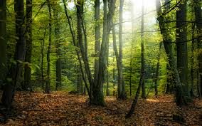
Sourcing of timber for pallets.
Pallets are generally made from cheaper softwoods, UK manufacturers sources these from the UK, Europe and Russia.
In 2006 it was calculated the between 2.01 and 2.49 million cubic meters of softwood was used to generate new pallets every year.

Slide 4
Why Up-Cycle?
Up-cycling is a greener way of recycling, its only uses the individuals energy.
It helps to stop the linear path that the pallets are currently on and turn it into a cyclic process with little waste after manufacture.
Encouraging learners to take products that have become redundant or that are destined for the bin and creating a new use for them.

Slide 5
Sourcing pallets for use
Schools regularly receive deliveries on pallets, these are then disposed of as general waste.
Collecting these and up-cycling them is a way to show learners how simple up-cycling can be is and also get them actively thinking about up-cycling
School receive an average of 30-35 every term.

Slide 6
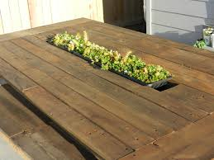
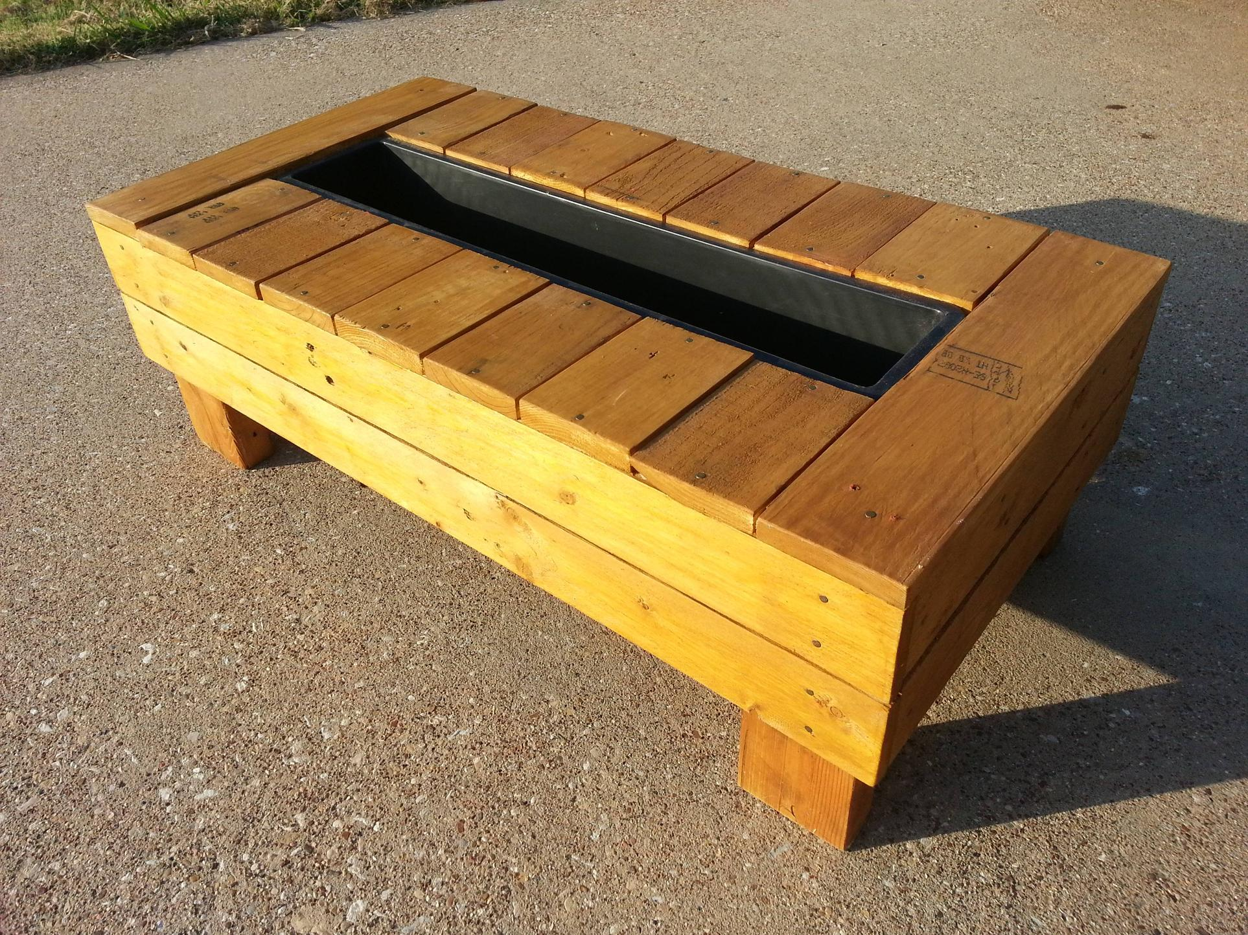
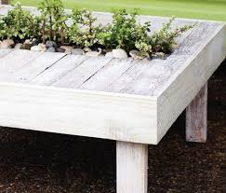
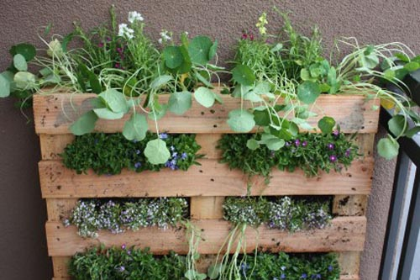
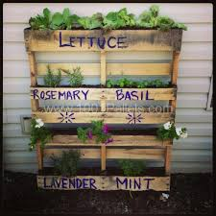
Pallet planters that already exist

Slide 7
Encouraging Biodiversity
Research
Choices
Flowers
Vegetables
Mosses/grasses
Weeds
Learners will carry out an investigation into what already lives in their gardens and local areas.
Learners will use this information and from it make an informed choice on the type of wildlife they want to attract to their eco-table.

Slide 8
Working with Science
Biology
Design Technology
Investigation
Decision
Collection
Germination
Planting
Sourcing
Designing
Deconstructing
Reconstructing
Planting

