Slide 1

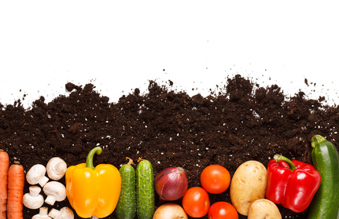
Food For Thought Food for a Sustainable Environment, Community and Economy
Aim & Rationale
This scheme of work is intended to highlight the environmental, social and economic advantages of consuming locally sourced food in terms of sustainable change. This will be implemented through highlighting the benefits of recycling and reducing food waste, reducing pollution, and saving energy using organic waste. All these aspects will be highlight the movement towards a Carbon Neutral nation.
Lesson 1: Where does our food come from? (1 hour)
The students will firstly be introduced to what a STEM career is and the skills to develop for these roles.
This lesson introduces the students to where their food is sourced from, and to assess if its sustainable. They will track the distances covered from different food groups in their diet to numerically calculate how far the food has travelled, find out who grew it, if its healthy, and if its been grown in an environmentally friendly way. Students will then assess if their diet is sustainable. They will consider the environmental and climatic implications of the distances covered by food during transportation in terms of CO2 emissions. Students will look at the environmental, social and economical benefits of consuming locally sourced produce. Students will reflect and evaluate upon their food choices to make their diet more sustainable
Lesson 2: Squashed Tomatoes Challenge (2 hours)
Students will investigate a case study upon the sustainable practices of farmers who grow produce on mountain sides in Nepal. Students will consider the environmental, social, and economic benefits of this method of food production. The students develop a scientific understanding of the environmentally friendly pulley gravity ropeway that the farmers use to transport food. In teams the challenge is to design and build a model for transporting tomatoes from desk height to the floor using a similar scientific methods. Aim is to transport all the tomatoes without squashing them, using a variety of materials.
Lesson 3: Food Recycling Challenge (3 hours)
Students will assess the volume of waste produced by the food industry and domestically. Students will numerically calculate how much organic waste is produced in their home, and suggest ways to cut down this waste.
Students will learn about the chemical breakdown of organic waste through microbial decomposition. Students will research the uses of compost heaps, recycling plants during aerobic digestion, and biogas plants during microbial anaerobic digestion (heat, electricity, transport, agricultural fertiliser).
Students will be given the challenge of engineering a model domestic biogas plant. The aim is to design a biogas plant which can allow a family of 4 to be as Carbon Neutral as possible. Costs will be implemented for material. Teams will have to consider economic viability , design, size, attractiveness, materials (allow for gas expansion), use of heating, solar panels, recycling of waste products etc. Students will present their idea as a group, and the most economic and environmentally sustainable design will win.
Learning Intentions
Investigate the sustainable practice of food production, transportation and consumption
Design and engineer a viable method of food transportation
Investigate the scientific processes involved in organic material decomposition
Design and build a biogas plant model which uses food waste to allow a household to become Carbon Neutral.
References
www.localfood.org.uk
http://practicalaction.org/squashed-tomato-challenge-5
http://www.renergon.ch/en/
Curriculum for Excellence E’s and O’s
It is intended that this scheme of work has an interdisciplinary focus upon science, design and technology, numeracy, literacy, and health and well being.
HWB 3-19a, 3-14a, 3-15a
LIT 3-02a, 3-06a, 3-09a, 3-24a, 3-28a
MNU 3-08a, 3-09a
SCI 3-03a, 3-04a, 3-05a, 3-13b, 3-17b, 3-20a
TCH 3-01a, 3-02a, 3-12a, 3-14a
SOC 3-08a, 3-10a

