Slide 1
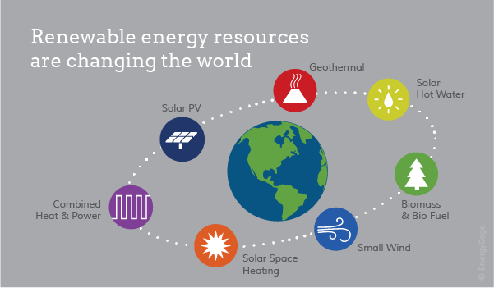
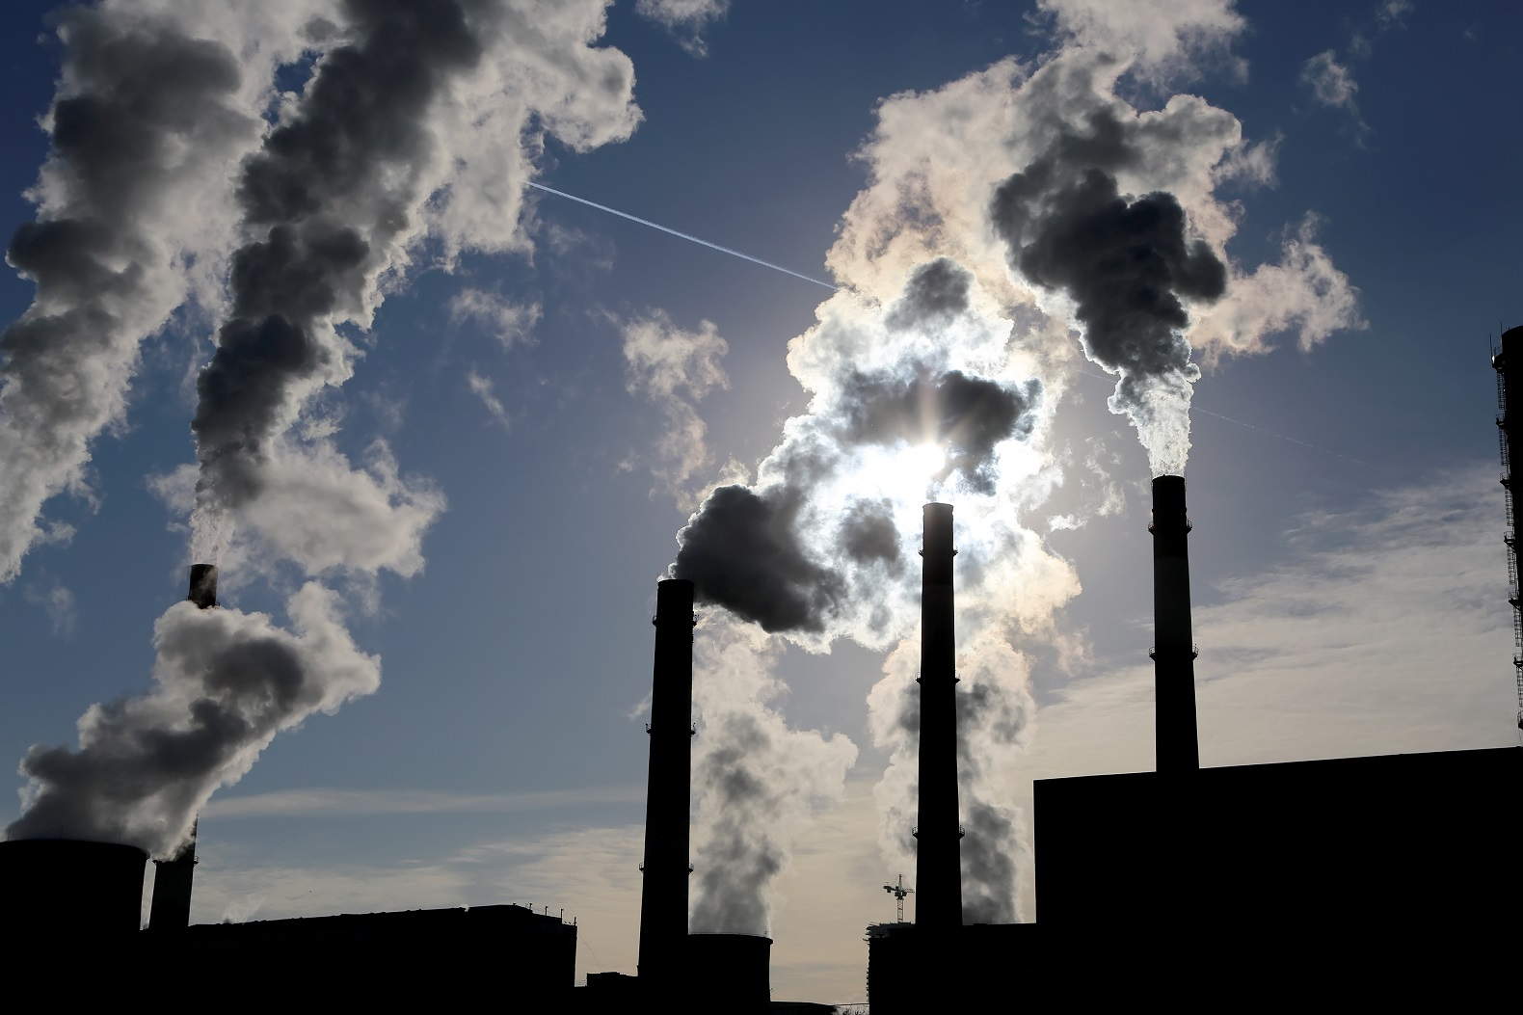
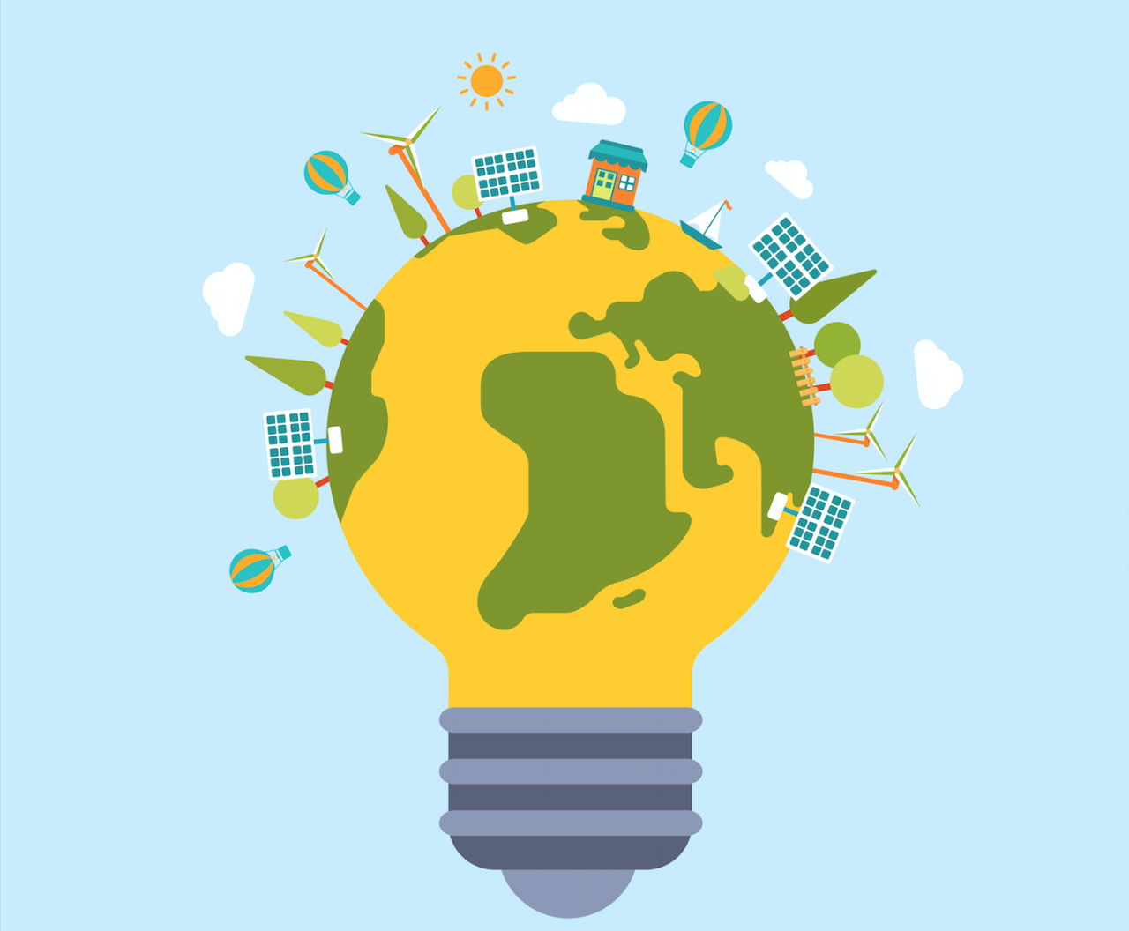
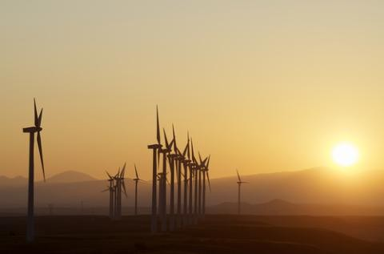
Sustainable Energy: Renewable Resources
Climate change is a huge issue within today’s society and it is important to make young people aware of the ways in which we can find alternative energy sources other than fossil fuels.
This set of 4 lessons is developed at CfE level 3 and encompasses experiences and outcomes from the sciences, technology and social sciences. This works aims to educate pupils about the topic whilst engaging them in numeracy and literacy skills.
CfE Experiences and Outcomes:
SCN 3-20a
SCN 3-04b
SCN 3-05b
TCH 3-02a
SOC 3-08a
SOC 3-10a
Learning Intentions:
To understand what is meant by a “finite resource”.
To see the impact fossil fuels have on our planet.
To understand what a renewable resource is.
To investigate and discuss the issues surrounding the use of renewable resources.
Lesson 2 (45mins) Types of renewables
This lesson would aim to develop pupils knowledge of different types of renewable energy resources and what makes something a renewable resource.
Lesson 1 (45mins) Fossil Fuels
Purpose of this lesson is to introduce the main types of energy sources that are currently used. Explanation of how these are finite and the pollution that they cause. Set up ideas for the next lesson.
Lesson 4 (120mins) Designing a renewable resource
Pupils will have to design a renewable energy source. They will be given a task sheet in which they will have to consider various issues including cost, public opinion, aesthetics and energy production.
Lesson 3 (90mins) The issues surrounding renewables
Pupils to work in groups to research and present the either the positive or negative side of the use of renewable resources in a debate format. They would then come to a general consensus of their opinions on renewable resources.
References: Education Scotland, STEM Central Renewables, http://www.educationscotland.gov.uk/stemcentral/contexts/renewables/about/index.asp last accessed 10/11/16

