Slide 1
Geochem Dataset : QAQC for Machine Learning
Nixis Carrero| 30th sept 2025

Slide 2
Table of Content
Purpose statement
Data & Methodology
Conclusion
Appendix

Slide 3
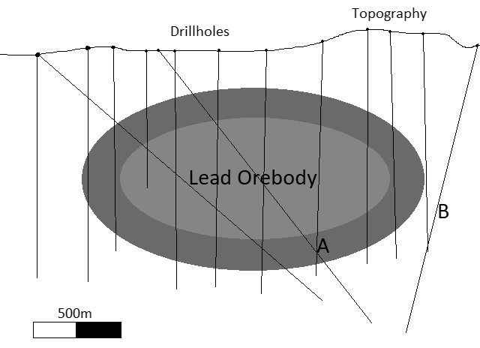
What are we talking about?

Slide 4
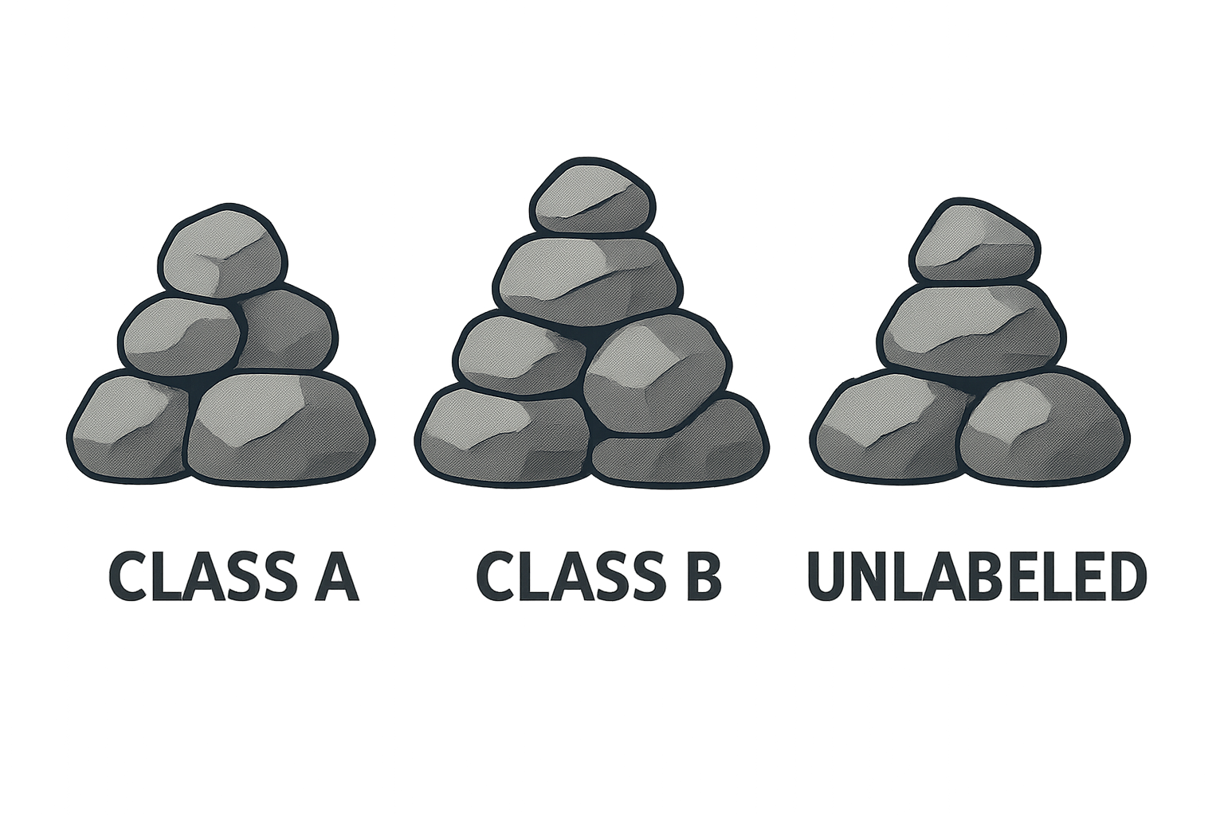
Objective
Can we use the same geochemical data and labels to generate a predictive model for future drill holes which can label samples on whether they are in class A or class B?
More data has been acquired since the geochemist completed her work - can we predict labels onto these data points (labelled “?”).

Slide 5
Data ⏐Methodology

Slide 6
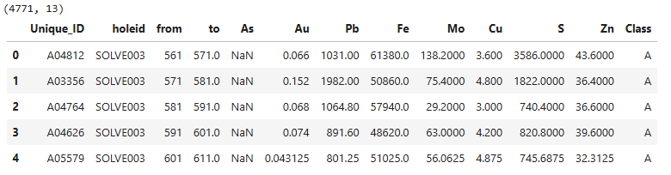
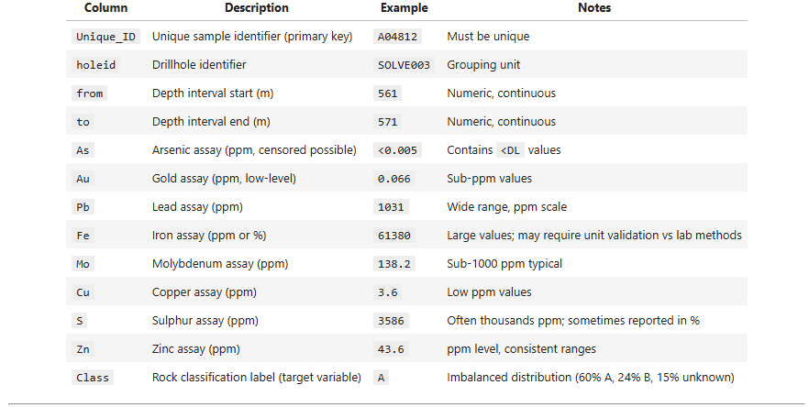
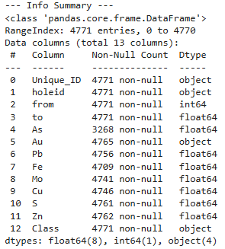
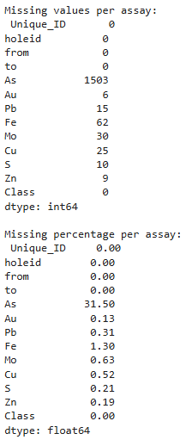
The Data
Geochem assays
Data Summary:
Samples: 4,771
Assays (8): As, Au, Pb, Fe, Mo, Cu, S, Zn
Labels: A, B, ?
Metadata: Unique_ID, holeid, from, to
Issues Detected
Wrong datatype
Missing values (notably As ~31%)
Truncated values at detection limits (e.g., “<0.005”)
Invalid placeholders (e.g., -999)

Slide 7
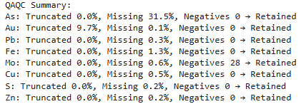
Data Cleaning
Invalid placeholders
Replace with placeholder NaN
+ flag
Missing Values
Truncated Values
True missing values may arise from unsaved intervals or lab reporting gaps (e.g., <-999).
<10%
impute with median
<10%
substitute
with statistical estimates
impute with median + missing_flag
substitute with with statistical estimates
+ truncation flag
Some assay results are reported as truncated values (e.g., <0.005), meaning the true concentration is below the detection limit (DL).
10–40%
10–40%
unreliable
recommend exclusion from ML data set
unreliable
recommend exclusion from ML data set
>40%
>40%
Use imputation methods — fill values in a statistically consistent way.
Use flags — keep as much information as possible without losing valuable samples
cleaned_data.csv → raw + clean + flags (traceable)
cleaned_data_for_ML.csv → compact ML-ready (metadata + *_clean + *_flag)

Slide 8
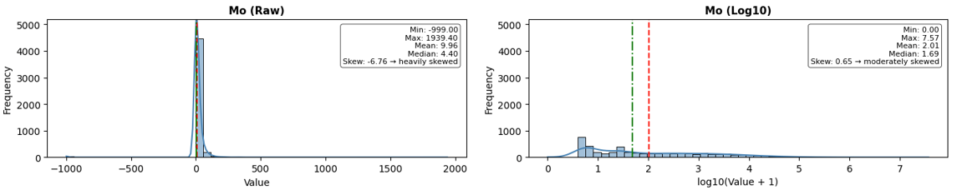
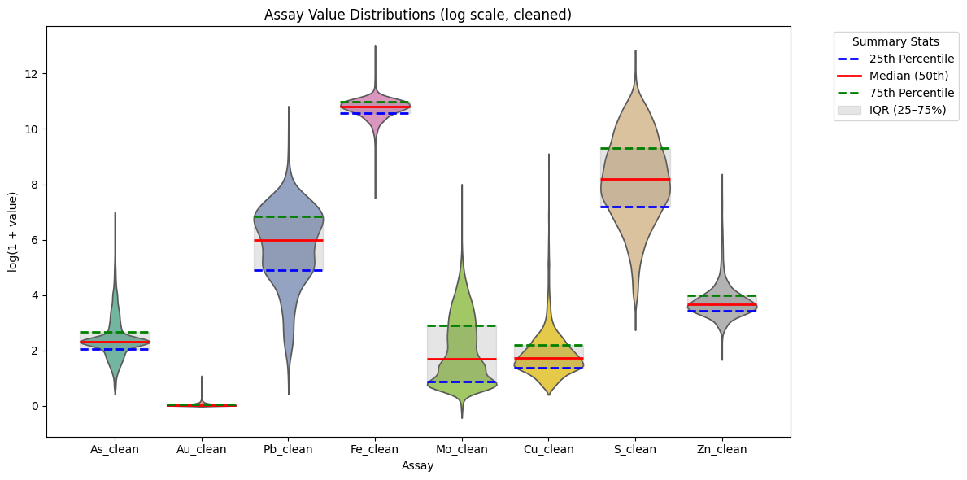
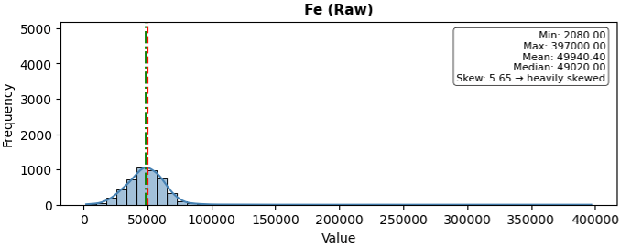
EDA (Exploratory Data Analysis)
Histograms reveal the shape of the data, highlight skewness and outliers.
Transforming to log space reduced skew and clarified patterns in the geochemical assays, but not all elements behave the same — some are stable, while others need extra care.
Violin plots reveal the spread and distribution of each element, making patterns and outliers easy to compare across multiple elements in a single view.

Slide 9
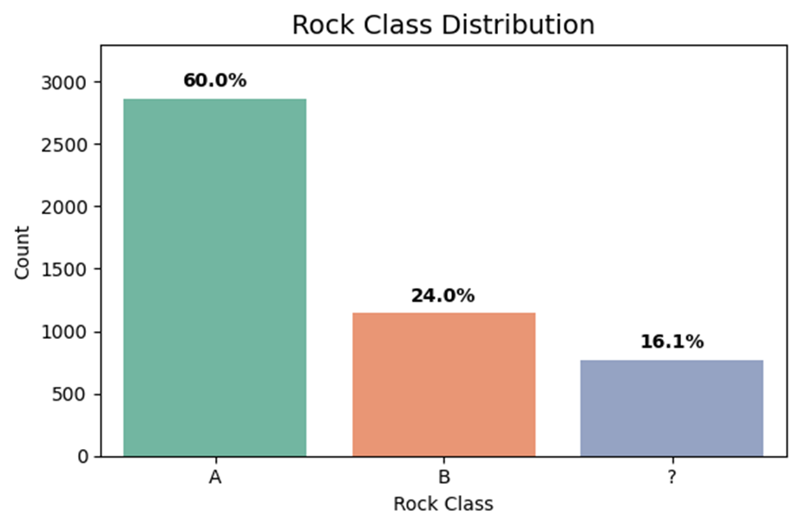

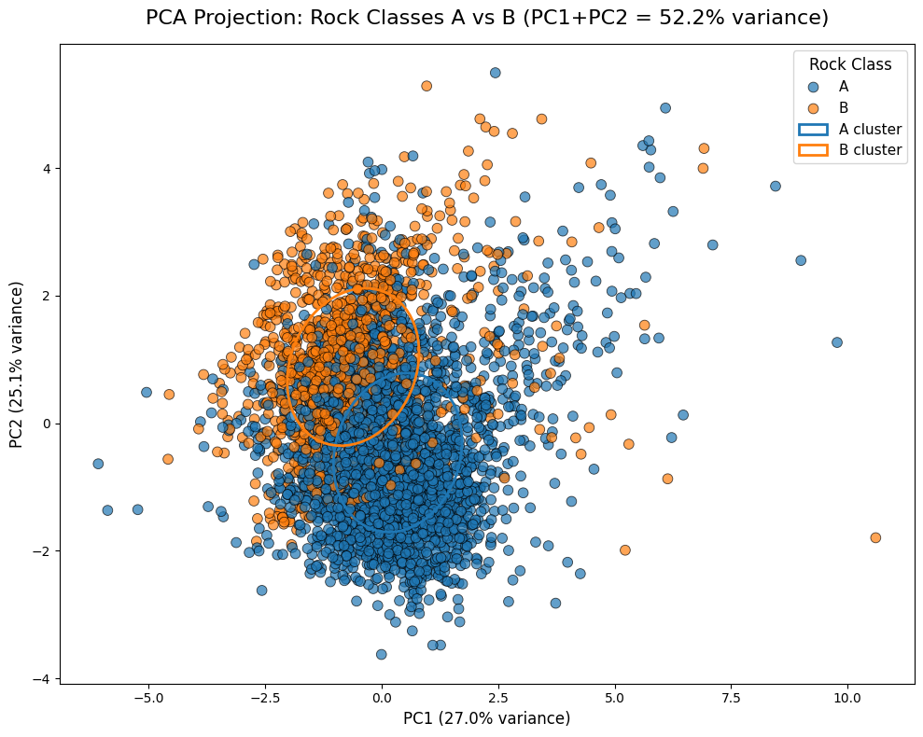
EDA (Exploratory Data Analysis)
Class distribution: Dataset is imbalanced (~60% Class A), which could bias models → balancing strategies needed.
PCA analysis: Partial A vs B separation (PC1+PC2 ≈ 52% variance); overlap suggests enrichment with geological/spatial features for stronger predictive models.

Slide 10
Conclusions

Slide 11
Conclusions
1
2
3
QAQC is not optional. Clean data is the foundation of reliable machine learning.
Smart preprocessing, like log transforms and structured imputation rules, makes complex g data interpretable and usable without losing traceability.
Predictive labeling is promising, but the dataset by itself is not enough.
To scale, we need richer data and more context.
“Clean data enables insight — but robust predictive models require richer datasets”

Slide 12

Thank you

Slide 13
Appendix
https://github.com/Nixis/geochem-assay-qaqc-ml

