Slide 1


Tranz-Algo
Explainable Landed-Cost Inventory Orchestration
for Import-Dependent SMEs
Nixon Shibuchi · Musonda Katongo
2021437361 · 2020583969
Final Year Project Presentation
University of Zambia · School of Natural and Applied Sciences
Department of Computing and Informatics · 2026
https://github.com/Nixon-Shibuchi/Tranz-Algo

Slide 2
Team Roles and Responsibilities
Member | Computer No. | Primary Role / Responsibilities
Nixon Shibuchi | 2021437361 | Implementation lead · costing engine · API · evaluation · docs
Musonda Katongo | 2020583969 | Co-design · literature review · UI / True Cost contribution · demo
Supervisor: Mrs. Leena Kumar
• Design & technology: discussed jointly before coding
• Most implementation: Nixon (including pending updates)
• UI / True Cost workflow commit + literature review: Musonda
Tranz-Algo · Final Year Project · Academic Year 2026
2 / 17

Slide 3
What is Tranz-Algo?
• A web admin app for import retailers — not a till/POS, not customs software, not a full ERP
• You create a shipment batch from supplier invoices plus shipping, duty and VAT paperwork
• It splits those shared costs onto each product → a clear true landed cost per unit
• It suggests a safe retail price (your margin, with a 10% safety floor above landed cost)
• When you commit: Cost history is saved and shelf stock is updated for that batch
• Two modes: Already-Local (amounts already in ZMW) or Auto FX (foreign prices × exchange rate)
Tranz-Algo · Final Year Project · Academic Year 2026
3 / 17

Slide 4
Presentation Overview
• What Tranz-Algo is (and is not)
• Background and Context
• System Analysis and Design (architecture, data, algorithms)
• Implementation / Development
• Testing, Results and Evaluation
• Discussion
• Conclusion
• System Demonstration
Tranz-Algo · Final Year Project · Academic Year 2026
4 / 17

Slide 5
Background and Context
• Import SMEs know invoices and clearing papers, yet struggle to recover per-item true cost
• Shared freight, duty and VAT plus mixed foreign/local paperwork erase margins
• FX movement can wipe cost-plus pricing after a selling price is set
• Users: retail administrators (desk workflow) — not till operators
• Tranz-Algo: landed cost → suggested retail → Cost history → batch stock
Tranz-Algo · Final Year Project · Academic Year 2026
5 / 17

Slide 6
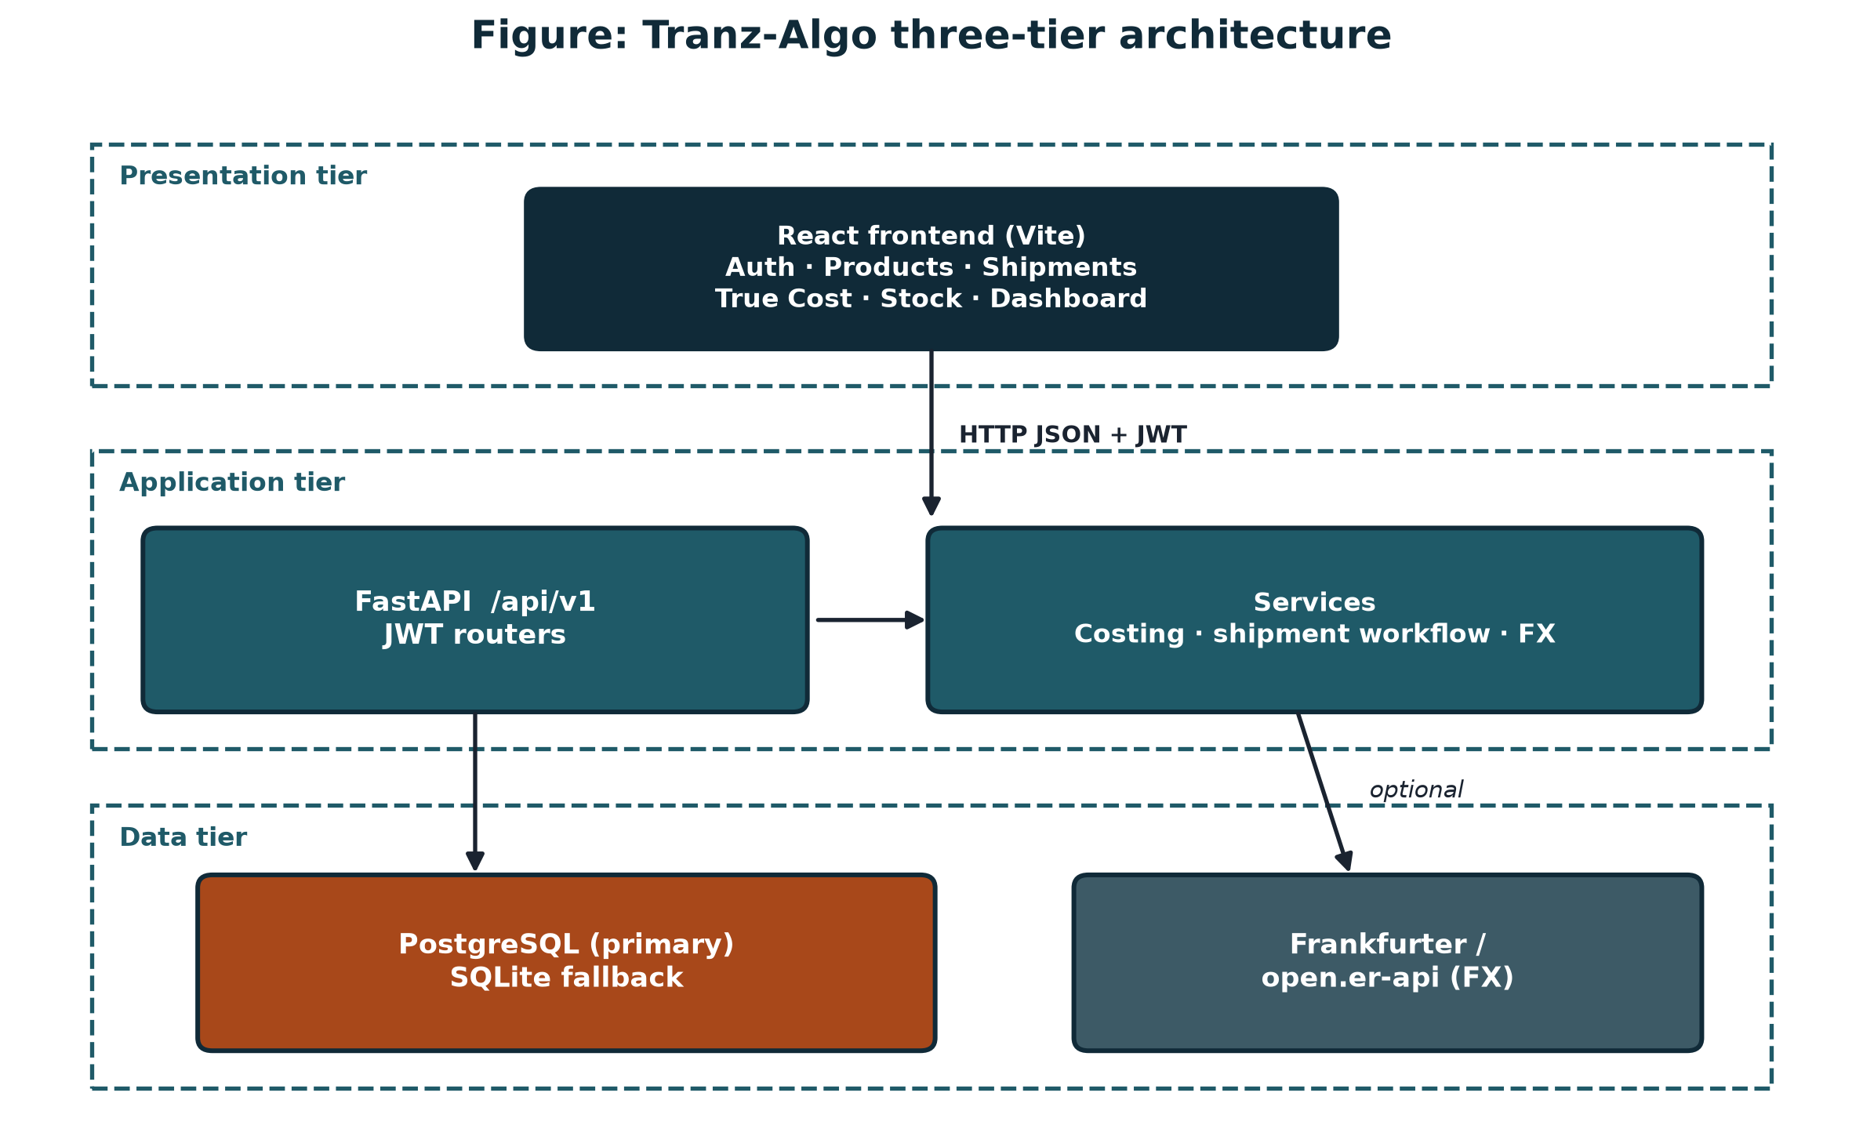
System Architecture
React screens → FastAPI → services (costing / workflow / FX) → PostgreSQL · optional live FX · JWT
Tranz-Algo · Final Year Project · Academic Year 2026
6 / 17

Slide 7
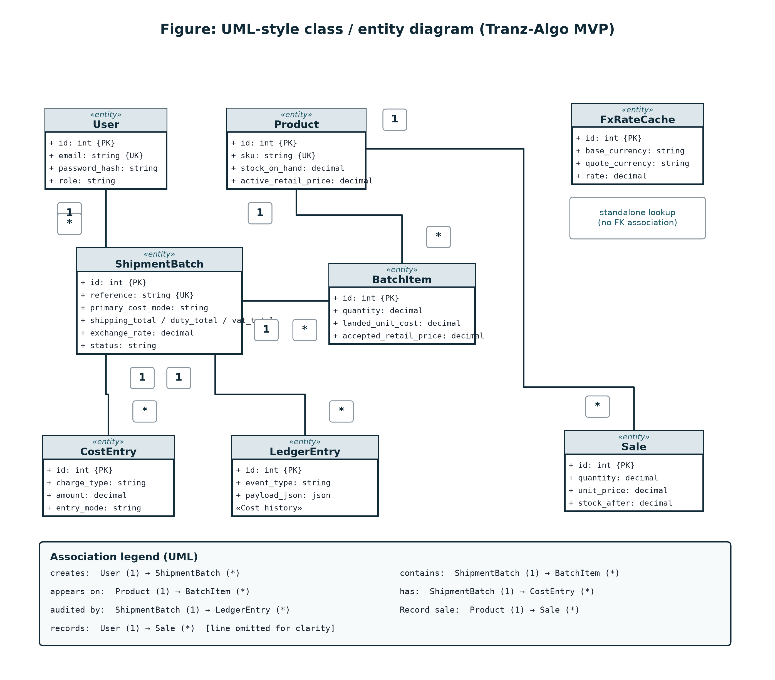
Database / Data Design
UML-style entities · duty/VAT as paperwork totals on the batch · Cost history from ledger · Sale = stock-out only
Tranz-Algo · Final Year Project · Academic Year 2026
7 / 17

Slide 8
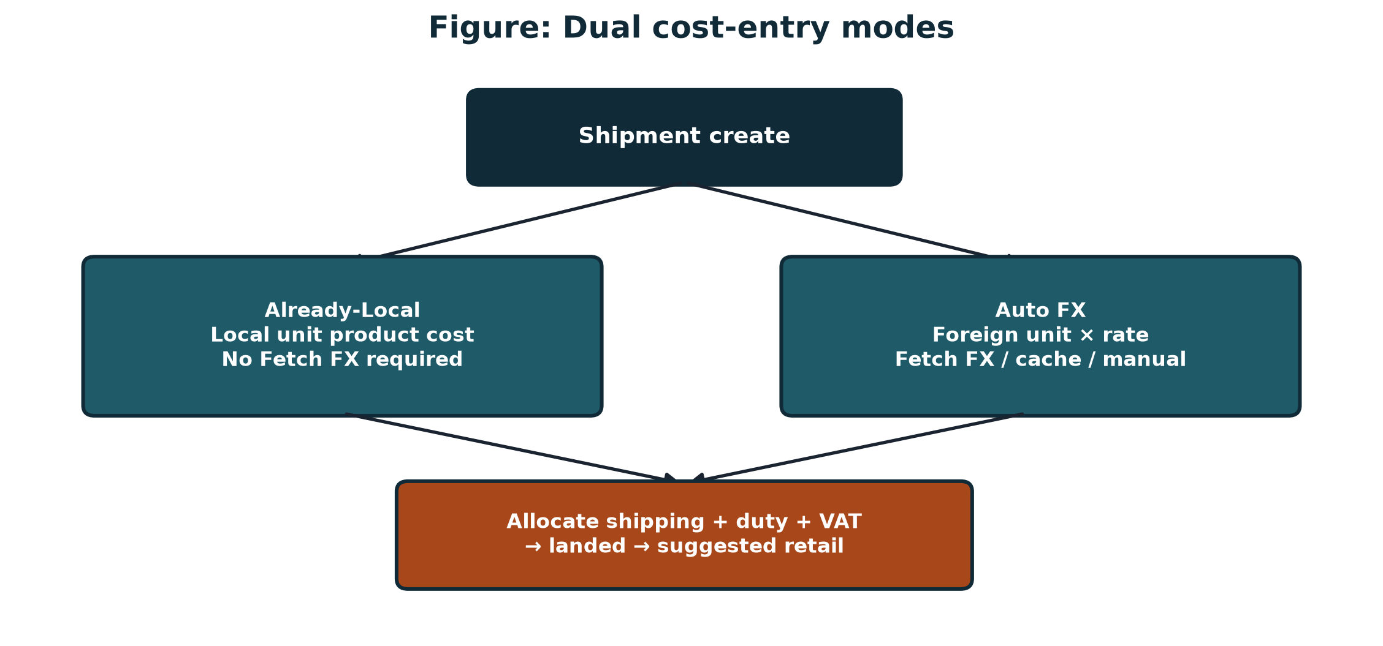
Algorithms / Models / Technical Design
• Auto FX: foreign unit × exchange rate
• Already-Local: local unit product cost (no Fetch FX required)
• Allocate shipping / duty / VAT by quantity or weight; compare methods
• Suggested RP = Landed × (1 + margin)
• Safety floor = Landed × 1.10 (live on True Cost adjust)
Tranz-Algo · Final Year Project · Academic Year 2026
8 / 17

Slide 9
Development Environment
• Languages: Python 3, JavaScript (React)
• Frameworks: FastAPI, Vite/React, SQLAlchemy 2, Pydantic
• Database: PostgreSQL (primary), SQLite fallback
• FX: Frankfurter / open.er-api + cache / manual
• Tools: VS Code / Cursor, Git / GitHub
• Repository: https://github.com/Nixon-Shibuchi/Tranz-Algo
Tranz-Algo · Final Year Project · Academic Year 2026
9 / 17

Slide 10
System Components / Modules
• Auth: JWT login / Create account
• Products: catalogue + CSV import (+ optional auto SKU)
• Shipments: dual modes, paperwork costs, CSV, Clear drafts
• True Cost studio: Lines → Allocate → Price → Commit
• FX service: Fetch / cache / starter 20 / manual
• Stock board + Record sale (stock-out only — not POS)
• Dashboard Start fresh + Cost history (When / What)
Tranz-Algo · Final Year Project · Academic Year 2026
10 / 17

Slide 11
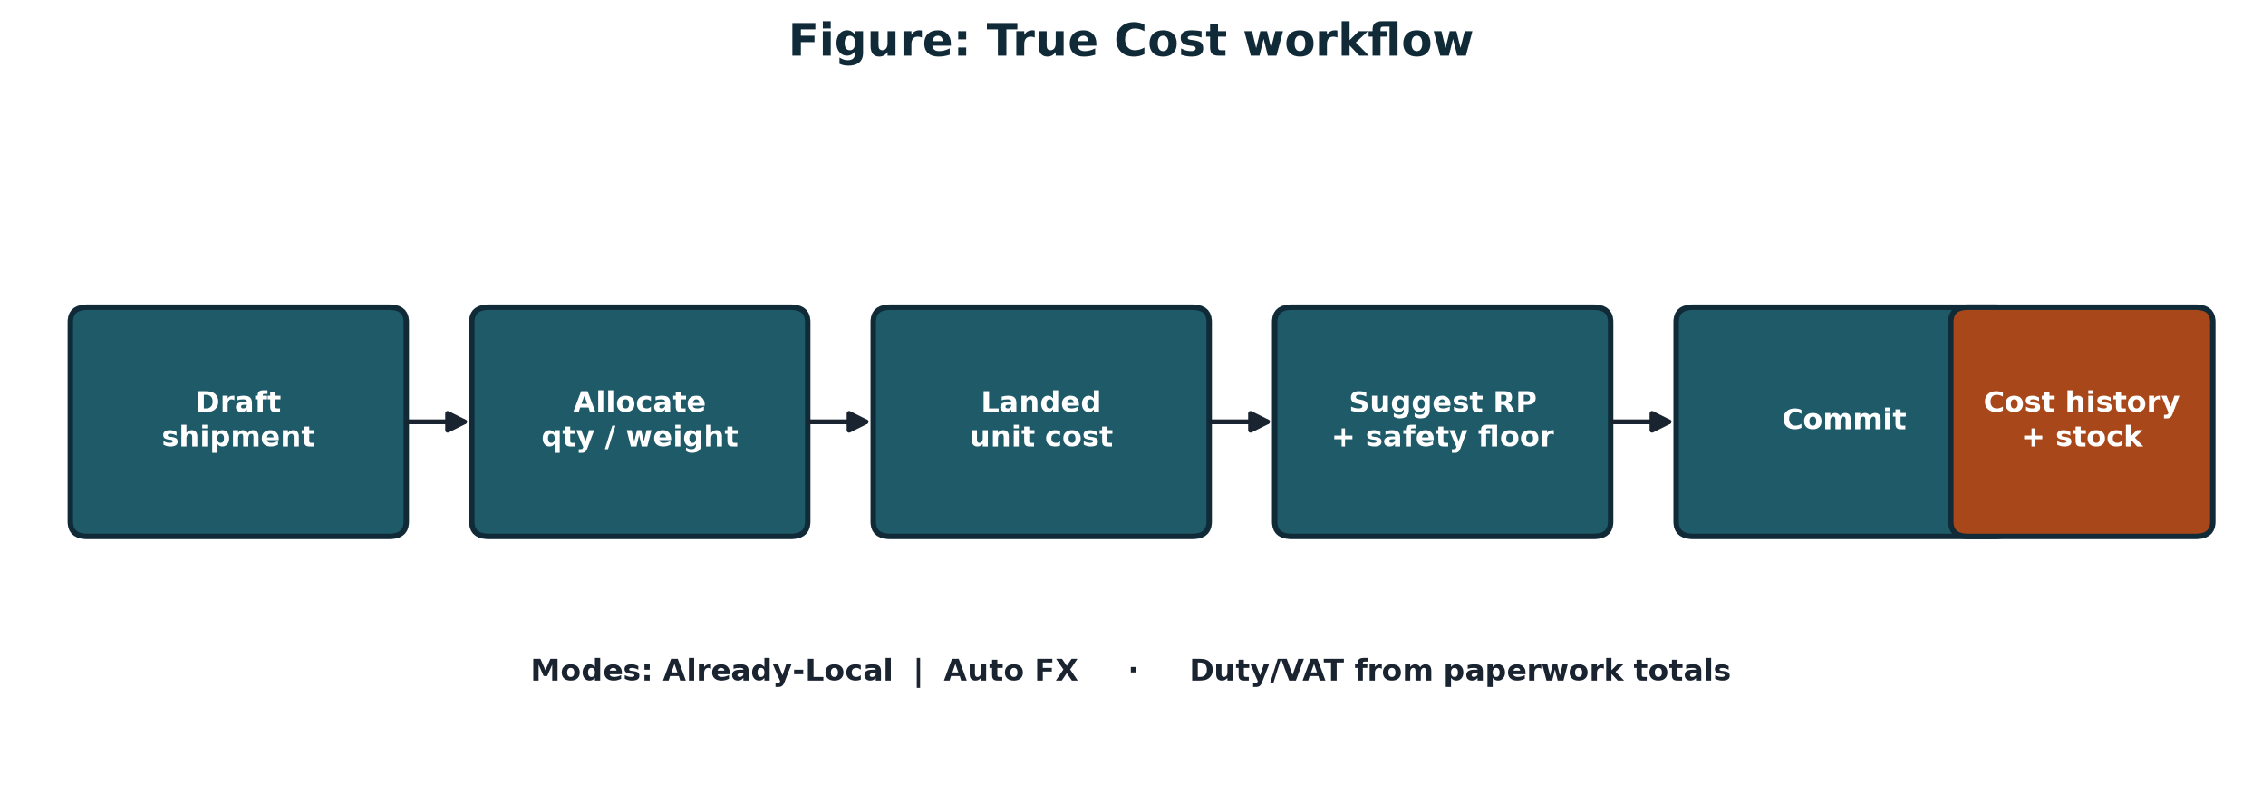
Key Implementation Details
• React web admin instead of React Native — prioritise desk costing MVP
• Strategy (modes/allocation) · Facade (commit) · Chain (FX providers)
• CSV import drives Demo A/B: SHP-DEMO-LOCAL-ZMW / SHP-DEMO-AUTO-FX
• Security: bcrypt · JWT Bearer · Pydantic validation
Tranz-Algo · Final Year Project · Academic Year 2026
11 / 17

Slide 12
Challenges and Solutions
• Mixed foreign/local paperwork → Dual cost modes at shipment create
• FX API downtime → Cache, starter rate 20, manual override
Tranz-Algo · Final Year Project · Academic Year 2026
12 / 17

Slide 13
Test Results
ID | Test case | Status
TC-01 | Already-Local Demo A vs expected spreadsheet costs (±0.01 ZMW) | PASS
TC-02 | Auto FX Demo B vs expected costs (rate 20) | PASS
TC-03 | Allocation compare qty vs weight (Demo A) | PASS
TC-04 | Safety floor on True Cost adjust | PASS
TC-05 | CSV UI demo path (Scenario 05) | PASS
TC-06 | Record sale stock-out (not POS) | PASS
Tranz-Algo · Final Year Project · Academic Year 2026
13 / 17

Slide 14
Discussion of Findings
• Demo A/B costs matched our pre-calculated spreadsheet answers — formulas are correct
• Dual modes address mixed paperwork — the original problem
• Design, build and evaluate objectives were met for MVP scope
• Key finding: explainable batch costing can be accurate and usable
Tranz-Algo · Final Year Project · Academic Year 2026
14 / 17

Slide 15
Limitations
• Does not legally assess customs duty/VAT — paperwork totals only
• Auto FX / Demo B number-check use rate 20 (same as UI starter)
• Value-based allocation is stretch in the UI
• No large-scale SME field trial yet — evaluation is spreadsheet checks + live demo
Tranz-Algo · Final Year Project · Academic Year 2026
15 / 17

Slide 16
Conclusion
• Tranz-Algo delivers explainable import true cost, suggested retail, Cost history and stock
• Design was joint; implementation mostly Nixon with Musonda’s UI / True Cost contribution
• Next: optional mobile companion, cloud Postgres, usability study
• Thank you — demonstration follows
Tranz-Algo · Final Year Project · Academic Year 2026
16 / 17

Slide 17
Questions and Discussion
Thank you
Tranz-Algo · University of Zambia · 2026
https://github.com/Nixon-Shibuchi/Tranz-Algo

