Slide 1
ADVANCED TOPICS IN MACHINE LEARNING · PAPER REPLICATION
Replicating RikoNet
A deep-autoencoder + spectral-clustering hybrid recommender for anime
Soni, Thakuria, Nath, Das & Boro · Multimedia Tools and Applications, vol. 82, pp. 32329-32348 (2023), Springer
DOI 10.1007/s11042-023-14710-9
Presented by: ______________________ Supervisor: ______________________
Notes:
Introduce yourself and the paper. RikoNet was published in 2023 in Springer's Multimedia Tools and Applications, a subscription journal. The goal of this project: re-implement the method from the paper alone and check whether its reported results hold.

Slide 2
The answer up front
What we rebuilt, and whether the paper's claim held up
0.591
0.942
0.942
RMSE on MovieLens-100K reported in the paper
our RikoNet RMSE, same data and protocol (mean of 3 seeds)
best baseline we trained: Biased MF (ALS)
Rebuilt end to end: masked deep autoencoder, 3-stage embeddings, spectral clustering, opposite clusters, hybrid filter.
Not reproduced: the headline RMSE. Ours is 0.351 higher, and about equal to a tuned classical baseline.
Type: simplified replication. The authors' anime data and code are not public, so we used the paper's public benchmark plus an alternative public anime dataset.
RikoNet replication · ATML
2
Notes:
Give the conclusion first so the audience knows where the talk is going. The three numbers: what the paper reports, what we got with the same dataset and protocol, and what a simple baseline gets.

Slide 3
Paper selection was verified before starting
1
Subscription only
2
Authors' code: gone
Springer page metadata: Open Access = N, isAccessibleForFree = false. (A preprint exists on arXiv 2106.12970.)
github.com/NilutpalNath/RikoNet returns 404 and is not in the author's public repository list.
3
Anime data: private
4
Benchmark data: public
Crawled from MyAnimeList via the Jikan API, never released, no reconstruction instructions.
Table 4 uses MovieLens-100K, which we downloaded from GroupLens, so that experiment can be reproduced exactly.
RikoNet replication · ATML
3
Notes:
Faculty asked for a closed-access Springer paper with public data. The journal version is subscription-only; mention honestly that an arXiv preprint exists. The anime dataset is private, which is why this is a simplified replication.

Slide 4
How RikoNet works
Collaborative signal (top) + content signal (bottom) meet in the hybrid filter
Similar Anime
top 10
User ratings
+ age, gender
Primary
autoencoder
Predicted ratings
for unrated titles (S)
Hybrid filter
S ∩ C / S − C
You May Like
top 10
Top raters'
ratings per anime
AE-1 Rᵐ→Rᵈ
+ 43 genres
AE-3 → hybrid
embedding (d)
Spectral
clustering (222)
Opposite
clusters (Alg. 1)
C = union of the clusters of the user's last 3 rated titles: own cluster if liked, logically opposite cluster if disliked.
RikoNet replication · ATML
4
Notes:
Top row: the collaborative part. A user's ratings go through the autoencoder, which fills in ratings for everything unrated. Bottom row: the content part. Anime are embedded using ratings from heavy users plus genres, then clustered. The hybrid filter splits the predictions into titles inside the relevant clusters (Similar) and outside them (You May Like).

Slide 5
The primary autoencoder
Kuchaiev & Ginsburg (2017) architecture, as RikoNet specifies
Input: one user = ratings of all titles, 0 = unknown (+ gender and 5 age groups).
Activations: SELU in hidden layers, ReLU on the output (ratings are never negative).
Masked MSE: error is counted only where a real rating exists.
Dense re-feeding: the dense output f(x) is fed back as a new input with target f(x).
Prediction: the reconstructed value at an unrated position is the predicted rating.
1024
512
512
512
512
n
n
K&G default sizes shown; code layer has dropout 0.8.
Tuned on validation: [256, 128] (MovieLens)
RikoNet replication · ATML
5
Notes:
The key idea of masked MSE: zeros mean 'unknown', so they must not be treated as real ratings of zero. Dense re-feeding is a data-augmentation trick from the NVIDIA paper.

Slide 6
Exact reproduction vs simplified replication
Component | Status
Autoencoder: SELU/ReLU, masked MSE, re-feeding | Faithful
5 % per-user hold-out, MSE/RMSE | Faithful
MovieLens-100K benchmark (Table 4) | Faithful, same public data
Spectral clustering, 222 clusters; Algorithm 1; hybrid filter | Faithful
Layer sizes, dropout, optimiser, d, t, like threshold | Not in paper: chosen on validation
Self-tuning cluster count (Table 1) | Approximated (eigengap)
MyAnimeList anime data + demographics | Substituted: Kaggle anime data
'Last 3 rated' (needs timestamps) | Approximated: 3 random known titles
Baselines | Re-trained on our split (paper copied them)
20-person user study | Not replicated
RikoNet replication · ATML
6
Notes:
Be explicit about this to the faculty: highlighted rows are where we had to deviate or guess, because the paper does not report the detail or the original resource is unavailable.

Slide 7
Data and evaluation protocol
MovieLens-100K
Anime (Kaggle)
Per-user split
943 users · 1,682 movies
100,000 ratings, 1-5
same data as paper Table 4
has age + gender
16,384 users · 6,668 titles
4,355,489 ratings, 1-10
43 genres (same as paper)
ALTERNATIVE dataset
train 90 % · validation 5 % · test 5 %
(same idea as the paper's 5 % hold-out)
No leakage: test ratings are removed from every model's input; tuning uses validation only; embeddings and clusters use training ratings only.
Fair baselines: averages, bias model, user/item KNN, biased MF, popularity - all on the same split.
Metrics: MSE, RMSE, MAE (paper) + Precision, Recall, NDCG, HitRate @10 (added).
RikoNet replication · ATML
7
Notes:
Explain why splitting per user matters: every user keeps most of their history as input, and the hidden 5 percent is what we try to predict. The validation split lets us tune without ever touching test.

Slide 8
Result 1: MovieLens-100K, paper protocol
Test RMSE, lower is better
Ours: 0.942 ± 0.002 (mean of 3 seeds).
Best baseline: Biased MF (ALS), 0.942.
K&G default config: 0.999.
Paper: 0.591, which we could not approach.
RikoNet replication · ATML
8
Notes:
Blue bars are our RikoNet runs, grey bars are baselines trained by us on exactly the same split, and the orange bar is the number printed in the paper. All methods we trained sit in roughly the same band.

Slide 9
Why the gap? Looking closely at paper Table 4
Method | MSE | RMSE | √MSE | OK?
Global Average | 1.129 | 1.062 | 1.063 | yes
User Average | 0.929 | 0.964 | 0.964 | yes
User KNN - Cosine | 0.813 | 0.813 | 0.902 | NO
Item KNN - Cosine | 0.854 | 0.862 | 0.924 | NO
User KNN - Pearson | 0.814 | 0.902 | 0.902 | yes
Item KNN - Pearson | 0.796 | 0.892 | 0.892 | yes
SVD | 0.879 | 0.937 | 0.938 | yes
Biased MF | 0.768 | 0.877 | 0.876 | yes
SVD++ | 0.756 | 0.869 | 0.869 | yes
DNNRec | 0.747 | 0.864 | 0.864 | yes
UBP | 0.724 | 0.851 | 0.851 | yes
PDMF-post 50D | 0.427 | 0.654 | 0.653 | yes
Proposed Model: RikoNet | 0.349 | 0.591 | 0.591 | yes
Inconsistent rows: for User/Item KNN-Cosine, RMSE is not √MSE.
Borrowed numbers: competitors were copied from another paper, so they were not run on the 5 % protocol.
Missing details: layer sizes, epochs, optimiser, d and t are not reported.
Our check: re-training every baseline on one split gives a like-for-like comparison.
RikoNet replication · ATML
9
Notes:
This is an important critical-thinking slide for ATML: the published comparison mixes numbers from different sources, and two rows are arithmetically inconsistent.

Slide 10
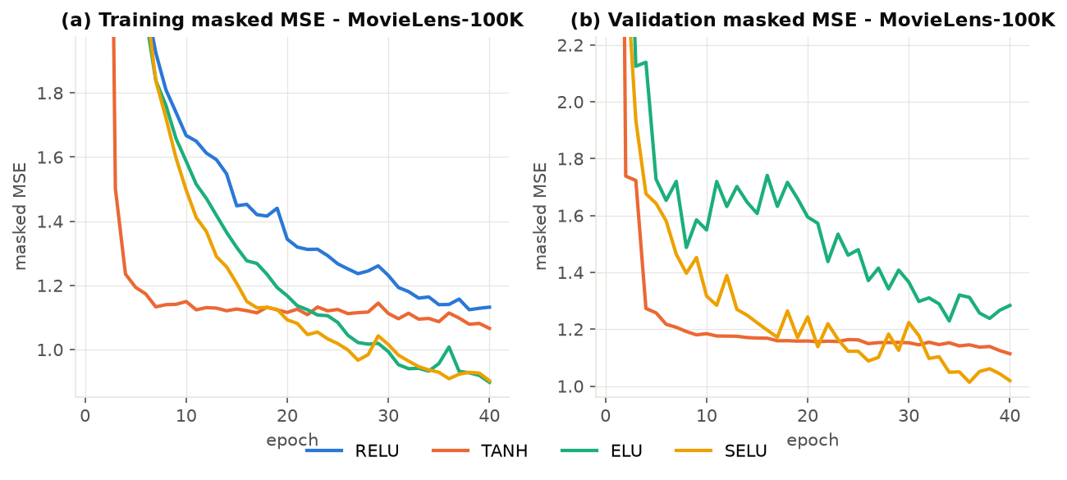
Result 2: which activation works best?
Paper Fig. 3 replicated on MovieLens-100K
Activation | Best val MSE
SELU | 1.013
TANH | 1.114
ELU | 1.229
RELU | 2.883
SELU is best: the paper's claim is confirmed.
RikoNet replication · ATML
10
Notes:
Same network, only the activation function changes. The paper reports SELU as best; the table shows the lowest validation MSE each activation reached.

Slide 11
Result 3: anime data, rating prediction and top-10 lists
RikoNet replication · ATML
11
Notes:
Left: rating error on held-out anime ratings. Right: quality of the top-10 list, counting a hit when the user rated the title 8 or more. Low rating error does not automatically give good top-10 lists; popularity is a strong ranking baseline on this data.

Slide 12
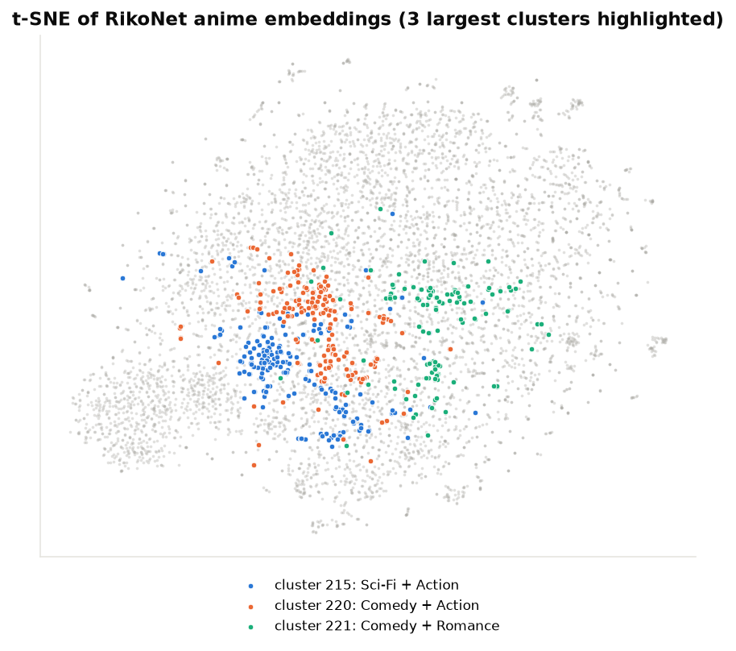
Result 4: anime embeddings and clusters
0.29
0.11
genre overlap inside a cluster
genre overlap of random pairs
0.03
222
title vs its 'opposite' title
spectral clusters (median size 20)
Clusters group anime with shared genres; Algorithm 1 picks titles whose genres differ more than a random title's.
RikoNet replication · ATML
12
Notes:
Genre overlap is the Jaccard similarity of two titles' genre sets. Inside a cluster it is much higher than for random pairs, so the embeddings capture content. The 'opposite' title shares fewer genres than random, which is what Algorithm 1 aims for.

Slide 13
Result 5: the hybrid filter in action
Example: Kaggle user 7
List | Anime | Rating
Context | Nisekoi: OVA | 5
Context | Planetarian: Chiisana Hoshi no Yum | 8
Context | Time Travel Shoujo: Mari Waka to 8 | 7
Similar Anime | Little Busters!: Sekai no Saitou w | 9.08
Similar Anime | Gosick Recap | 8.72
Similar Anime | Kaiba | 8.54
Similar Anime | Noir | 8.54
Similar Anime | Anime Tenchou x Touhou Project | 8.48
RikoNet replication · ATML
13
Notes:
Top chart: the Similar list is closer in genre to what the user just rated, which is its purpose. Bottom chart: hit rate against held-out ratings. Right: a real example from the test set.

Slide 14
What we learned
1
Pipeline works
Every RikoNet component was implemented and produces sensible, genre-coherent lists.
2
Headline not reproduced
MovieLens RMSE 0.942 vs 0.591 reported; about equal to a tuned baseline.
3
Reporting matters
Unreported hyper-parameters, borrowed baseline numbers and table errors make the claim hard to verify.
4
RMSE ≠ good lists
Rating error and top-10 quality disagree; recommenders need ranking metrics too.
RikoNet replication · ATML
14
Notes:
Summarise the takeaways. Emphasise that a failed reproduction is still a valid scientific result if it is done carefully and transparently.

Slide 15
Conclusion & future work
Simplified replication of RikoNet completed: exact benchmark data, alternative anime data.
Our RikoNet: RMSE 0.942 on MovieLens-100K; the paper's 0.591 was not reproduced.
Next: ask the authors for code/data, try item-based autoencoders, run a small user study.
Thank you - questions?
Notes:
Close with the main finding and the next steps, then open the floor for questions.

Slide 16
References
Soni B., Thakuria D., Nath N., Das N., Boro B. RikoNet: A novel anime recommendation engine. Multimedia Tools and Applications 82:32329-32348 (2023). doi:10.1007/s11042-023-14710-9
Kuchaiev O., Ginsburg B. Training deep autoencoders for collaborative filtering. arXiv:1708.01715 (2017).
Zelnik-Manor L., Perona P. Self-tuning spectral clustering. NIPS 17 (2004).
Klambauer G. et al. Self-normalizing neural networks. NIPS (2017).
Harper F. M., Konstan J. A. The MovieLens datasets: history and context. ACM TiiS 5(4) (2015).
CooperUnion. Anime Recommendations Database, Kaggle.
RikoNet replication · ATML
16
Notes:
Reference list.

