Slide 1
Data Science Jobs Analysis
Data 101 | Final Project | Niyal Thakkar

Slide 2
Research Topic: Data Science Jobs
Data science is the domain of study that deals with vast volumes of data using modern tools and techniques to find unseen patterns, derive meaningful information, and make business decisions.
Data science uses complex machine learning algorithms to build predictive models.
The data used for analysis can come from many different sources and be presented in various formats.
Data science is an essential part of many industries today, given the massive amounts of data that are produced, and is one of the most debated topics in IT circles.

Slide 3
Project Goals
📊Explore every feature in the dataset;
Analyzing the data of Data Science Salary from the year 2021 to the year 2022 and testing the hypothesis of different stats by z-test, Permutation test, and P-Hacking.
💰💵Salary Analysis (with Work Year, Experience Level, Company Size, Job Title, Remote Ratio)
🗓Work Year Analysis(with Salary, Remote Ratio);
📝Experience Level Analysis (with Top 2 Job Title, Company Size);

Slide 4
URL: https://www.kaggle.com/datasets/ruchi798/data-science-job-salaries
Description: Analysis of different types of jobs in the field of Data Science from the year 2020 to the year 2022, categorized by Salary, Remote Ratio, Location, Experience Level, and company size
Attributes:
Job Title
Work Year
Location
Salary
Remote Ratio
Experience Level
No. of employees
No. of companies
Company Size

Slide 5
P-Value and Z-score
Explore the meaning of the P-value
P-Value is the probability of getting the observed value of the test statistic if the null hypothesis is true.
The smaller the P-Value, the stronger the evidence that we can reject the NULL hypothesis.
P-Values range from 0 to 1.
If P-Value is greater than an acceptable threshold, then we cannot reject the NULL hypothesis Because then we have strong evidence in favor of it.
Most of the time threshold will be 0.05, which is equal to 5%.

Slide 6
Hypothesis 1
Hypothesis: Salaries in the field of Data Science in the year 2022 is higher than in the year 2021.
Null: Salaries in the field of Data Science in the year 2022 are less than in the year 2021.
Analyzing and testing the hypothesis by the Z-Test.

Slide 7
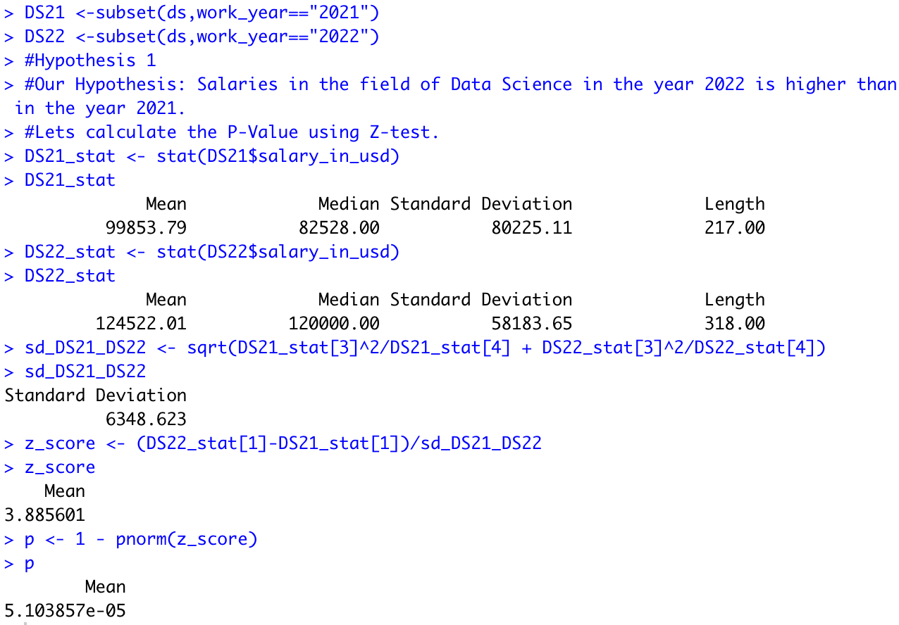
Hypothesis 1
According to the calculation, the average salaries of Data Science Jobs in the year 2022 are higher than in the year 2021.
But the Standard Deviation of the salaries of Data Science Jobs in the year 2021 is higher than that in the year 2022.
The z - score is positive and the p-value is so small, it returns a value that is almost zero.
As the p-value is less than 0.05, i.e., 5%, we can reject the null value

Slide 8
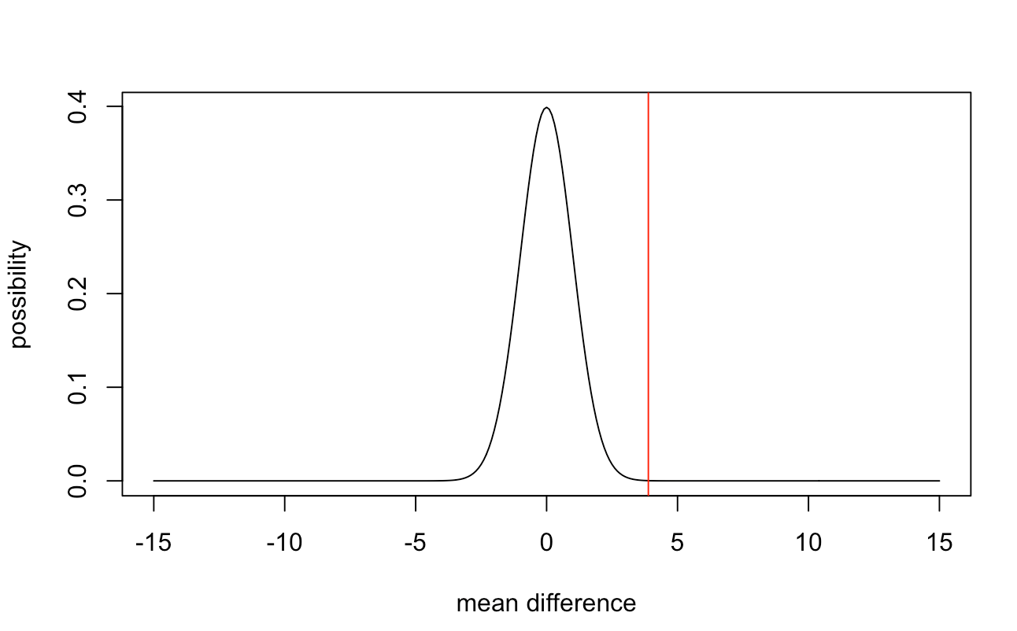
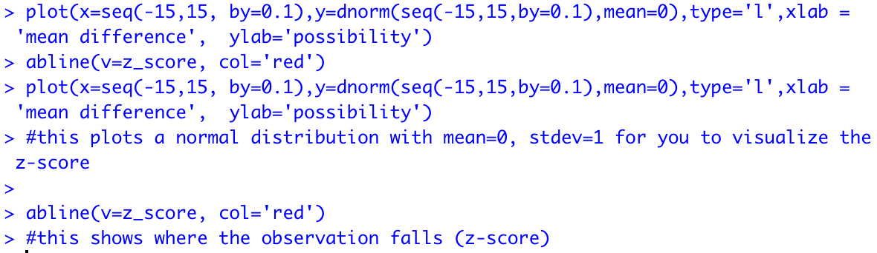
Hypothesis 1
Graph of the p-value and z-score

Slide 9
Hypothesis 1
Conclusion
As the p-value is less than the threshold, i.e., 0.05, i.e., 5%, we can reject the null value.
It is almost impossible for that result (the difference in means between the year 2022 and the year 2021) to happen by chance
Therefore, We found great evidence to support our hypothesis that Salaries in the field of Data Science in the year 2022 is higher than in the year 2021.

Slide 10
Hypothesis 2
Hypothesis: Average Salary of a Data Scientist is higher than a Data Analyst.
Null: Average Salary of a Data Analyst is higher than a Data Scientist
Analyzing and testing the hypothesis by the Z-Test.

Slide 11
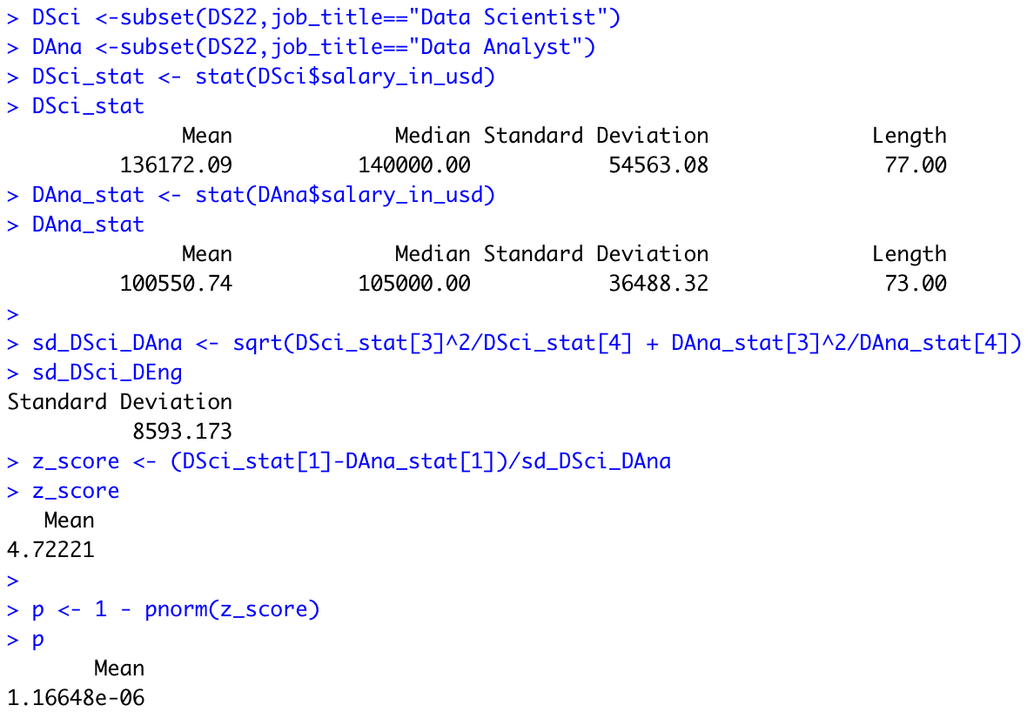
Hypothesis 2
According to the calculation, the average Salary of a Data Scientist is higher than the average salary of a Data Analyst.
Similarly, the Standard Deviation of the average salary of a Data Scientist is higher than the average salary of a Data Analyst.
The z - score is positive and the p-value is so small, it returns a value that is almost zero.
As the p-value is less than 0.05, i.e., 5%, we can reject the null value

Slide 12
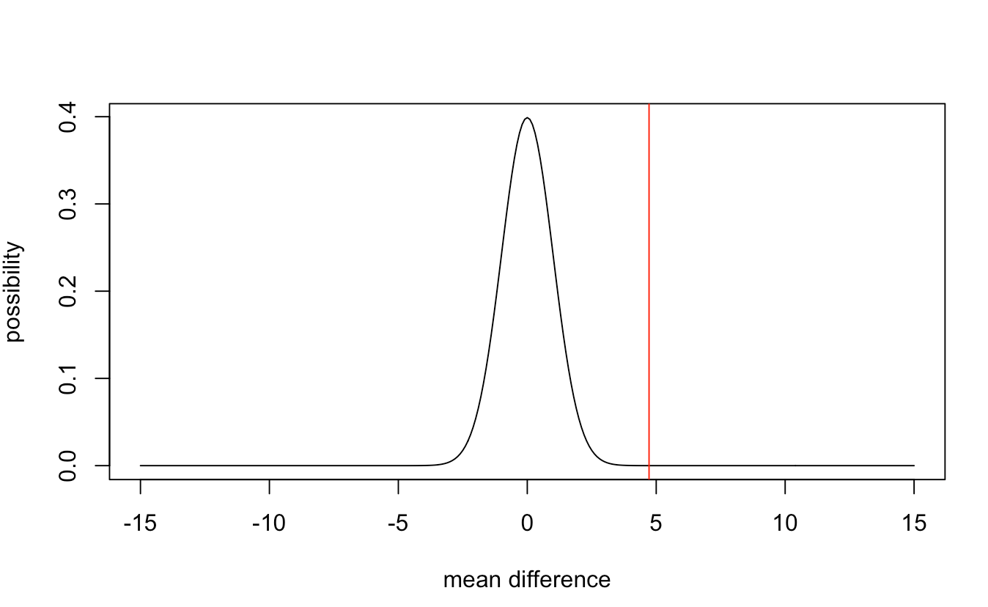
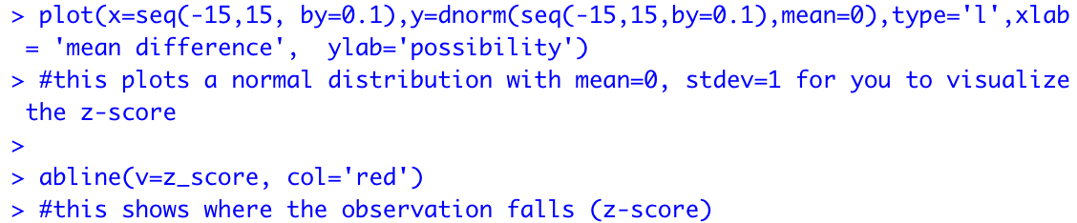
Hypothesis 2
Graph of the p-value and z-score

Slide 13
Hypothesis 2
Conclusion
As the p-value is less than the threshold, i.e., 0.05, i.e., 5%, we can reject the null value.
It is almost impossible for that result (the difference in means between the salaries of Data Scientists and Data analysts) to happen by chance
Therefore, We found great evidence to support our hypothesis that the Average Salary of a Data Scientist is higher than a Data Analyst.

Slide 14
Hypothesis 3
Hypothesis: The Average Salary of Data Science Jobs in the year 2021 is more than the average salary of Data Science Jobs in the year 2020.
Analyzing and testing the hypothesis by the Permutation Test.

Slide 15
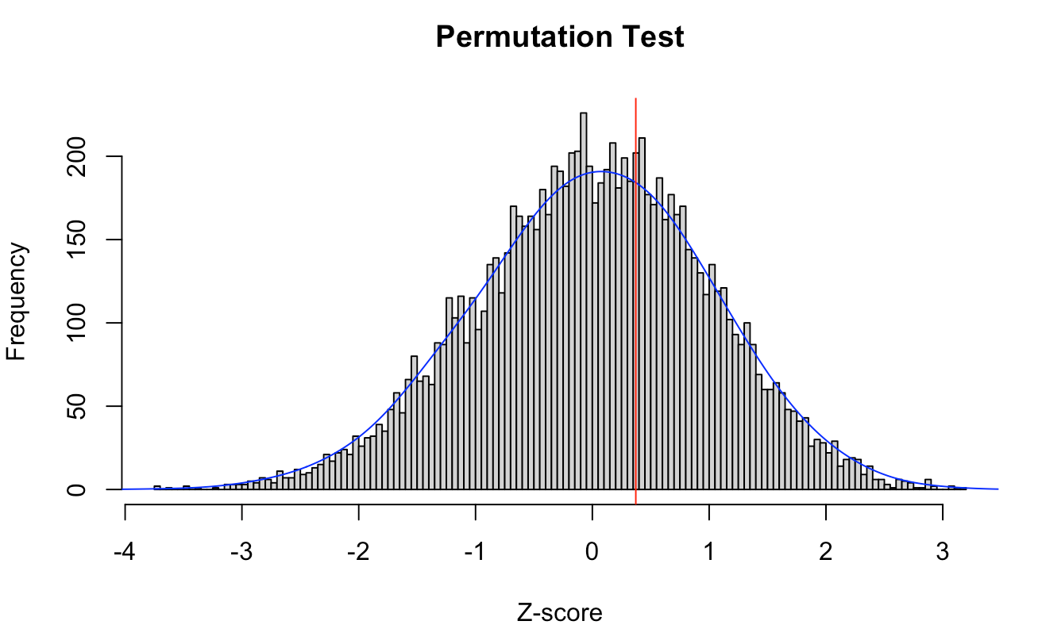
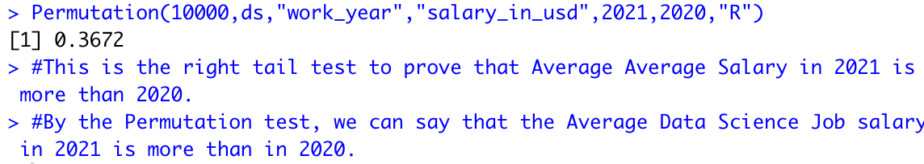
Hypothesis 3
This test is the right-tail test.
By the right tail test, we can prove that the Average Salary of Data Science Jobs in 2021 is more than in 2020.

Slide 16
Hypothesis 4
Analyzing and testing the hypothesis by the p-hacking (testing various variables and sample sizes).

Slide 17
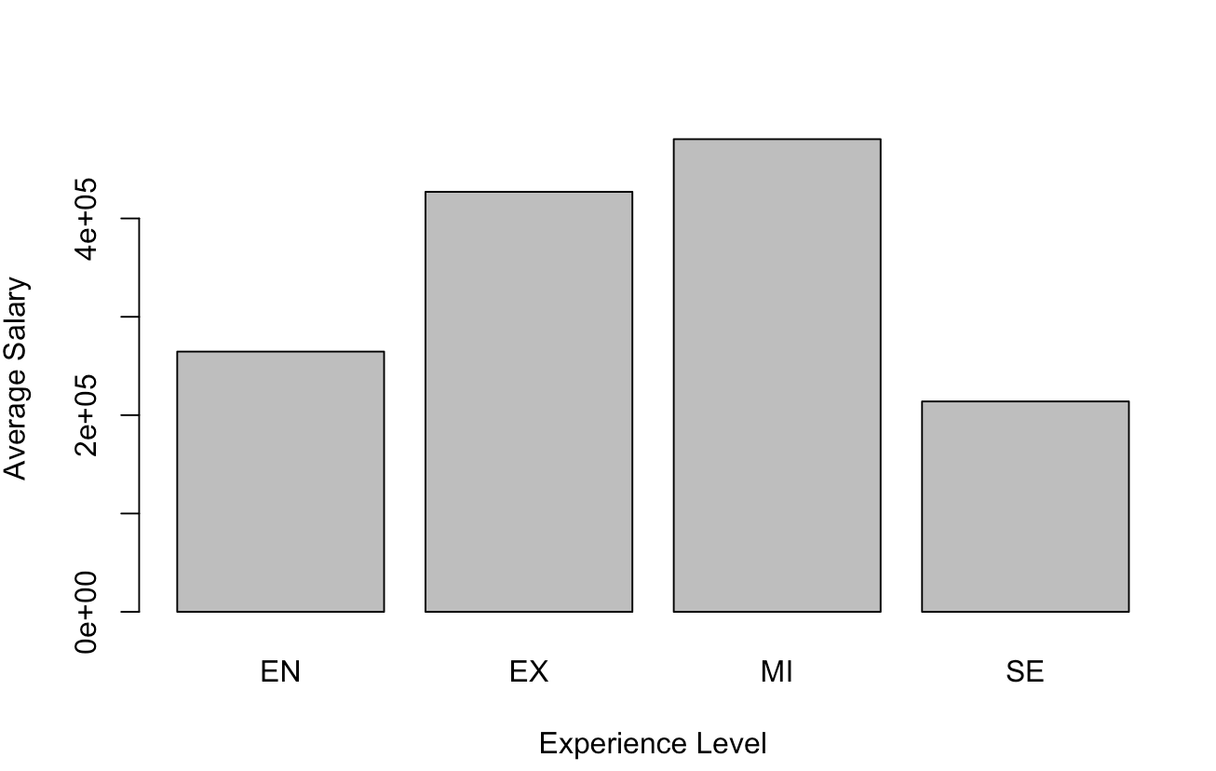
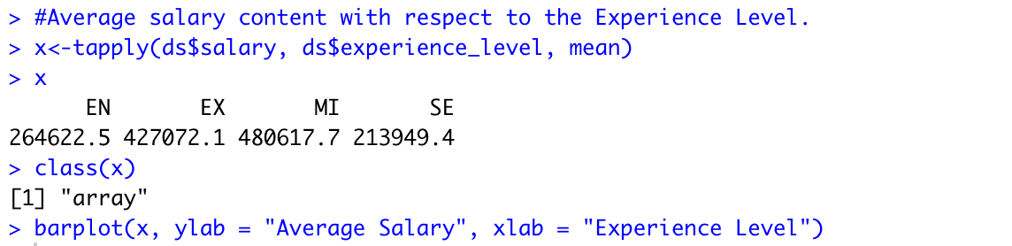
Hypothesis 4
Here, we are analyzing the Average Salary of Data Science Jobs over the years 2020 to 2022 with respect to the Experience Level.

Slide 18
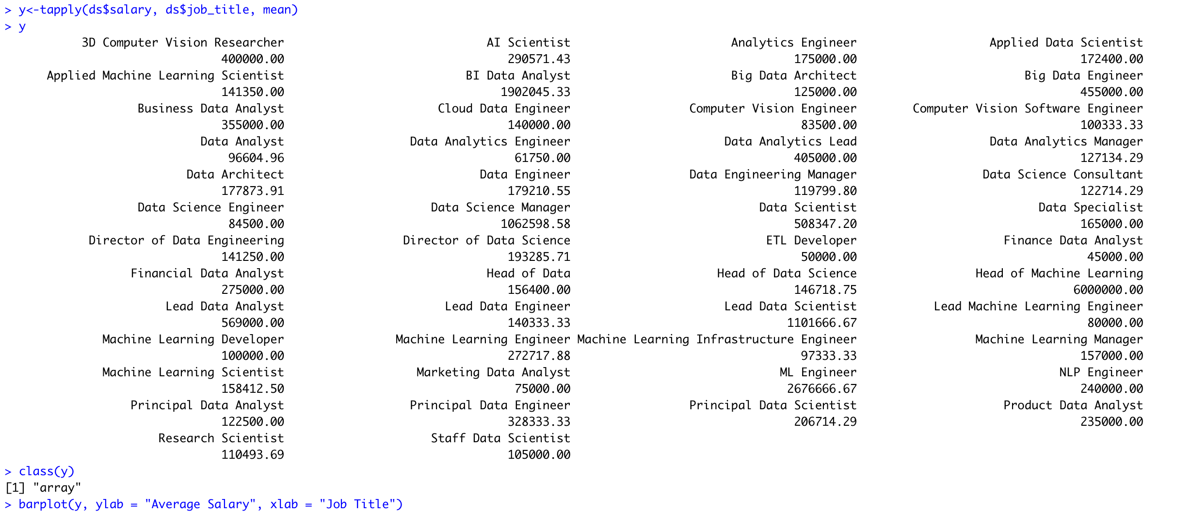
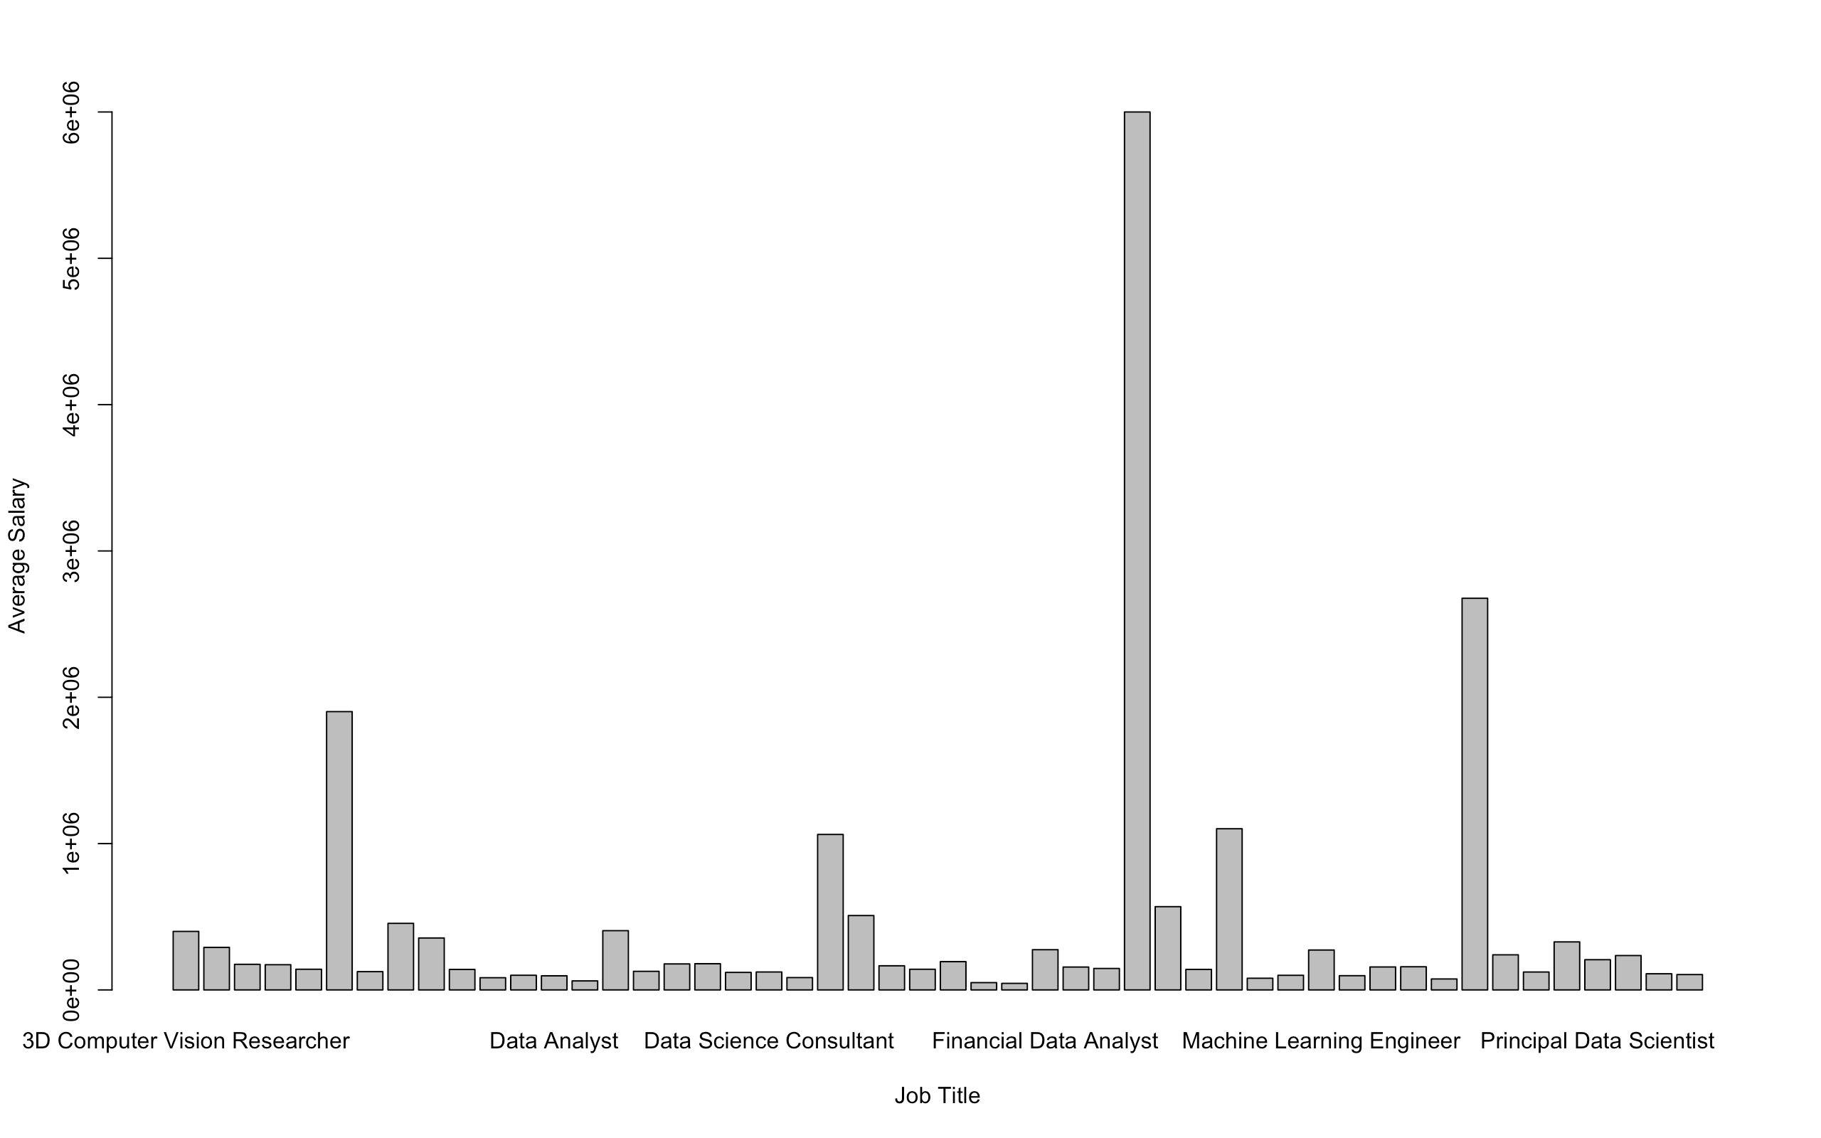
Hypothesis 4
Here, we are analyzing the Average Salary of Data Science Jobs over the years 2020 to 2022 with respect to the Job Title.

Slide 19
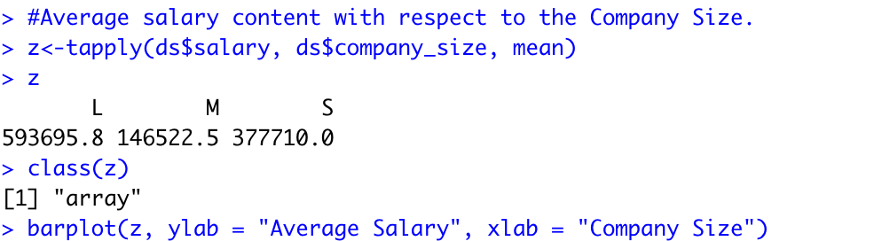
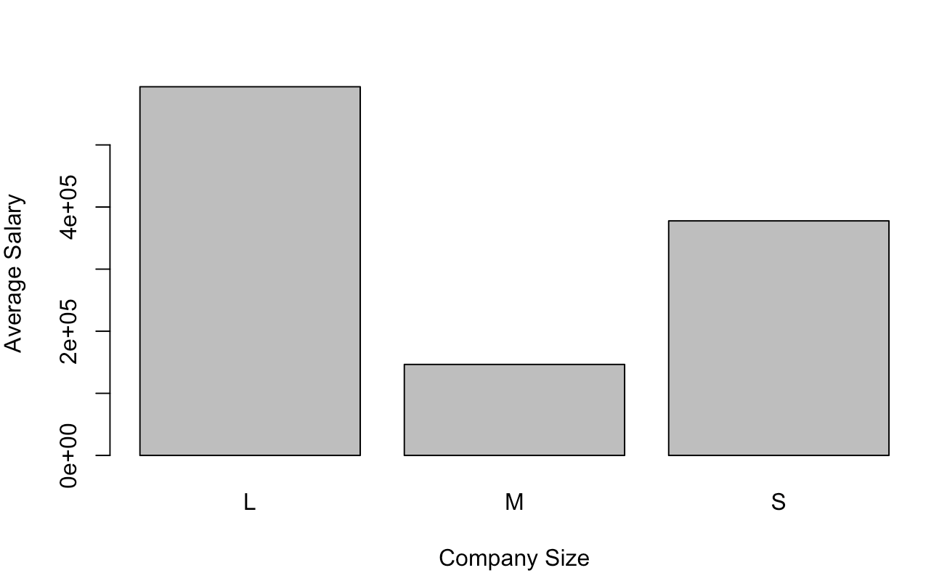
Hypothesis 4
Here, we are analyzing the Average Salary of Data Science Jobs over the years 2020 to 2022 with respect to the company size.

Slide 20
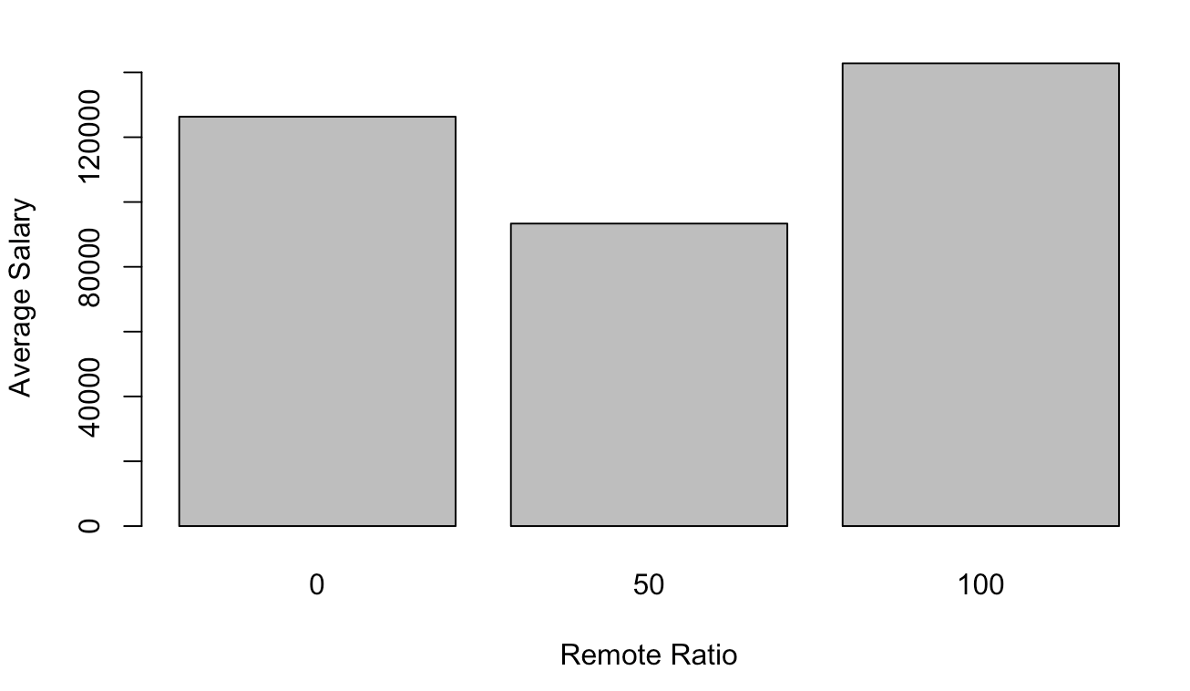
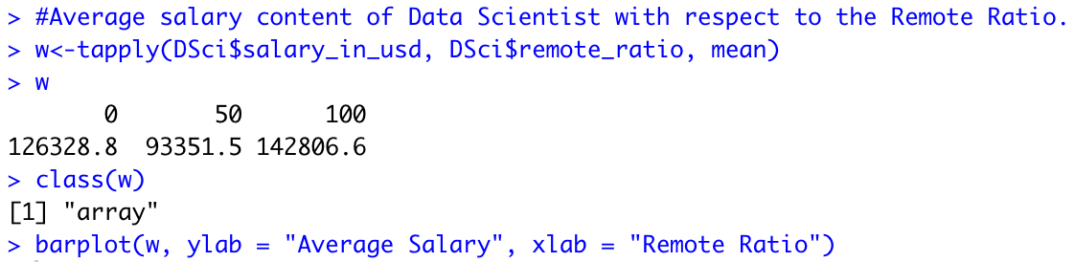
Hypothesis 4
Here, we are analyzing the Average Salary of Data Science Jobs over the years 2020 to 2022 with respect to Experience Level.

Slide 21
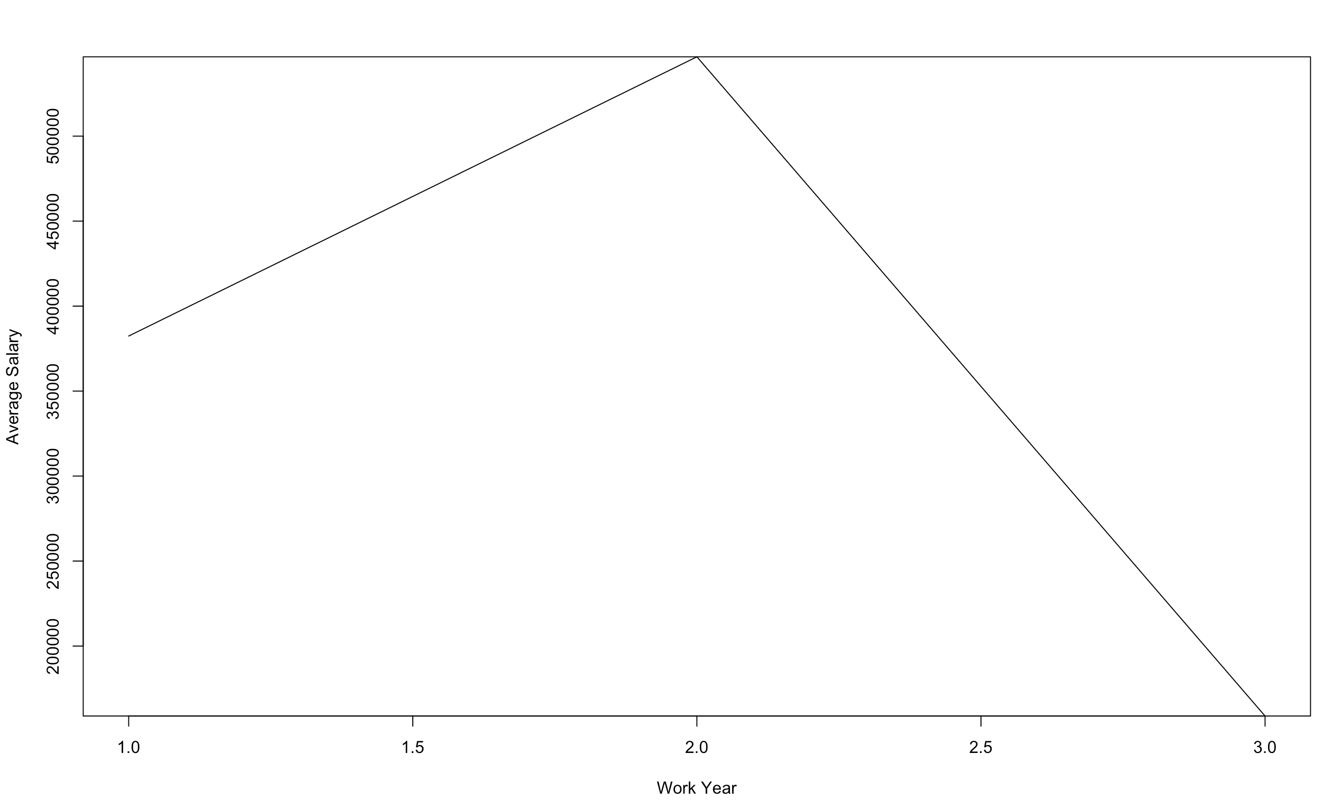
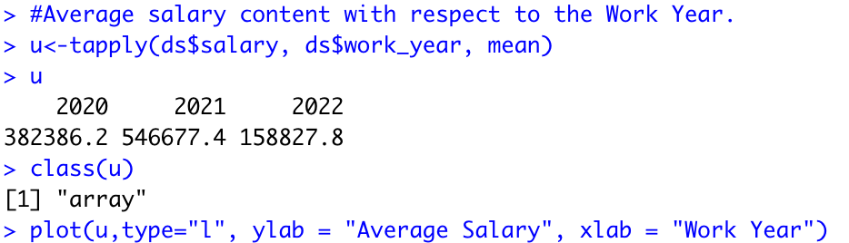
Hypothesis 4
Here, we are analyzing the Average Salary of Data Science Jobs over the years 2020 to 2022 with respect to Experience Level.

Slide 22
Conclusion
The Average Salary of Data Science Jobs in the year 2021 is more than the average salary of Data Science Jobs in the year 2020.
The Average salaries in the field of Data Science in the year 2022 are higher than in the year 2021.
The average Salary of a Data Scientist is higher than the average Salary of a Data Analyst.
We analyzed the Average Salary of Data Science Jobs over the years 2020 to 2022 with respect to Experience Level, and we can conclude that Mid-Level employees have a maximum average salary in the field of Data Science.

Slide 23
Conclusion
By analyzing the given data, we can say that some highest paying jobs are Data Scientist, BI Data Analyst, ML Engineer, and Head of Machine Learning.
We can also conclude that large-scale and small-scale industries have the highest average salary in the field of Data Science.
Because of Covid-19, a Maximum number of companies adopted the Remote system. As per the data, The highest-paying companies offer remote positions.
As per the data, we can see the increment from the year 2020 to the year 2021. But we can also see a great fall in 2021. Our given data also describes that around 63% of companies allow remote workers, around 21% of companies allow in-person workers, and around 16% of companies allow Hybrid workers.

Slide 24
Resources
https://www.kaggle.com/datasets/ruchi798/data-science-job-salaries
https://www.kaggle.com/code/wonduk/eda-on-data-science-job-salaries

Slide 25
Thank You

