Slide 1
Retail Sales Dashboard – Task 3
Data Analyst Internship Task
Created by: Niyansha Dubey
Tool: Power BI
Date: August 2025

Slide 2
Task Overview
Objective: Analyze retail sales data using Power BI to generate insights.
Dataset: Retail Sales Dataset (Kaggle) including transactions, sales and gender.
Key Goals:
• Track sales performance
• Understand customer behavior
• Visualize trends over time
• Estimate profit using assumptions

Slide 3
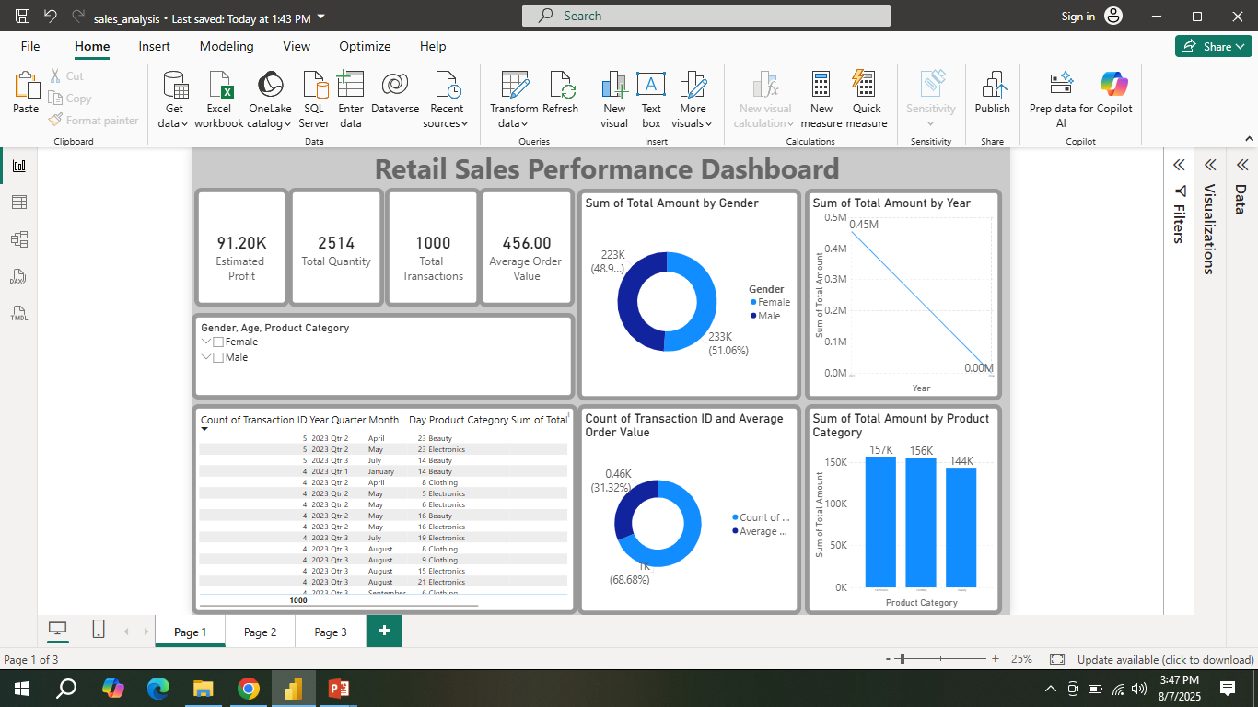
Page 1 – Retail Performance Overview
• KPIs: Estimated Profit, Total Quantity, Transactions, AOV
• Visuals: Pie charts by Gender, Bar chart by Category
• Insight: Balanced gender contribution, top categories include Electronics & Beauty

Slide 4
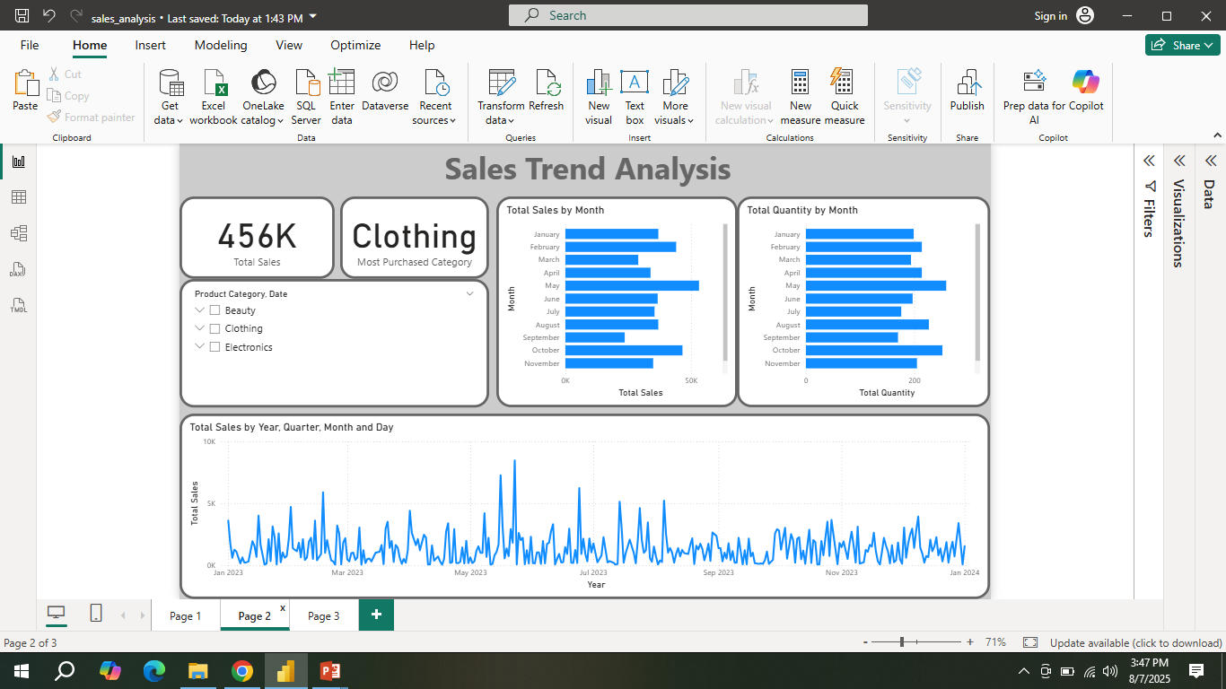
Page 2 – Sales Trend Analysis
• KPIs: Total Sales and Most Purchased Category
• Visuals: Sales and Quantity by Month, Daily Sales Line Chart
• Insight: Clothing is the top category. Sales remained steady across months.

Slide 5
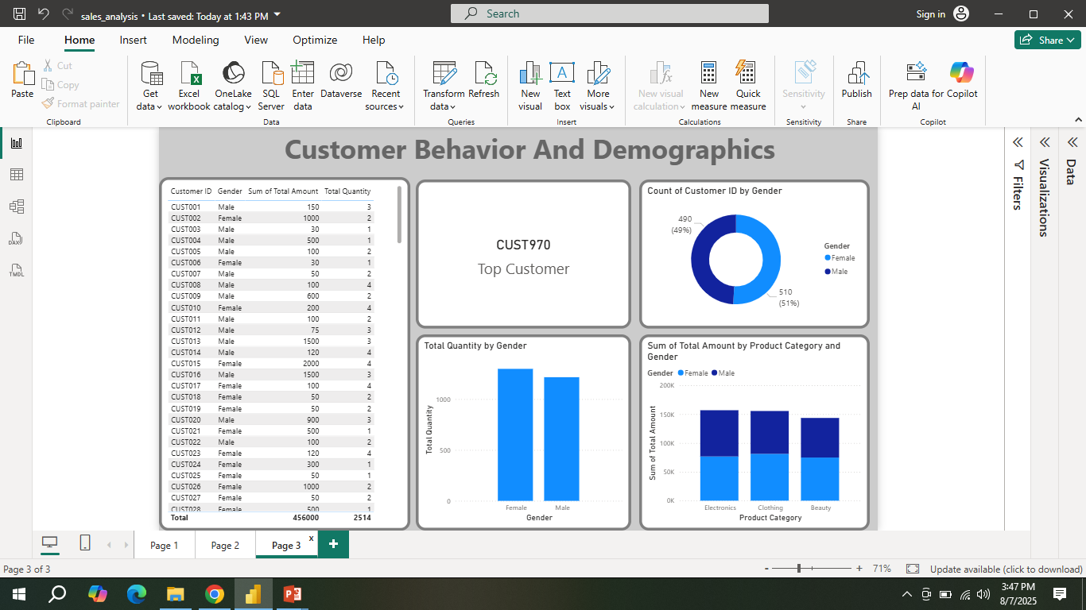
Page 3 – Customer Behavior & Demographics
• Visuals: Customer table, Top Customer, Pie by Gender, Category vs Gender
• Insight: Customer CUST970 spent the most. Females bought more Beauty, Males spent more overall.

Slide 6
Summary & Learnings
• Built 3-page dashboard using Power BI
• Used cards, charts, and filters for data storytelling
• Estimated profit via assumed margin (20%)
• Improved understanding of DAX, data modeling and dashboard design

