Slide 1
Exploring Air Pollution Trends in the U.S. using AWS Services
Leveraging Cloud Solutions for In-depth Analysis
Presented By Group 2:
Anagh Sharma
Aniket Tripathi
Mohit Kosekar
Niyanta Pandey
Priya Tinna
Rujhan Maniktalia

Slide 2
Project Scope
Our Purpose: Gain deeper insights into air quality trends across the United States by analyzing daily summary data from the US EPA's Air Quality System (AQS). This project aims to address the critical issue of air pollution by uncovering patterns, identifying areas of concern, and potentially predicting future trends.
Problem Statement: Air pollution poses a significant threat to public health, yet readily available data often remains unexplored. By delving into the rich details captured in daily AQS summaries, we can move beyond basic understanding and identify actionable insights to inform decision-making.

Slide 3
Project Timeline and MileStones

Slide 4
RACI Matrix

Slide 5
Data Integration and Management
Individual datasets, each containing around 0.1 million rows in CSV format, were merged, corresponding to different air quality features for a specific year (e.g., 2022). This merging process aligned data based on the same day, resulting in a consolidated CSV file with approximately 1 million rows. Additionally, to prevent duplication, the AQS API was utilized to fetch similar details for another year (e.g., 2023) programmatically, with multiple API calls managed efficiently. The approach involved leveraging various libraries and tools, including AWS services like Lambda, to interact with the AQS API. Consequently, the dataset for the specific date encompassed approximately 2 million rows.
Data Sources:
CSV files: https://aqs.epa.gov/aqsweb/airdata/download_files.html
Web API: https://aqs.epa.gov/aqsweb/documents/data_api.html

Slide 6
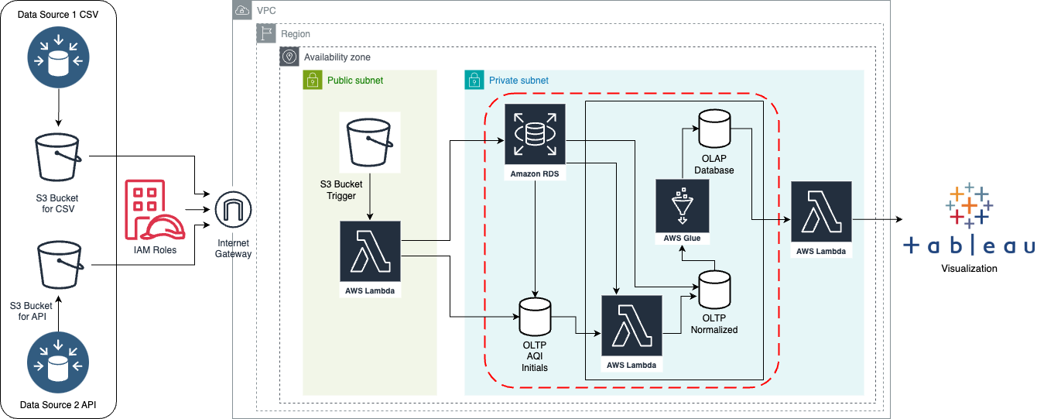
AWS Architecture Diagram

Slide 7
Data Model Summary: Daily Air Quality Analysis
Grain: Daily level; each record in the fact table represents air quality measurements for a specific parameter at a particular location for one day.
Dimensions:
Time Dimension: Attributes include Date Local, Day of the Week, Month, and Year.
Location Dimension: Attributes cover geographical details like State Code, County Code, Latitude, Longitude, State Name, County Name, and City Name.
Parameter Dimension: Attributes encompass Parameter Key and Parameter Name.
Air Quality Fact: Core measurements include AQI, 1st Max Value, 1st Max Hour, and Arithmetic Mean.
Focus Parameters: Our analysis centers on ozone, NO2, PM2.5, PM10, and CO, critical indicators of air quality.

Slide 8
Dimensional Modelling

Slide 9
Demo of the Visualizations

