Slide 1
SC1015 Mini Project​ Fake News Detection
Tutorial Group SC18, Team 4
Nicholas Wee Chun We​
Niyatha Srinivasan​
Tai Wai Man

Slide 2


Contents
Topic Ideas
Practical Motivation
Sample Collection
Problem Formulation
Models Overview
Preliminary Exploration and Analytical Visualization
Data Preparation and Cleaning
Explanation of Models:
Word2Vec
4 Classification Models
Result Analysis
Recommendations

Slide 3
Finding a Topic and Appropriate Dataset
Original Idea
To predict rise in Worldwide temperature levels with CO2 emissions per year.
Obstacles
Datasets found either had too little data
Sources of the datasets have broken links

Slide 4
Practical Motivation
Real-life Problem
Misinformation and Disinformation can pose threats to society.
Solution
We believe we can make use of Machine learning models to identify fake news

Slide 5

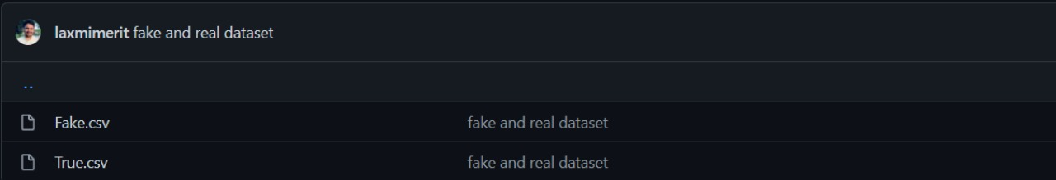
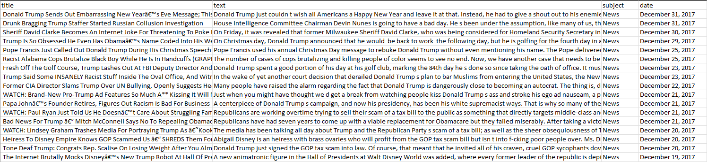
Sample Collection
Dataset
Fake Dataset Size: 23,481 entries
True Dataset Size: 21,417 entries

Slide 6
Problem Formulation
Classification Problem:
Using Machine Learning models to determine if news falls under the True (1) or False (0) category.

Slide 7

Models
Word2Vec
Classification​
- Logistic Regression​
- Decision Tree classification​
- Gradient Boosting Classifier​
- Random Forest classification ​

Slide 8
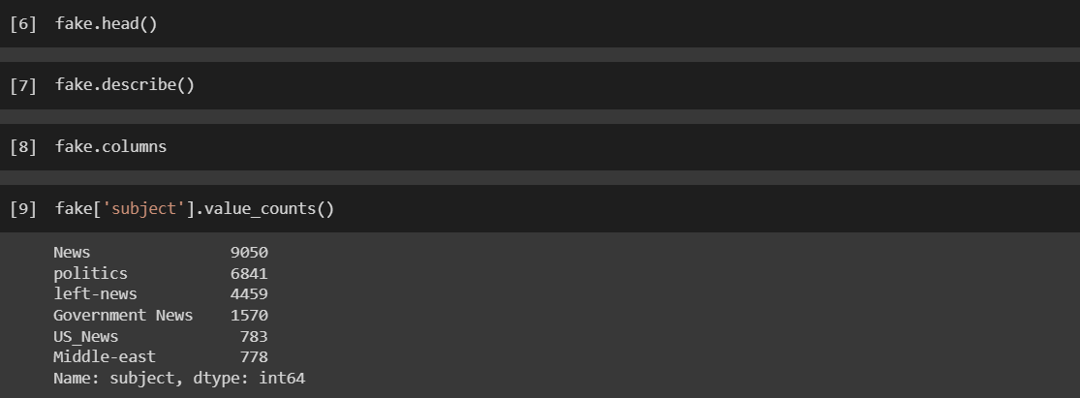
Preliminary Exploration & Analytic Visualization
Explore the data using statistical exploration tools to identify news types and see if they might reveal a trend

Slide 9
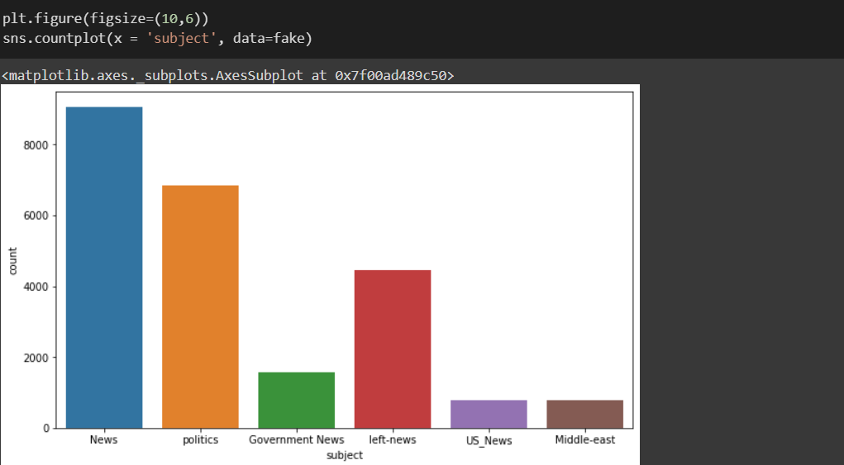
Preliminary Exploration & Analytic Visualization
Visualization to understand the quantity of each news type better

Slide 10
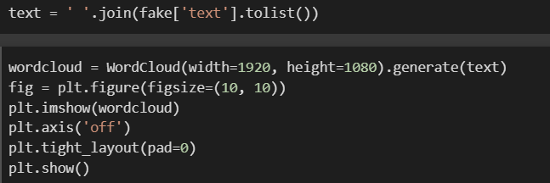
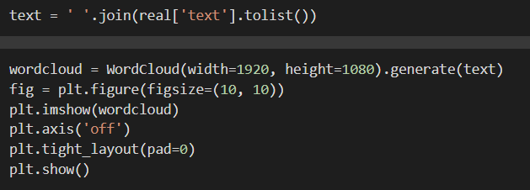
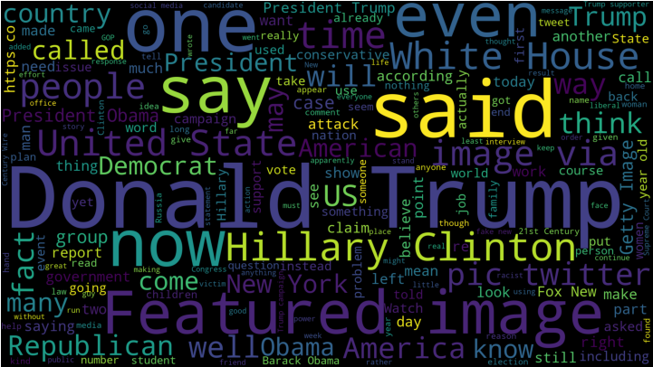
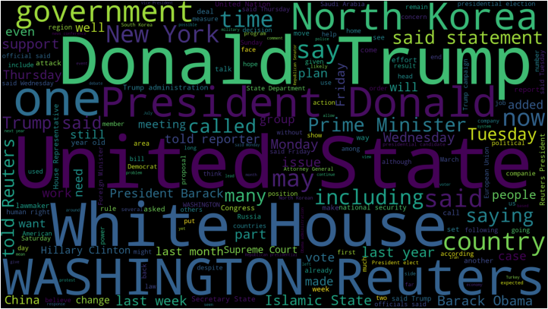
Preliminary Exploration & Analytic Visualization
Fake News Word Cloud
Real News Word Cloud

Slide 11
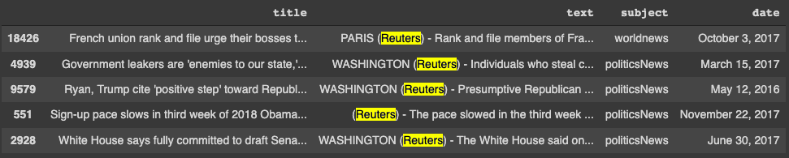
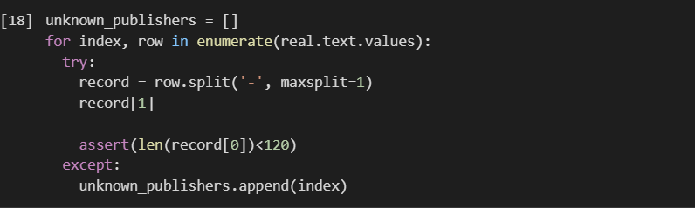
Data Preparation and Cleaning
Cleaning out columns and information that is unimportant for computation.
Remove "Reuters" and Twitter handles from the text
Notes:
Remove Reuters or Twitter Tweet info from the text
Text can be split only once at " - " which is always present after mentioning source of publication, this gives us the publication part and the text part
If we do not get text part, this means publication details wasn't given for that record.

Slide 12
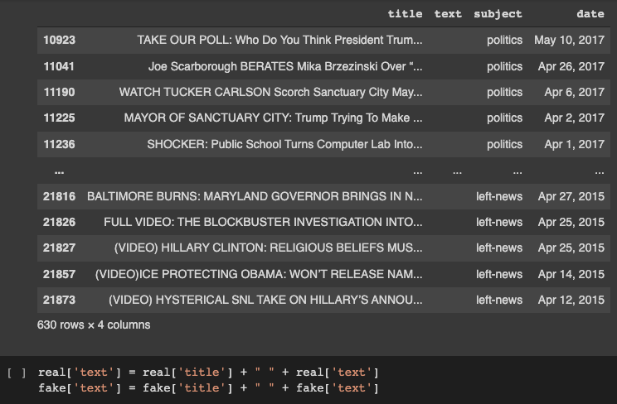
Data Preparation and Cleaning
Cleaning out columns and information that is unimportant for computation.
Remove rows with no text
Notes:
Goal: Remove rows with no text
Since rows with no text appears to have the text in the title column, we merge the title and text columns together

Slide 13
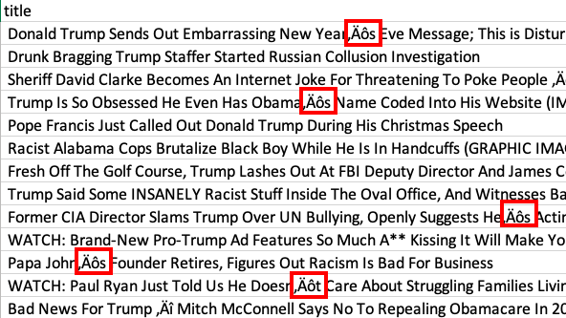
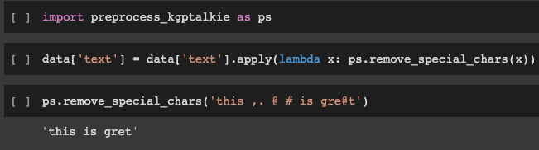
Data Preparation and Cleaning
Cleaning out columns and information that is unimportant for computation.
Remove special characters

Slide 14

Machine Learning : Word2Vec
Motivation for using Word2Vec:
Accuracy
It allows the model to "UNDERSTAND" meaning of words
Notes:
Motivation for choosing Word2Vec:
Coz it will be more accurate to use a model that uses a neural network like Word2Vec
Also, the machine learning model can derive the meaning of words using Word2Vec. The idea behind it is that it’s possible to predict a word based on its neighbouring words under the assumption that the meaning of a word can be inferred by the words that surround it. And since Word2Vec converts words into vectors, it is then possible to use these vectors to determine the accuracy of the pieces of news.

Slide 15
Machine Learning : Word2Vec
Basics of Word2Vec:
The
Quick
Brown
Fox
Jumps
Over
Notes:
General concept behind Word2Vec:
There is a window that moves across a corpus of text
This window comprises of 3 adjacent words where the center word is the input word while the other 2 words are the contextual words: In this case "brown" is the input word, while "quick" and "fox" are the contextual words
This forms training pairs where the input is the center word and the output is one of the 2 contextual words
And then we train the single layer neural network using these training pairs
This system then tunes itself using backpropagation, where the weights in the hidden layer are the vector representations of the word

Slide 16
Machine Learning : Word2Vec
Training Pairs:
quick
The
fox
brown
quick
brown
fox
jumps
brown
quick
jumps
fox
brown
fox
jumps
over
Notes:
General concept behind Word2Vec:
There is a window that moves across a corpus of text
This window comprises of 3 adjacent words where the center word is the input word while the other 2 words are the contextual words
This forms training pairs where the input is the center word and the output is one of the 2 contextual words
And then we train the single layer neural network using these training pairs
This system then tunes itself using backpropagation, where the weights in the hidden layer are the vector representations of the word

Slide 17
Machine Learning : Word2Vec
Hidden Layer
Input Layer
Output Layer
Notes:
General concept behind Word2Vec:
There is a window that moves across a corpus of text
This window comprises of 3 adjacent words where the center word is the input word while the other 2 words are the contextual words
This forms training pairs where the input is the center word and the output is one of the 2 contextual words
And then we train the single layer neural network using these training pairs
This system then tunes itself using backpropagation, where the weights in the hidden layer are the vector representations of the word

Slide 18
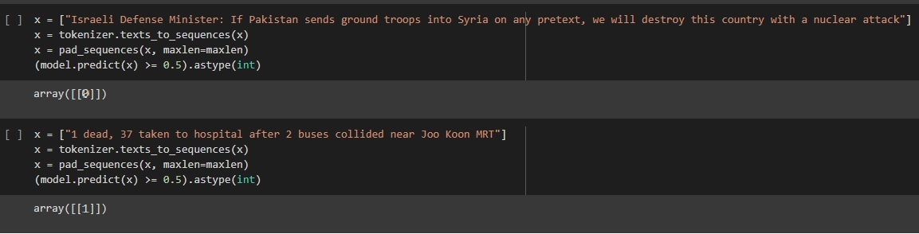
Machine Learning : Word2Vec
Output of the Word2Vec model:
0: Fake, 1: True
Notes:
General concept behind Word2Vec:
There is a window that moves across a corpus of text
This window comprises of 3 adjacent words where the center word is the input word while the other 2 words are the contextual words
This forms training pairs where the input is the center word and the output is one of the 2 contextual words
And then we train the single layer neural network using these training pairs
This system then tunes itself using backpropagation, where the weights in the hidden layer are the vector representations of the word

Slide 19

Machine Learning : Classification
4 Models used for Cross-referencing:
Logistic Regression: A regression model that is used for classification problems
Decision Trees Classification
Gradient Boosting Classification: Model that combines several weak models together to form a strong model
Random Forest Classification: Model that uses multiple Decision Trees

Slide 20
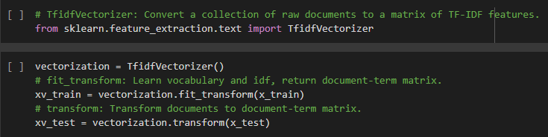
Machine Learning : Classification
Convert words to a matrix

Slide 21
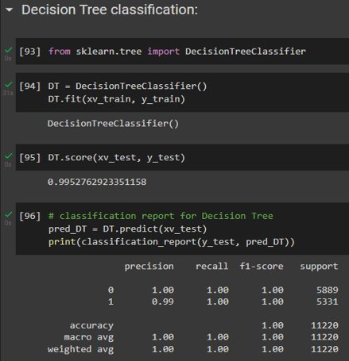
Machine Learning : Classification

Slide 22

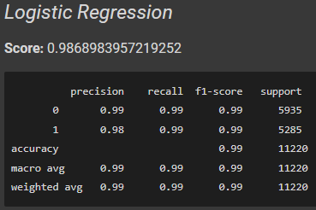
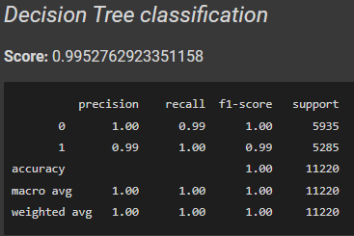
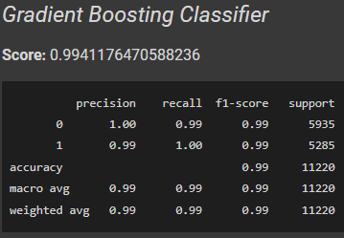
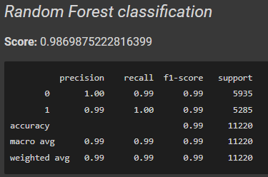
Result Analysis
For Original Dataset​

Slide 23
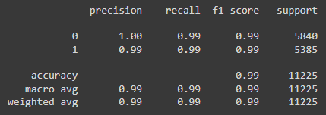
Result Analysis
For Original Dataset​
Decision Tree
Word2Vec

Slide 24
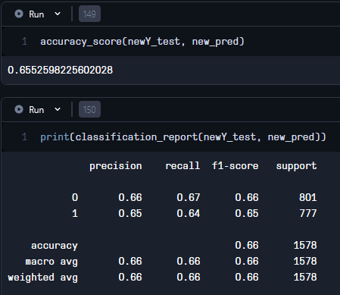
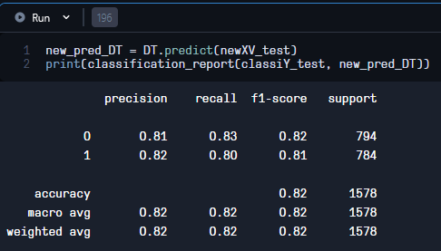
Result Analysis
For 2nd Test Dataset
Decision Tree performed better than Word2Vec model
Word2Vec
Decision Tree

Slide 25

Recommendations
Additional function that can locate the source of the fake news
Function that can analyze and list out common fake news sites in general

Slide 26
THANK YOU

