Slide 1
Team Entwicklers
Loan Processing System
Developed By:
Niyati Sinha
Rayman Kaur

Slide 2

Technologies Used
Front-end
Backend
Database
HTML
CSS
JavaScript
Bootstrap
Jquery
MySQL
Java EE
Spring MVC
Hibernate ORM
Server-Side
JSP

Slide 3
Project Flowchart

Slide 4
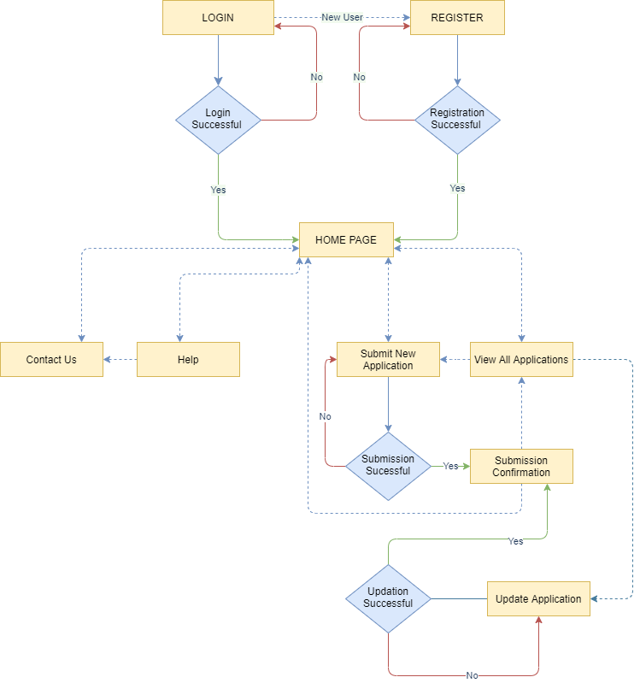

Slide 5
Functionality & USP

Slide 6
Front-End:
Fully Responsive Front-end
Magnificent UI
Added pages for Help and Contact Us
Client-Side Validations
Unsplash API
Download Loan Application
CRUD Operations:
Add
Search
Sort
View
Update
Delete
Security:
DB verified Login & Registration
Independent DB Entities
User-Entity & Loan Applicant Entity

Slide 7
Problems we overcame!

Slide 8
Resolving Merge conflicts
Update form: a new database entry was getting created.
Validations: Earlier @Annotations were used by which Age & Experience were not getting validated, later we switched to JavaScript.
In Login Form : verifying user credentials according to the register form entries.
Pop Up Issue on login/registration failure

Slide 9
Future Scope
Reset Password
Direct Customer Support via chat box connected to developer email
Loan interest calculator – via loan payback time

Slide 10
Here’s the demo! Open to reviews

