Slide 1
Bay-area housing price prediction UC Berkeley ext. – final project presentation
Indrani Kompella | Niyati Desai

Slide 2

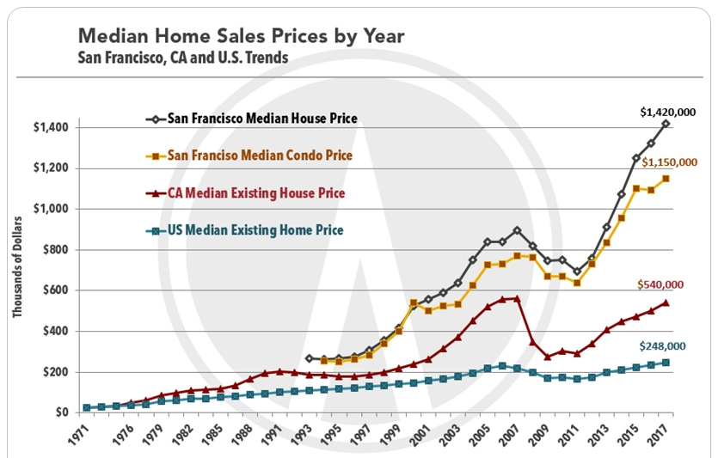
Why?

Slide 3

counties
Alameda
Contra costa
Marin
Napa
San Francisco
San Mateo
Solano
Sonoma

Slide 4
data
The data was collected from following sources:
California Association of Realtors[CAR]
Zillow - Housing Estimates
US Census Bureau
Bureau of Labor Statistics
Metropolitan Transportation Commission (http://www.vitalsigns.mtc.ca.gov)

Slide 5
Machine learning model
Steps :
State hypothesis
Identify dependent and potential predictor variables
Check initial correlation between dependent and potential predictor variables
Short-list 3 most correlated predictor variables
run uni-variate linear regression model for each predictor variable
Run multi-variate linear regression model for all 3 predictor variable
Use the coefficients and y-intercept to predict future outcomes

Slide 6
Machine learning model
POTENTIAL PREDICTOR VARIABLES | BAY AREA LEVEL | COUNTY LEVEL
TOTAL POPULATION |  | 0.835920
HOUSEHOLD POPULATION |  | -
HOUSEHOLDS |  | 0.851533
IMMIGRATION |  | 0.569903
NET MIGRATION |  | -0.137122
JOBS |  | 0.824421
INTEREST RATE |  | -0.711596
NEW HOMES CONSTRUCTED |  | 0.052245
EMPLOYERS |  | 0.783928
AVERAGE ANNUAL PAY |  | 0.848847
Multi-variate Linear regression model
Dependent variable :
Median home price
Predictor variables :
Average annual pay
Households
jobs

