Slide 1
Bay-area housing price prediction UC Berkeley ext. 2018 – final project presentation
Indrani Kompella | Niyati Desai

Slide 2

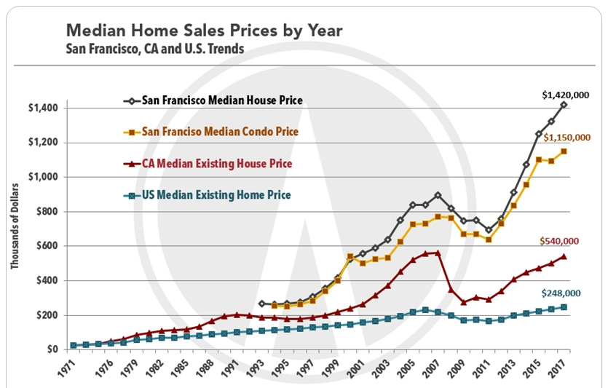
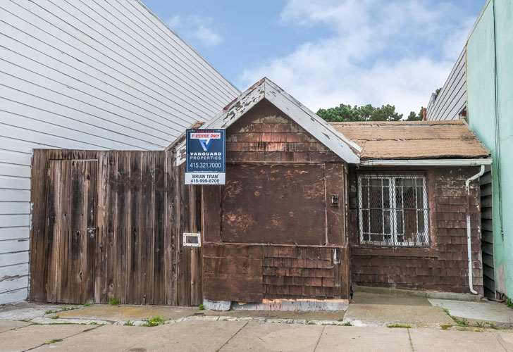

Why?
It is a worn-down, decomposing wooden shack that was built in 1906, and the interior is unlivable in its current condition. The San Francisco house is also selling for
$350,000.00
http://fortune.com/2015/09/25/san-francisco-cheapest-home/

Slide 3
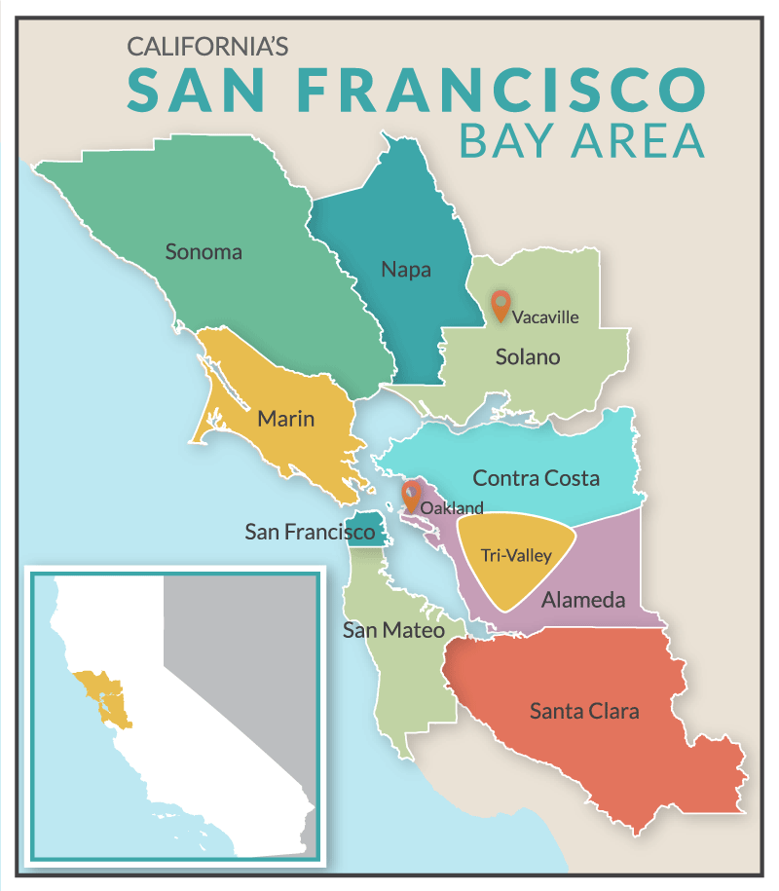
counties
Alameda
Contra costa
Marin
Napa
San Francisco
Santa clara
San Mateo
Solano
Sonoma

Slide 4
data
The data was collected from following sources:
California Association of Realtors[CAR]
Zillow - Housing Estimates
US Census Bureau
Bureau of Labor Statistics
Metropolitan Transportation Commission (http://www.vitalsigns.mtc.ca.gov)

Slide 5
Machine learning model
Hypothesis : The reason for astronomical rise in the housing prices in the bay area in the past few years,
is the increasing gap between the demand (population and wage growth) and supply (new housing construction).
Model: time series analysis
Steps :
Identify dependent and potential predictor variables
Check initial correlation between dependent and potential predictor variables
Short-list 3 most correlated predictor variables
run uni-variate linear regression model for each predictor variable
Run multi-variate linear regression model for all 3 predictor variable
Use the coefficients and y-intercept to predict future outcomes
Result & Conclusion :
A peek into the future
What if the wages continue to rise at their current rate and the mortgage rate (30 year fixed) holds steady at 4.6 %,
........Can you afford to buy a median price home in the future???

Slide 6
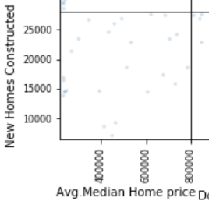
Machine learning model
POTENTIAL PREDICTOR VARIABLES | BAY AREA LEVEL correlation | COUNTY LEVEL correlation
TOTAL POPULATION | 0.799286 | 0.835920
HOUSEHOLD POPULATION | 0.800972 | -
HOUSEHOLDS | 0.814675 | 0.851533
IMMIGRATION | 0.177585 | 0.569903
NET MIGRATION | -0.180791 | -0.137122
JOBS | 0.725683 | 0.824421
INTEREST RATE | -0.683790 | -0.711596
NEW HOMES CONSTRUCTED | 0.291740 | 0.052245
EMPLOYERS | 0.738533 | 0.783928
AVERAGE ANNUAL PAY | 0.829636 | 0.848847
Model:
Multi-variate Linear regression model
Dependent variable :
Median home price
Predictor variables :
Average annual pay
Households
jobs

Slide 7
Machine learning model
After running machine learning model, our initial hypothesis did not give expected results.
Final hypothesis - The median annual home price in bay-area is a function of
average annual pay, no. of households & jobs.
y = m_{o}X_{o} + m₁X₁ + m₂X₂ + b
y = Median Annual Home Price
X_{o} = Average Annual Pay,
X₁ = No. of Households
X₂ = Jobs
m = Multipliers/Coefficients
b = Y-Intercept

Slide 8
Thanks to
Github
Work-flow, partner co-ordination & project compilation
Jupyter notebook, spyder & vs code
Data munging, initial machine learning model & coding
Flask, html, css, javascript, bootstrap
Build the interactive prediction App webpage
Tableau
Visualize past data and its trends & plot for user interaction on the webpage
Plotly & D3
Interactively Plot visualization for future predictions as per user selection on the webpage

