Slide 1
Bay-area housing price prediction UC Berkeley ext. 2018 – final project presentation
Indrani Kompella | Niyati Desai

Slide 2

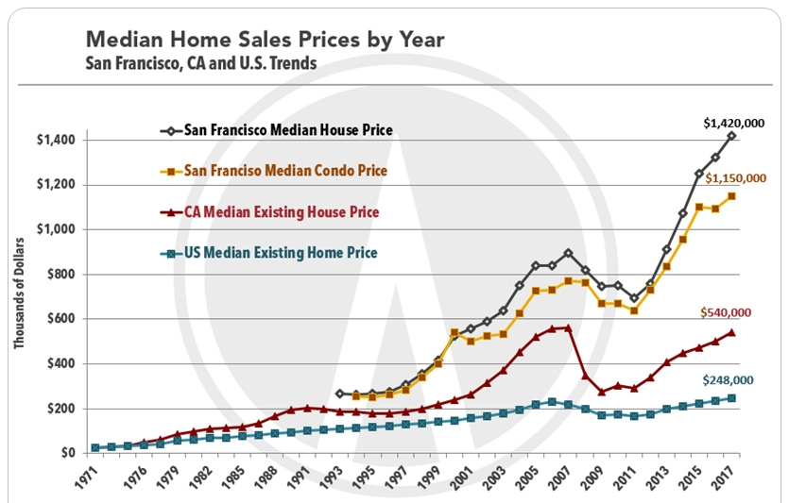
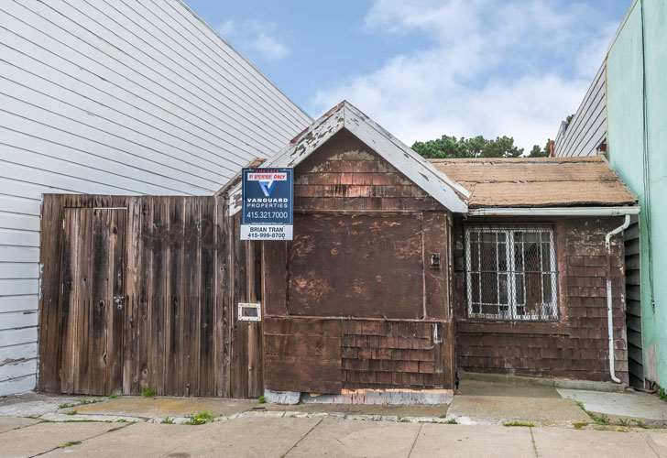

Why?
It is a worn-down, decomposing wooden shack that was built in 1906, and the interior is unlivable in its current condition. The San Francisco house is also selling for
$350,000.00
http://fortune.com/2015/09/25/san-francisco-cheapest-home/

Slide 3
counties
Alameda
Contra costa
Marin
Napa
San Francisco
Santa clara
San Mateo
Solano
Sonoma

Slide 4
data
The data was collected from following sources:
California Association of Realtors[CAR]
Zillow - Housing Estimates
US Census Bureau
Bureau of Labor Statistics
Metropolitan Transportation Commission (http://www.vitalsigns.mtc.ca.gov)

Slide 5
Machine learning model
Hypothesis :
Steps :
Identify dependent and potential predictor variables
Check initial correlation between dependent and potential predictor variables
Short-list 3 most correlated predictor variables
run uni-variate linear regression model for each predictor variable
Run multi-variate linear regression model for all 3 predictor variable
Use the coefficients and y-intercept to predict future outcomes
Result & Conclusion :
A peek into the future
What if the wages continue to rise at their current rate and the mortgage rate (30 year fixed) holds steady at 4.6 %,
........Can you afford to buy a median price home in the future???

Slide 6
Machine learning model
POTENTIAL PREDICTOR VARIABLES | BAY AREA LEVEL correlation | COUNTY LEVEL correlation
TOTAL POPULATION | 0.799286 | 0.835920
HOUSEHOLD POPULATION | 0.800972 | -
HOUSEHOLDS | 0.814675 | 0.851533
IMMIGRATION | 0.177585 | 0.569903
NET MIGRATION | -0.180791 | -0.137122
JOBS | 0.725683 | 0.824421
INTEREST RATE | -0.683790 | -0.711596
NEW HOMES CONSTRUCTED | 0.291740 | 0.052245
EMPLOYERS | 0.738533 | 0.783928
AVERAGE ANNUAL PAY | 0.829636 | 0.848847
Multi-variate Linear regression model
Dependent variable :
Median home price
Predictor variables :
Average annual pay
Households
jobs

Slide 7
Thanks to
Github
Work-flow, partner co-ordination & project compilation
Jupyter notebook, spyder & vs code
Data munging, initial machine learning model & coding
Flask, html, css, javascript, bootstrap
Build the interactive prediction App webpage
Tableau
Visualize past data and its trends & plot for user interaction on the webpage
Plotly & D3
Interactively Plot visualization for future predictions as per user selection on the webpage

