Slide 1
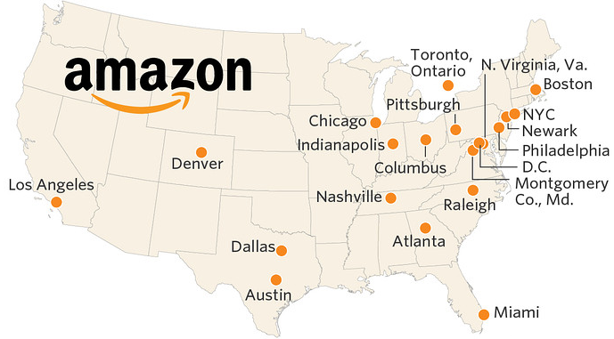
Pick Me Amazon!
Project 1 – UCB-DATA ANLYTICS BOOTCAMP
Guirlyn V Olivar, Helen LeAO, Indrani Kompella and Niyati Desai

Slide 2
The $5 Billion Question
Cities across the U.S are competing to attract Amazon’s second head quarters which would bring 50,000 jobs and $5 billion investment. Out of the original 238 cities, 20 cities made it the final cut.
If Amazon were a person (Yes…corporations are people!) which city should he choose?
We are here to help!

Slide 3
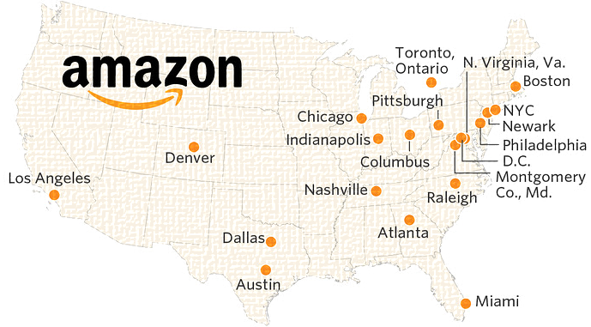
Amazon Cities & Sites
Washington DC
Atlanta
Nationals Park/ D.C United Stadium
Union Station
Hill-East Neighborhood
Shaw-Howard University Area
Downtown Atlanta
Midtown
Former GM plant
The High Street Site
Los Angeles
New York
Warner Center West San Fernando Valley
New Hall Ranch Santa Clarita Valley
Pomona Fairplex
Hudson Yards
Long Island City
Brooklyn Tech Triangle
Financial District
Boston
Suffolk Downs
South Boston Waterfront
Downtown
South End
Raleigh
Research Triangle Park
Chatham Park
Warehouse District
Chicago
Austin
Lincoln Yards
The River District
Futton Market
City Center Campus
The Downtown District
The Illinois Medical District
The 78
Burnham Lakefront
American-Statesman
Eightfold
Former 3M site
The Domain
Bardmoor Campus
Robinson Ranch
Project Catalyst

Slide 4
Amazon’s Selection Criteria
Metropolitan areas with more than one million people.
(Spoiler Alert : All the 20 shortlisted cities meet this criteria.)
A stable and business-friendly environment.
Communities that think big and creatively when considering locations and real estate options.
Non quantifiable metrics. We assumed all the cities meet this criteria as well.
Urban or suburban locations with the potential to attract and retain strong technical talent.
Measurable Metrics. Criteria we used!

Slide 5
Metrics Used/Questions Asked
Educated Talent Pool.
Existing Labor Force in Technology, Business and Financial occupations.
Diversity /Cultural Community Fit.
Crime Index - How safe is your city?
Schools and Colleges - Does your city have good schools? Do your city have institutions of higher education?
Housing Affordability .
Community/Quality of Life – What amenities does your city have to offer?
Transportation Options – Airport, Transit, Bike and Pedestrian accessibility.
Others : Climate, Pollution etc.

Slide 6
Metrics At The City Level
Educated Talent Pool.
Existing Labor Force in Technology, Business and Financial occupations.
Diversity /Cultural Community Fit.
Crime Index.
Housing Affordability.
Others : Climate, Pollution etc.

Slide 7
Metrics At The Site Level
Schools and Colleges.
Community/Quality of Life/Amenities.
Transportation Options.
Note: The data is analyzed at the site level and aggregated at the city level in the final analysis.

Slide 8
Primary Data Sources
Census API : 2016 American Community 5 Year Survey
Greater Schools API
Google API
Walk Score API

Slide 9
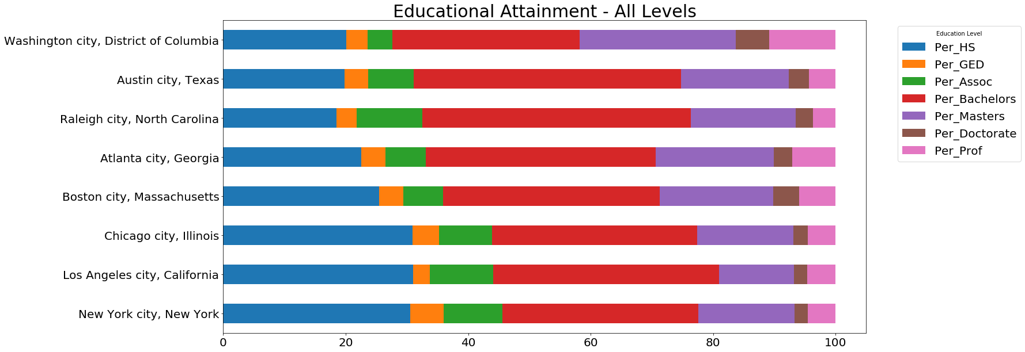
Talent Pool - Education

Slide 10
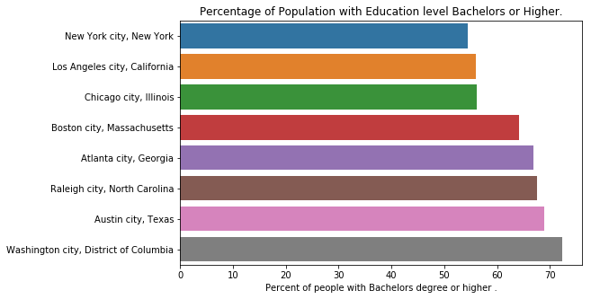
Talent Pool - Education

Slide 11
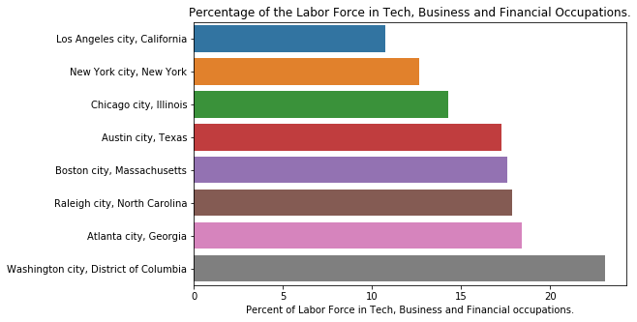
Talent Pool - Labor Force

Slide 12
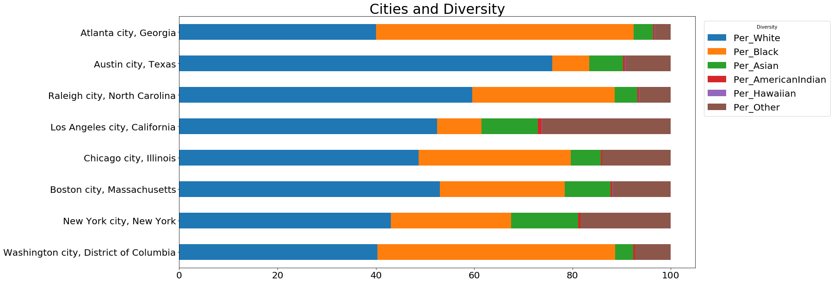
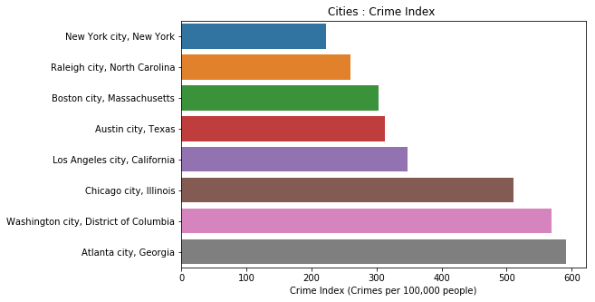
Diversity

Slide 13
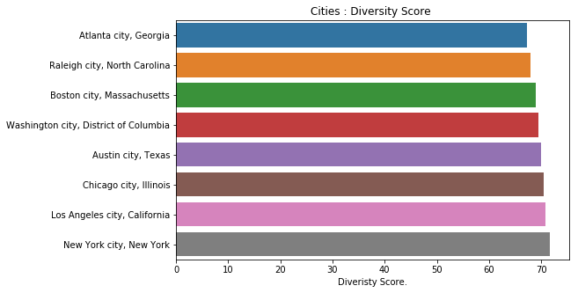
Diversity Score

Slide 14
Crime Index

Slide 15
Findings

Slide 16
Lessons learnt

Slide 17
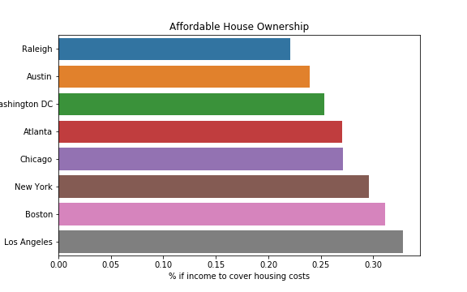
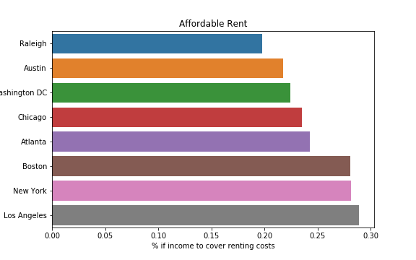
Housing affordability

Slide 18
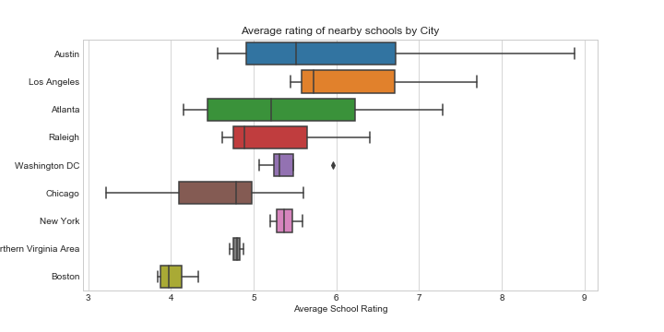
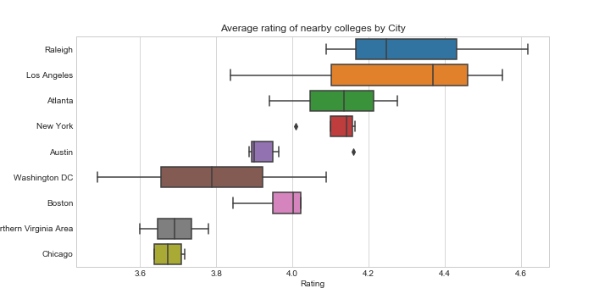
Schools and College Ratings

Slide 19
Findings
Home ownership and rent
API: used Census 2016 data
Process:
Collected median data for housing cost and income by City (defined as Locations in the Census data)
Defined estimate for affordability as housing cost / income. The lower the value the better the location.
Results: Consistent trend of home ownership and rent costs. Raleigh, Austin, and Washington ranked top 3
Notebook: https://github.com/indranik/BC_Project1/blob/master/HousingSchools/housing_results.ipynb
Nearby K-12 schools for site location
API: Great Schools API
Using: State and zip code information
Process: Average school rating per city and sort
Results: Austin, LA, Atlanta ranked higher
Nearby Colleges for site location
API: Google Search
Using: Latitude and Longitude information
Process: Average site ratings per city and sort
Results: Raleigh, LA, Atlanta ranked higher
Notebook: https://github.com/indranik/BC_Project1/blob/master/HousingSchools/schools_results.ipynb

Slide 20
Lessons learnt

Slide 21
Nearby Amenities
A. Emergency Facilities
How accessible are these facilities in case of mass emergency on/around sites for containing the situation and resuming business asap. Hospitals, Fire Stations, Doctors.
B. Accommodation
Many executive employees travel from outside the city for few days a week and might need lodging facility as close to the company as possible. Also lot of local/not-local employees use vehicle for commute and will need parking nearby. Lodging, Parking.
C. Refreshments
Basic Refreshment facilities. Café, Restaurants.
D. Basic Errands/appointments
By large employees tend to take care of daily errands and appointments in lunch breaks or before/after work hours and prefer it to be as close to work as possible for obvious reasons. Super markets, Post Office, Doctor.
E. Fitness
Fitness is top on priority list for a significant amount of employees now a days. Gym.

Slide 22
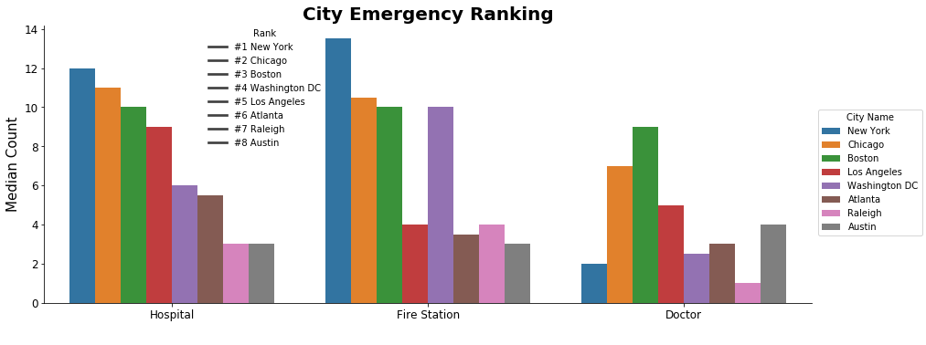
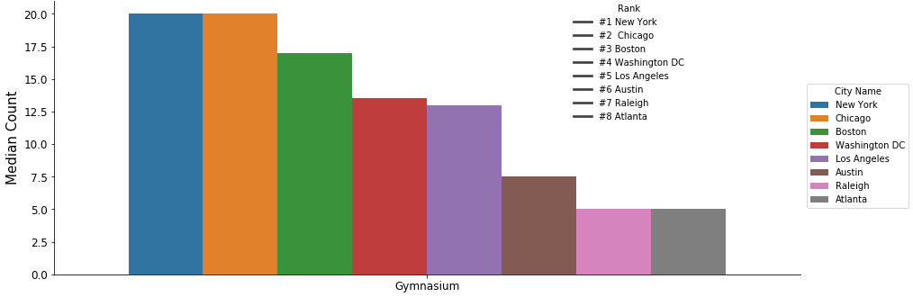
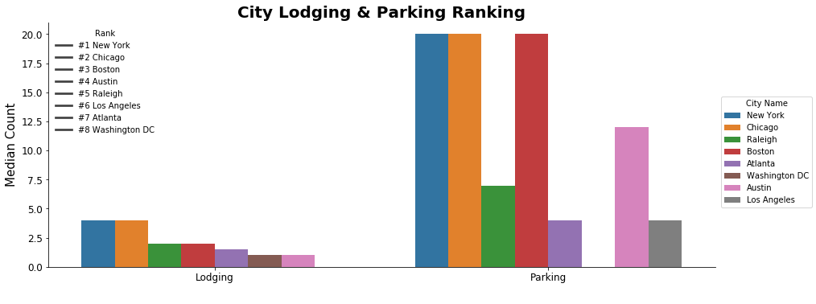
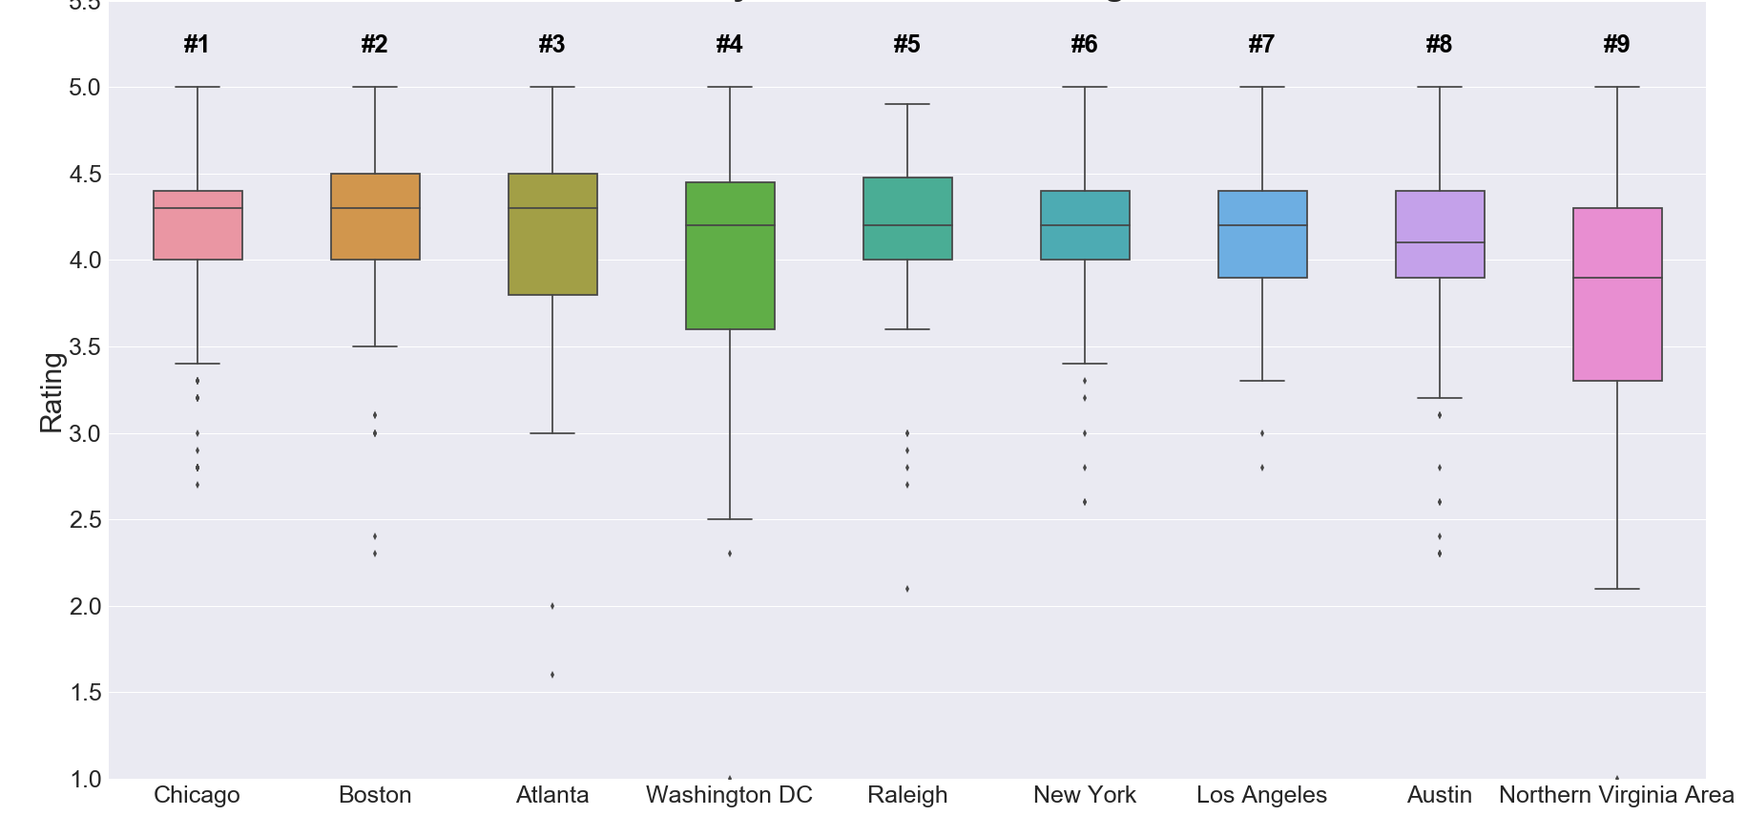
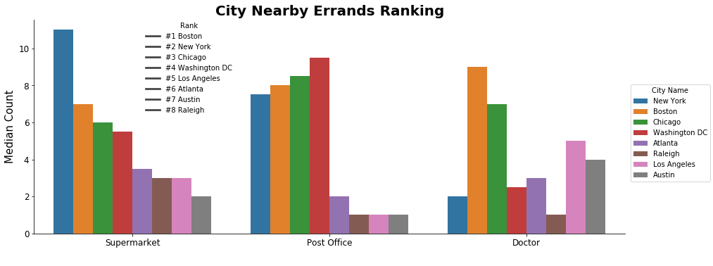
City Gymnasium Ranking
City Refreshments Ranking
*City Amenities results within 2 mile radius were averaged over all the sites.
** For Restaurants and Cafes, all cities had more than 20, and so was
ranked over average ratings.
Observations:
New York, Chicago & Boston were consistently top cities for most of
the amenities.
Los Angeles resulted in 0 lodging within 2 mile radius of all sites.
Washington DC resulted in 0 parking within 2 mile radius of all sites.

Slide 23
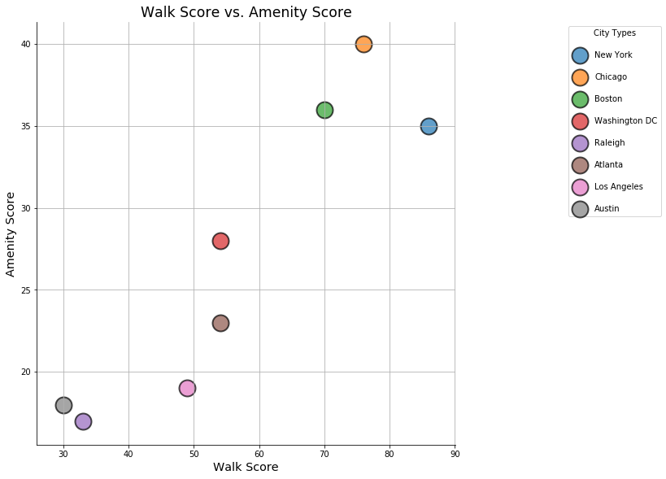
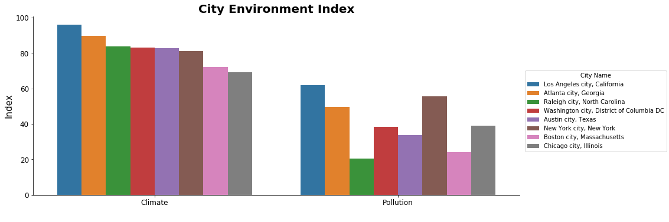
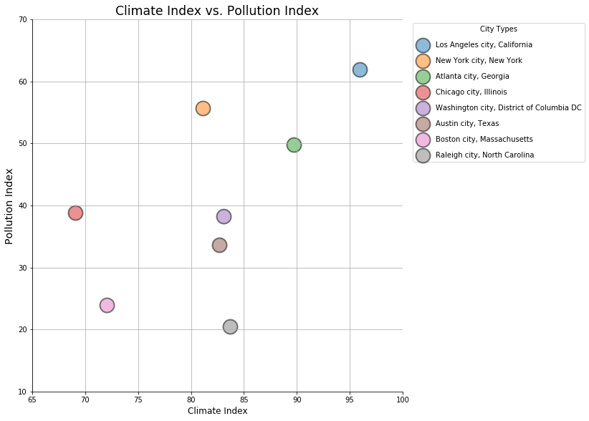
Amenities & Environment Index summary
*Looking at the correlation between Amenities accessibility within 2 miles radius of
Site and its walk score to observe the efficiency of site.
Amenity vs Walk Score Observations:
New York, Chicago & Boston not only were consistently top cities for most of
the amenities, but also had best walk score.
Environment Index Observations:
Most cities with higher Climate Index also tends to have a very high Pollution Index, which is highly contradictory.
Raleigh fairs well amongst all as it has Climate Index and lower Pollution Index.
Source: https://www.numbeo.com/quality-of-life/region_rankings.jsp?title=2018&region=019

Slide 24
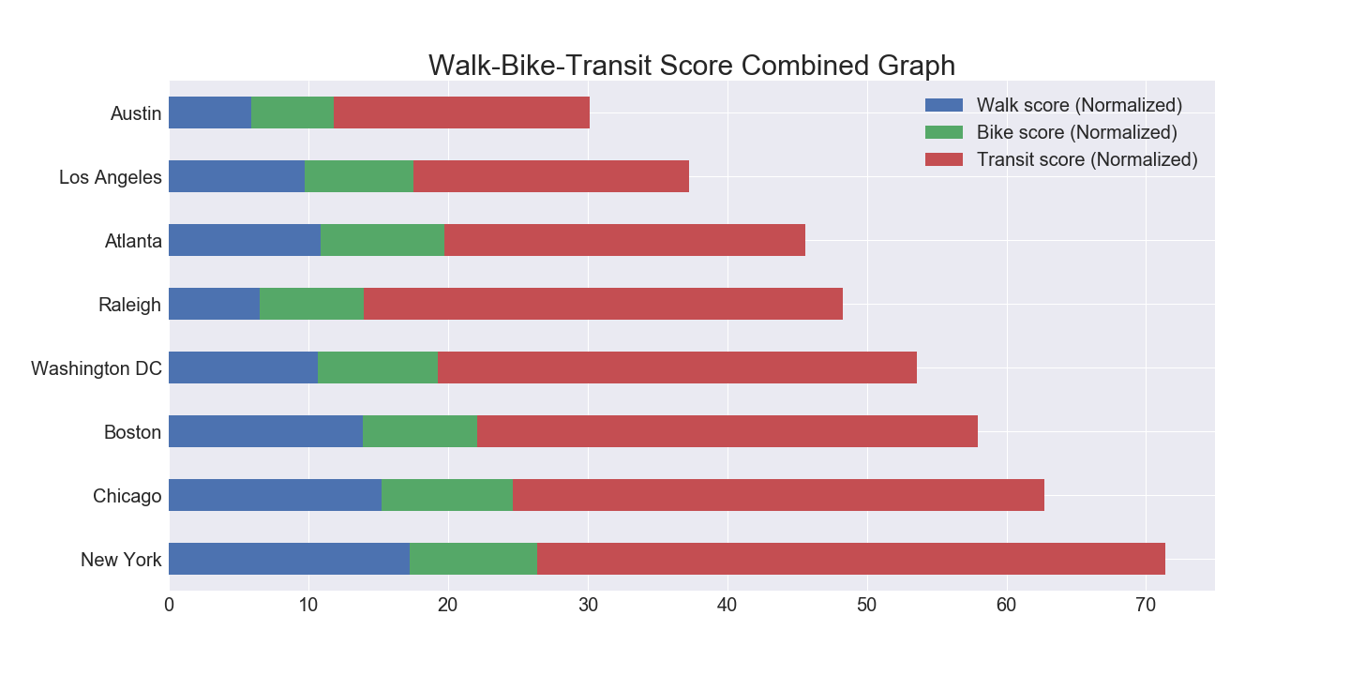
Walk/Bike/Transit Score
Amazon wants to be less car-dependent
To determine if having a high transit score is favored over walk or bike score or vice versa. The score has been weighted by Amazon current modes of commute
Current Amazon workforce commute in Seattle split*:
20% of workers walk to work
12% of workers bike to work
47% of workers take public transit
New York Top Sites
Hudson Yards | Brooklyn Tech Triangles
Redfin (API source of the scores) categories these top NY sites as
Walker’s Paradise (Daily errands do not require a car)
Rider’s Paradise (World-class public transportation)
Very Bikeable (Biking is convenient for most trips)
*Source: https://www.seattletimes.com/seattle-news/transportation/as-jobs-grow-in-downtown-seattle-workers-turn-more-to-transit/
**API source: Redfin walk, bike, and transit score where higher is better

Slide 25
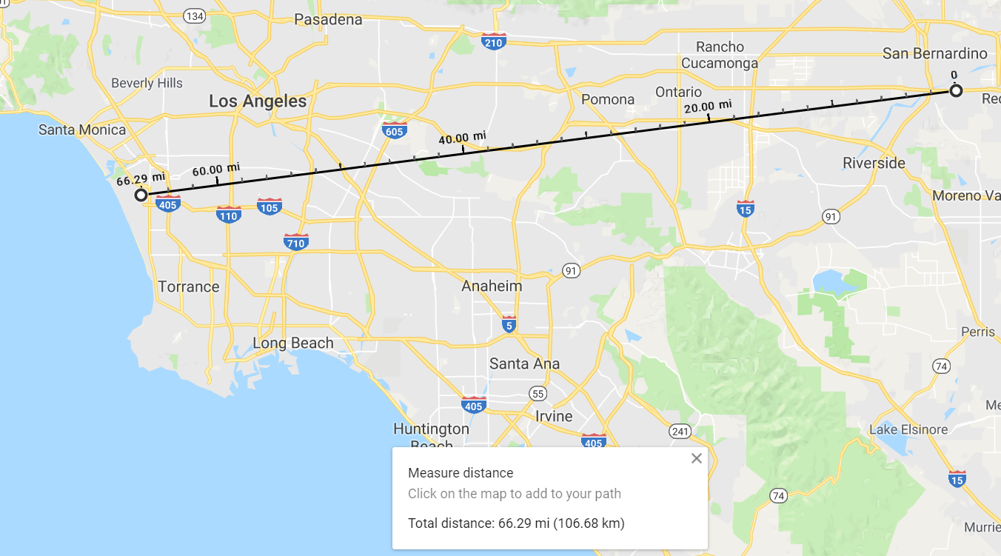
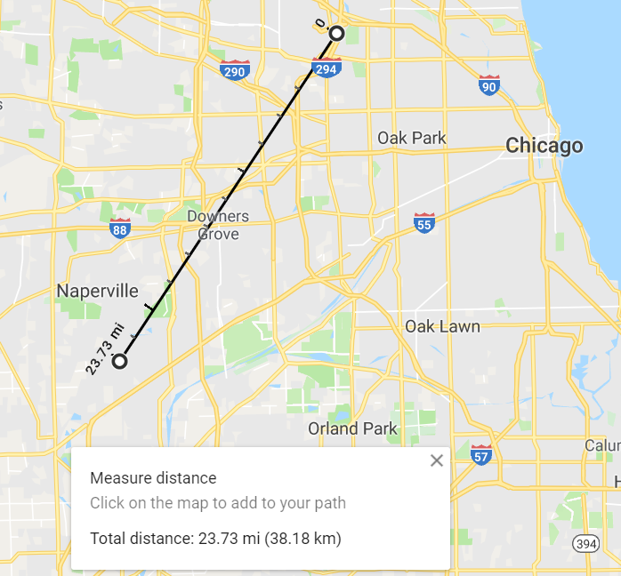
Airport Score
Amazon wants HQ2 to have airport access to major cities
Los Angeles : 66 miles between 2 furthest international airport
Ranking | Cities | # of Airports | # of International Airports
1 | Los Angeles | 20 | 3
2 | Chicago | 10 | 3
3 | Atlanta | 10 | 2
3 | New York | 10 | 2
4 | Washington DC | 9 | 2
5 | Austin | 9 | 1
6 | Raleigh | 6 | 1
7 | Boston | 5 | 1
Chicago: 24 miles between 2 furthest international airport
Number of airports were determined if airports were within 30 miles of the sites’ address.
Note: This is ranking is biased towards larger area cities.

Slide 26
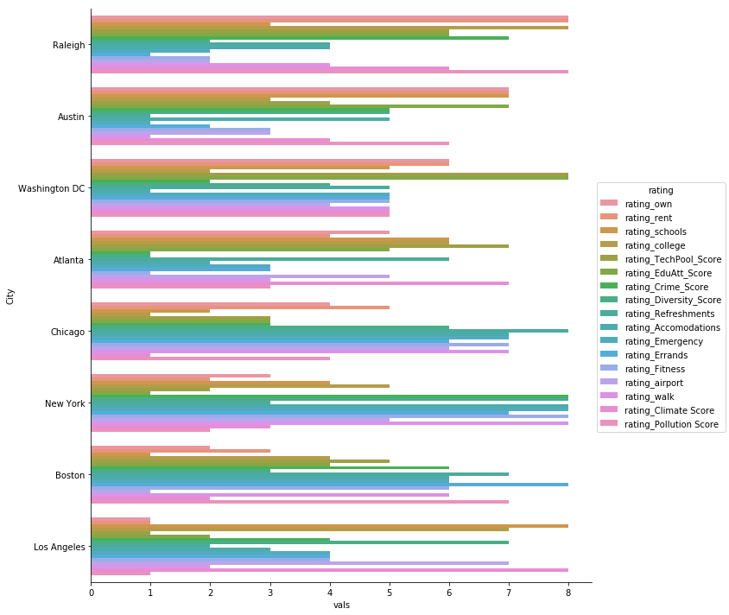
Overall City Ranking
From multiple sources we defined a score for each city
We agree that all rankings do not weigh equally, so we defined a set of weights per category to calculate totals.

Slide 27
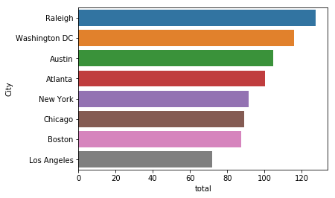
Overall City Ranking
Weights (Definition: What would make someone in tech move cities or what would grow the tech labor force) :
House | Rent | Ed Attain | School | College | Tec Pool | Transit | Airport | Rest | Hotels | Hospitals | Shops | Fitness | Crime | Climate | Pollution
3 | 2 | 2 | 1 | 2 | 3 | 2 | 1 | 0.25 | 0.75 | 0.5 | 0.25 | 2 | 1 | 1 | 1

Slide 28
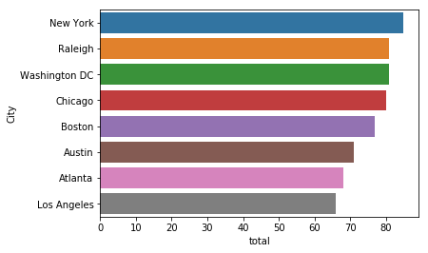
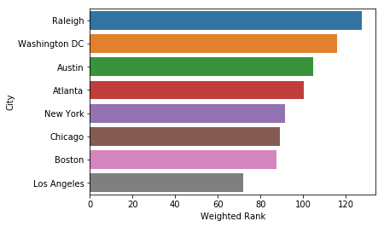
Overall City Ranking
Unweighted rankings
Weighted rankings
Weights (Definition: What would make someone in tech move cities or what would grow the tech labor force) :
House | Rent | Ed Attain | School | College | Tec Pool | Transit | Airport | Rest | Hotels | Hospitals | Shops | Fitness | Crime | Climate | Pollution
3 | 2 | 2 | 1 | 2 | 3 | 2 | 1 | 0.25 | 0.75 | 0.5 | 0.25 | 2 | 1 | 1 | 1

Slide 29
Findings
The top three choices based on un-weighted ranking : New York, Raleigh and Washington DC.
The top three choices based on weighted ranking : Raleigh, Washington DC and Austin.
While we predict that one of these four cities will be Amazon’s second home, the final decision may be influenced by several other factors:
Incentives offered by the local governments.
The site characteristics.
Amazon’s preference scale. Our analysis is based on a subset of Metrics that we thought were important for deciding on the best location/city. There may be other metrics that Amazon might value more in its decision making.

