Slide 1
01 · PROBLEM DISCOVERY
Skills Are Invisible Until They Become a Business Problem
1
Skills evolve rapidly
THE CHALLENGE
Capabilities shift faster than systems can track.
Organizations cannot make effective upskilling and workforce planning decisions because skills data is fragmented, outdated and difficult to trust.
2
Skill naming is inconsistent
The same skill is labelled many ways.
3
Validation is difficult
Self-reported skills lack verification.
4
Profiles become outdated
Employee data decays within months.
5
Decisions become reactive
Gaps surface only after they hurt.
WHERE VISIBILITY BREAKS
Employees
Skills Data
HR Teams
Business Decisions
Skills Intelligence Platform · UX Case Study
1 / 7

Slide 2
02 · USER RESEARCH
Who Experiences The Problem?
HRBP
HR Business Partner
L&D
L&D Manager
VP
VP Talent
GOAL
GOAL
GOAL
Understand workforce readiness
Create targeted learning plans
Plan future workforce capability
PAIN POINT
PAIN POINT
PAIN POINT
No visibility into actual capabilities
Cannot identify learning priorities
Skills data cannot be trusted
KEY INSIGHTS
01
02
03
Most decisions are based on assumptions instead of verified skills.
Critical skill gaps are discovered too late.
Managers spend excessive time gathering data from multiple systems.
Skills Intelligence Platform · UX Case Study
2 / 7

Slide 3
03 · OPPORTUNITY
How Might We Make Skills Data Decision-Ready?
“How might we help HR leaders instantly understand skill health, workforce readiness and future gaps?”
01
02
03
Visibility
Trust
Actionability
Make skills transparent across the organization.
Improve skill validation and confidence.
Convert insights into clear recommendations.
Raw Skills Data
Insights
Actions
Business Outcomes
Skills Intelligence Platform · UX Case Study
3 / 7

Slide 4
04 · INFORMATION ARCHITECTURE
Designing The Skills Intelligence Hub
Skills Intelligence Hub
WHY EACH MODULE EXISTS
Overview Dashboard
Overview Dashboard
A single snapshot of organizational skill health.
Skills Inventory
Skills Inventory
A living catalogue of every skill across the workforce.
Skill Gap Analysis
Skill Gap Analysis
Surfaces shortages against current and future needs.
Employee Profiles
Employee Profiles
Verified, up-to-date capability records per person.
Team Insights
Team Insights
Compares readiness and gaps across departments.
Learning Recommendations
Learning Recommendations
Turns gaps into targeted, assignable learning paths.
Skills Intelligence Platform · UX Case Study
4 / 7

Slide 5
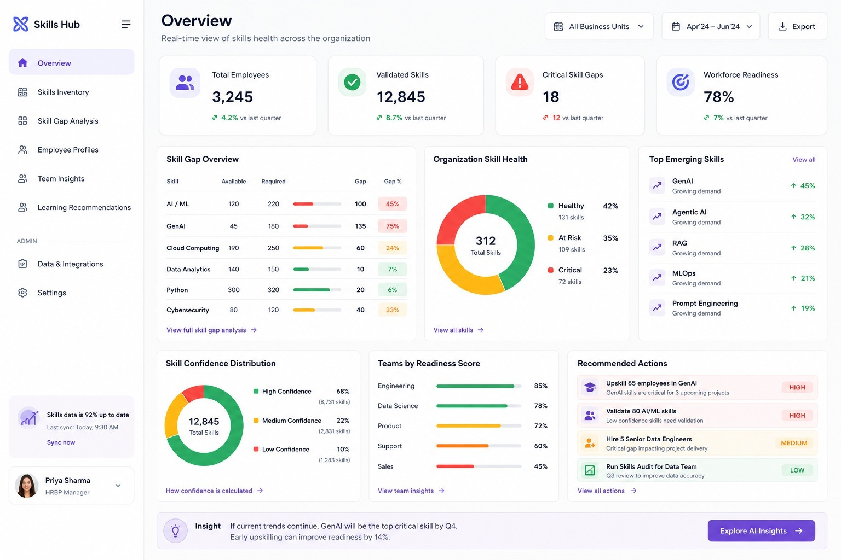
05 · CORE EXPERIENCE
Skills Intelligence Hub Dashboard
6 KEY AREAS
Workforce Readiness Score
Track overall preparedness at a glance
Critical Skill Gaps
Prioritize hiring or upskilling
Skill Health Distribution
Spot risk concentration early
Emerging Skills
Invest ahead of demand
Department Readiness
Target the weakest teams first
Recommended Actions
Move from insight to execution
Skills Intelligence Platform · UX Case Study
5 / 7

Slide 6
06 · DECISION FLOW
From Insight To Action
1
2
3
4
5
6
Skill Gap Detected
GenAI shortage identified
Affected teams highlighted
Employees recommended
Learning path assigned
Readiness score improves
BEFORE
AFTER
✕
Reactive decisions
✓
Data-driven decisions
✕
Manual analysis
✓
Instant visibility
✕
Unclear priorities
✓
Targeted interventions
Skills Intelligence Platform · UX Case Study
6 / 7

Slide 7
07 · IMPACT
Business Impact
75%
90%
30%
45%
Reduction in skill gap
identification time
Increase in skills
visibility
Improvement in workforce
readiness
Increase in targeted
learning adoption
“The Skills Intelligence Hub transforms fragmented skills data into trusted, actionable intelligence that helps HR leaders make faster and more confident workforce decisions.”
✓
Visibility
✓
Trust
✓
Actionability
✓
Scalability
Skills Intelligence Platform · UX Case Study
7 / 7

