Slide 1
Standard Operating Procedure (SOP)
VMS: AI Vision Studio & Flutter AI Studio Workflow
Project: Rpass_Sensor Digitization

Slide 2
Section 1: AI Vision Studio (Data Labeling & Training)

Slide 3
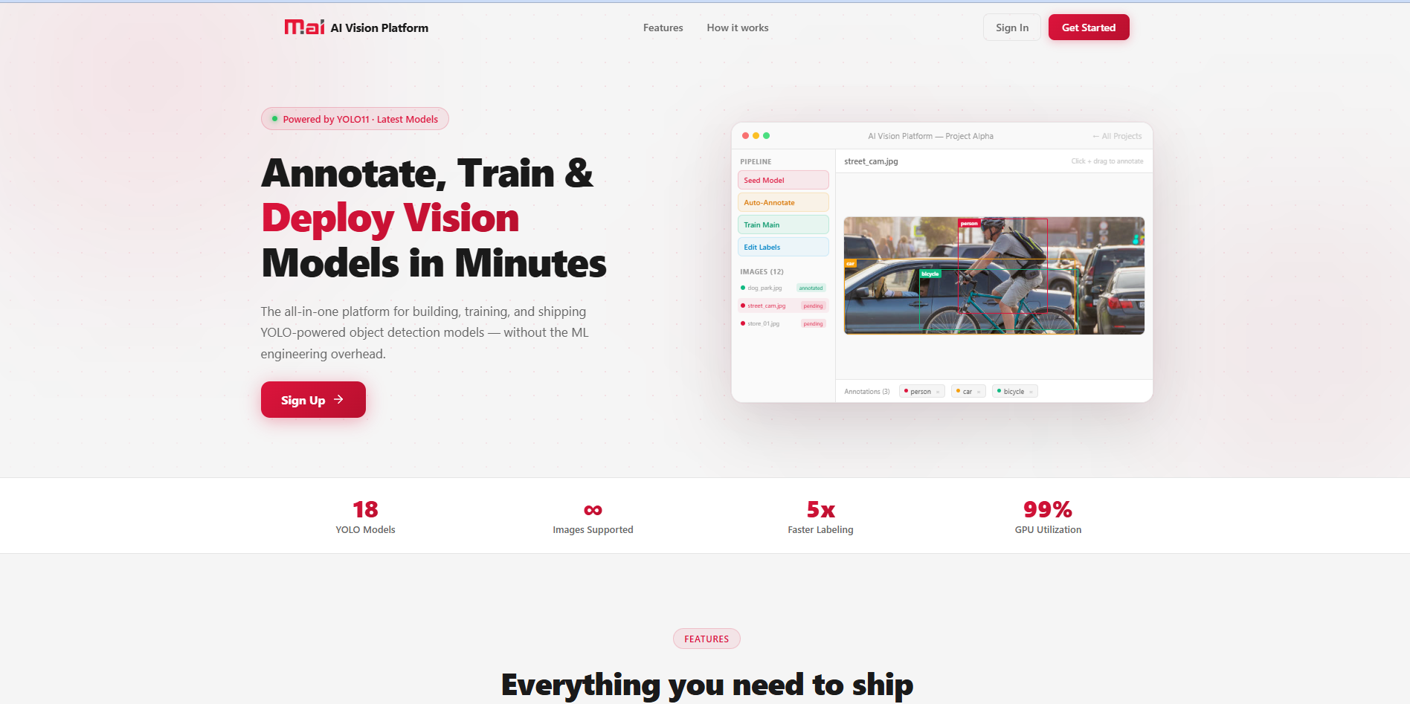
Step 1: Get Started with AI Vision Platform
Access the AI Vision Platform landing page. Click on 'Get Started' to begin your computer-vision project.

Slide 4
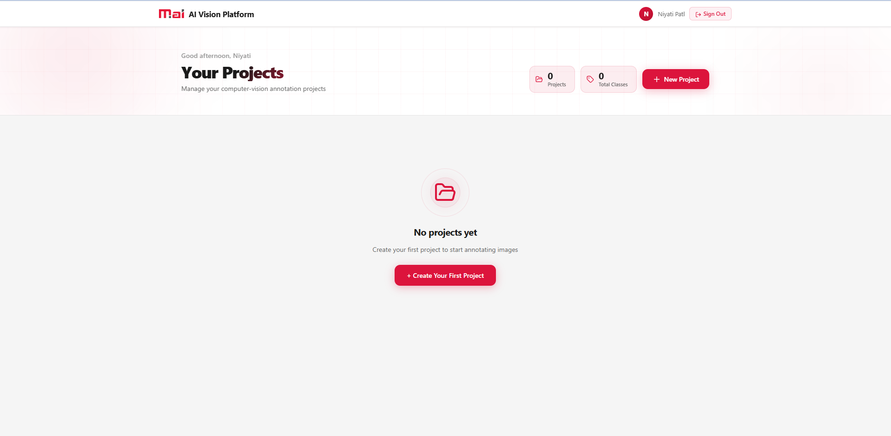
Step 2: Create a New Project
In the dashboard, click on '+ Create Your First Project' to start a new annotation task for your sensors.

Slide 5
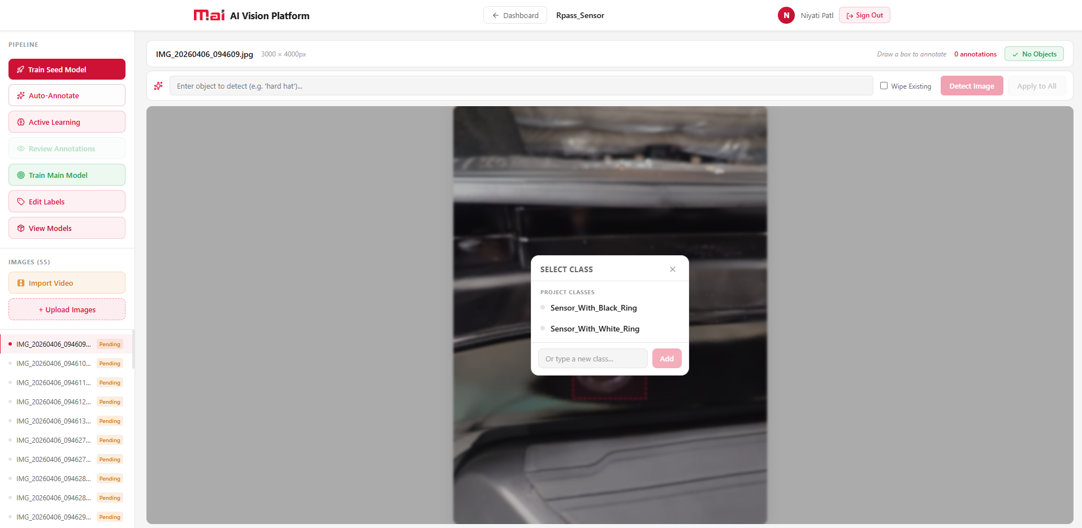
Step 3: Define Classes and Annotate
Upload your images and define classes (e.g., Black/White Ring). Select the appropriate class before detecting objects.

Slide 6
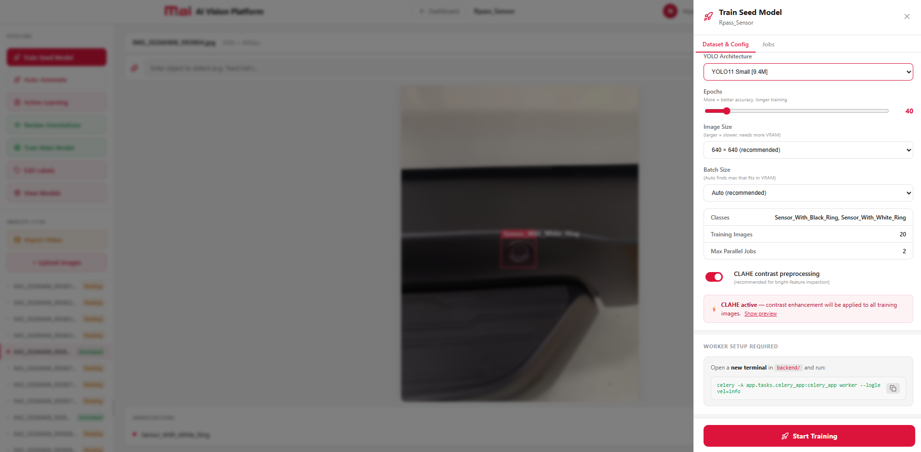
Step 4: Train Seed Model
Configure YOLOv11 parameters (epochs, image size) and click 'Start Training' to create your initial model.

Slide 7
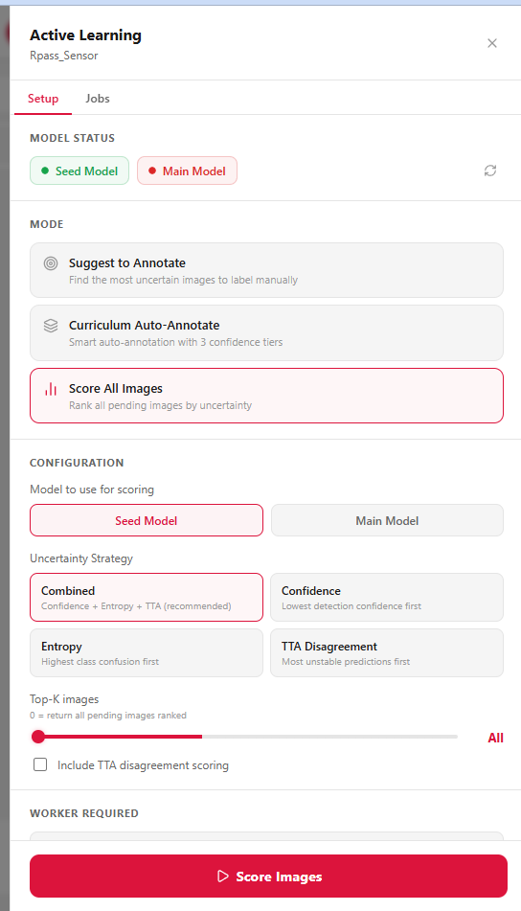
Step 5: Active Learning & Scoring
Use the 'Active Learning' feature to score all images. This helps prioritize uncertain images for manual review.

Slide 8
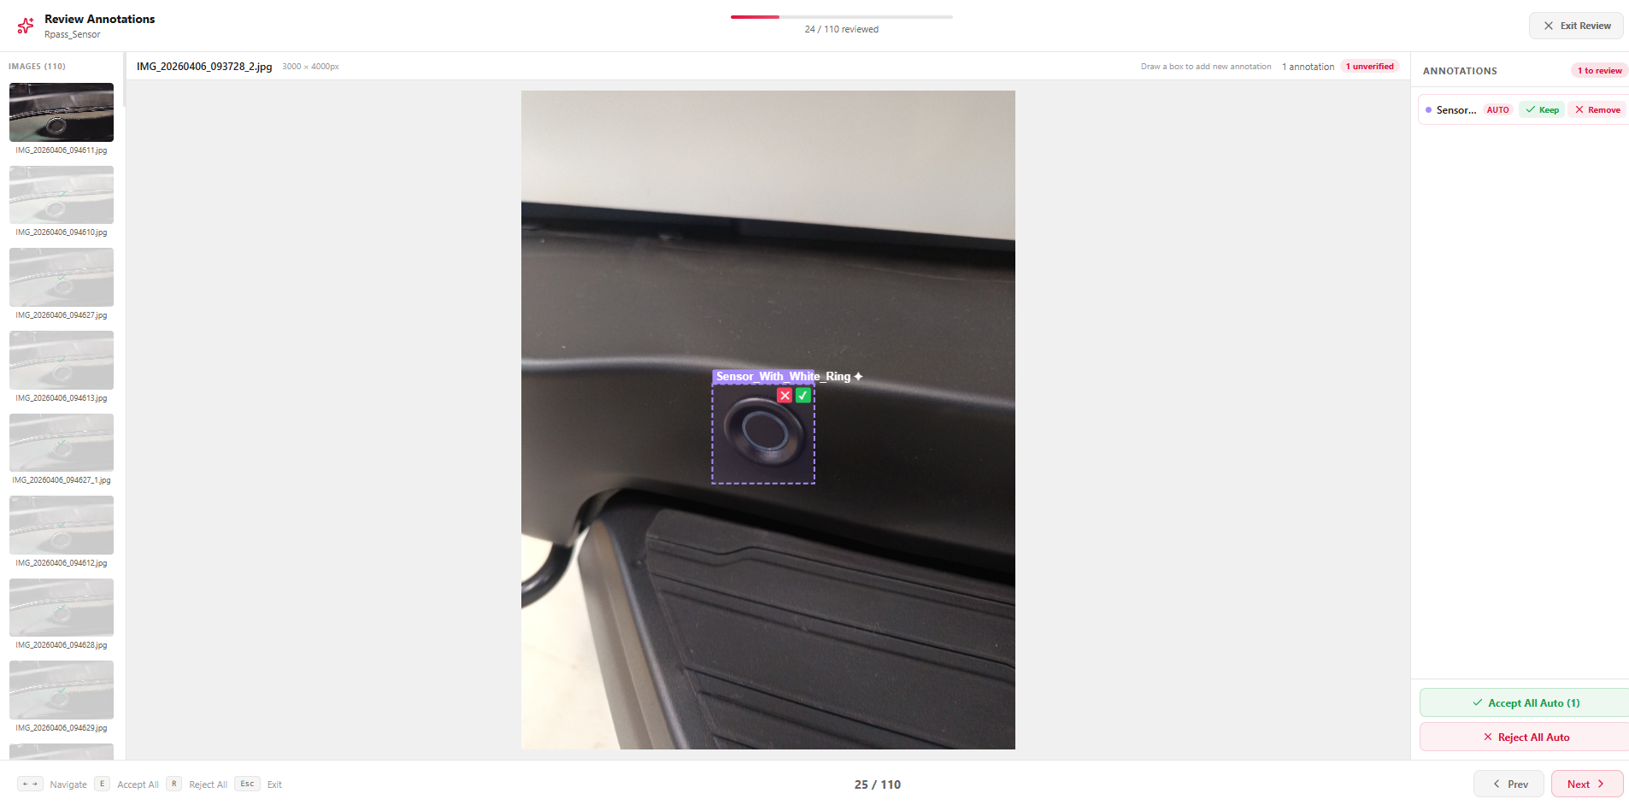
Step 6: Review and Accept Auto-Annotations
Verify the auto-annotations generated by the model. Click 'Accept All Auto' or manually correct labels if needed.

Slide 9
Section 2: Flutter AI Studio (APK Generation)

Slide 10
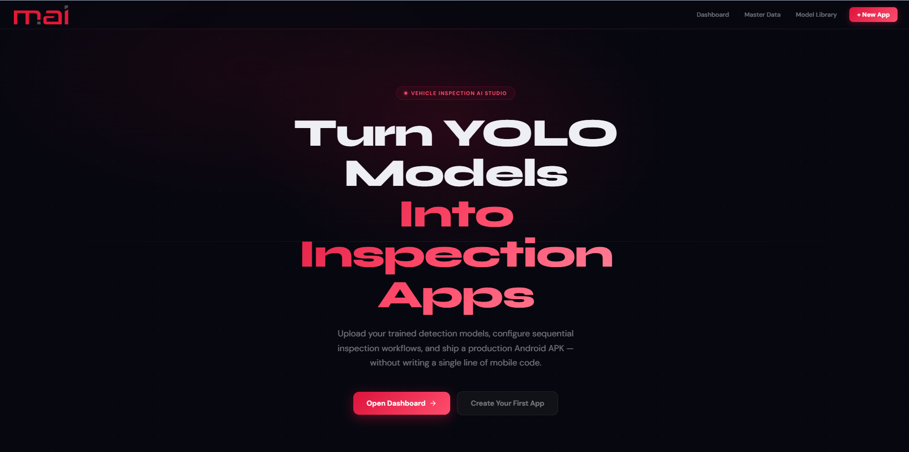
Step 7: Launch Flutter AI Studio
Open Flutter AI Studio to convert your trained YOLO models into inspection-ready mobile applications.

Slide 11
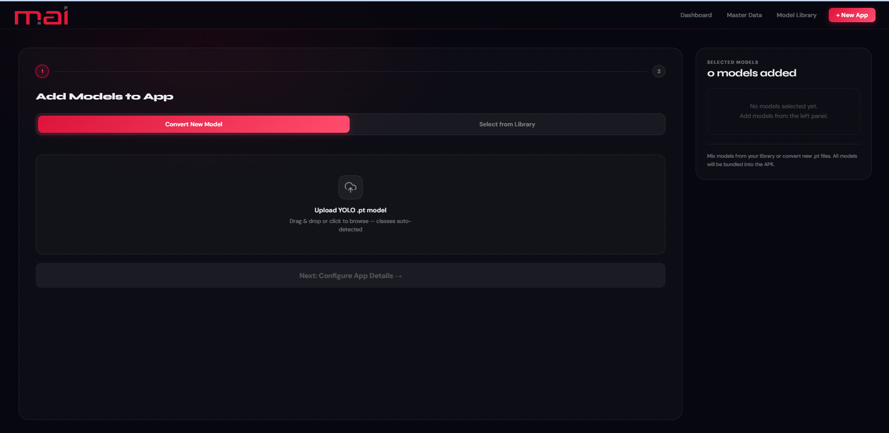
Step 8: Upload Trained YOLO Models
Upload the .pt model exported from AI Vision Studio. This model will be bundled into the APK.

Slide 12
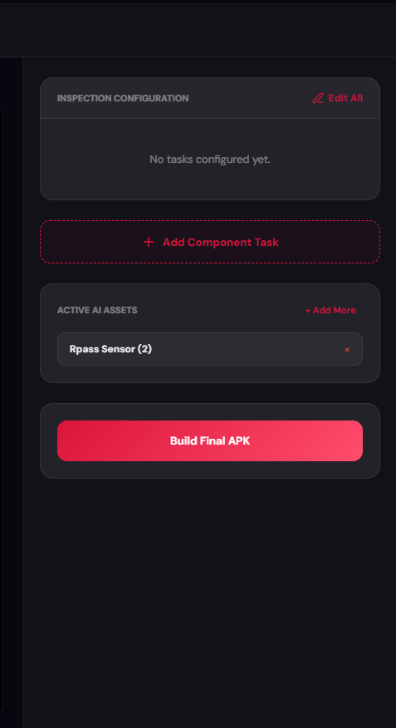
Step 9: Configure Inspection Tasks
Define sequential inspection workflows. Map model codes to specific capture instructions for operators.

Slide 13
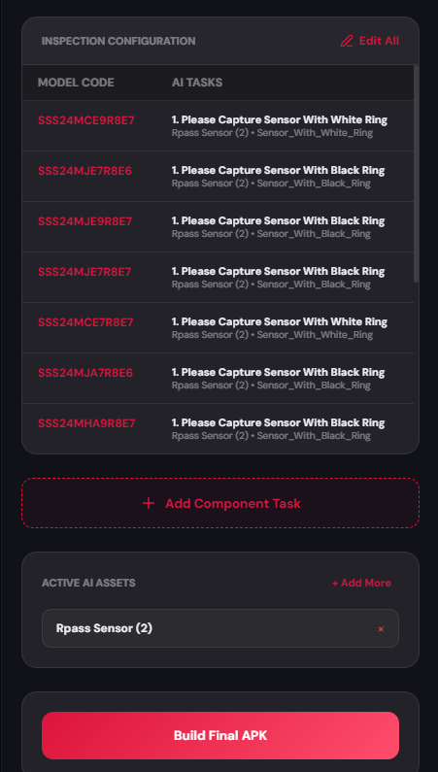
Step 10: Build and Export Final APK
Review the configuration and click 'Build Final APK' to generate the Android installer for testing on devices.

