Slide 1
Z-Stage – SOP

Slide 2
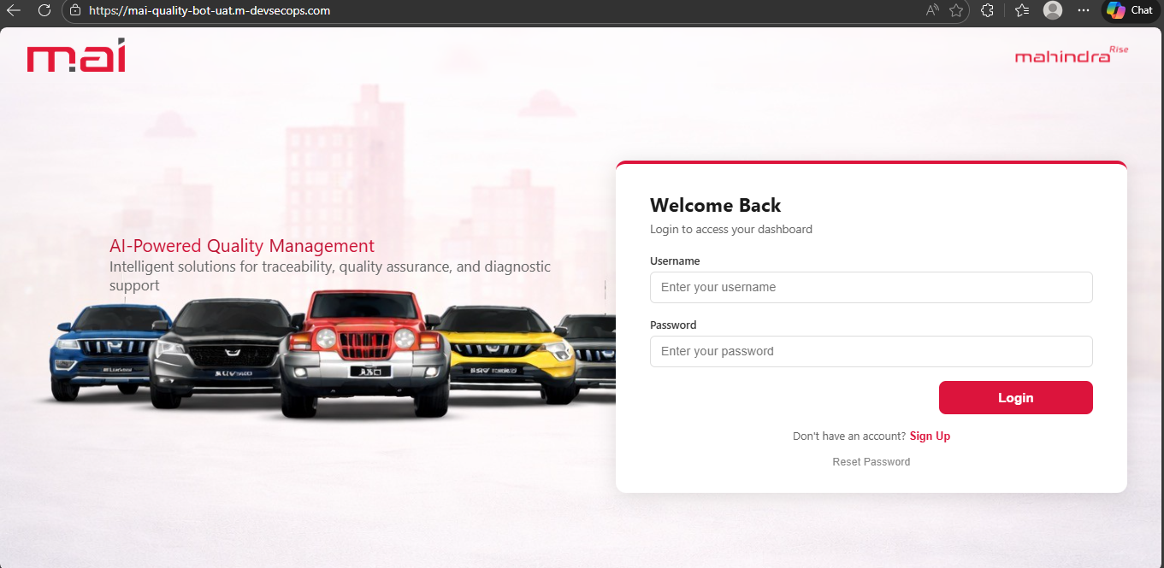
Z Stage – Step 1: Access the Link
Open link: https://mai-quality-bot-uat.m-devsecops.com/

Slide 3
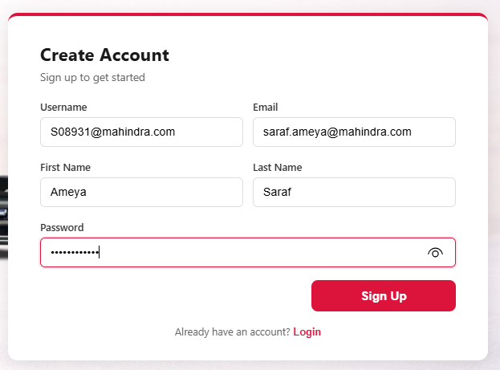
Z-Stage – Step 2: Create Account
If new user then create account fill all details and click on Sign Up.

Slide 4
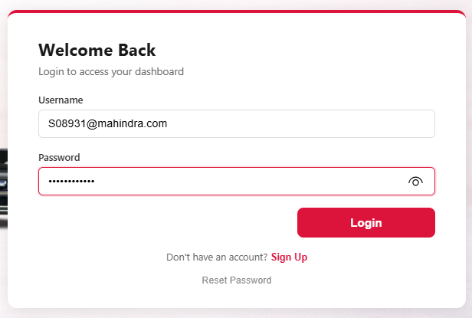
Z-Stage – Step 3: Login Page
If already sign up then Enter Username and Password and click on login.

Slide 5
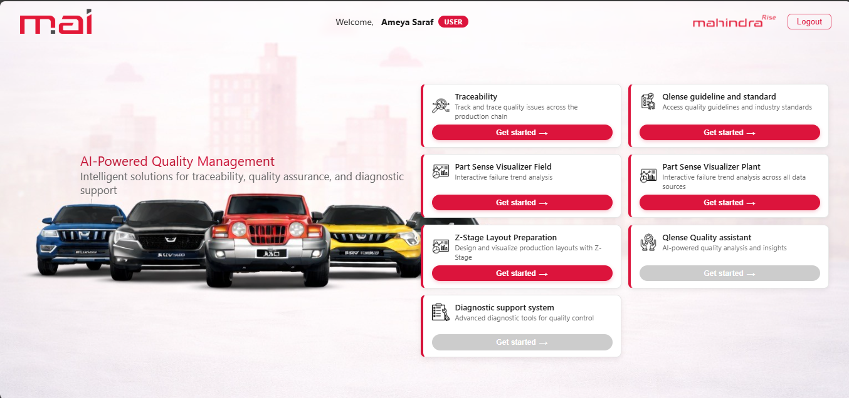
Z-Stage – Step 4: Home Page
Fill username and password and click on login, below Window will open

Slide 6
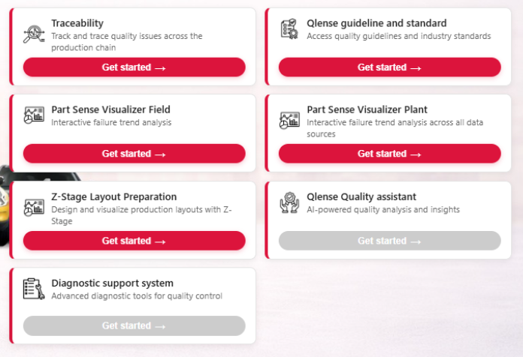
Z-Stage – Step 5: Select Tool
A new window will open then click on Z-Stage Layout Preparation

Slide 7
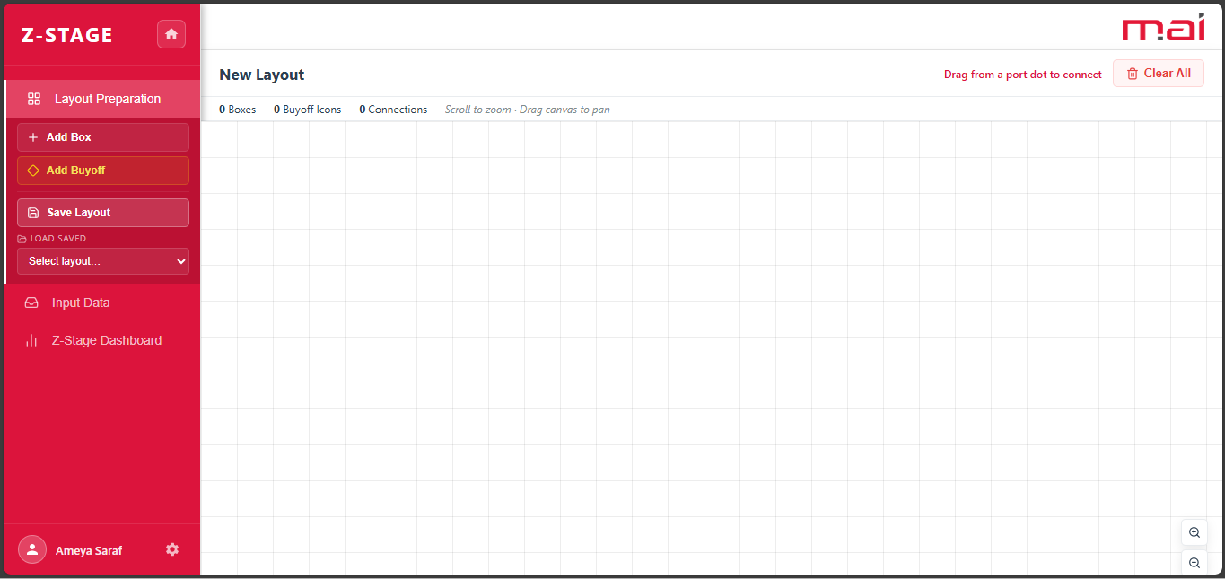
Z-Stage – Step 6: Main Panel Overview
In main panel you will able to see New Layout Window.

Slide 8
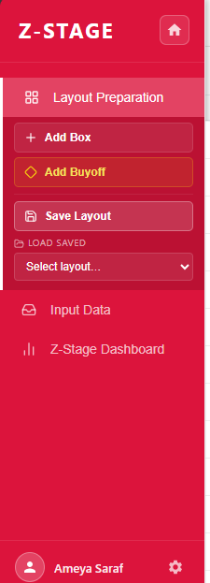
Z-Stage – Step 7: Left Panel Navigation
In left panel you will see dashboard
1. Layout Preparation
Add Box
Add Buyoff
Save Layout
Select Layout
2. Input Data
3. Z-Stage Dashboard

Slide 9
Z-Stage – Step 8: Add Box
Click on Add Box new window will open

Slide 10
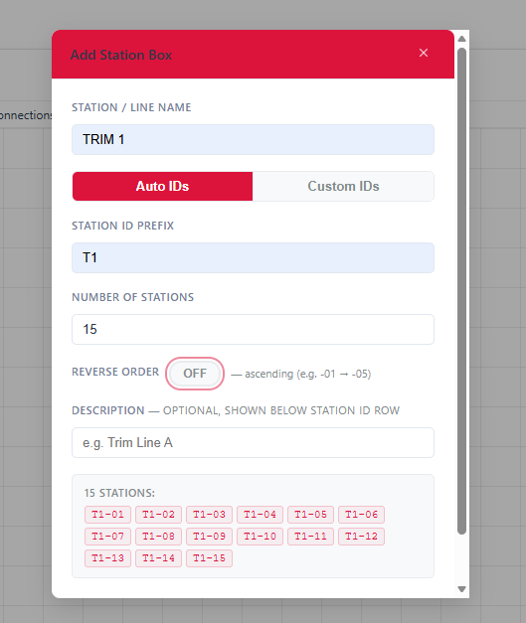
Z-Stage – Step 9: Fill Details
Fill Out All Details
1. Station / Line Name
2. Select Auto IDs to automatically assign IDs
3. Station to Prefix
4. Number of Station
5. Turn off the Toggle if you want stations in ascending order
6. Turn on the Toggle if you want stations in descending order
7. Write description for stations(Optional)
8. You will be able to see number of stations that you have selected

Slide 11
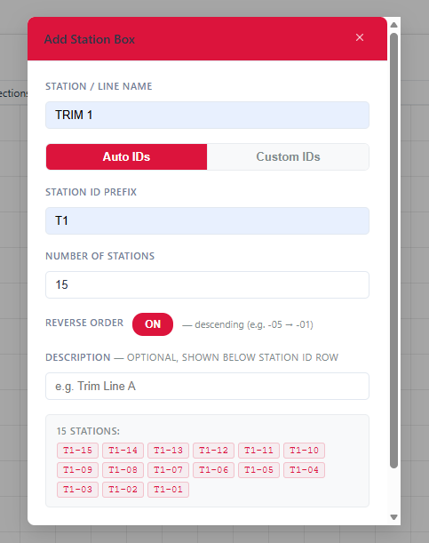
Z-Stage – Step 9: Fill Details
Turn on the Toggle if you want stations in descending order

Slide 12
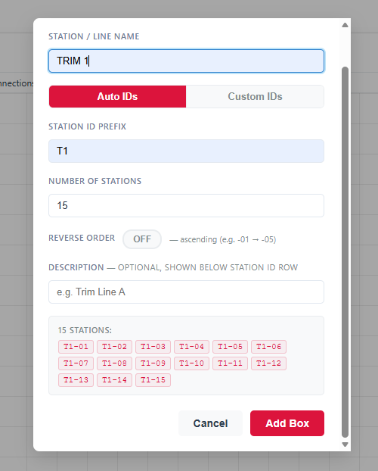
Z-Stage – Step 10: Fill Details
After filling all details click on Add Box

Slide 13
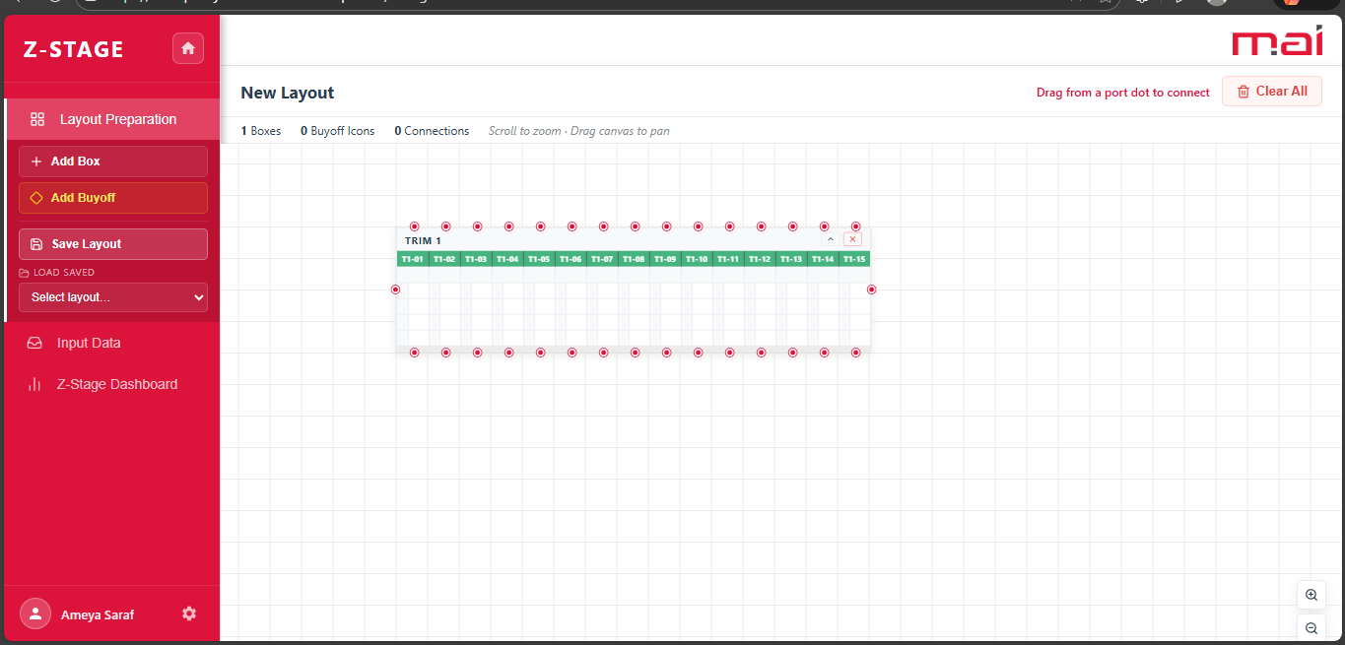
Z-Stage – Step 11: Layout Preparation
New Layout window with selected stations will be generated
Click on New Layout to edit the name of Layout
You can move this layout by clicking on it

Slide 14
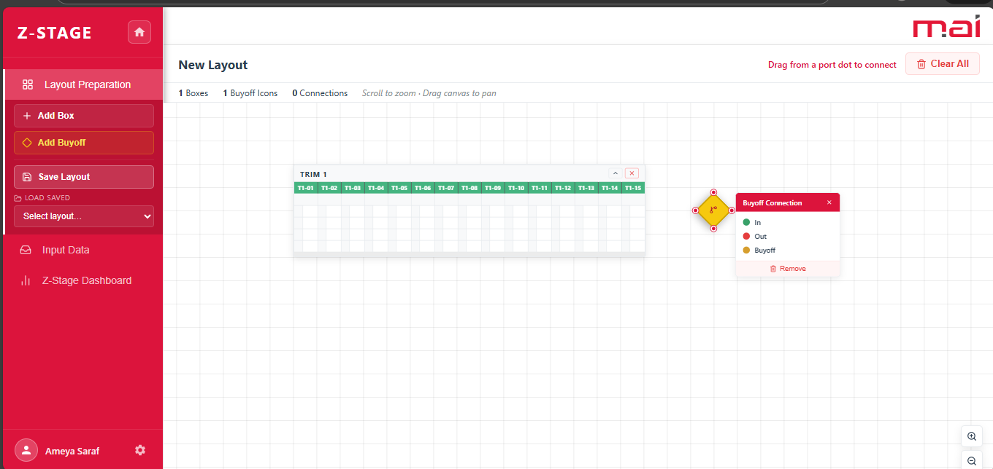
Z-Stage – Step 11: Layout Preparation
To add Buyoff, Click on Add Buyoff
Buyoff will get added

Slide 15
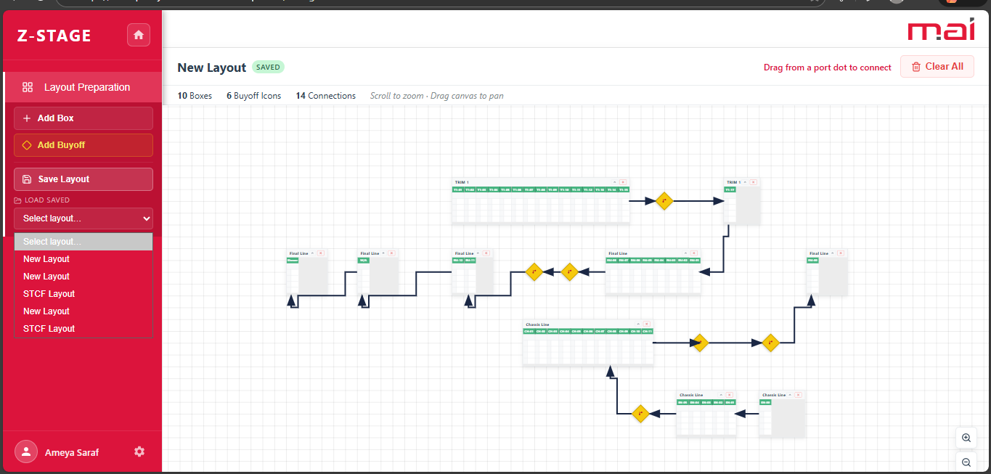
Z-Stage – Step 11: Layout Preparation
Click on Select Layout Dropdown where all Layout are saved just click on the Layout if you want to do changes

Slide 16
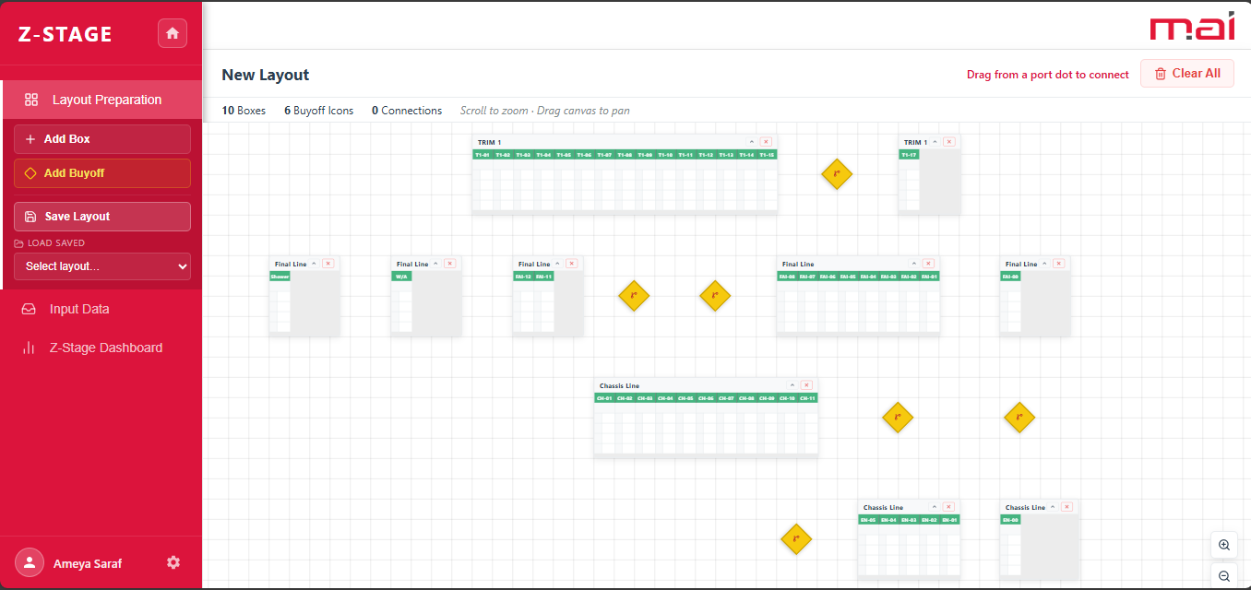
Z-Stage – Step 11: Layout Preparation
To add more station and buyoff you can click on Add Box and Add Buyoff respectively

Slide 17
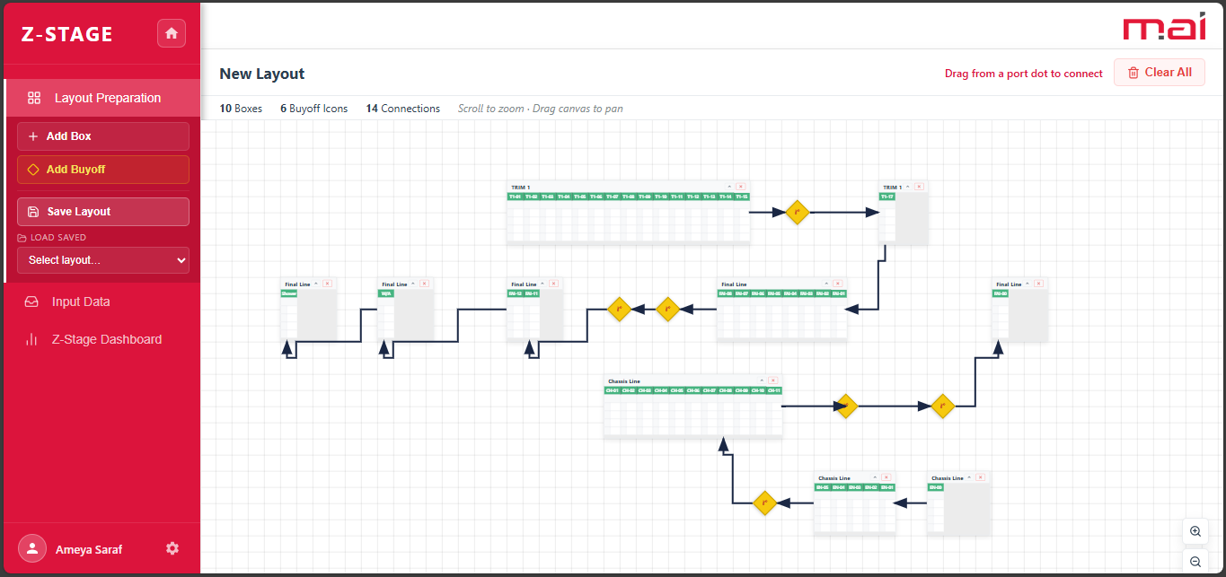
Z-Stage – Step 12 : Save Layout
To connect all station you have to drag an arrow from one stage to another.
After connecting all stages click on Save Layout.

Slide 18
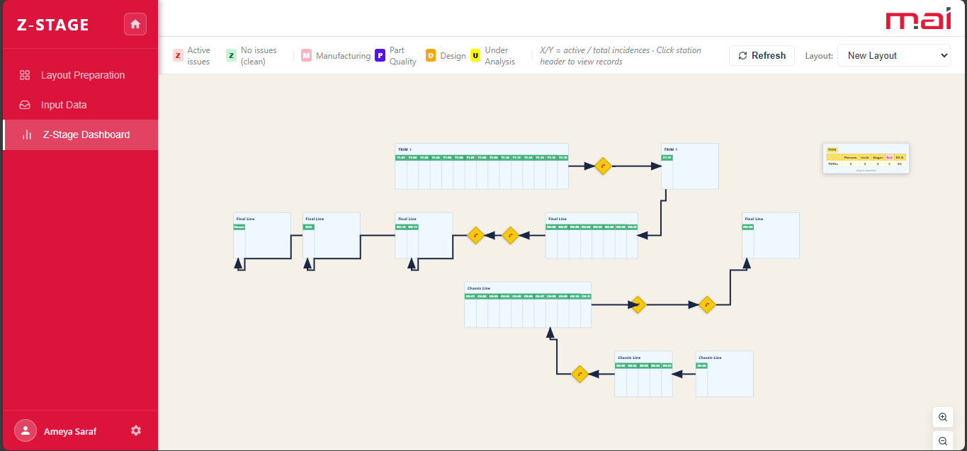
Z-Stage – Step 13 : Z-Stage Dashboard
Once Layout is saved you will able to see this Window in Z-Stage Dashboard.

Slide 19
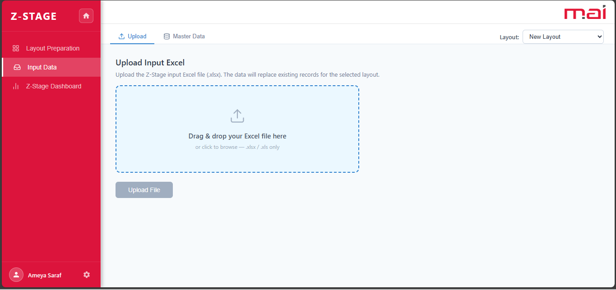
Z-Stage – Step 14 : Input Data
Click on Input Data to load the Data into Layout.

Slide 20
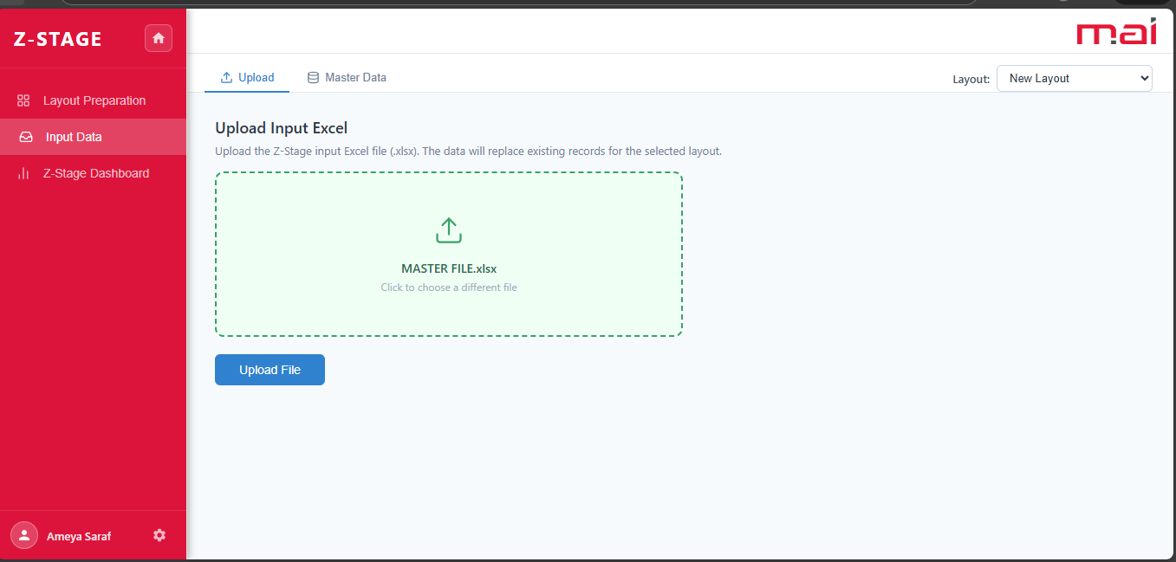
Z-Stage – Step 14 : Input Data
Select the Data File and click on Upload File.

Slide 21
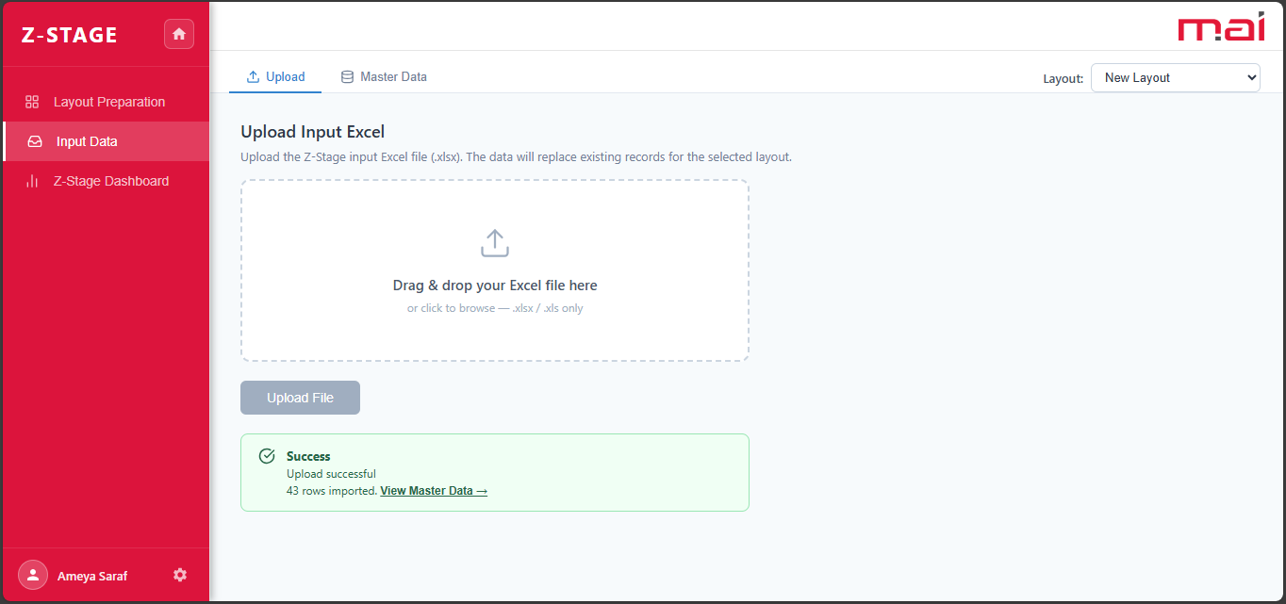
Z-Stage – Step 14 : Input Data
Once you click on Upload File you will get Success Message and by clicking on view Master Data you are able to see the Data.
Click on View Master Data to see the loaded Data

Slide 22
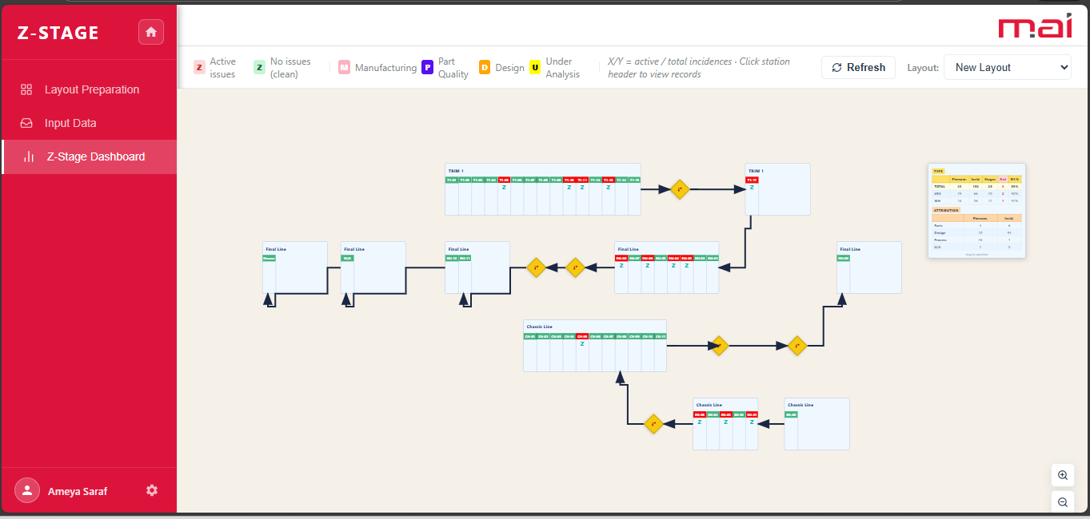
Z-Stage – Step 15 : Final Layout
Once the Data Upload is completed click on Z-Stage Dashboard to view the Final Layout

