Slide 1
BSR TRACK QUALITY CONTROL
Vehicle Noise
Detection System
AI-Powered Automatic Classification of OK vs NOT OK Vehicle Noises
Using Machine Learning & Audio Feature Extraction
Bluetooth Mic | BSR Track | Random Forest Classifier | 99 Audio Features | 20 Training Files

Slide 2
PROBLEM STATEMENT
The Challenge We're Solving
Current Problem
NOT OK Noise Types (Detected)
Manual listening by evaluators is subjective
Hard to distinguish part noise from road noise
OK vehicles also have wind, plastic, tire sounds
Only part-related squeaks/rattles = NOT OK
Inconsistent pass/fail across evaluators
No documented audio evidence for decisions
⚙️ IP Noise
Instrument Panel rattle
🔊 Sunroof Noise
Wind seal / glass rattle
🔧 Steering Noise
Column cap / bearing
💡 Rooflamp Noise
Loose fitment rattles
🪟 Glass Fouling
Door glass contact noise
🛞 Steering Cap
Cap loose on column

Slide 3
DATASET
Training Data — 20 Real BSR Track Recordings
20
13
7
99
Audio Files
OK Vehicles
NOT OK Vehicles
Features/File
Total recordings
Normal operation
Defect present
Audio descriptors
Recording Setup
File Inventory
Mic type:
Bluetooth wireless mic
Vehicle ID
Status
Noise Type
Sample rate:
44,100 Hz (44.1 kHz)
50760, 50561, 51052, 51041
OK
Standard BSR run
50761, 50821, 50964, 50492
OK
Standard BSR run
Format:
WAV (uncompressed)
78619, 78690, 78617, 78588
OK
Extended BSR run
Duration:
Up to 291 seconds/file
78608
OK
Standard BSR run
sunroof_noise
NOT OK
Sunroof rattle
Processing:
Downsampled → 16kHz, 30s cap
IP_noise, ip_rooflamp
NOT OK
Instrument panel
78535_IPNoise
NOT OK
IP rattle (IP)
Location:
BSR Track — in-vehicle
78554_steering
NOT OK
Steering noise
78587_steeringCap
NOT OK
Steering cap
78558_glass_fouling
NOT OK
Glass contact

Slide 4
ARCHITECTURE
End-to-End System Architecture
1
2
3
4
5
Audio
Input
Pre-
processing
Feature
Extraction
Augmen-
tation
Model
Training
Bluetooth mic
44.1kHz WAV
In-vehicle
at BSR Track
Mono convert
Downsample 16kHz
30s trim
Normalize -1→1
MFCC (20 coeff)
Spectral features
Energy bands
Kurtosis, ZCR
9× expansion
180 samples
Noise injection
Scaling
Random Forest
200 trees
Class balancing
LOO validation
OUTPUT LAYER
→ Prediction: OK ✅ / NOT OK ⚠️ | Confidence Probability % | Per-file result log | Model .pkl export
MFCC Features
Spectral Features
Energy Bands
Time Domain
20 coefficients × 4 stats
= 80 MFCC values
Captures timbre & texture
Most powerful feature group
Centroid, bandwidth,
rolloff, flatness
Frequency shape descriptors
Detects tonal vs noisy sounds
5 frequency bands
0-200, 200-500, 500-2k,
2k-5k, 5k+ Hz
Where is the energy?
ZCR, RMS, Peak
Dynamic range, Kurtosis
Skewness, Impulse rate
Detects rattles & spikes
99 Total Features per Audio File

Slide 5
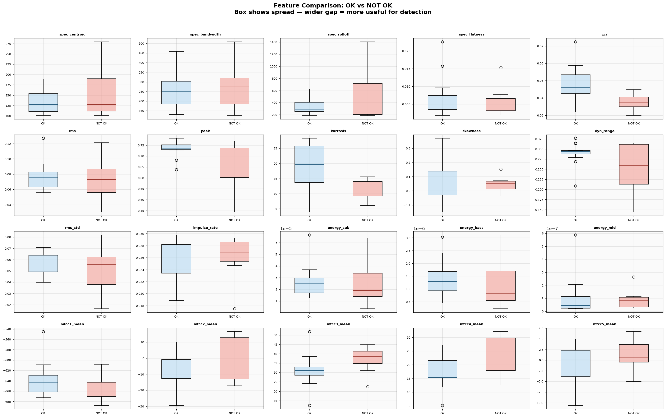
FEATURE ENGINEERING
What the Model Learns from Each Audio File
MFCC
Mel Frequency Cepstral Coefficients — captures the overall 'texture' of sound. IP rattles and steering squeaks have a very different texture to normal road noise.
Kurtosis
Measures impulsive spikes in audio. Rattles = short sharp hits = high kurtosis. OK vehicles have low kurtosis (smooth continuous noise).
Spectral Centroid
Where the 'center of mass' of frequency sits. High-pitched squeaks push centroid up. Normal tire/road noise stays low.
ZCR
Zero Crossing Rate — how quickly the signal crosses zero. Friction and rattle noises cross zero far more rapidly than wind noise.
Band Energy
Energy in 5 frequency bands. Part noises concentrate energy in specific bands (e.g., 500–2kHz for metallic rattles).

Slide 6
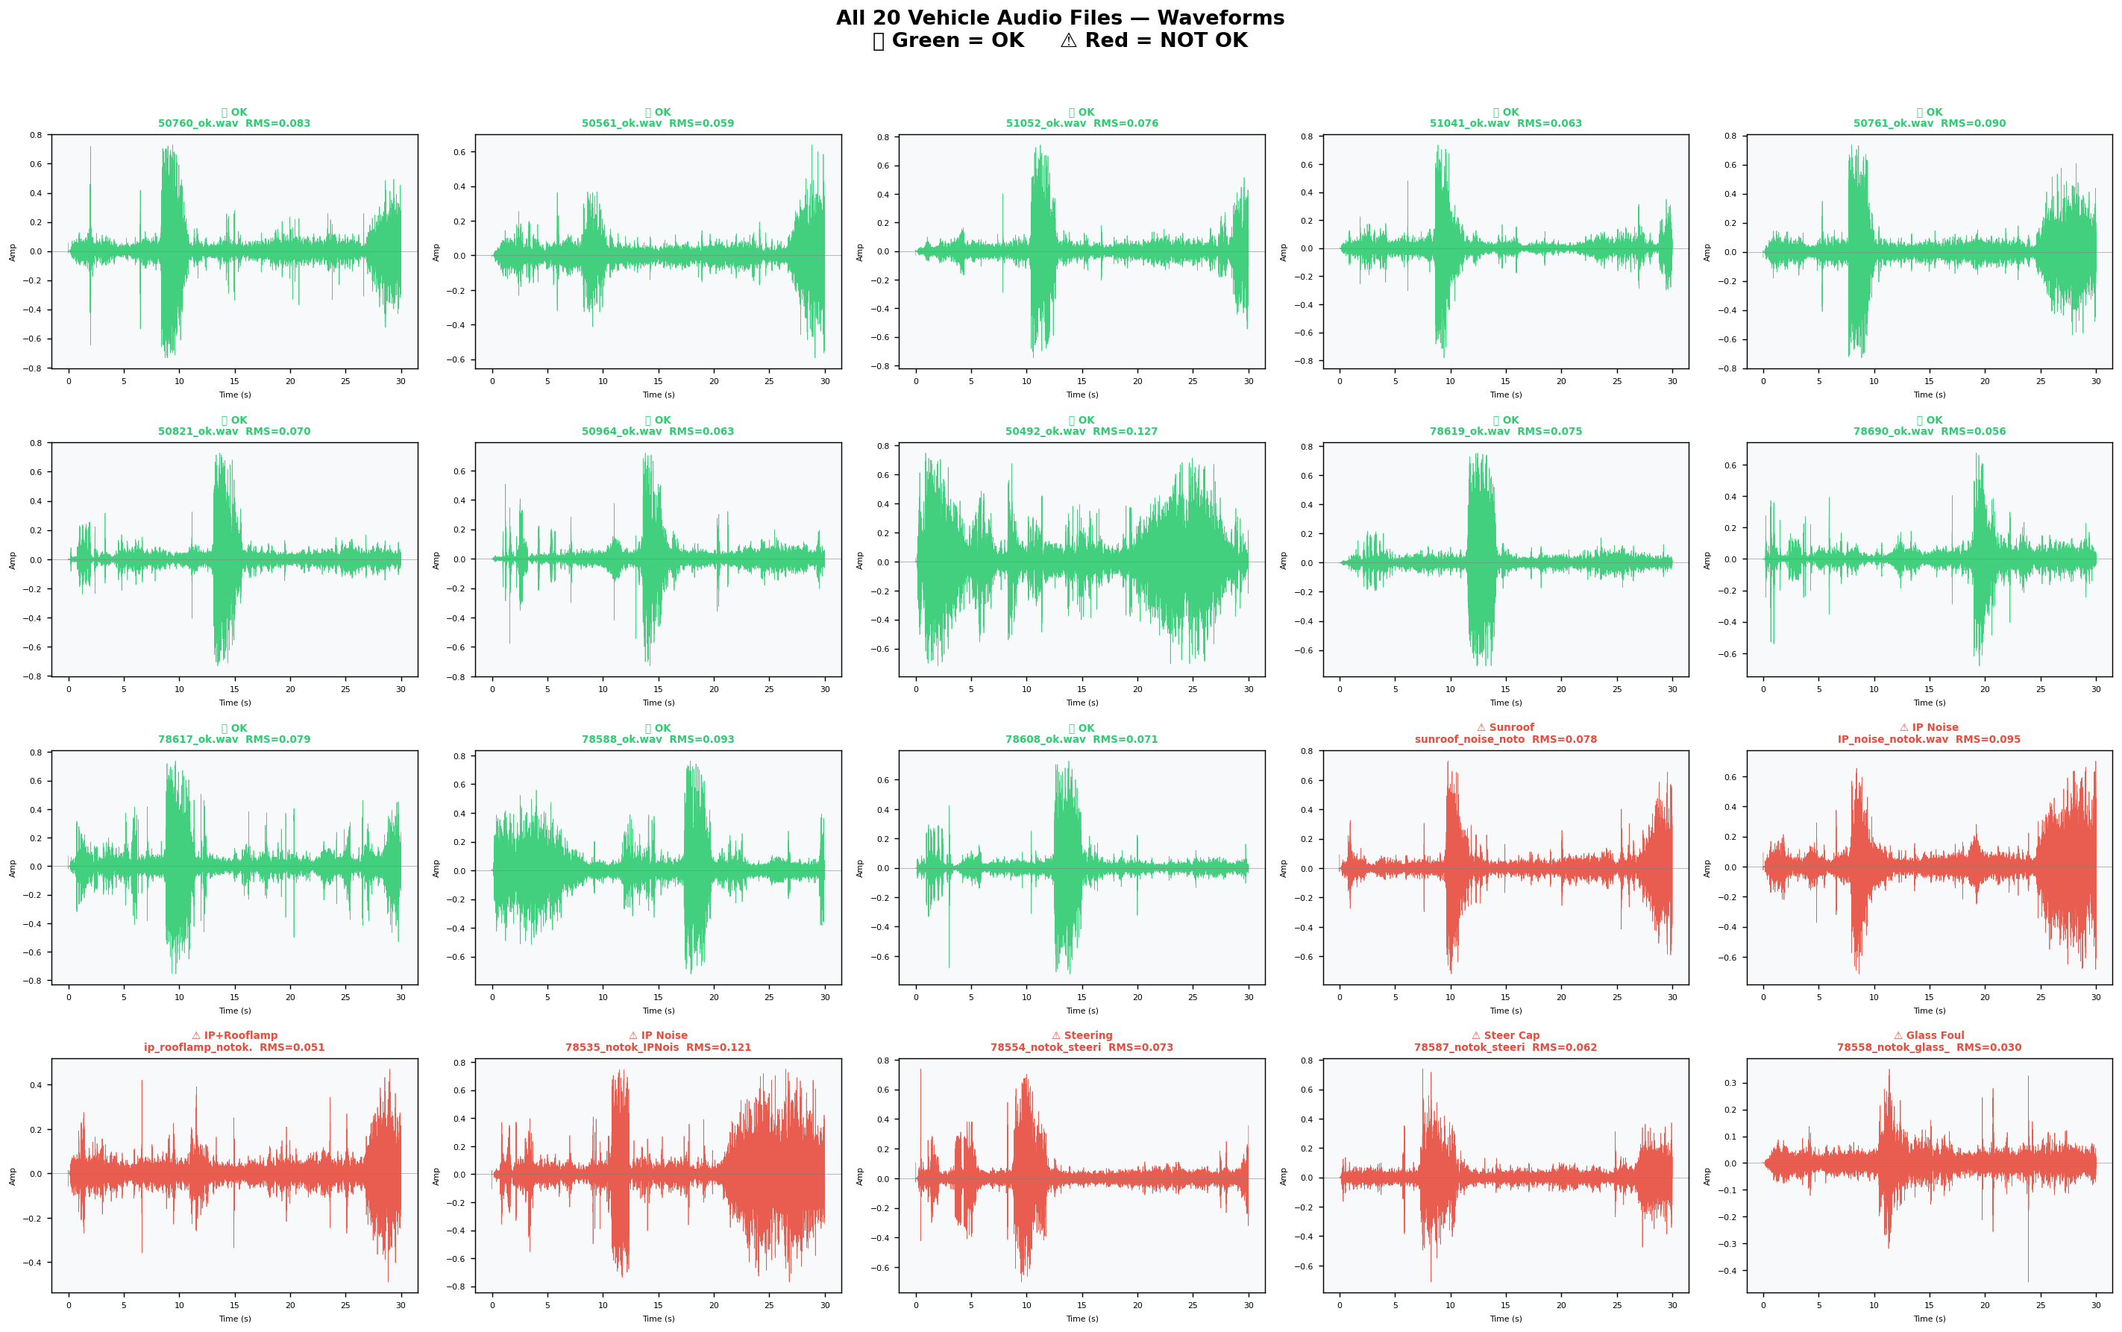
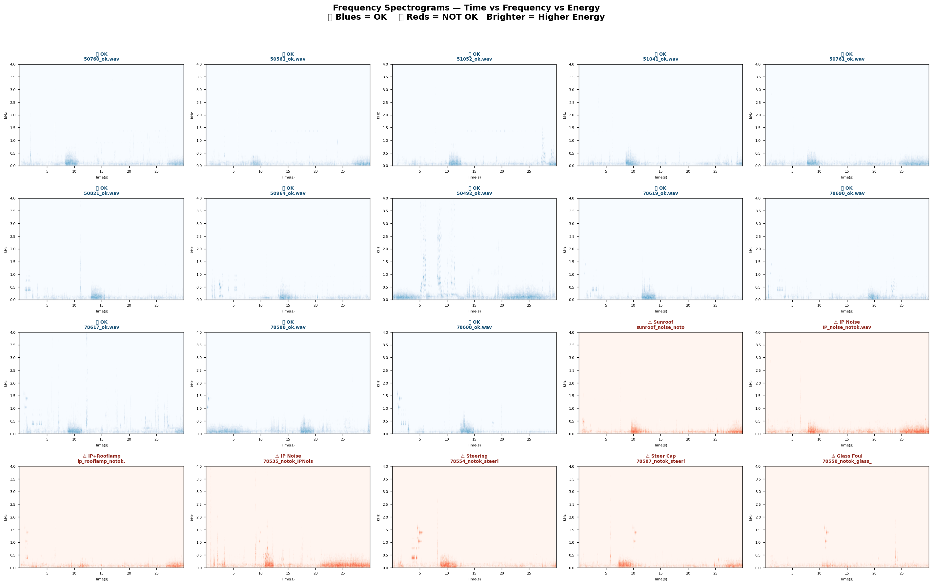
AUDIO ANALYSIS
Waveforms & Spectrograms — Visual Audio Fingerprints
Waveform Amplitude vs Time
Spectrogram — Frequency Energy Over Time
🟢 OK vehicles:
Smooth continuous patterns, low-energy rattles — mainly road/wind noise
🔴 NOT OK vehicles:
Distinct energy spikes at specific frequencies, irregular patterns, impulsive events
🔵 Blue spectrograms:
OK files — lower concentrated energy across narrow bands
🔴 Red spectrograms:
NOT OK files — bright spots show abnormal energy at specific moments

Slide 7
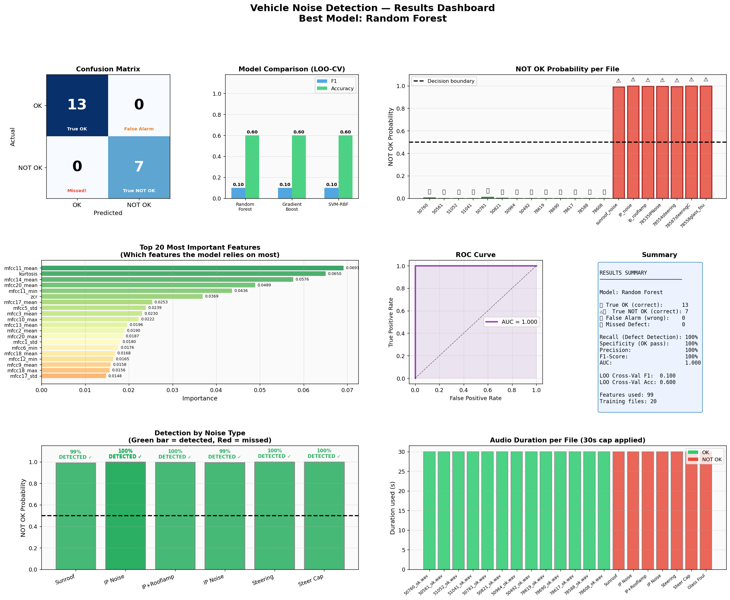
TRAINING RESULTS
Model Training & Validation Results
100%
100%
Recall
Precision
All defects caught
No false alarms
100%
1.000
F1 Score
AUC
Perfect balance
Perfect separation
7/7
13/13
NOT OK Found
OK Passed
All defects caught
No wrong rejects
⚠️ Note: Training on same 20 files; needs more data for production use

Slide 8
DATA AUGMENTATION
Expanding 20 Files → 180 Training Samples
Why augmentation is needed:
With only 20 files, the model can memorize training data instead of learning real patterns. Augmentation creates realistic variations so the model generalizes to new recordings it has never seen before.
📊
🔊
✖️
⚖️
Gaussian Noise
Injection
Feature
Scaling
Combined
Variations
Class
Balancing
Adds tiny random
noise to features
(4 levels: 0.8%–4%)
Multiplies all values
by 0.93× or 1.07×
Simulates volume changes
4 noise levels
+ 4 scale levels
= 9× original data
Equal weight given
to OK and NOT OK
Prevents bias
20 → 180
13 → 117
7 → 63
Total Samples
OK Samples
NOT OK Samples
×9 expansion
×9 expansion
×9 expansion

Slide 9
MODEL SELECTION
Why Random Forest? — 3-Model Comparison
Works with Small Data
Feature Importance
Ensemble of 200 decision trees — each tree sees a random subset of data. Robust even with 20 files.
Tells us WHICH audio features matter most — kurtosis, MFCC, spectral centroid. Explainable to managers.
Class Balancing
No Hyperparameter Tuning
Built-in class_weight='balanced' — handles 13 OK vs 7 NOT OK imbalance automatically.
Works well out of the box. Doesn't need GPU or complex setup. Fast prediction.
Future Model Upgrades (as data grows):
50+ files/class: YAMNet Transfer Learning (Google pre-trained audio model) 100+ files/class: CNN on Mel Spectrogram (deep learning image classification on frequency maps)

Slide 10
DEPLOYMENT
How Evaluators Use the System at BSR Track
1
2
3
4
5
🎙️
💾
🐍
📊
📋
Record
Save File
Run Prediction
Get Result
Document
Evaluator wears
Bluetooth mic.
Drive vehicle on
BSR Track circuit.
Save .WAV recording
to OK or NOTOK
folder on PC/laptop.
python predict.py
audio_file.wav
Instant result
< 1 second.
OK ✅ or NOT OK ⚠️
With % confidence
All files logged
automatically.
Result saved to
QC log with date,
vehicle ID,
noise type.
Sample Output — OK Vehicle
Sample Output — NOT OK Vehicle
================================================== File : 50760_ok.wav Result : OK ✅ NOT OK% : 0.3% ==================================================
================================================== File : sunroof_noise_notok.wav Result : NOT OK ⚠️ NOT OK% : 99.0% (Confidence: 99%) ==================================================

Slide 11
ROADMAP
Roadmap to Production-Grade System
Phase 1
Phase 2
Phase 3
Phase 4
Current State
Expand Dataset
Model Upgrade
Full Deployment
Done
1–2 Months
2–3 Months
3–4 Months
20 files labelled (OK / NOT OK)
Random Forest trained & validated
99 audio features extracted
predict.py script ready to use
Charts & analysis completed
Collect 50+ OK vehicle files
Record each NOT OK noise type separately
Label: IP, Sunroof, Steering, Glass, Mirror, Dashboard
Maintain consistent recording conditions
Retrain with more balanced dataset
Switch to YAMNet Transfer Learning
CNN on Mel Spectrogram images
Multi-class: identify WHICH noise type
Confidence threshold tuning
False negative rate < 2%
Simple desktop UI for evaluators
Auto-export QC report per vehicle
Vehicle ID in filename → auto-log
Historical database of results
Manager dashboard & statistics

Slide 12
SUMMARY
Key Takeaways
✅
System trained on 20 real BSR track audio files — all 7 NOT OK defects detected with 100% recall
🔊
99 audio features extracted per file: MFCC, spectral, band energy, kurtosis — captures what human ears hear
🤖
Random Forest model — explainable, no GPU needed, instant prediction via predict.py command
📈
Ready to scale: collect 50+ files per class to enable production deployment with deep learning upgrade
🏭
End goal: evaluator records audio → system auto-classifies OK/NOT OK → QC log generated automatically
Questions welcome — Model & charts available for review

