Slide 1

Intelligent Multimodal Interaction University of Paris-Sud 02/03/2015
An intelligent multimodal android application
Designed by: Niyati Roy Chowdhury
David Jan Mercado
Seren Thompson
Panagiota Tziova

Slide 2

Notes:
Motivation: too much sitting is bad for your health so we created this app.

Slide 3
How Activo works (1/2)
On call (call detection)
Activo detects user’s movement
(Accelerometer)
User’s Activity
In meeting (retrieve data from calendar)
Blank node
In pocket (proximity sensor)
Phone Location
Not pocket (proximity sensor)
Silent mode (phone mode detection)
Phone mode
Normal mode(phone mode detection)

Slide 4
How Activo works (2/2)
On call
Notifications are blocked
User’s Activity
In meeting
Blank node
Input Modalities: Speech
Output Modalities: Vibration
Silent mode
Phone mode
Normal mode
In pocket
Input Modalities: Speech
Output Modalities: Vibration
Sound
Phone Location
Not pocket
Input Modalities: Speech
Gesture
Output Modalities: Vibration
Sound
Text
Image
Phone mode
Silent mode
Input Modalities: Speech
Gesture
Output Modalities: Vibration
Text
Image
Normal mode

Slide 5
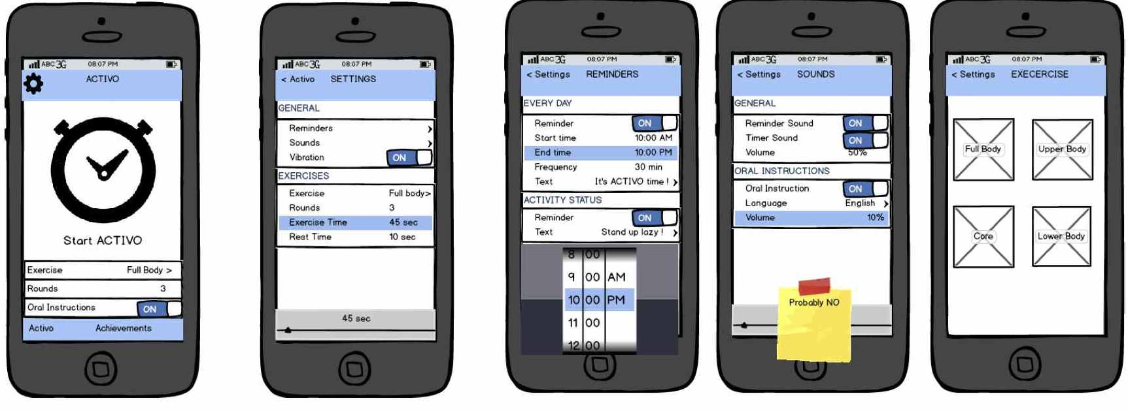
Wireframes

Slide 6
Snapshots of application
To be uploaded soon…

Slide 7
Conclusion
Activo helps improve user's lifestyle.
Integrates different Input modalities (speech, tap, gestures) and output modalities (vibration, sound, text, image).
For our future work, we would like to run different modes such as accelerometer and proximity sensors as a service.
We would like to have different exercises for different parts of the body.
With the improvements, our intelligent multimodal application will be ready for real-world use.
Notes:
Conclusion, future work, contributions

