Slide 1
28V 1A Boost Converter
3.3V Input
28V 1A Output
200kHz switching frequency
LT3757 IC
Niyazi Emirhan Yeşil

Slide 2
28V 1A Boost Converter
Design Steps
System parameters and design constraints
Examination of working mods of System and Power IC
Duty cycle calculation (Duty)
Inductor selection (L)
Output capacitor selection (C)
Diode selection(D)
Switching component selection(Q)
Configuration of power IC’s peripherals (UVLO, RT etc.)

Slide 3
28V 1A Boost Converter
Tasarım Adımları
Input capacitor selection
Defining control Loop parameters
Spice Simulation ve design validation
Schematic design
PCB Layout design

Slide 4
28V 1A Boost Converter
1. System parameters and design constraints
Input Voltage (Vin) = 3.3V
Output Voltage (Vout) = 28V
Output Current (Iout) = 1.0A
Output Power (Pout) = 28W
Switching frequency (fsw) = 200kHz
%dVo/dt: 0.1%
%diL/dt: 25%
Boost
Converter
3.3V 9.64A
28V 1A
31.81W
28W
Desired Eff:88%

Slide 5
28V 1A Boost Converter
2. Examination of working mods of System and Power IC
nput Voltage (Vin) = 3.3V
Output Voltage (Vout) = 28V
Output Current (Iout) = 1.0A
Output Power (Pout) = 28W
Switching frequency (fsw) = 200kHz
%dVo/dt: 0.1%
%diL/dt: 25%
Boost
Converter
3.3V 9.64A
28V 1A
31.81W
28W
Desired Eff:88%

Slide 6
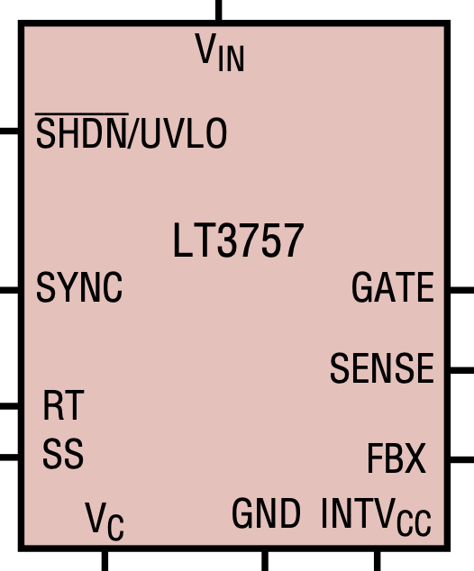
LT3757
Boost Controller IC
Vin range: 2.9V to 40V
Operating frequency: 100kHz-1MHz
Current mode control
Synchronizable to External Clock
UVLO feature at 1.22V with Hysteresis
Soft start, Frequency foldback

Slide 7
28V 1A Boost Converter
3. Duty cycle value calculation (ideal Duty)
$\frac{Vout}{Vin}=\frac{1}{1-D}$ (ideal boost converter)
$D=\frac{Vout-Vin}{Vin}=\frac{28-3.3}{28}=0.882$ %88.2 Duty cycle (İdeal duty cycle)

Slide 8
28V 1A Boost Converter
4. Inductor selection (L)
Average Inductor Current
$$I_{L}=\frac{Vin}{R*(1-D)^{2}}=\frac{3.3}{28*(1-0.8821)^{2}}=8.484A$$
$$ΔI_{L}=\%ΔI_{L}*I_{L}=0.25*8.484A=2.121A$$
$$I_{L_{peak}}=I_{L}+ΔI_{L}=8.484+2.121=10.606A$$
$$I_{L_{sat}}=I_{L_{peak}}*S=10.606*1.5=15.909A$$
$$ΔI_{L}=\frac{VinDT_{sw}}{2L}$$
$$L≥\frac{VinD}{2ΔI_{L}f_{sw}}$$
$$L≥\frac{3.3}{2*2.121*200000}$$
$L≥3.431μH$ closest commercial inductor value 3.9uH

Slide 9
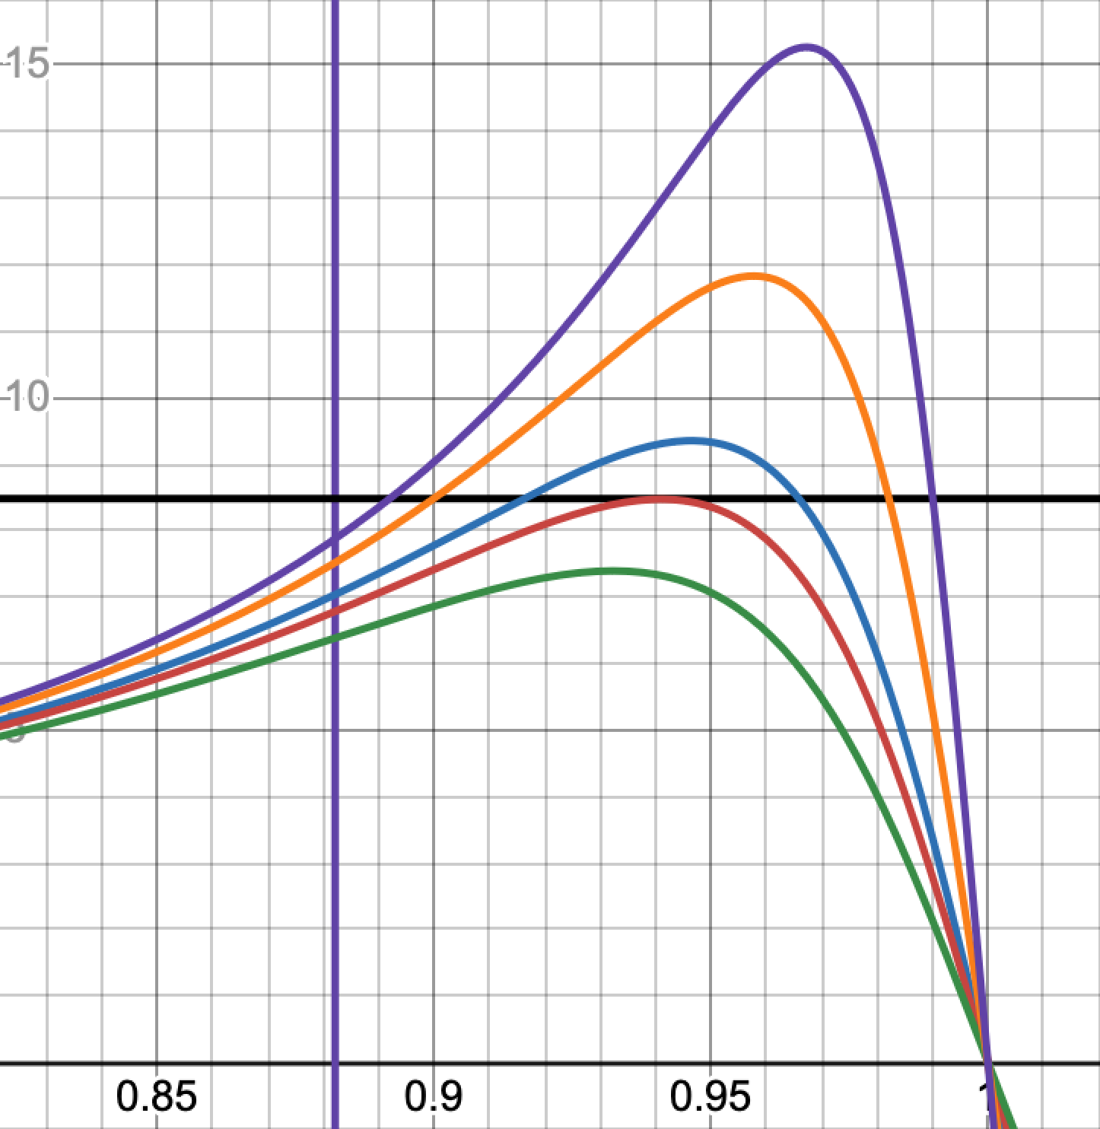
28V 1A Boost Converter
4. Inductor selection (L)
$$\frac{Vout}{Vin}$$
$R_{L}≤0.0975ohm$ boundary condition
The graph in the right side of the page, numerically obtained value of the inductor internal resistance must be equal or less than 0.0975ohm, if not the desired Vout/Vin ration will not be achieved.
A small RL will reduce the duty cycle value and have a positive contribution to efficiency.
By this reason RL value will be selected equal or less than $R_{L}≤0.01ohm$.
$$R_{L}=0.03ohm$$
$$R_{L}=0.05ohm$$
$$R_{L}=0.08ohm$$
$$R_{L}=0.0975ohm$$
$$D$$
$$R_{L}=0.128ohm$$

Slide 10
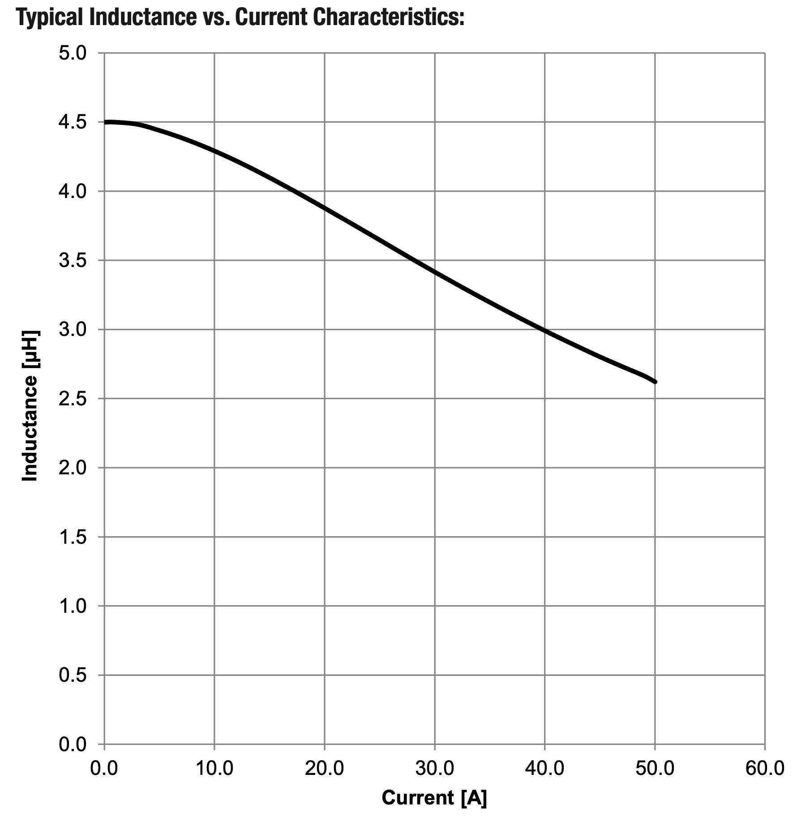
28V 1A Boost Converter
4. Inductor selection (L)
The coil that best meets these criteria was selected as the coil with the product number 7443556450 from Würth Elektronik.
L = 4.5uH
IL rated = 20.5A
Isat = 37A
DCRmax= 3.4mohm

Slide 11
28V 1A Boost Converter
5. Output Capacitor Selection (Cout)
$$Δ_{V_{out}}=\frac{Vout*D}{2*R*C_{out}*f_{sw}}$$
$$Δ_{V_{out}}=\%Δ_{V_{out}}*V_{out}=0.001*28=0.028=28mV$$
$$C_{out}=\frac{Vout*D}{2*R*ΔV_{out}*f_{sw}}=\frac{28*0.848}{2*28*0.028*200000}≥78.76μF$$
$C_{out}=100μF$ seçildi
$ESR≤\frac{ΔV_{out}}{\frac{I_{out_{max}}}{1-D}+ΔI_{L}}=\frac{0.028}{\frac{1.001}{1-0.882}+2.121}≤2.63mohm$

Slide 12
28V 1A Boost Converter
5. Output Capacitor Selection (Cout)
In order to reduce the ESR in the output capacitor, two 39uF 50SVPF39M electrolytic capacitors and two C1210C106K5RAC7800 MLCC capacitors will be used.

Slide 13
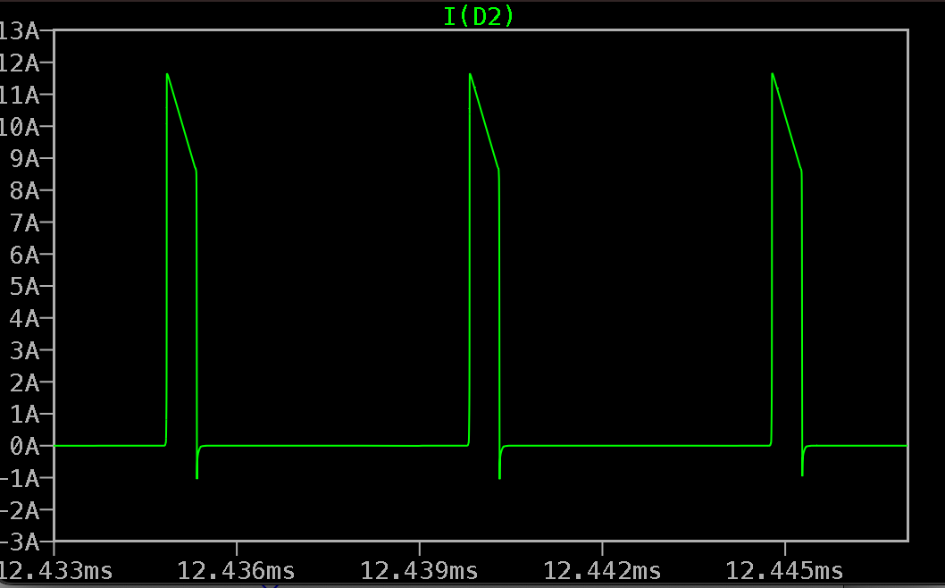
28V 1A Boost Converter
6. Diode selection (D)
$$I_{D_{peak}}=I_{L_{peak}}=10.606A$$
$$I_{D_{max}}=I_{D}*1.5=15.909A$$
$V_{D_{VRRM}}∼V_{out}=28V$
$$V_{D_{VRRM}max}=28*1.5=42$$
$$V_{D_{VRRM}max}≥42V$$

Slide 14
28V 1A Boost Converter
6. Ploss of Diode
Forward power loss (Pf)
As a result of the calculations made
The diode RBQ30NS45B from Rohm company was selected.
$$P_{f}=V_{f}*I_{d}=0.590W$$
RBQ30NS45B

Slide 15
28V 1A Boost Converter
7. Switching component selection(Q)
$$V_{ds}=Vout+V_{f}=28+0.5V=28.5V$$
The maximum Vds is multiplied by the 1.5 safety factor, and the minimum Vds value that the switching element must have is 42.75V. For this reason, a switching element with a minimum Vds value of 50V has been selected.
$I_{mosfet_{peak}}=I_{L_{peak}}$=10.606A
$V_{gs_{th}}≤3V$ The maximum voltage that the gate driver of the LT3757 integrated circuit can provide is 3.3V.
$P_{fet}=I_{L}^{2}*r_{dson}*D+2*V_{out}^{2}*I_{Lpeak}*C_{RSS}*f_{sw}/1$=1.8W
Infineon IPD079N06L3 mosfet was selected as a mosfet suitable for these conditions.

Slide 16
28V 1A Boost Converter
8. Configuration of power IC’s peripherals (UVLO, RT etc.)
1. Rsense resistor selection
Rsense=$\frac{80mV}{I_{L}peak}=6.8mohm$
PRsense = $\frac{80mV^{2}}{R_{sense}}=933mW$
$$ΔV_{sense}=ΔI_{L}peak*R_{sense}=30mV$$
X=$\frac{ΔV_{sense}}{80mV-0.5*ΔV_{sense}}=0.44$
The Vishay Dale WSL25126L800FEA18 6.8mR 2W resistor was selected to meet these conditions.

Slide 17
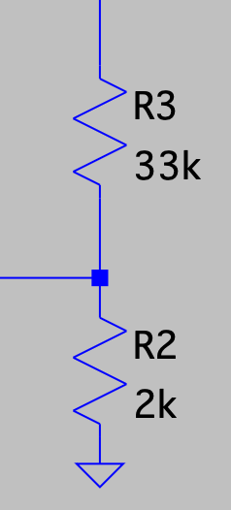
28V 1A Boost Converter
8. Configuration of power IC’s peripherals (UVLO, RT etc.)
2. Voltage feedback resistor selection
For Rtop = 33k;
$$R_{bot}=R_{top}*\frac{V_{fb}}{V_{out}-V_{fb}}=2kohm$$
0.1% precision resistors were used as tolerance.
Rtop 33k: ERA-3AEB333V
Rbot 2k: ERA-3AEB202V
Vout
Rtop
Vfb1.6V
Rbot

Slide 18
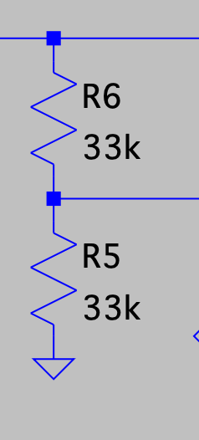
28V 1A Boost Converter
8. Configuration of power IC’s peripherals (UVLO, RT etc.)
3.Under Voltage Lock Out resistor selection
Vuvlo voltage is chosen 2.4V
For Rtop = 33k
$$R_{bot}=R_{top}*\frac{V_{uvlo}}{V_{in}-V_{uvlo}}=33kohm$$
0.1% tolerance precision resistors were used.
Rtop 33k: ERA-3AEB333V
Rbot 33k: ERA-3AEB333V
Vin
Rtop
Vuvlo1.22V
Rbot

Slide 19
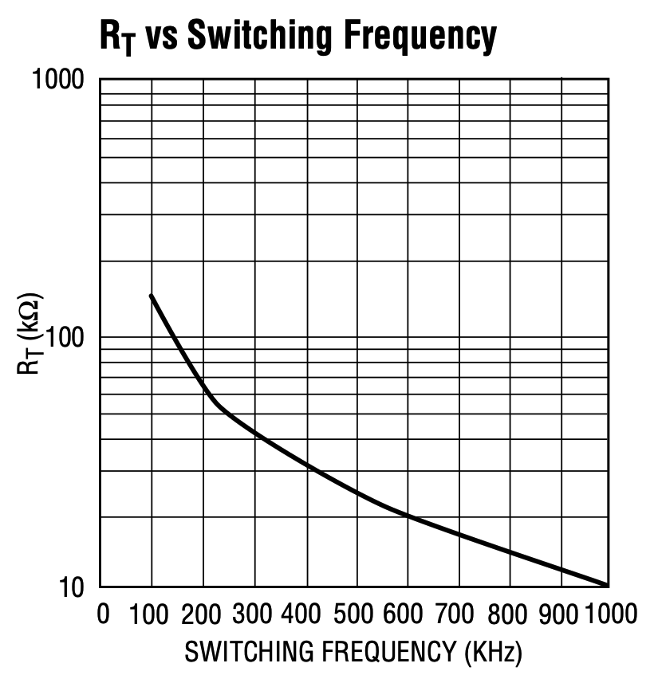
28V 1A Boost Converter
8. Configuration of power IC’s peripherals (UVLO, RT etc.)
4.Rt resistor selection
The Rt resistance value is obtained from the graph on the side taken from the datasheet. According to this graph, a resistor of 68k will allow the IC to operate at a frequency of 200kHz.
Rt = 68k : ERA-6AEB683V

Slide 20
28V 1A Boost Converter
8. Configuration of power IC’s peripherals (UVLO, RT etc.)
5.Soft Start (SS) capacitor
To ensure that the system performs an 8ms soft start
$Css=Tss*\frac{10μA}{1.25V}=64nF$ aproximately 68nF
Css = 68nF : C0603C683J1RACTU %5 tolerance was chosen

Slide 21
28V 1A Boost Converter
8. Configuration of power IC’s peripherals (UVLO, RT etc.)
6. INTVcc capacitor selection
A capacitor of 4.7uF value specified in the datasheet was preferred. The voltage was selected as 35V.
CintVcc = 4.7uF : GRM188R6YA475KE15D was chosen.

Slide 22
28V 1A Boost Converter
9. Input Capacitor Selection
The input capacitor must have a very low ESR value. For this design <6mohm. For this reason, three parallel 56uF EEH-ZV1J560P capacitors were selected.

Slide 23
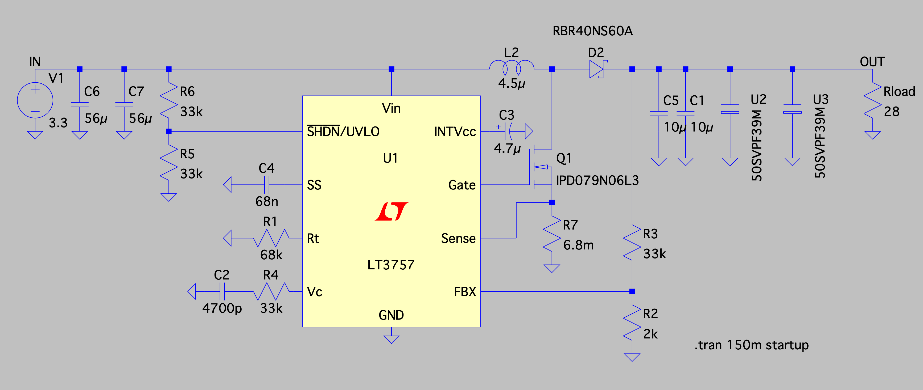
28V 1A Boost Converter
11. Spice Simulation and Design Validation
Spice simulation schematic

Slide 24
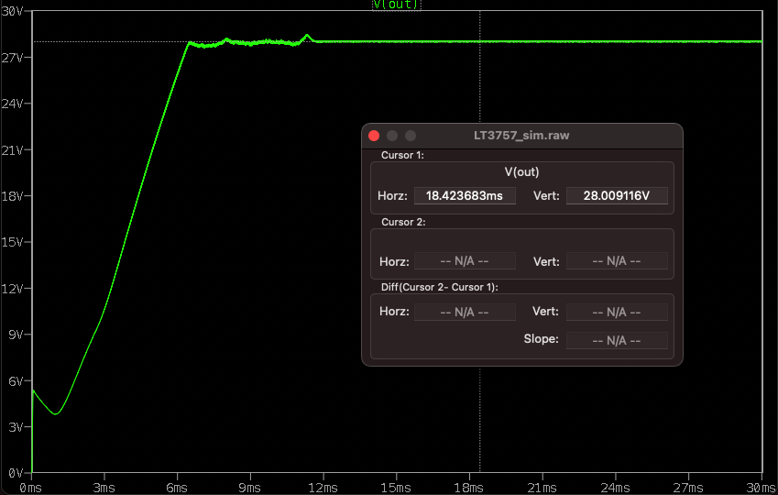
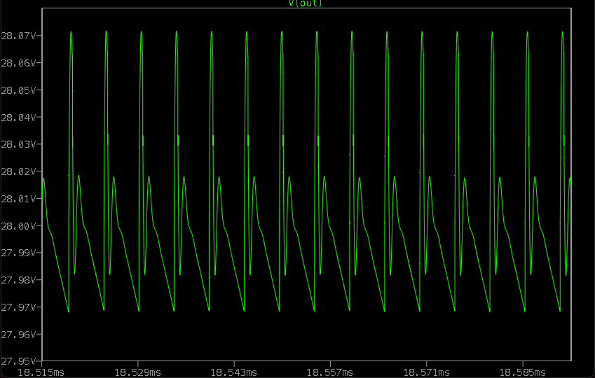
28V 1A Boost Converter
11. Spice Simulation and Design Validation
Output Voltage simulation

Slide 25
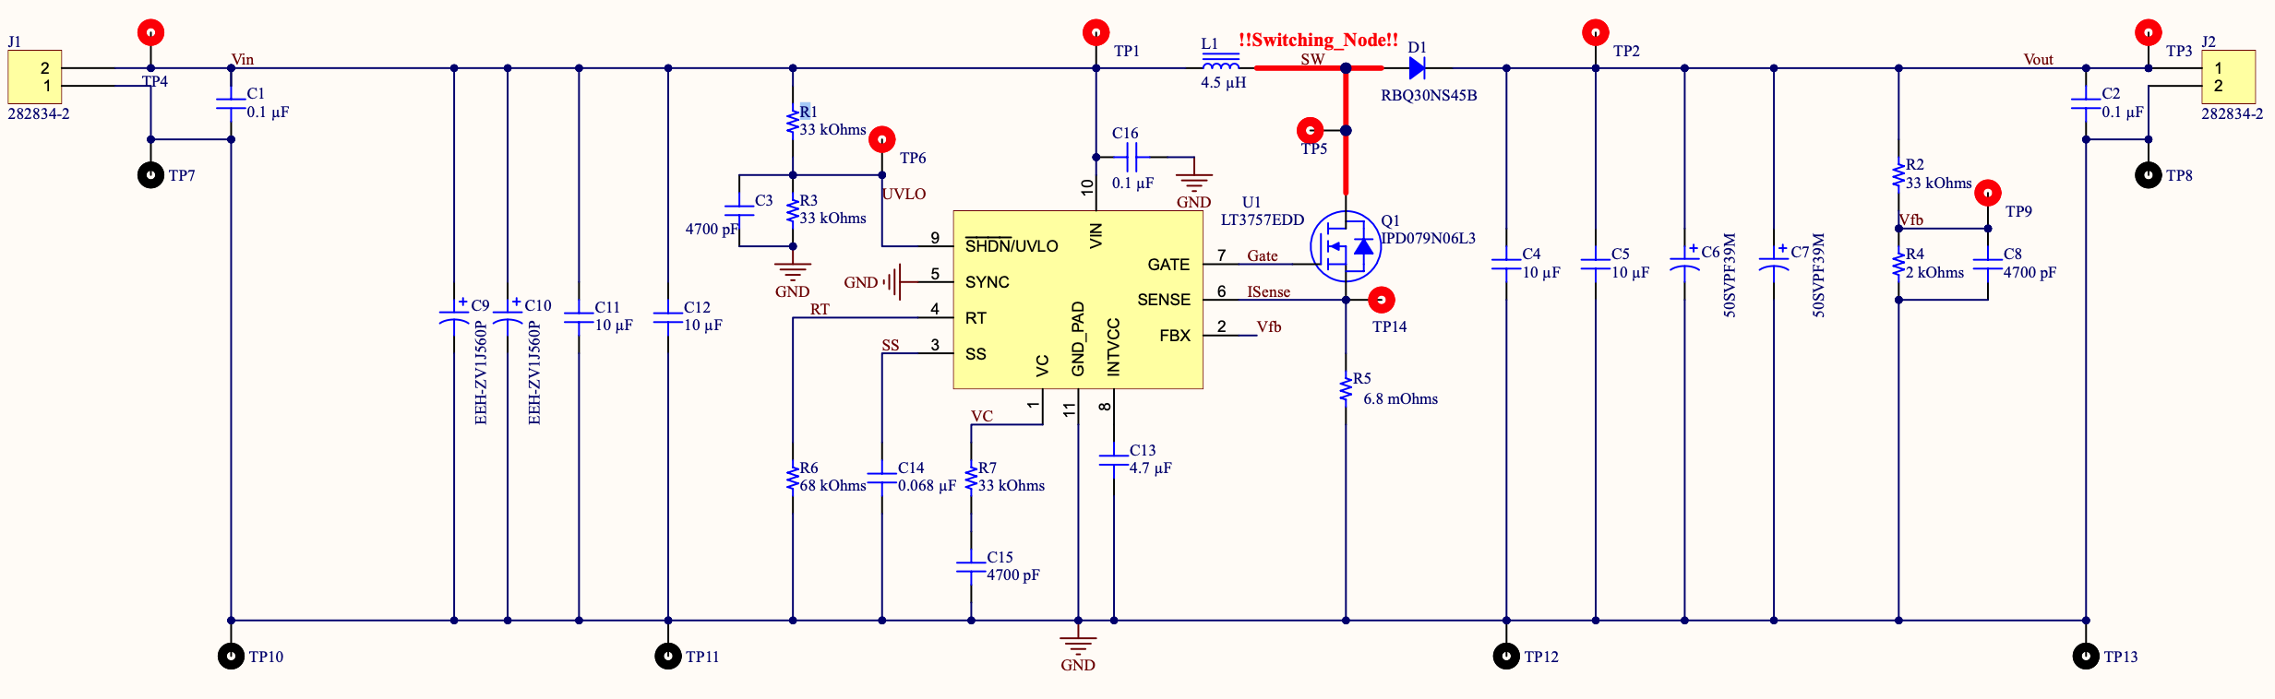
28V 1A Boost Converter
12. Schematic Design

Slide 26
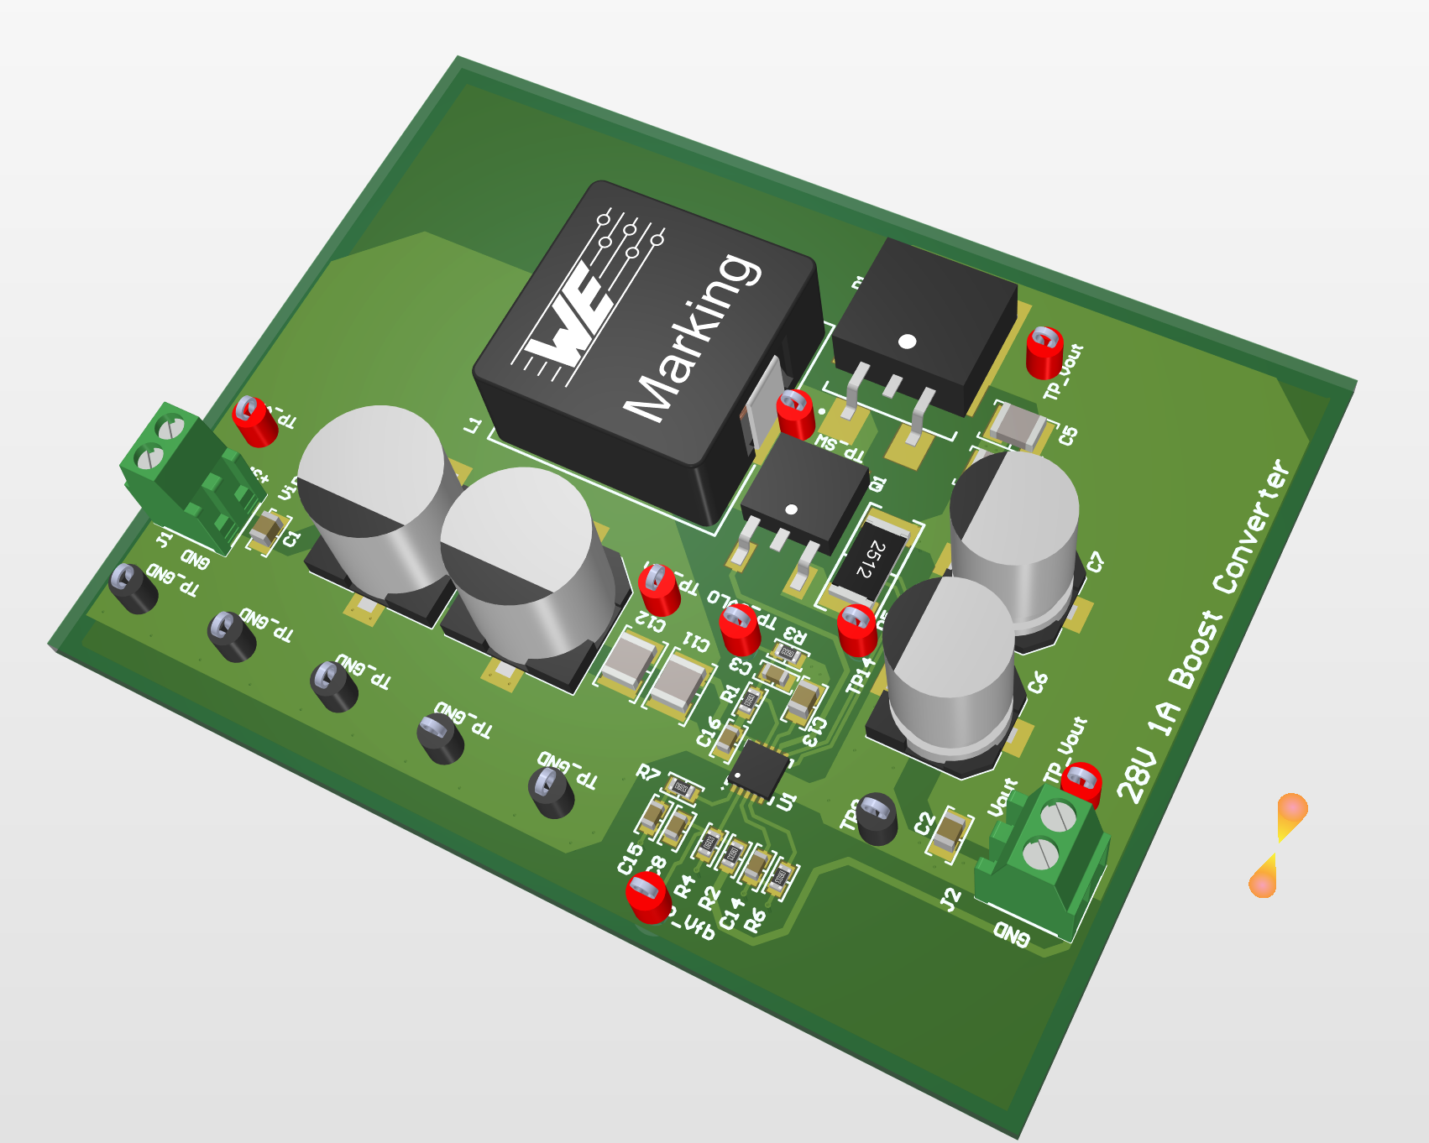
28V 1A Boost Converter
13. PCB Layout Design
3D Görünüm

Slide 27
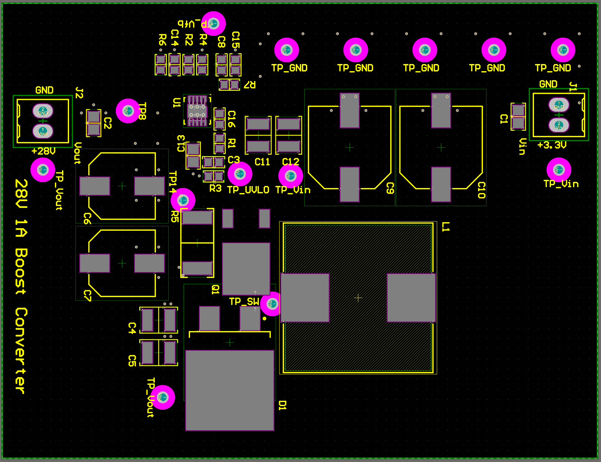
28V 1A Boost Converter
13. PCB Layout Design
Komponent Yerleşimi

Slide 28
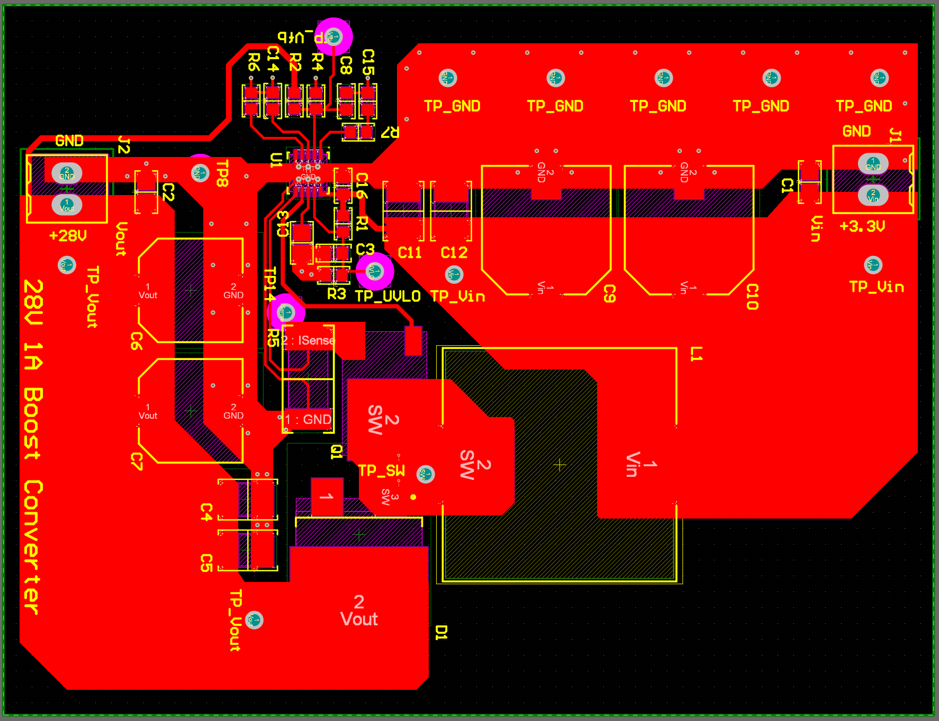
28V 1A Boost Converter
13. PCB Layout Design
Top Layer

Slide 29
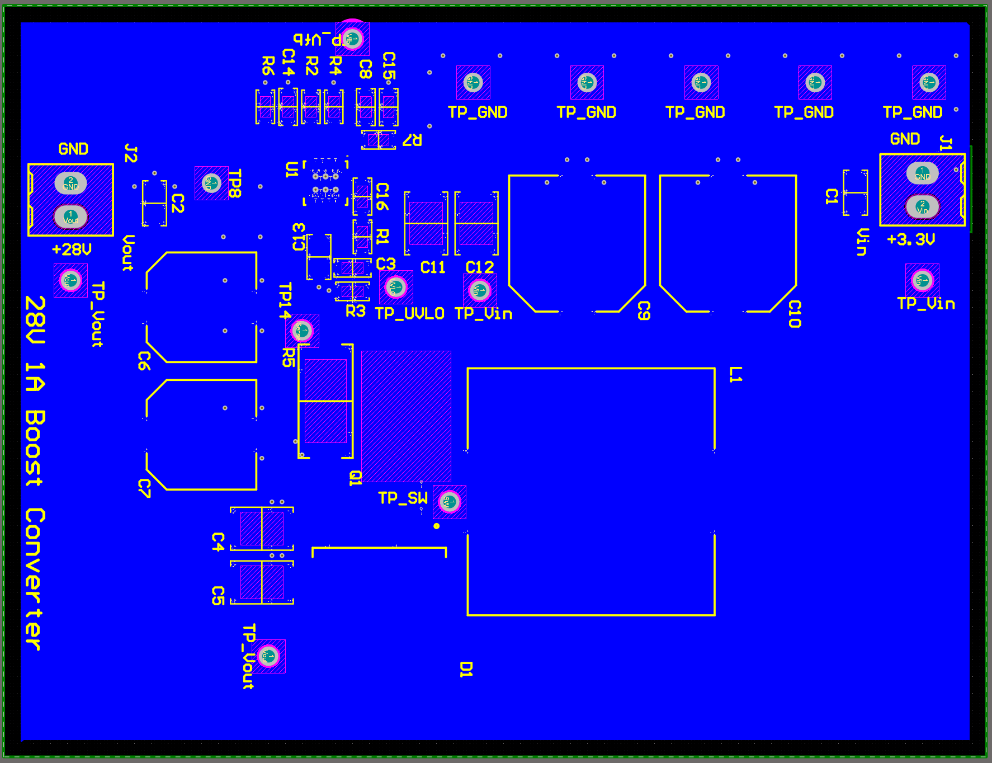
28V 1A Boost Converter
13. PCB Layout Design
Bottom Layer

