Slide 1



BLUESTOCK MUTUAL FUND ANALYTICS CAPSTONE
By Niyukti D Jain
Bluestock Fintech Internship
June 2026

Slide 2
PROBLEM STATEMENT
• Mutual fund data is spread across multiple sources.
• Investors need better insights.
• Risk-adjusted evaluation is often ignored.
OBJECTIVES
• Build ETL Pipeline
• Perform EDA
• Compute Risk Metrics
• Build Dashboard
• Generate Insights

Slide 3
DATA SOURCES
Datas provided by the organization .
• Fund Master
• NAV History
• AUM Data
• SIP Inflows
• Investor Transactions
• Portfolio Holdings
• Benchmark Indices

Slide 4
BASIC ARCHITECTURE

Slide 5
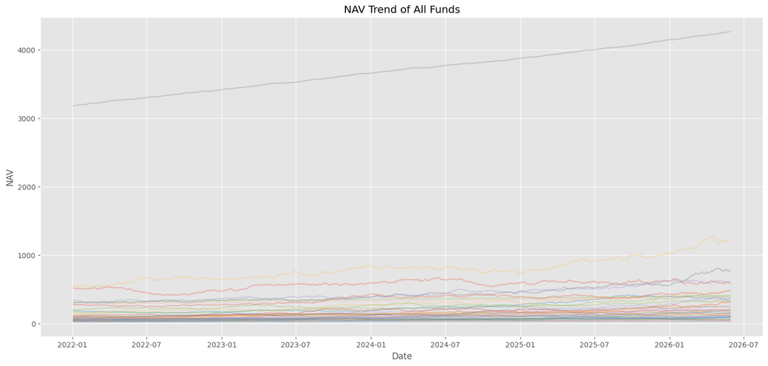
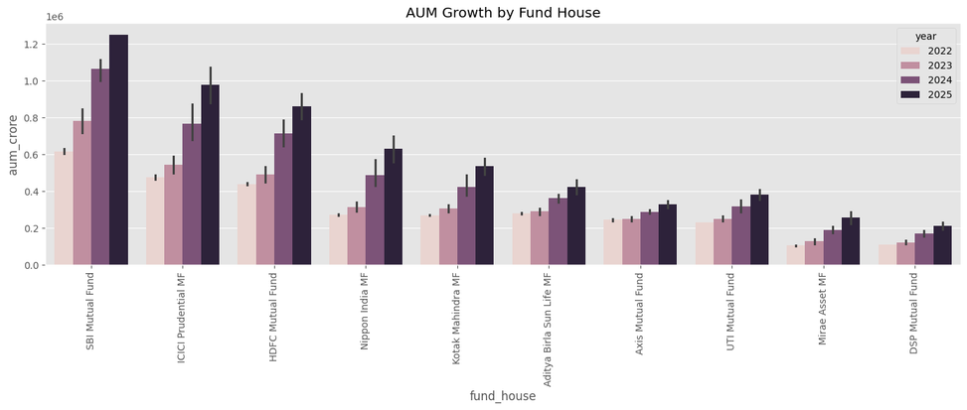
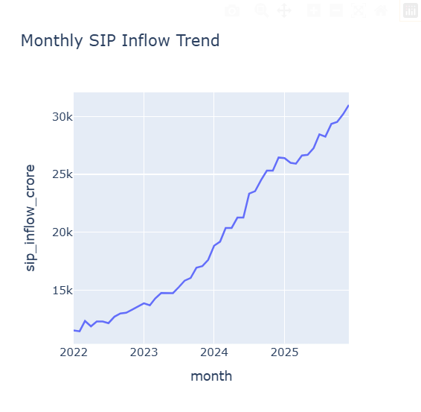
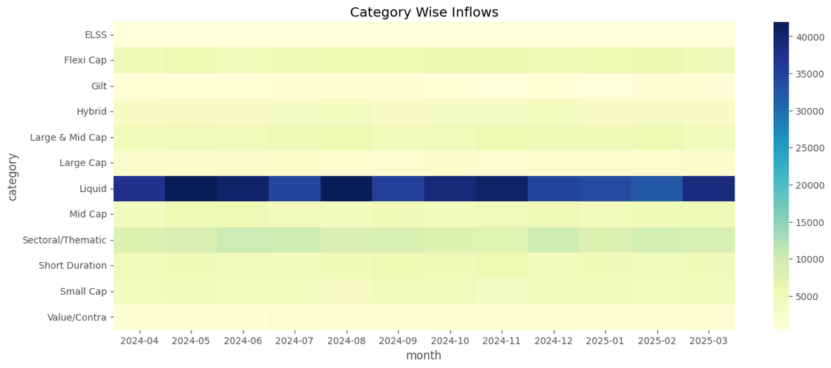
EDA HIGHLIGHTS

Slide 6
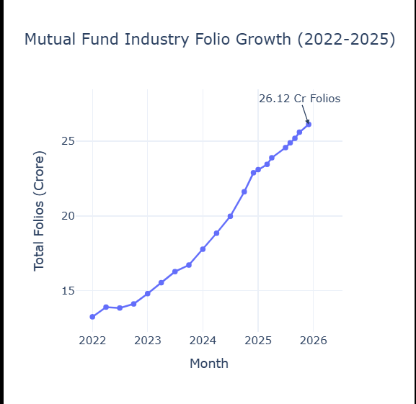
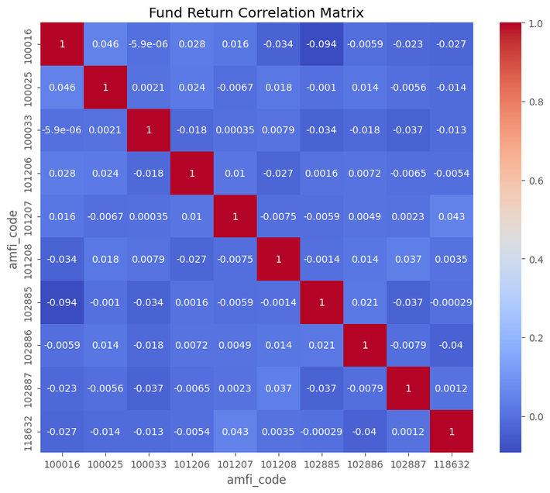
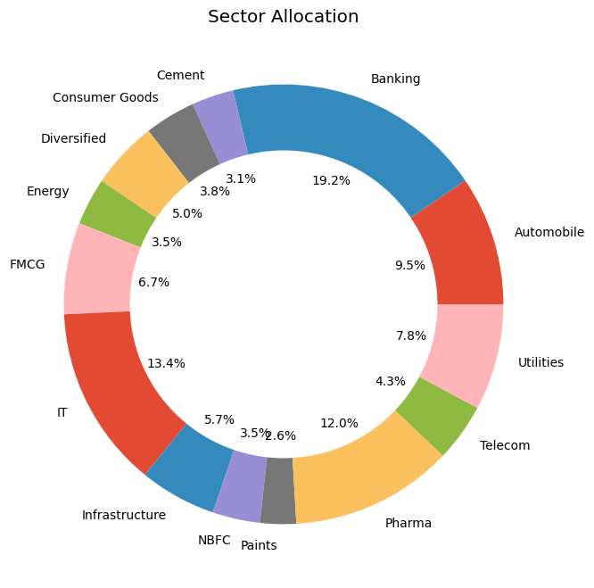
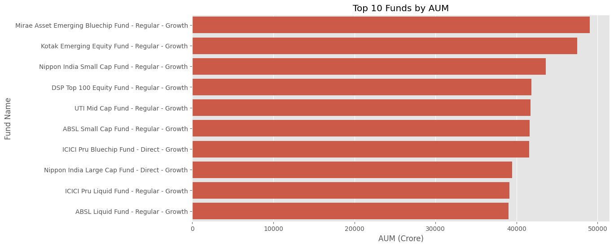

Slide 7
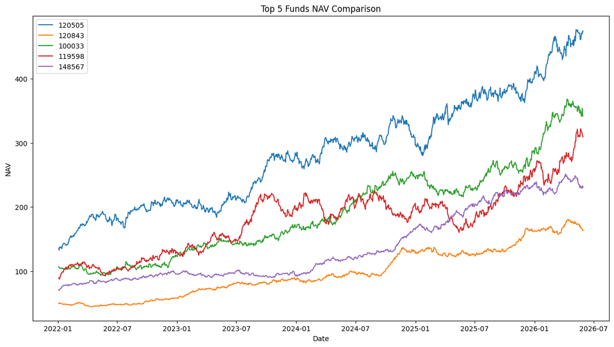
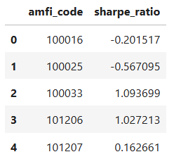
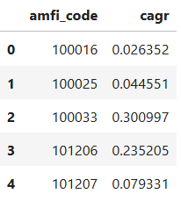
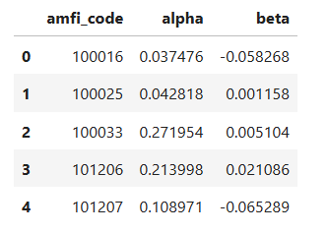
PERFORMANCE HIGHLIGHTS

Slide 8
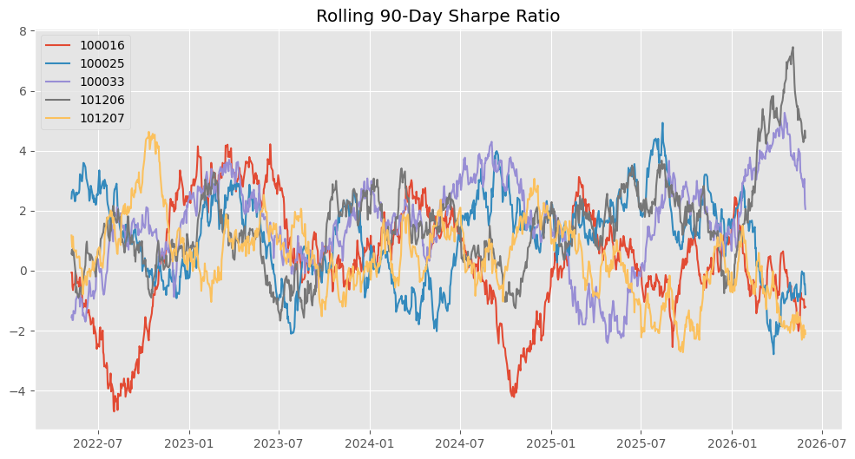
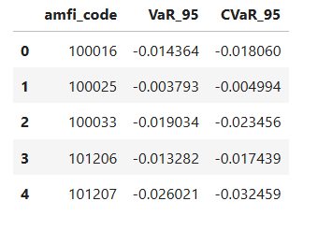
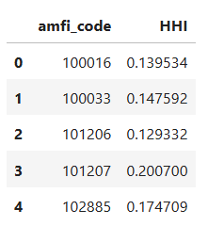
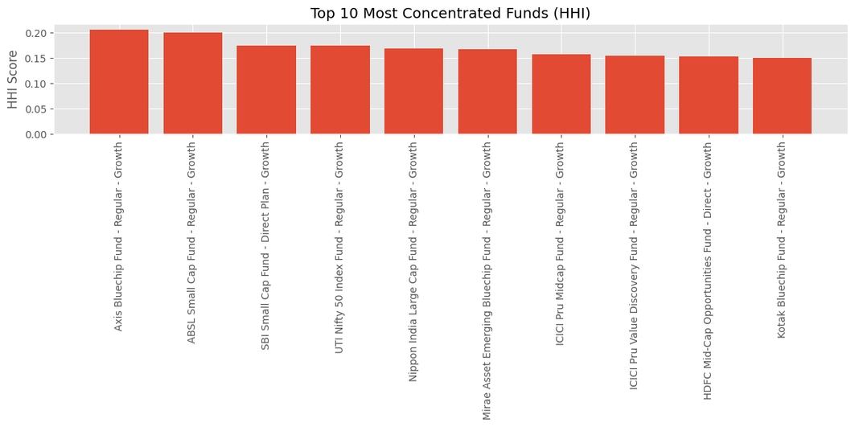
RISK ANALYSIS

Slide 9
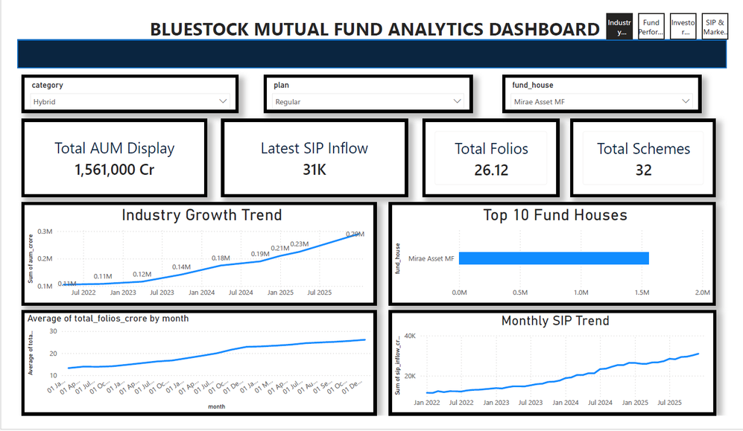
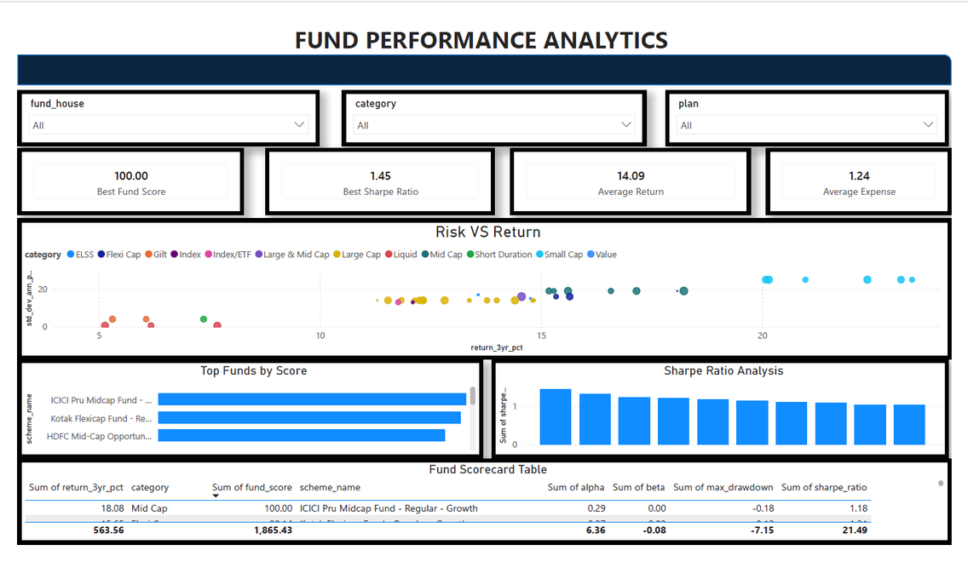
DASHBOARDS FROM POWERBI

Slide 10
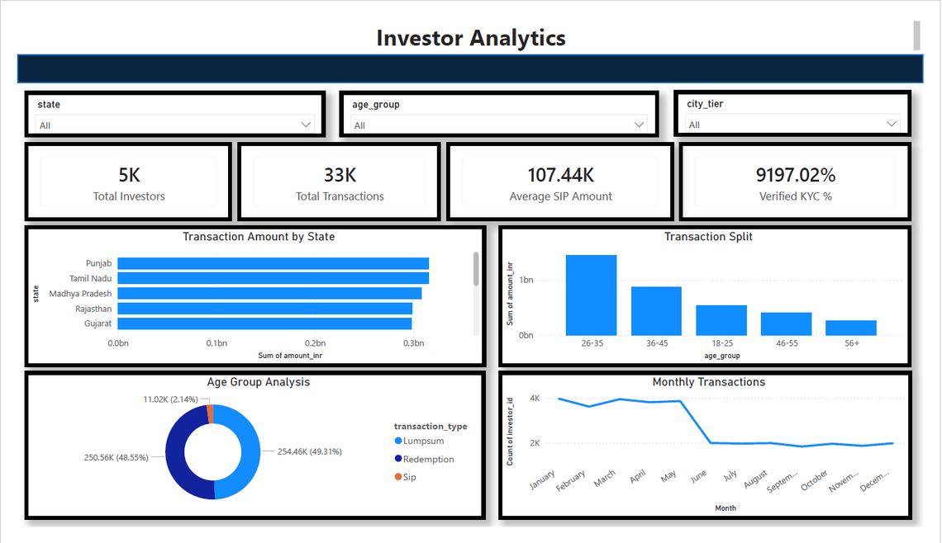
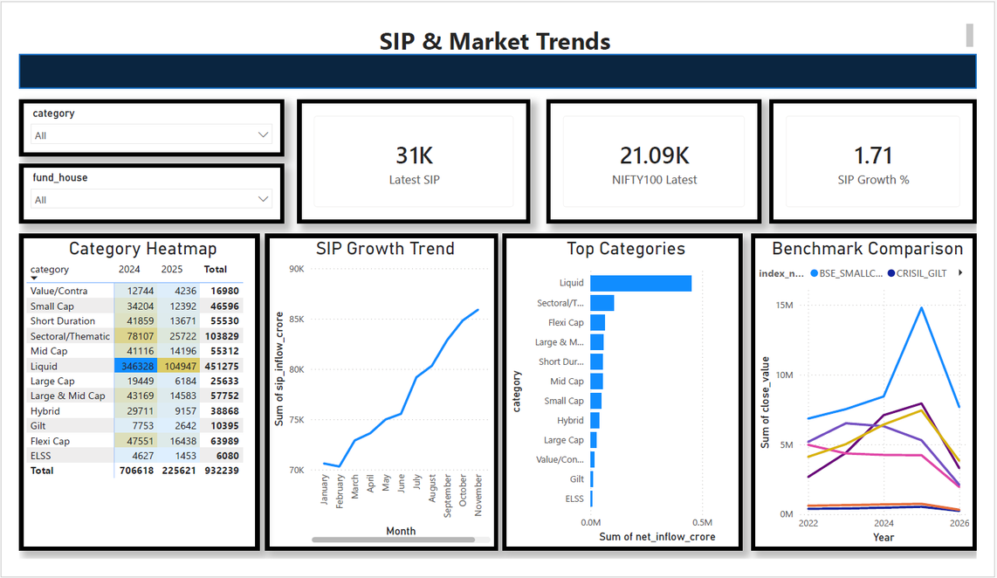
DASHBOARDS FROM POWERBI

Slide 11
KEY FINDINGS
• SIP INFLOWS INCREASED STEADILY.
• FOLIO COUNT DOUBLED.
• RISK-ADJUSTED RETURNS PROVIDED BETTER INSIGHTS.
• HIGH CONCENTRATION FUNDS SHOWED GREATER RISK.
• RECOMMENDATION ENGINE SUCCESSFULLY RANKED FUNDS.

Slide 12
THANK YOU

