Slide 1
CSS
Cascading Style Sheets

Slide 2
Why should I use CSS?
HTML is the content and CSS is the style.
CSS defines the presentation of the content.
CSS will have a collection of styling rules to apply the style.

Slide 3

CSS is used to add styles to the content

Slide 4
Syntax
tag name {
color: green;
bg-color:yellow;
}
tag name {
color: green;
}

Slide 5
Class based grouping
Class based grouping is mainly used for styling.
Id based grouping is mainly used for java-script.
Syntax for class based grouping.
https://css-tricks.com/

Slide 6
Magazine task
http://www.magazinedesigning.com/wp-content/uploads/2014/03/magazine-body-text-copy-2.png

Slide 7
CSS Syntax
.hello{
color:Green;
}
Functional block, attributes it should be in a name value pair.
“;” indicates end of the statement in CSS.

Slide 8
We should we use class over id?
If I use an id then it cannot be extended.

Slide 9
Text Attributes in CSS
color
font-weight
text-align
font-style
font-size
text-indent – Indent the paragraphs

Slide 10
Web Measurements
Pixels →px
Percentage → %
Pts
Em
In
Mm
Cm
Rem
Ex
Em(relative measurement with letter m)

Slide 11
Legacy application(Old Applications).
Deprecated(out of service).

Slide 12
px and em should be used
Px means Pixels.
Em means wide of letter M relatively in the current font.

Slide 13
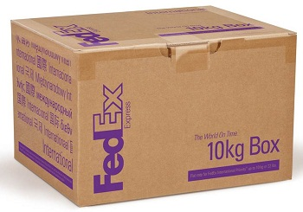
CSS Boxes

Slide 14
Box in CSS
It will have height and width.
No more surprises.
Border: It will draw a border around the box.
Ex: 5px solid black

Slide 15
Suggestions
Use div to define the paragraph
Use span to define the font styling.

Slide 16
div
The HTML <div> element is the generic container for flow content. Use it to group elements for purposes such as styling (using the class or id attributes).

Slide 17
Margin-top
Border-top
Padding-top
Height
Width
Margin-left
Border-left
Padding-left
Margin-bottom
Border-bottom
Padding-bottom
Margin-right
Border-right
Padding-right

Slide 18
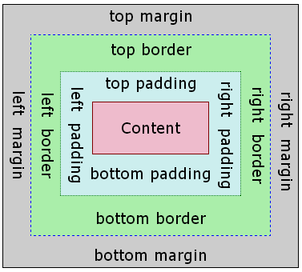

Slide 19
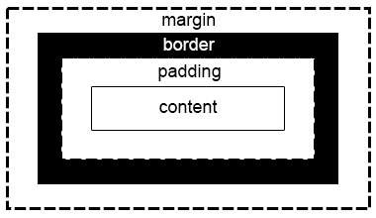
Margin vs Padding

Slide 20
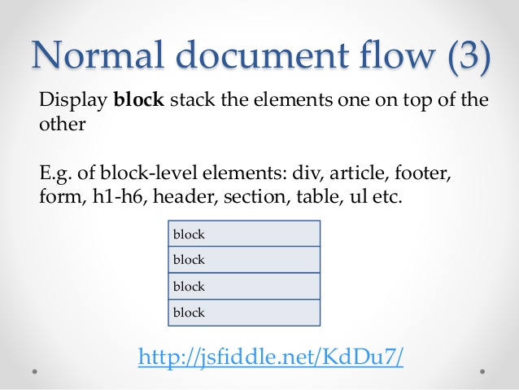
Document flow

Slide 21
Default Document Flow
Default document flow is block on top of block.
Side by side(floating next to each other instead of every item in a new line). Then the concept of document flow comes.
How many divs can be side by side on a single page?
Until the space is left the browser will place.
Ex: Blocklevel elements like div, section, ul etc.

Slide 22
Float
This is a CSS concept.
I want to have two divs side by side in a single webpage.
This cannot be possible.
Having two divs is nothing but floating divs next to each other.
By default divs will be line by line or in a new line.
The only option is using concept called float.

Slide 23
Scalability
Applications should be extended scaled.

Slide 24
CSS Parent Child Hierarchy
Parent and Child is nothing but nested tags.
A tag is inside another then it is called as a nested tag.
How the styling applies?
Whenever the child has a style defined it will override the parent style

Slide 25
POC on display grid
div {
display: block;
}
This is default. Kind of advanced displays. Flexbox and Grid Layout.
Some other important displays which will be important for this POC.

Slide 26
CSS Box Model
Margin
Border
Padding
Content

Slide 27
CSS Box Model
Content: The box where text will be appeared.(V)
Padding: Gap aroung the content.(NV)
Border: Around the content and padding.(V)
Margin: Covers the whole page(NV)

Slide 28
CSS Box model mathematics
How much width space we are using for the complete div?

Slide 29
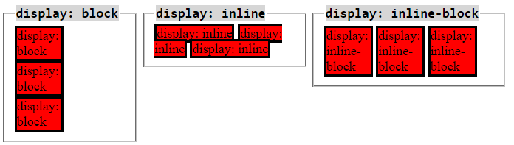
Various Display Mode

Slide 30
Width Styling
Only for box-sizing:border-box: (Width is equal to border width).
For others width = content width.
Others means = block, inline, inline-block

Slide 31
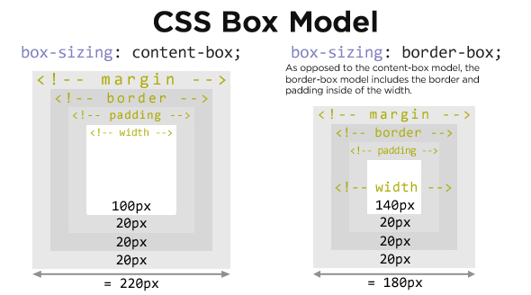
Border-box vs Block(Content-Box)

