Slide 1
Web Scraping
Nizar EL Mouaquit

Slide 2
What is Web Scraping
Web scraping (or data scraping) is a technique used to collect content and data from the internet. This data is usually saved in a local file so that it can be manipulated and analyzed as needed. If you’ve ever copied and pasted content from a website into an Excel spreadsheet, this is essentially what web scraping is, but on a very small scale.

Slide 3
Sequential Code
with open('links.csv', 'r') as f:
csv_reader = reader(f)
for row in csv_reader:
urls.append(row[0])
def go_scrappy(url):
request = requests.get(str(url))
codeH = BeautifulSoup(request.content, 'html.parser')
price = codeH.find('p').text
PRICES.append(price)
print(price)
for url in urls:
go_scrappy(url)
DataFrame = pd.DataFrame(PRICES)
DataFrame.to_csv('sequential_prices.csv', index=False)

Slide 4
Why Make a Parallel version ??
It takes us 9 Minutes just to scrape the price of 1000 books with a 50Mbps broadband

Slide 5
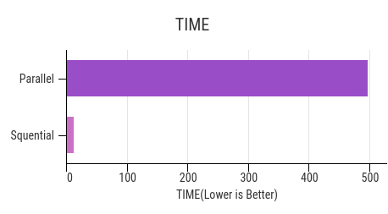
With a parallel version
Managed to decrease the processing time down to 11 Seconds
Runned on Linux with I7-9750H pulling 70W

Slide 6
What made it possible
Adding this simple line of code precising the number of thread we want to use
with concurrent.futures.ThreadPoolExecutor(Num_of_threads) as executor:
executor.map(go_scrappy, urls)

Slide 7
DEMO
Please wait

Slide 8
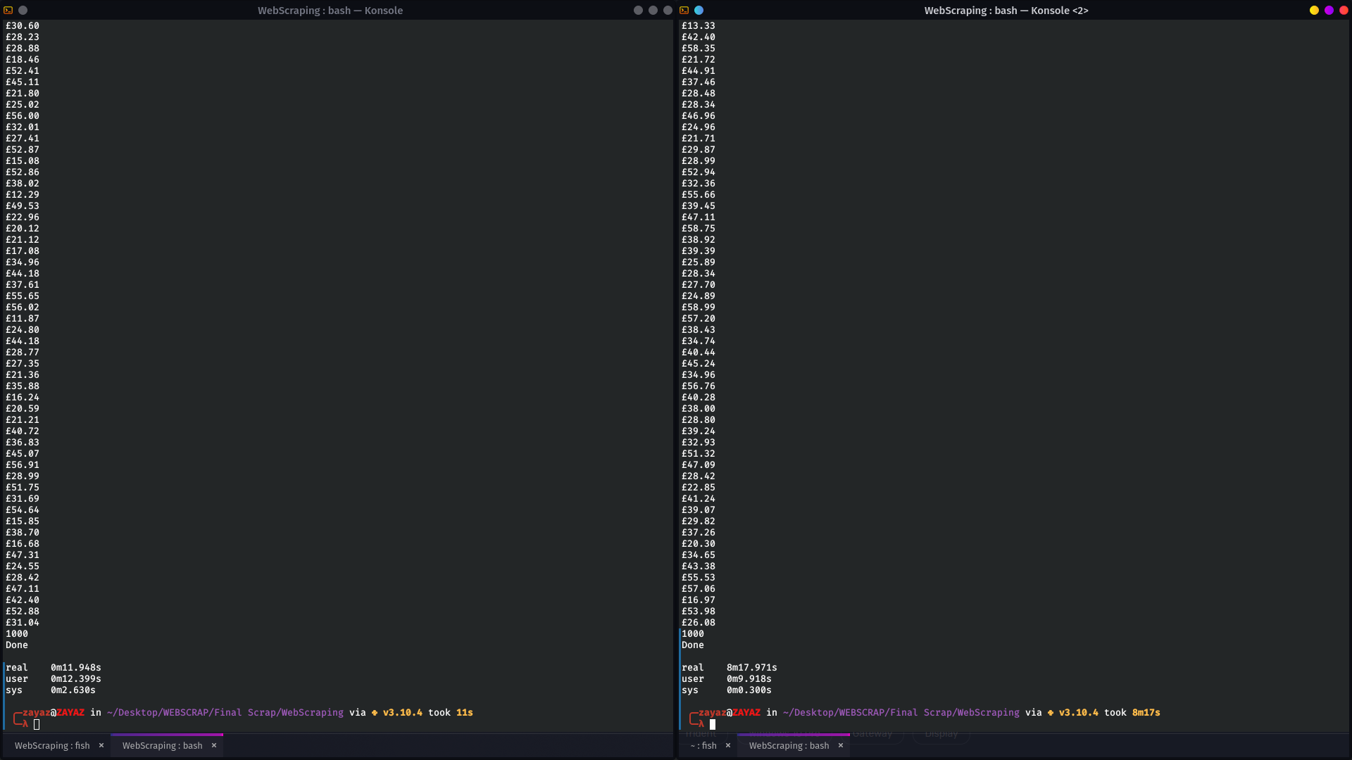
Difference within shell

Slide 9
Thanks for your attention

