Slide 1
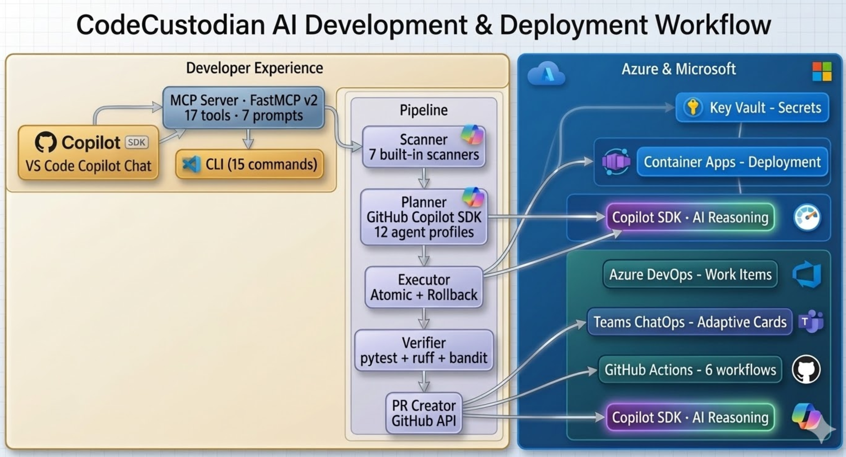

CodeCustodian
Autonomous AI Agent for Technical Debt Management
"Engineering teams spend 40% on maintenance. What if an AI agent handled it?"
GitHub Copilot SDK
Work IQ
FastMCP v2
Azure Services
953 Tests · 82% Cov
7
17
62h
Built-in Scanners (Security, APIs, TODOs, Smells, Types, Drift, Deps)
MCP Tools + 7 Prompts + 12 Agent Profiles
Engineering hours saved (per 3-week cycle)
Scan
→
De-dup
→
Prioritize
→
Plan (SDK)
→
Execute
→
Verify
→
PR
Confidence 8-10 → Auto-PR
Confidence 5-7 → Draft PR
Confidence <5 → Proposal Only
https://github.com/Nizarel/CodeCustodian
v0.15.2 · MIT License · Python 3.11+

Slide 2

Architecture & Azure Integration
🤖 AI & Developer Experience
☁️ Deployed on Azure (7 services)
→ GitHub Copilot SDK — AI-powered refactoring (12 agent profiles)
→ Azure Key Vault — secrets management (GitHub PAT, webhooks)
→ FastMCP v2 Server — 17 tools, 7 prompts, 8 resources
→ Azure Container Apps — serverless MCP deployment (Bicep IaC)
→ Typer + Rich CLI — 15 commands (JSON/table/CSV/SARIF)
→ Azure Monitor — OpenTelemetry observability
→ AI Test Synthesis — auto-generate regression tests
→ Azure DevOps — work item integration
→ Agentic Migrations — multi-stage framework upgrades
→ Microsoft Teams — ChatOps Adaptive Cards + Work IQ
→ Remote Repo Scanning — scan any public Git repo via URL
→ GitHub Actions — 6 CI/CD workflows (lint, test, deploy, scan)
→ Feedback Loop — learns from PR outcomes over time
→ Work IQ MCP — sprint context enrichment
🏢 Enterprise Features
🛡️ Security & Responsible AI
→ Budget Manager — prevents AI spend overruns
→ 7-point safety system (syntax, size, path, encoding, secrets, blast radius)
→ SLA Reporter — debt resolution tracking
→ Audit Logger — SHA-256 tamper-evident chain
→ ROI Calculator — cost savings with HTML/CSV export
→ Dangerous function detection (eval, exec, __import__)
→ RBAC + Approval Workflows — multi-team governance
→ Confidence-gated safety — low confidence = proposal only
→ Business Impact Scoring — 5-factor prioritization
→ Responsible AI Policy — 8 documented principles
→ Predictive Debt Forecasting — trend analysis
→ Bandit + Trivy security scanning in CI/CD
953 tests
82% coverage
6 CI/CD workflows
0 lint errors
v0.15.2
Scan → De-dup → Prioritize → Plan (Copilot SDK) → Execute → Verify → PR
https://github.com/Nizarel/CodeCustodian

