Slide 1

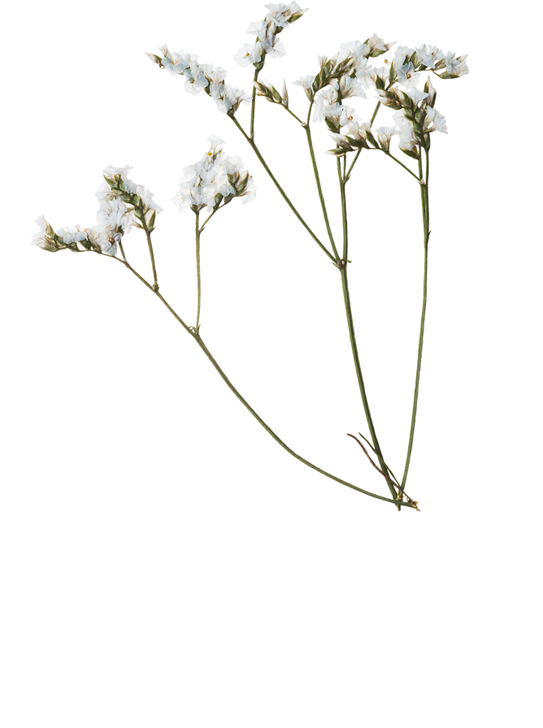
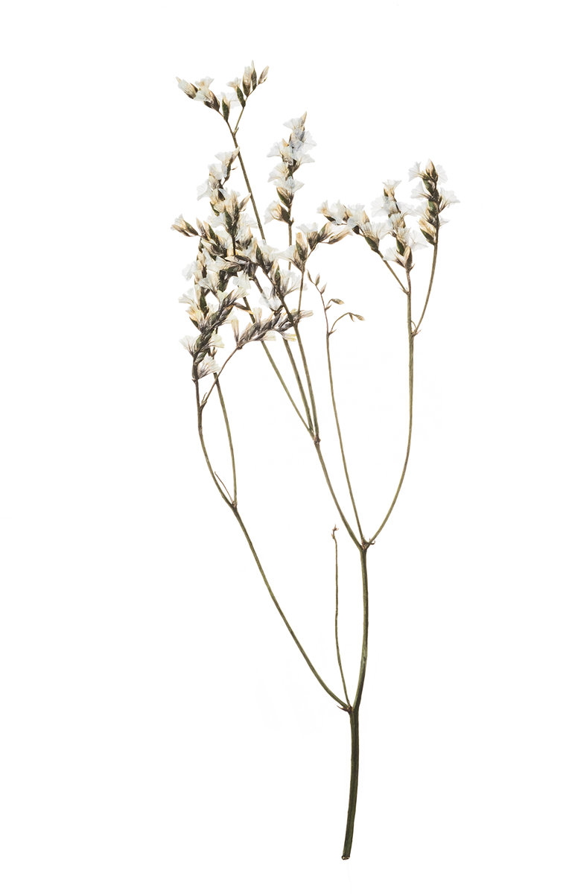
SLOWLY SEEING THE LIGHT: AN INTEGRATIVE REVIEW
ON ECOLOGICAL LIGHT
POLLUTION AS A POTENTIAL THREAT FOR MOLLUSKS
NAME:NIZBATH AHSAN
ID:20101227
GROUP NUMBER:18
ST NAME:EHSANUR RAHMAN RHYTHM
RA NAME:MD HUMAION KABIR MEHEDI

Slide 2
INTRODUCTION
DEFINITION
ANAYSIS OF LIGHT POLLUTION
BIODIVERSITY

Slide 3
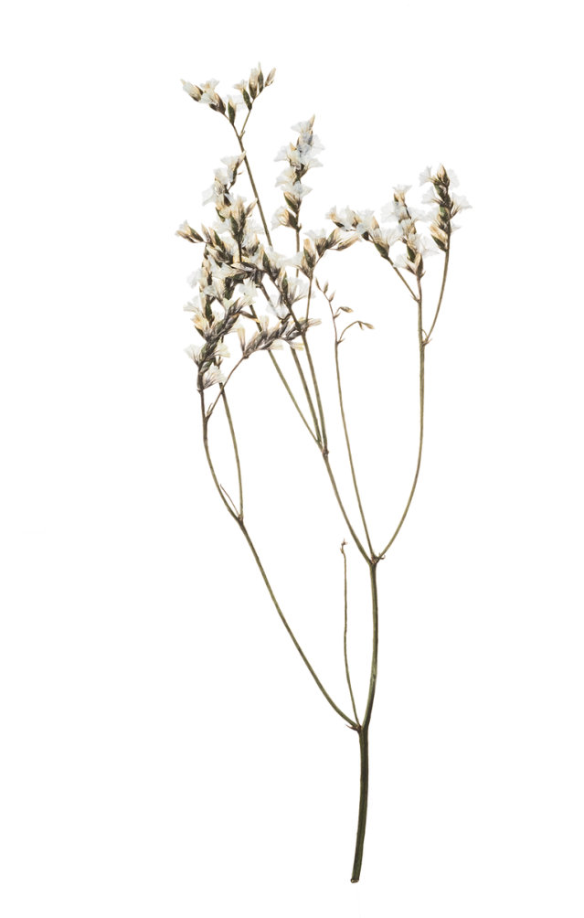
METHODS OF DECTECTION LIGHT POLLUTION
LIGHT PERCEPTION
HOW ARTIFICIAL LIGHT CAUSE LIGHT POLLUTION
QUANTIFICATION OF LIGHT POLLUTION

Slide 4
AFFFECTS OF LIGHT POLLUTION IN MOLLUSKS
REPRODUCTION
GROWTH
HABITAT
CIRCADIAN CLOCK SYSTEM

Slide 5
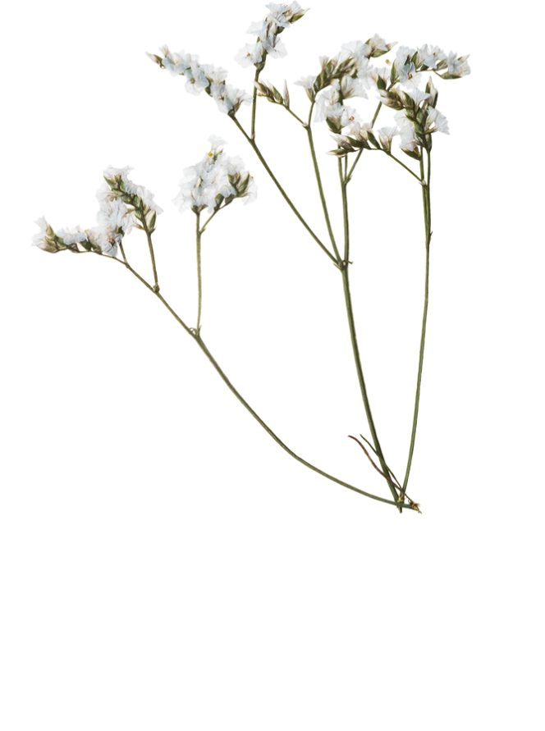
CONCLUSION AND FUTURE WORKS
MECHANISSM OF LOW LEVEL LIGHT POLLUTION IN MOVEMNET,FEEDING,ABLITY OF LEARNING
EFFECTS OF LIGHT POLLTUION NEROLOGY FORMATION
INTERACTION OF LIGHT POLLTUION WITH TEMPERATURE.

Slide 6
THANK YOU FOR WATCHING

