Slide 1
Development Project - CIS 6035 Proposal
AI-Powered Smart Healthcare System
for Multi-Disease Prediction, Risk Assessment, and Personalized Health Recommendations
Programme: B. Sc (Hons) Software Engineering
Student Name: Nishmiya Gnanaseelan
ICBT No: JF/BSCSD/17/33
October 2025

Slide 2
Introduction
Background: Healthcare sectors globally face critical challenges. Chronic diseases (Diabetes, Heart Disease, Kidney Disease) account for 71% of global deaths. There is a growing demand for accessible preventive healthcare.
Purpose: To develop an AI-powered web-based system for early disease detection, making quality healthcare advice accessible to all users.
Relevance: Demonstrates application of machine learning in real-world problems, involving full-stack web development and modern software engineering practices.

Slide 3
Problem Statement
Problem Statement
• Late-stage disease detection: 422M diabetes cases, 17.9M heart disease
deaths annually
• Limited healthcare access: Rural areas have few doctors, and medical treatment is expensive. • No personalized guidance: Health advice is general and not suitable for each person. • High healthcare costs: Regular checkups and doctor consulting are too costly. • Slow diagnosis: Hospitals are crowded, so patients wait a long time for treatment. • Low health awareness: People do not know early signs or ways to prevent diseases.

Slide 4
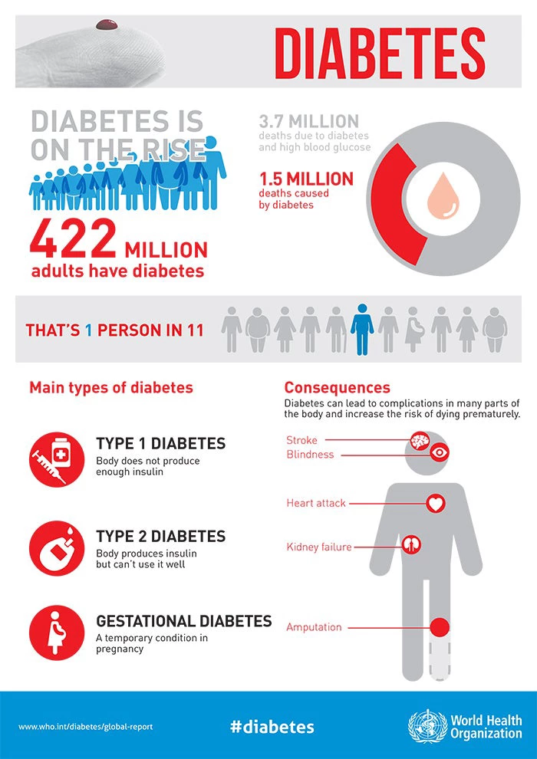
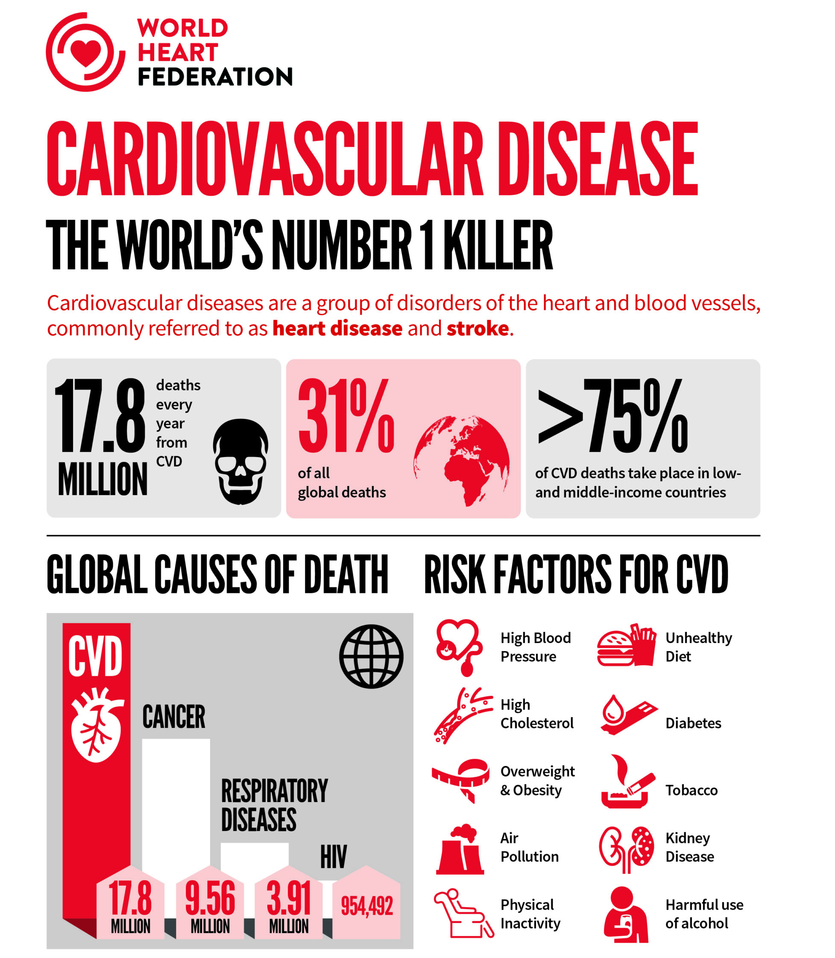
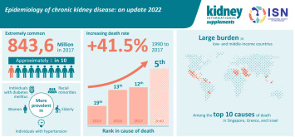
Worldwide number of people affected by each disease

Slide 5
Key Issues Faced Existing systems
Expensive (premium subscriptions $10-50/month)
Poor user interfaces
Limited to single disease prediction
No personalized recommendations with lifestyle guidance
No multi-language support (translation feature missing)
No real-time alert system for critical health risks
Machine learning algorithms not clearly specified or optimized per disease
Importance
Early detection can prevent 71% of deaths from non-communicable diseases,
reduces healthcare costs, and improves patient outcomes. Multi-language
support enables access for diverse populations, real-time alerts enable
timely intervention, Comprehensive recommendations improve patient adherence and outcomes.

Slide 6
Objectives
Main Objective To design and develop an AI-powered web-based healthcare system for real-time multi-disease prediction, risk assessment, and personalized health recommendations.
Sub-Objectives
Research existing AI-based healthcare systems to identify functional and non-functional requirements.
Collect and preprocess healthcare datasets for multi-disease prediction and risk assessment.
Train and validate machine learning models to ensure high prediction accuracy.
Design the system architecture, database schema, and user-friendly UI/UX plan.
Develop the frontend using Next.js and backend using Python FastAPI with ML model integration.
Implement multi-disease prediction, health risk assessment, and personalized recommendations.
Add translation functionality to support multi-language accessibility.
Integrate a real-time alert system to notify users about high-risk conditions.
Test and evaluate the system for accuracy, usability, performance, and security.

Slide 7
Proposed Solution / System Overview
Overview of the Proposed Software/System
The proposed solution is a web-based AI healthcare system designed using a three-tier architecture. It combines a Next.js frontend, FastAPI (Python) backend, and MongoDB database with integrated machine learning models for real-time multi-disease prediction and personalized health management.
Key Functionalities
• Multi-disease prediction (Diabetes, Heart Disease, Kidney Disease)
• Machine learning algorithms optimized per disease:
- Diabetes: Random Forest Classifier
- Heart Disease: Logistic Regression
- Kidney Disease: Support Vector Machine (SVM) with RBF kernel
• Risk assessment (Low, Medium, High, Critical) with detailed recommendations
• Personalized health recommendations including:
- Life cycle management routines
- Customized food recommendations
- Exercise and physical activity plans
• Role-based access control (Patients, Doctors, Administrators)
• Prediction history tracking
• Multi-language translation support (Google Translate API integration)
• Real-time alerts for high-risk predictions via WebSocket

Slide 8
System Overview the Role Based Features
Feature Category | Patient | Doctor | Admin
Main Function | Disease prediction, health monitoring, and personal management | Patient supervision, prediction analysis, and medical review | System control, user management, and analytics
Disease Predictions | • Diabetes Risk Prediction • Heart Disease Risk Prediction • Kidney Disease Risk Prediction | • Review patient predictions • Analyze disease risk levels | • Monitor prediction statistics
Prediction History | • View all past predictions • Filter by disease type • Track risk levels and percentages | • Access patient prediction history • Compare patient progress | • View overall system prediction logs and activity
Profile Management | • Update personal info • Add medical history, allergies, medications | • Access patient profiles • Update medical remarks | • Manage all user profiles (Patients, Doctors, Admins)
Dashboard Features | • Recent predictions • Health tips • Quick actions | • Statistics (Patients, Reviews, Consultations) • High-risk alerts banner | • System statistics • Reports and analytics dashboard
Patient Management | — | • View all patients • Monitor patient risk levels • Manage consultations | • Assign doctors to patients • Approve/Deactivate user accounts
High-Risk Alerts | • Receive alerts about critical predictions | • Receive high-risk alerts for patients • Priority review access | • Monitor high-risk statistics across system
User Management | — | — | • Manage all user accounts • Create/Edit/Delete users • Approve doctor registrations
System Analytics & Settings | — | — | • Generate reports and trends • Manage ML models • Configure system settings
Security Features | • JWT Authentication • Password Encryption (bcrypt) | • Role-Based Route Protection • Secure API Access | • Full access control over all security layers

Slide 9
Technologies to Be Used
Frontend: Next.js 14 TypeScript, TailwindCSS, ShadCN components.
Backend: Python , FastAPI, MongoDB.
ML: scikit-learn, pandas, joblib.
Dataset: Kaggle API, UCI ML Repository integration.
Translation: Google Translate API.
Real-time: WebSocket for instant notifications

Slide 10
System Design / Methodology
Development Model
The project follows the Agile methodology to support iterative and flexible development. Agile enables continuous improvement, early detection of issues, and quick adaptation to changing requirements. It also ensures better collaboration, faster feedback cycles, and consistent progress throughout development.
Tools
Development: VS Code, Git, GitHub
Database: MongoDB, MongoDB Compass
ML: VS Code, scikit-learn, pandas, joblib
Dataset Management: Kaggle API, pandas for preprocessing
Testing: pytest, Postman

Slide 11
Architecture
1. PRESENTATION LAYER (Frontend - Next.js)
User Interface (React Components)
Patient/Doctor/Admin Dashboards
Prediction Forms
Multi-language Translation UI
Real-time Alert Notifications
2.APPLICATION LAYER (Backend – Python ,FastAPI)
API Endpoints (/api/v1/auth, /api/v1/predictions, etc.)
Authentication & Authorization (JWT)
ML Model Loading & Prediction
Risk Assessment Calculation
Recommendation Generation
Real-time Alert Triggering
3. DATA LAYER (Database - MongoDB)
users' collection
predictions collection
notifications collection

Slide 12
Work Plan / Timeline
The project is structured into distinct phases to ensure systematic development and timely delivery. Each phase focuses on specific objectives and deliverables, from initial planning to deployment.
Task | Start | End | Key Deliverables
Requirements Analysis and Planning | Week 1 | Week 2 | Requirement document, project plan
Database Setup and Authentication System | Week 3 | Week 4 | Database schema, login & registration modules
Data Collection and Machine Learning Model Development | Week 5 | Week 6 | Dataset collection, trained ML models
Backend API Development | Week 7 | Week 8 | RESTful APIs for data and prediction services
Frontend Development – Core Features | Week 9 | Week 10 | Basic UI for patient, doctor, admin panels
Frontend Development – Advanced Features and Integration | Week 11 | Week 12 | Real-time prediction display, user dashboards
Integration, Testing, and Optimization | Week 13 | Week 13 | Fully integrated system, bug fixes
User Acceptance Testing and Refinement | Week 14 | Week 15 | User feedback implementation, performance tuning
Deployment and Final Review | Week 16 | Week 16 | Final deployment, project presentation

Slide 13
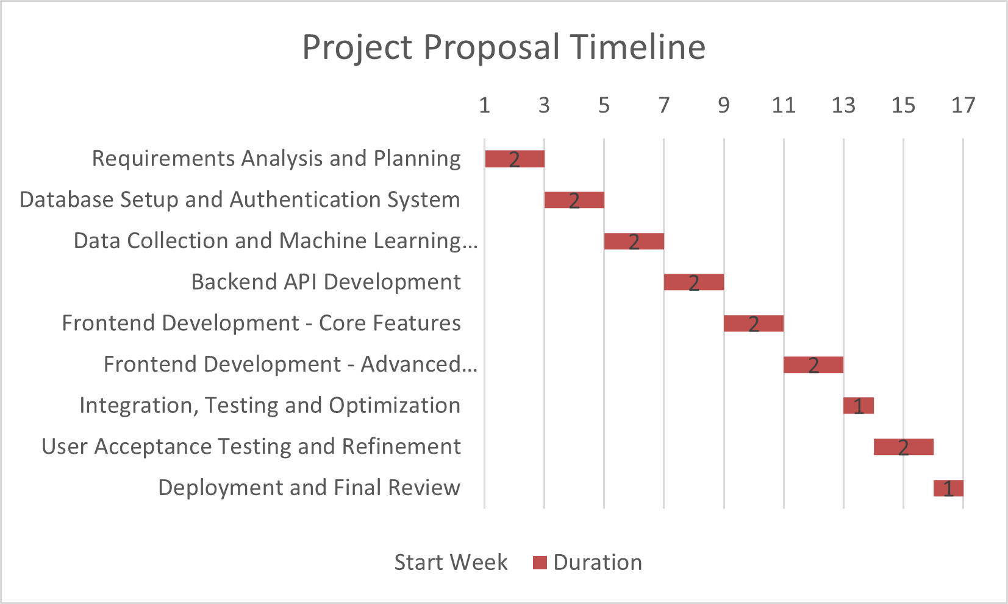
Project Timeline (Gantt Chart)

Slide 14
Expected Outcomes
Final Deliverables of the Project
• Functional multi-disease prediction system
• Machine learning models optimized per disease:
- Random Forest for Diabetes (75-85% accuracy)
- Logistic Regression for Heart Disease (80-90% accuracy)
- SVM with RBF for Kidney Disease (90-95% accuracy)
• Role-based access control system with three user roles:
- Patient role: Disease predictions, history tracking, profile management
- Doctor role: Patient management, prediction reviews, high-risk alerts
- Admin role: User management, system analytics, configuration settings
• Multi-language translation feature (Google Translate API)
• Real-time alert system for high-risk predictions
• Comprehensive patient output with:
- Risk level assessment (Low, Medium, High, Critical)
- Life cycle management recommendations
- Daily routines and lifestyle guidance
- Personalized food and nutrition recommendations
- Customized exercise and physical activity plans
• Complete source code repository (GitHub)

Slide 15
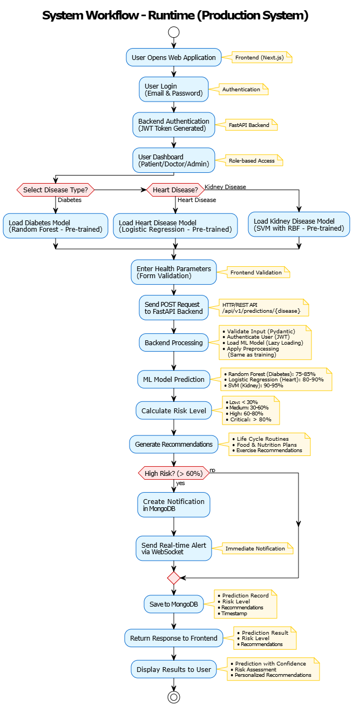

Slide 16
Anticipated Impact or Benefits
Early disease detection: 75-95% prediction accuracy (disease-specific)
Accessible healthcare: Free and available to all users
Multi-language support: Enables access for non-English speakers
Real-time alerts: Enable immediate action for high-risk cases
Improved preventive care: Through personalized recommendations
Comprehensive lifestyle guidance: Improves patient adherence
Support for healthcare professionals: Detailed patient insights
Reduced healthcare costs: Early detection prevents expensive treatments
Better patient outcomes: Timely intervention saves lives
Global accessibility: Available to users worldwide regardless of location
User-friendly interface: Easy to use for all age groups

Slide 17
Conclusion
This project presents an AI-powered web-based healthcare system that predicts multiple diseases using machine learning, provides real-time alerts, and supports multiple languages. It addresses major healthcare challenges such as delayed diagnosis and limited access, offering accurate, accessible, and data-driven health insights for all users. In the future, the system can expand into a mobile-friendly platform with wearable integration, chatbot, telemedicine features , location add, additional disease predictions, and record support to enhance scalability and impact.

Slide 18
Reference
World Health Organization (2024). Noncommunicable diseases. [online] World Health Organization. Available at: https://www.who.int/news-room/fact-sheets/detail/noncommunicable-diseases.
‌Frank Edughom Ekpar (2024). A Comprehensive Artificial Intelligence-Driven Healthcare System. European Journal of Electrical Engineering and Computer Science, 8(3), pp.1–6. doi: https://doi.org/10.24018/ejece.2024.8.3.617.
Xie, S., Yu, Z. and Lv, Z. (2021). Multi-Disease Prediction Based on Deep Learning: A Survey. Computer Modeling in Engineering & Sciences, 128(2), pp.489–522. doi: https://doi.org/10.32604/cmes.2021.016728.
Amutha, R. and Sank, R. (2024). MULTIPLE DISEASE PREDICTION SYSTEM USING MACHINE LEARNING. [online] 11. Available at: https://www.jetir.org/papers/JETIRGG06032.pdf [Accessed 1 Nov. 2025].

