Slide 1
Dataset Overview
POWER BI ASSIGNMENT
Hospital & Pharmacy
Data Period
Jan 2024 – Dec 2024
Counties Covered
Nairobi, Kiambu, Kisumu,
Mombasa, Nakuru, Uasin Gishu
Data Analysis
Diseases Tracked
Comprehensive analytics on patient visits, disease patterns,
and pharmacy performance for management decision-making.
Flu, Typhoid, Diabetes,
Hypertension, Pneumonia, Malaria
120
300
Departments
Inpatient, Outpatient, Emergency
Patients
Visits
Drug Categories
Malaria, Cold & Flu, Diabetes,
Painkiller, Antibiotic, Hypertension

Slide 2
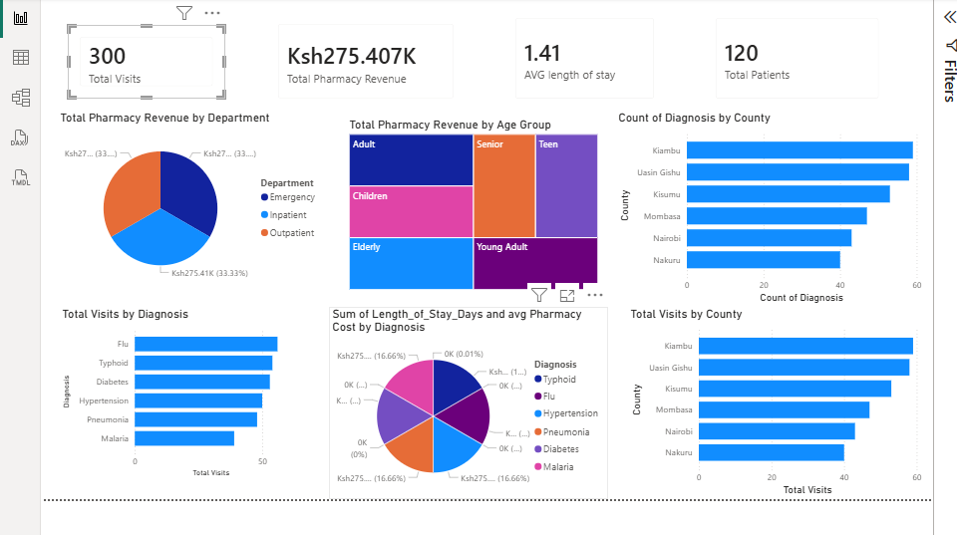

Slide 3
EXECUTIVE INSIGHTS & RECOMMENDATIONS
Q1 — Disease Patterns Across Counties
Q4 - Age Group Medication Consumption
Flu (56 visits) and Typhoid (54) are the most prevalent conditions. Uasin Gishu is an epicenter for Flu (15 cases) and Typhoid (13), suggesting a public health intervention priority. Kisumu shows the highest Hypertension concentration (16 cases), pointing to chronic disease burden in the region.
The Elderly (65+) demographic consumes 36.6% of all pharmacy spending despite being a minority patient group driven by chronic conditions like Diabetes and Hypertension. The average per visit pharmacy spend for the elderly is also the highest of any age group.
Q2 — Visits vs Pharmacy Revenue
Q5 -Diagnoses: Long Stay vs Low Spending
Higher visit counts do NOT always translate to higher revenue. Uasin Gishu records 58 visits yet generates the highest revenue of all counties while Kiambu has 59 visits. This suggests Uasin Gishu patients present with more complex or expensive conditions.
Flu patients have the longest average hospital stay yet moderate pharmacy spend , indicating resource-intensive care with lower drug costs likely due to supportive treatment. Diabetes is the opposite: shortest stays AND lowest pharmacy spend , reflecting efficient outpatient management. Malaria shows the highest pharmacy cost per visit with a shorter stay .
Q3- Department Pharmacy Costs
Inpatient and Emergency departments generate nearly identical and highest pharmacy costs. Outpatient is only marginally lower, suggesting all departments have high medication demand. Malaria drugs alone account for the single largest drug category.

