Slide 2
Introduction
Mpumalanga is one of South Africa’s major coal-mining regions. Mining activities can produce contaminated and acidic runoff that can enter rivers and groundwater.
This pollution can affect water used by communities, farmers, livestock and ecosystems.
Our project focuses on detecting changes in water quality early and enabling a rapid automated response before contamination can cause greater harm.

Slide 3
Problem Statement
Coal mining can expose minerals that react with water and produce acid mine drainage and toxic runoff.
This can introduce pollutants such as sulphates, iron and manganese into water sources.
The main problems are:
Water sources can become contaminated.
Pollution can spread through connected water systems.
Communities and agriculture depend on these water sources.
Traditional monitoring may not provide an immediate response.
A delayed response can allow contaminated water to continue spreading.
Our challenge
How can we detect dangerous changes in water quality early and respond automatically?

Slide 4
TARGET AUDIENCE
Who Is Our Solution For?
Mining companies
Mining companies may lose revenue due to environmental legal fees and cost associated
Famers
Farmers need reliable water for crops and livestock

Slide 5
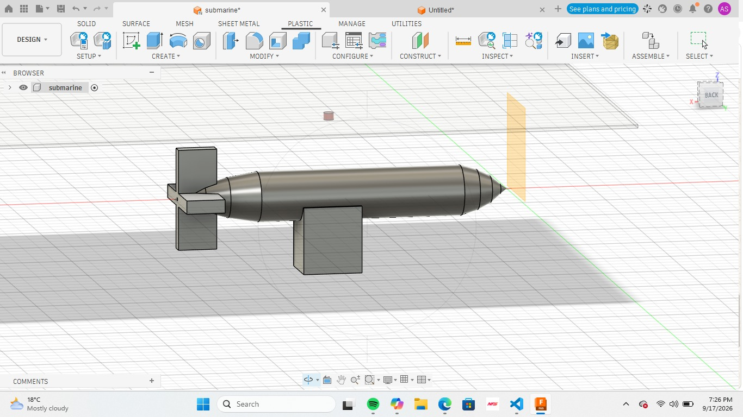
THE SOLUTION ARCHITECTURE

Slide 6
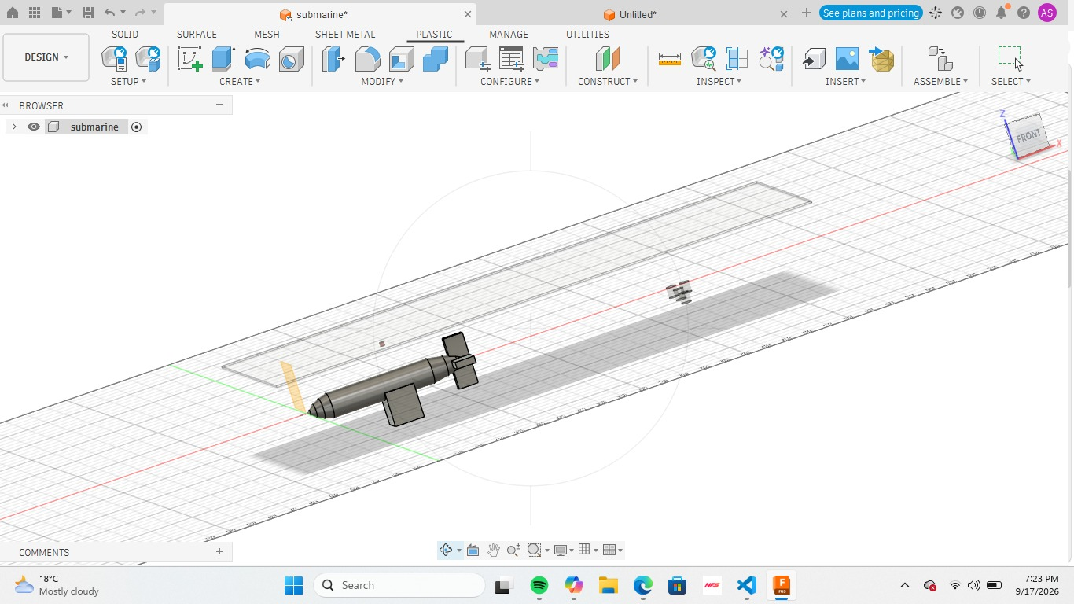

Slide 7
What is our system do?
-AUTOMIMUS SUBARAINE
-HAS MAGNETIC FIELD DETECTOR
-GAS DETECTOR
-MOVES AUTONIMUSLY
-CAN BE MONITORED ON A APP
-

