Slide 1
CodeCraft
ACID MINE DRAINAGE (AMD) & DECENTRALISED WATER TREATMENT
SMART WATER QUALITY MONITORING AND AUTOMATED RESPONSE SYSTEM

Slide 2
Introduction
Mpumalanga is one of South Africa’s major coal-mining regions. Mining activities can produce contaminated and acidic runoff that can enter rivers and groundwater.
This pollution can affect water used by communities, farmers, livestock and ecosystems.
Our project focuses on detecting changes in water quality early and enabling a rapid automated response before contamination can cause greater harm.

Slide 3
Problem Statement
Coal mining can expose minerals that react with water and produce acid mine drainage and toxic runoff.
This can introduce pollutants such as sulphates, iron and manganese into water sources.
The main problems are:
-Water sources can become contaminated.
-Communities and agriculture depend on these water sources.
-Traditional monitoring may not provide an immediate response.
-A delayed response can allow contaminated water to continue spreading.
-Mine may have to pay for enviromental damages,restoration costs and penalties caused by water pollution
Our challenge
-How can we detect dangerous changes in water quality early and respond automatically?

Slide 4
THE IMPACT OF MINING WATER eMalahleni (Witbank): This heavily mined hub faces relentless structural strain. Recent Statistics South Africa data reveals that 66,9% of households in Mpumalanga suffer from chronic water interruptions. In eMalahleni, residents frequently open taps to find dark brown, heavily oxidized water loaded with sediment. The municipal water management system is in a state of collapse, highlighted by a landmark R650 million High Court fine

Slide 5
TARGET AUDIENCE
Who Is Our Solution For?
Mining companies
Mining companies that need to manage water pollution and reduce environmental damage, legal costs and potential penalties
Famers
Farmers need reliable water for crops and livestock

Slide 6
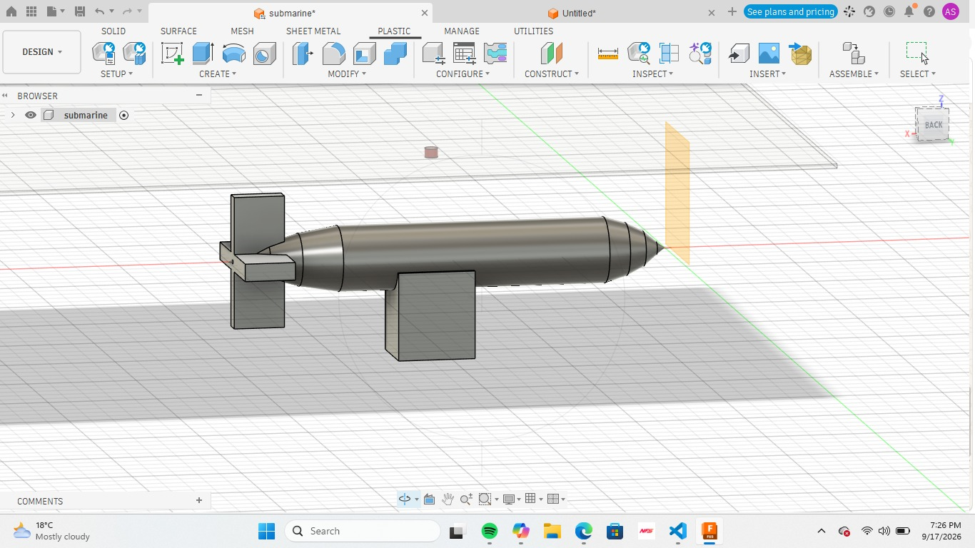
THE SOLUTION ARCHITECTURE

Slide 7
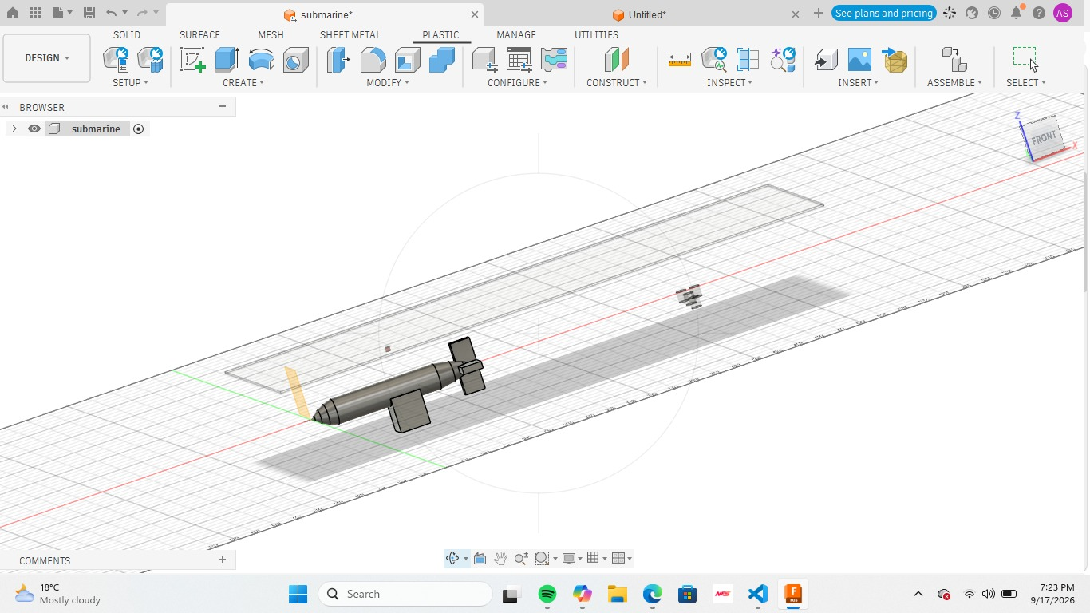

Slide 8
What is our system do?
-AUTOMIMUS SUBARAINE
-HAS MAGNETIC FIELD DETECTOR
-GAS DETECTOR
-MOVES AUTONIMUSLY
-CAN BE MONITORED ON A APP

