Slide 1
SunCulture
Quarterly Business Review
Data-Driven Insights for Strategic Decision-Making
Senior Data Scientist Assessment | Kevin Kamau Njagi | May 2026

Slide 2
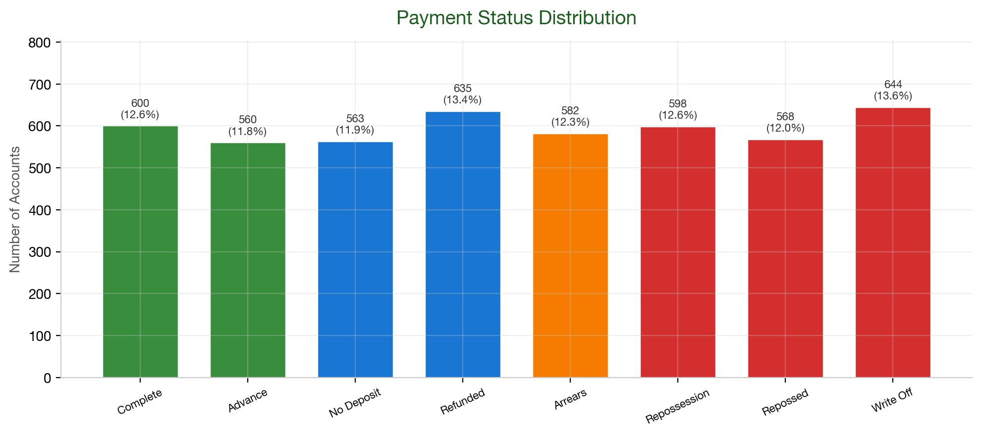
Customer Payment Health Overview
Key Insights
Only 12.6% of customers have fully completed payment (600 accounts). Another 11.8% are paid ahead (Advance).
36.8% are in arrears, repossession, or repossessed — 1,748 accounts requiring immediate attention.
13.6% (644 accounts) are Write-Offs — uncollectable. Root-cause analysis recommended.
Action: Prioritise collections on 582 Arrears accounts; investigate Write-Off drivers.

Slide 3
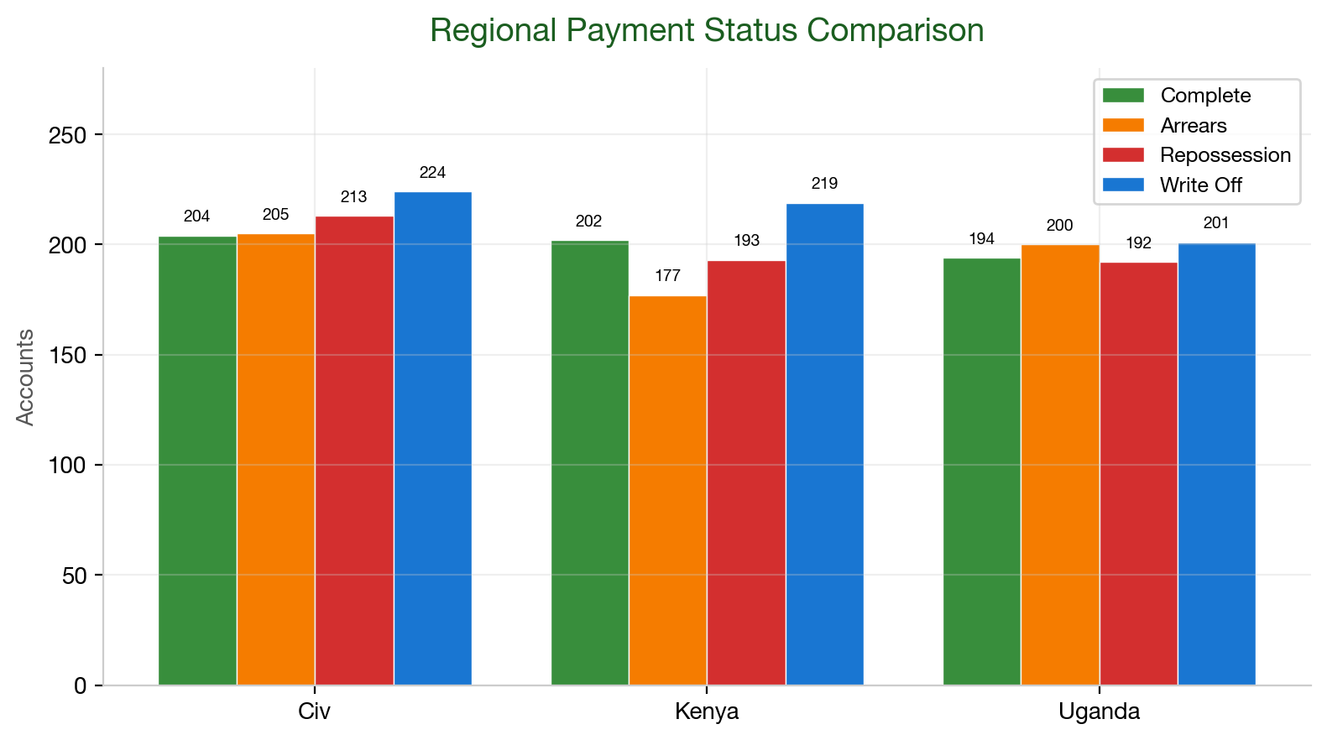
Regional Performance & Risk Disparities
Key Insights
Kenya has the highest Write-Off rate (14.1%) and Repossed rate (13.0%) despite the lowest Arrears (11.4% vs 12.3% avg) — suggesting accounts may skip arrears and go straight to bad debt.
Côte d'Ivoire over-indexes on Repossession (13.2%, highest of any region) with 13.9% Write-Offs. Uganda is the most balanced, near-average across all statuses.
Customer base is nearly evenly split: 33.9% CIV, 33.3% Uganda, 32.8% Kenya.
Action: Investigate Kenya's direct-to-bad-debt pattern; deploy day-15 early intervention in CIV.

Slide 4
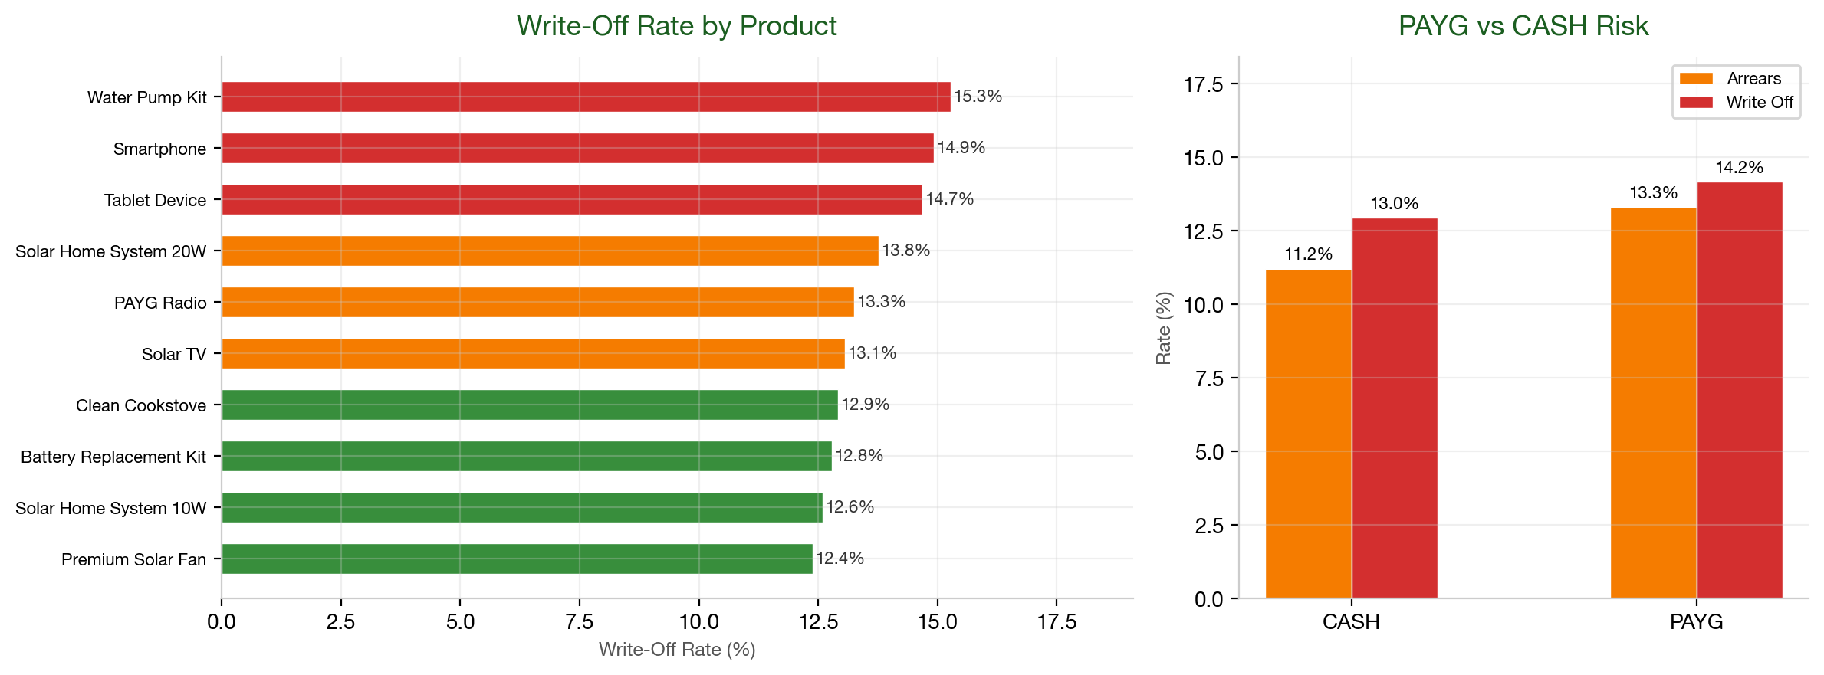
Product-Level Risk & Credit Loss Drivers
Key Insights
Highest write-off rates: Water Pumps (15.3%), Smartphones (14.9%), Tablets (14.7%).
PAYG accounts show 13.3% arrears vs. 11.2% for Cash — a 1.19× risk multiple.
Refurbished Solar Home Systems dominate Segment 2 (68.8%) — moderate risk profile.
Action: Increase down-payment requirements on Water/Smartphone/Tablet.

Slide 5
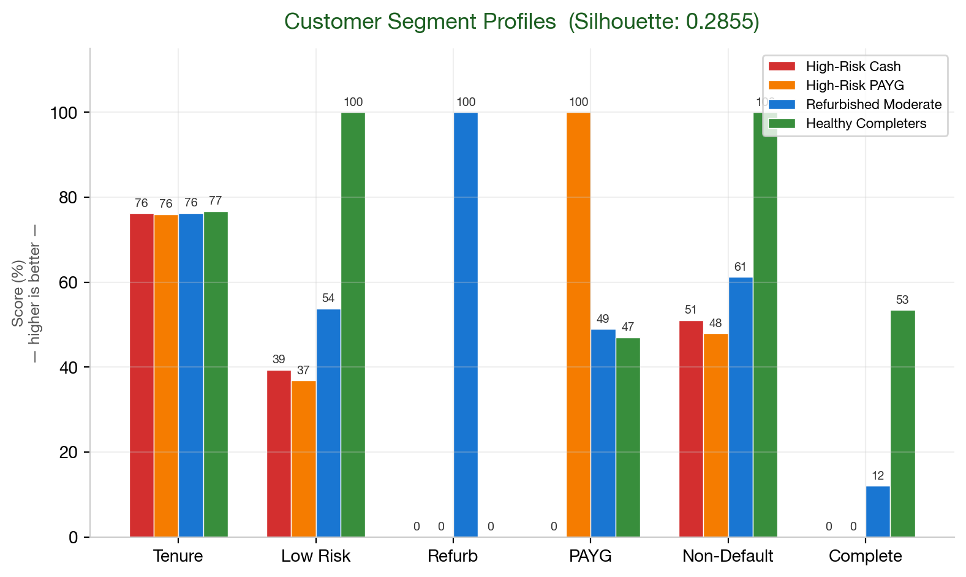
Customer Segmentation & Strategic Roadmap
Segment | Label | Count | % | Risk Score | Default Rate | Complete Rate | Key Characteristic
0 | High-Risk Cash | 1177 | 26.2% | 1.82 | 48.9% | 0.0% | CASH, high default
1 | High-Risk PAYG | 1179 | 26.2% | 1.89 | 52.1% | 0.0% | PAYG, high default
2 | Refurb Mod. | 1376 | 30.6% | 1.39 | 38.8% | 12.0% | Refurbished, mixed
3 | Healthy Comp. | 768 | 17.1% | 0 | 0.0% | 53.4% | Zero risk, completers

Slide 6
Recommended Strategic Actions
STRATEGY 1 — Premium Loan Cross-Sell
Target Segment 3 (Healthy Completers, 768 accounts, 0% default) for zero-risk loans. Target Segment 2 (Refurbished Buyers, 1,376 accounts, 12% complete rate) for graduation programs.
STRATEGY 2 — Collections Optimization
Deploy weekly risk-scoring via the segmentation model. Tiered outreach: SMS at day-7 → call at day-14 → field visit at day-21. Focus on Segments 0 and 1 (~50% default rate).
STRATEGY 3 — Product Portfolio Adjustment
Increase minimum deposits on Water Pumps (15.3% write-off), Smartphones (14.9%), and Tablets (14.7%). Pilot hybrid PAYG + deposit model with completion incentives for PAYG Segment 1.
STRATEGY 4 — Data-Driven Credit Scoring Roadmap
Pre-behaviour features (region, product, age) reach only 0.55 AUC — insufficient for deployment. Collect 3-6 months of payment history (days-late, payment ratios, seasonality) to unlock 0.70+ AUC. Infrastructure ready: Airflow pipeline, anti-leakage features, PR-optimised thresholds.
Next Steps: Deploy segmentation via BentoML → Weekly Airflow retraining → Collect payment behaviour data → Build 0.70+ AUC credit model

