Slide 1
Data Science with Kaggle Decal
Instructors: Jerry Chen, Joseph Simonian, Phillip Kuznetsov
Website: kaggledecal.github.io
Github: https://github.com/kaggledecal/kaggle_fa16 (Updated syllabus is up!)
OH: See Piazza
Sign-In: https://tinyurl.com/[See board]
Fall ’16

Slide 2
Outline for Today
Kaggle Tour
Titanic Overview
Summary Statistics
Data Visualization
First Project Overview
Form Teams by next Monday 9/26 (up to 4)

Slide 3

The Titanic
The sinking of the RMS Titanic is one of the most infamous shipwrecks in history. On April 15, 1912, during her maiden voyage, the Titanic sank after colliding with an iceberg, killing 1502 out of 2224 passengers and crew. This sensational tragedy shocked the international community and led to better safety regulations for ships.
Notes:
https://en.wikipedia.org/wiki/RMS_Titanic

Slide 4
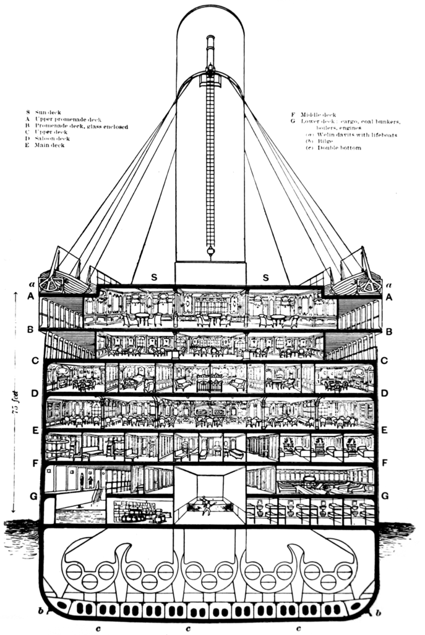
The Titanic
The Titanic was designed to carry 32 lifeboats, but this number was reduced to 20 (enough for about 1,180 people) for its maiden voyage.
Given that constraint, it is not surprising that a disproportionate number of men were apparently left aboard because of a women and children first protocol followed by some of the officers overseeing the loading of lifeboats with passengers.
In fact, the "Women and Children" lifeboat policy was enforced differently on the port and starboard sides of the Titanic. On the starboard side men were allowed to board lifeboats if there were no women or children to board, while on the port side only women and children were allowed to board.

Slide 5
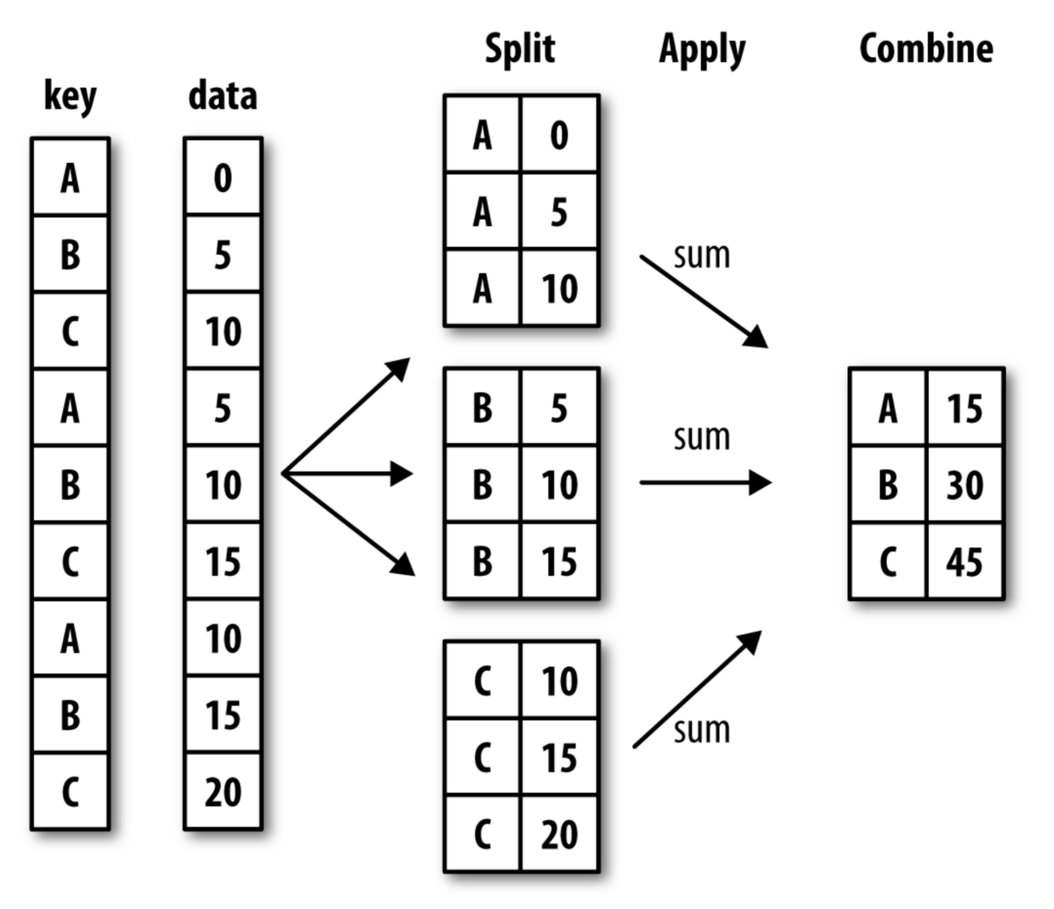
Summary Statistics – “Split, Apply, Combine”
Notes:
Python for Data Analysis by Wes McKinney

Slide 6
Summary Statistics – “Split, Apply, Combine”
Groupby
In [13]: train.groupby('Sex')
<pandas.core.groupby.DataFrameGroupBy at …>
In [14]: train.groupby('Sex')['Survived'].mean()
Sex
female 0.742038
male 0.188908
Name: Survived, dtype: float64
Notes:
Python for Data Analysis by Wes McKinney

Slide 7
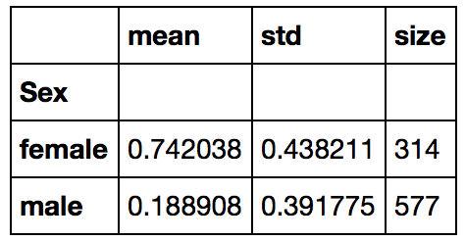
Summary Statistics – “Split, Apply, Combine”
Agg
In [15]: t = train.groupby('Sex')
In [16]: t['Survived'].agg([np.mean,np.size,np.std])
Important:
Function passed to agg must return a single value!
Notes:
Python for Data Analysis by Wes McKinney

Slide 8
Summary Statistics – “Split, Apply, Combine”
Apply
In [15]: t = train.groupby('Sex')
In [16]: t['Survived'].apply(np.mean)
Sex
female 0.742038
male 0.188908
Name: Survived, dtype: float64
Return value does not have to be a single value!
Notes:
Python for Data Analysis by Wes McKinney

Slide 9
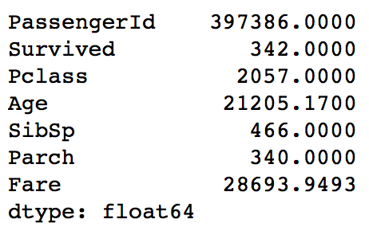
Summary Statistics – Another use for Apply
Apply (Groupby)
Apply (DataFrame)
In [15]: t = train.groupby('Sex')
In [16]: numerics = train.select_dtypes([np.number])
In [16]: t['Survived'].apply(np.mean)
In [16]: numerics.apply(np.sum,axis=0)
Sex
female 0.742038
male 0.188908
Name: Survived, dtype: float64
Return value does not have to be a single value!
Axis = 0 applies function to each column
(in general, axis=0 refers to rows and axis=1 refers to columns)

Slide 10
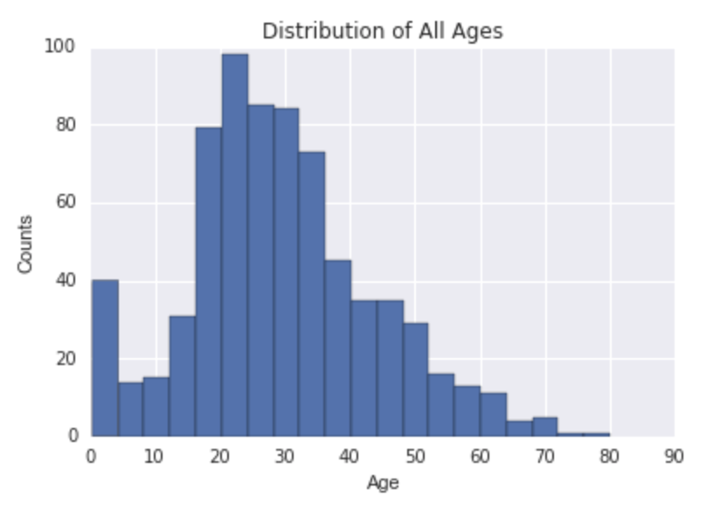
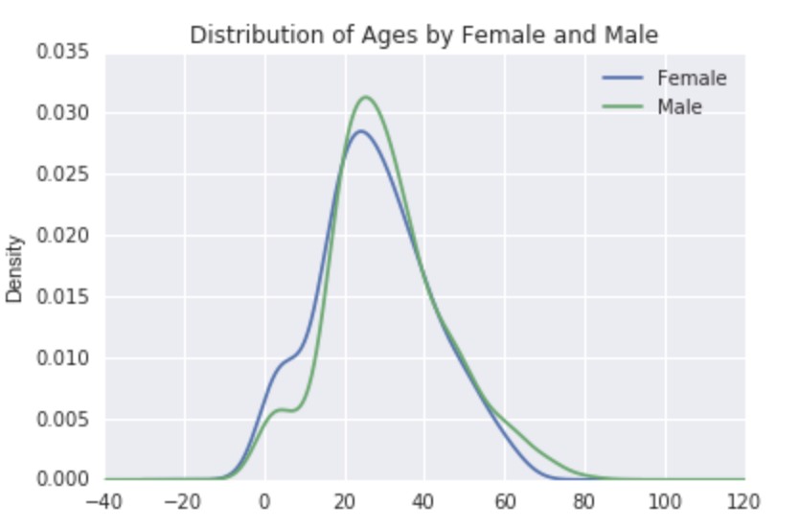
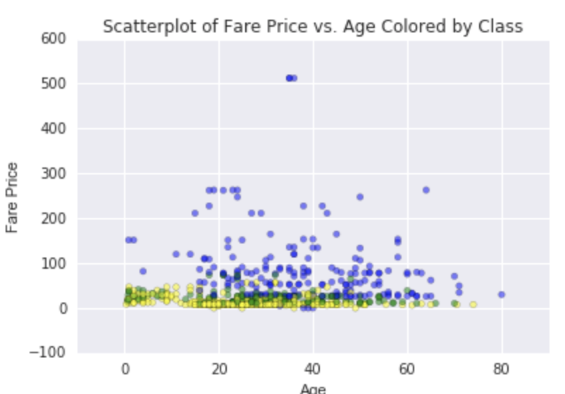
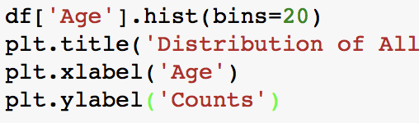
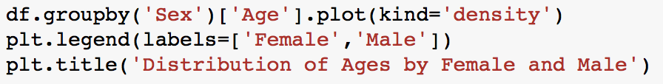
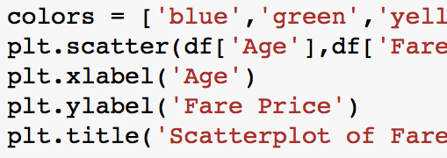
Data Visualization - Plots
Numerical Data
Histogram
Density
Scatterplot

Slide 11
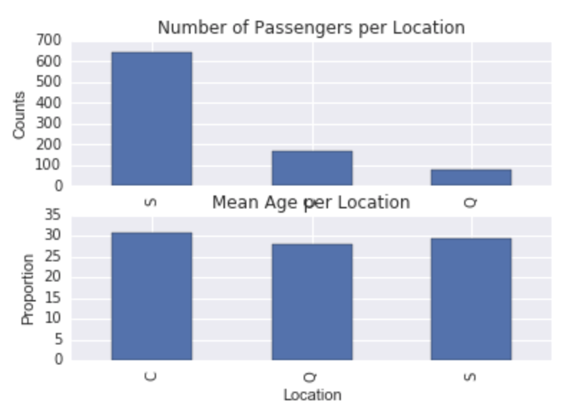
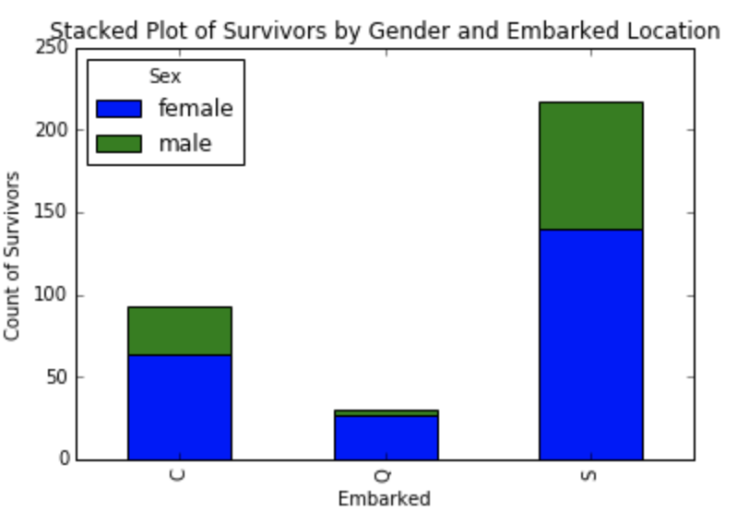
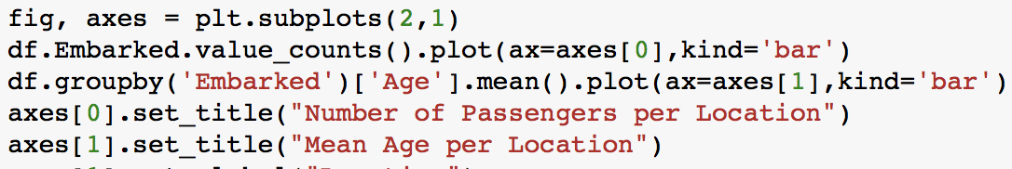
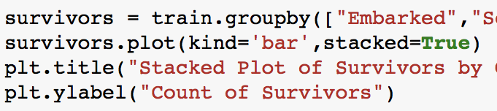
Data Visualization - Plots
Categorical Data
Barplots
Stacked Barplots

Slide 12
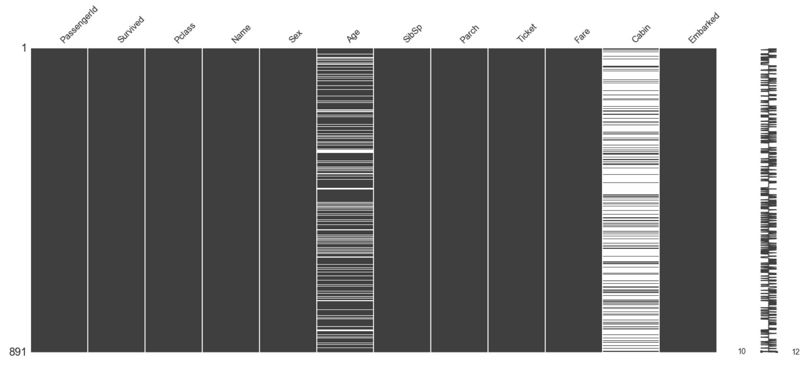

Data Visualization - Plots
Missing Data

Slide 13
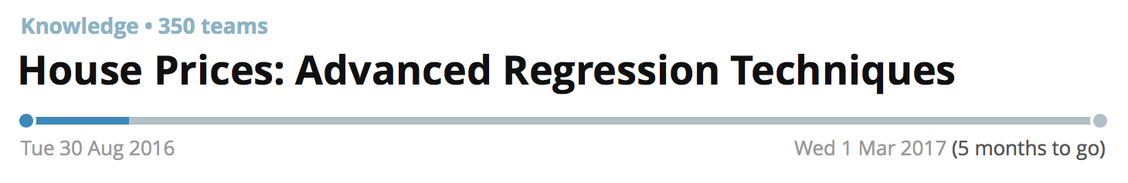
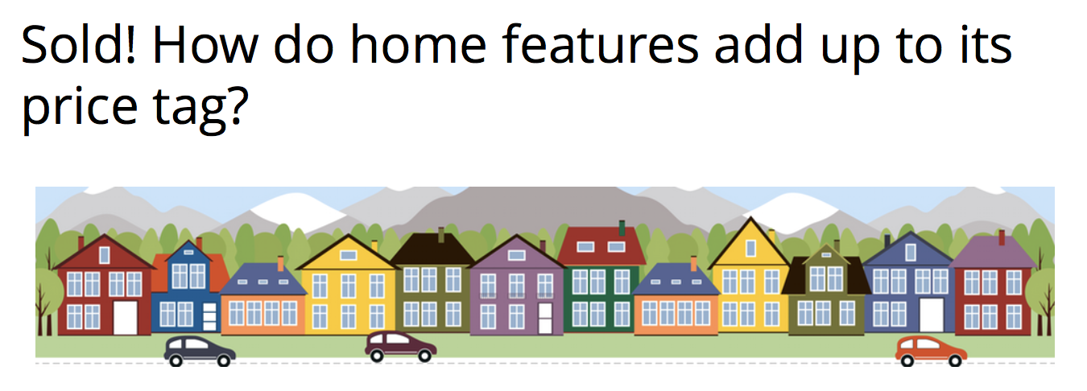
Project 1
By Monday 9/26!
1. Create a Kaggle account
2. Get in teams of up to 4
3. Form your team on Kaggle
4. Email your team name and team emails to us

