Slide 1
Data Science with Kaggle Decal – Linear Regression, Interpretation, Validation
Instructors: Jerry Chen, Joseph Simonian, Phillip Kuznetsov
Website: kaggledecal.github.io
Github: https://github.com/kaggledecal/kaggle_fa16
OH: See Piazza
Sign-In: https://tinyurl.com/[See board]
Fall ’16

Slide 2
Outline for Today
The Linear Regression model
Linear regression interpretation
Model validation
Validation Method for Machine Learning
Announcements:
1. Project 1 Specs updated to reflect single due date 10/2 11:59pm. All other changes in bold.
2. Please send your team name in by midnight tonight!

Slide 3
Motivation
College GPA
3.5
3.6
3.7
SAT Score
1800
1900
2000
College GPA
SAT Score

Slide 4
Motivation
College GPA
3.5
3.4
3.7
SAT Score
1800
1900
2000
College GPA
SAT Score

Slide 5
Motivation
College GPA
3.5
3.4
3.7
SAT Score
1800
1900
2000
College GPA
SAT Score

Slide 6


Motivation
College GPA
3.5
3.4
3.7
SAT Score
1800
1900
2000
College GPA
SAT Score

Slide 7

How to find beta? Minimize objective function
College GPA
3.5
3.4
3.7
SAT Score
1800
1900
2000
College GPA
SAT Score
minimize

Slide 8
How to find beta? Minimize objective function
College GPA
3.5
3.4
3.7
SAT Score
1800
1900
2000
College GPA
SAT Score
or
minimize

Slide 9
How to find beta? Minimize objective function
College GPA
3.5
3.4
3.7
SAT Score
1800
1900
2000
College GPA
SAT Score
For this example:

Slide 10
How to find beta? Minimize objective function
College GPA
3.5
3.4
3.7
SAT Score
1800
1900
2000
College GPA
SAT Score
For this example:

Slide 11


How to find beta? Minimize objective function

Slide 12
How to find beta? Minimize objective function
With Two Unknown Betas
Becomes much more cumbersome with more betas…

Slide 13
How to find beta? Matrix Notation
College GPA
3.5
3.4
3.7
SAT Score
1800
1900
2000
College GPA
SAT Score

Slide 14
How to find beta? Matrix Notation

Slide 15
How to find beta? Matrix Notation
Normal Equations

Slide 16
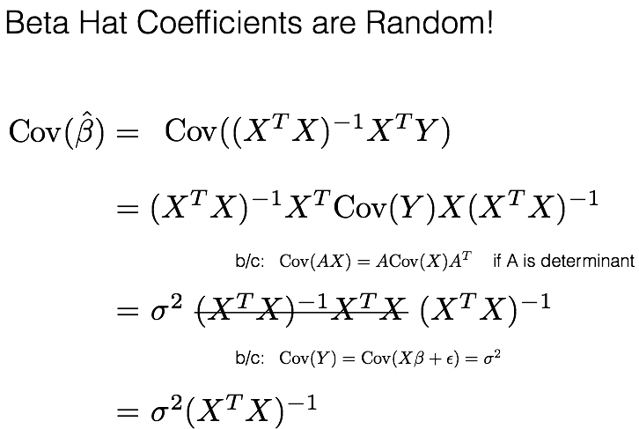
Beta errors

Slide 17
Beta errors
What is ?
comes from the errors that we’ve previously been ignoring (epsilon). In the real world, we don’t know this
parameter. We can only estimate it based on the following equation:
(residual standard error)

Slide 18
Beta errors
What is ?
comes from the errors that we’ve previously been ignoring (epsilon). In the real world, we don’t know this
parameter. We can only estimate it based on the following equation:
(residual standard error)
Can now calculate our covariance matrix!

Slide 19
Getting p-values for Beta Coefficients
Motivation: If a feature (beta) turns out to have absolutely no relation to our response variable (e.g. number of
strands of hair vs. College GPA), we should have a coefficient of something very close to 0.
But as we saw earlier, our beta for SAT Score was really small! We know this feature is important so the next step
is to convert our coefficients to a p-value by dividing by the standard errors we calculated from before.

Slide 20
Getting p-values for Beta Coefficients
Motivation: If a feature (beta) turns out to have absolutely no relation to our response variable (e.g. number of
strands of hair vs. College GPA), we should have a coefficient of something very close to 0.
But as we saw earlier, our beta for SAT Score was really small! We know this feature is important so the next step
is to convert our coefficients to a p-value by dividing by the standard errors we calculated from before.
Definition of p-value: Given the null hypothesis is true that SAT Score has no relationship with College GPA
and its beta coefficient is 0, what is the chance that we see a beta coefficient as or more extreme than the
one we just calculated?
Confidence Interval Perspective:
Does the range contain 0?
Standard Error of Beta 1
(or some multiple)
Standard Error of Beta 1
(or some multiple)

Slide 21
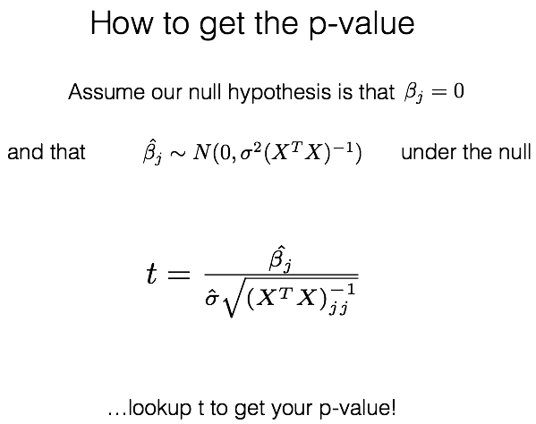
Getting p-values for Beta Coefficients
(or use a python package)

Slide 22
Linear regression interpretation
Questions:
1. If a beta coefficient is 0.0000000151 and it’s p-value is 0.005, is the variable significant?
2. If a beta coefficient is 1501 and it’s p-value is 0.25, is the variable significant?
3. If beta1 = 1501 and it’s p-value is 0.01, what can we say will happen to y if we increase x1 by 1 unit?
4. If beta1 = 0.00414 and it’s p-value is 0.1, what can we say will happen to y if we increase x1 by 1 unit?

Slide 23

Model Validation
How well did our linear model fit the data?
College GPA
College GPA
SAT Score
SAT Score
How much variance
did we reduce?

Slide 24
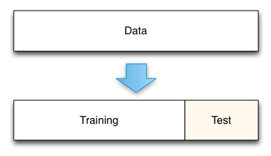
Validation Method for Machine Learning
Caveat to previous slide: In prediction, we care about how well our model does on new data, not old.
R squared is good for model interpretation but it is measuring how good our model is on current data.
What we can do instead is measure our model’s performance based on the test data SSE (or some other metric).

Slide 25
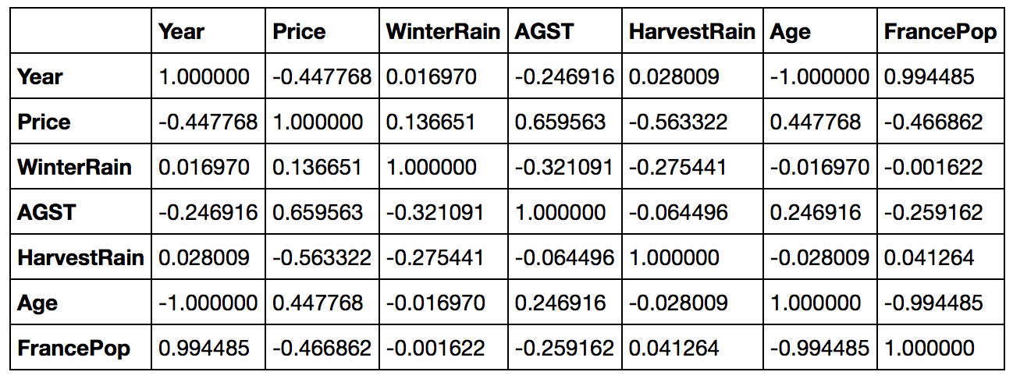
Linear regression interpretation (revisited)
The problem of multicollinearity:
Don’t know if age or population is the true signal!
(Best to remove one of them)

Slide 26
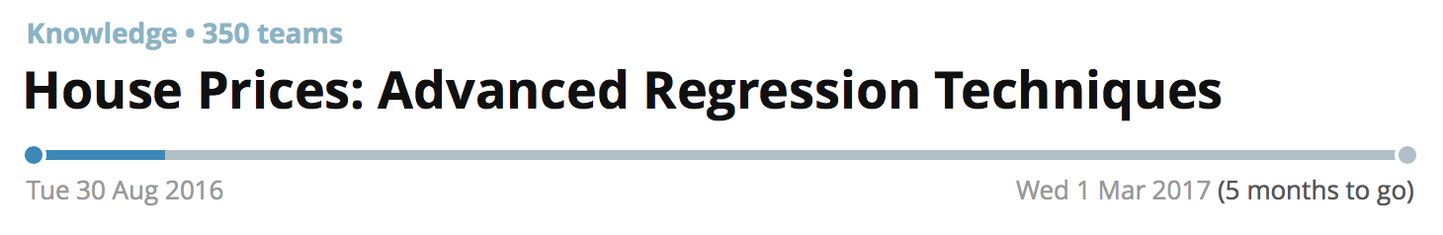
Project 1
1. Create a Kaggle account
2. Get in teams of up to 4
3. Form your team on
Kaggle
Team Names Received:
Data Bears
Sexy KaggSwagg
databears
4. Email your team name
and team emails to us by
tonight 9/26
Project Due
11:59pm 10/2
Just the notebook!
Please also include your
leaderboard score somewhere.

