Slide 1

Air Pollution in the us
DSC-530 Exploratory Data ANalysis
By: njei akuro

Slide 2
Introduction
There is quite a significant number of air-quality-related early deaths in the United States
Reference: https://www.kaggle.com/sogun3/uspollution
Hypothesis: which of the above listed pollutants is released the most to the atmosphere? Carbon monoxide (CO), Nitrogen dioxide (NO2), Sulphur dioxide
Major variables in the dataset were the AQI (Air quality index) for the air pollutants, Date, and state it occurred.

Slide 3
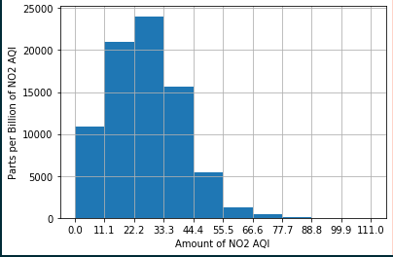
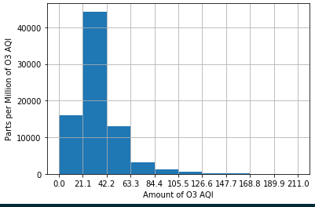
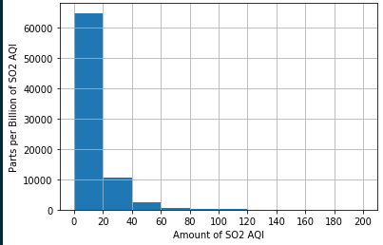
Histogram variables
Four major air pollutants: NO2, O3, SO2 and CO

Slide 4
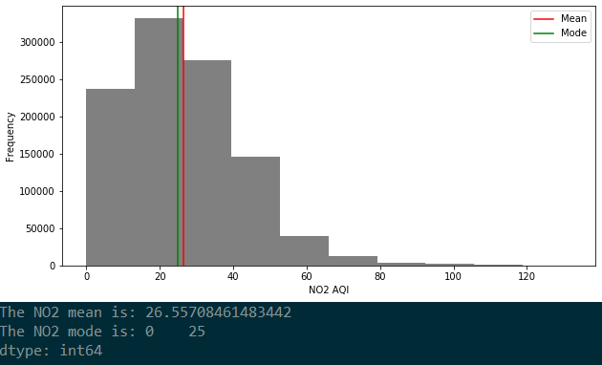
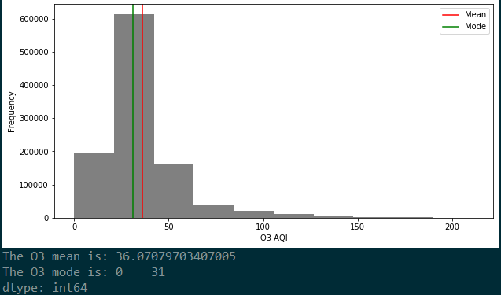
Descriptive Statistics
NO2 has an asymmetric distribution, and the Tail and Spread is also higher towards the left.(skewed to the left) While O3 has a normal distribution
There are a few outliers towards the higher end of the graph for both NO2 and O3. The data points were too small to matter in the data and shift it more towards the right(skewed to the right).

Slide 5
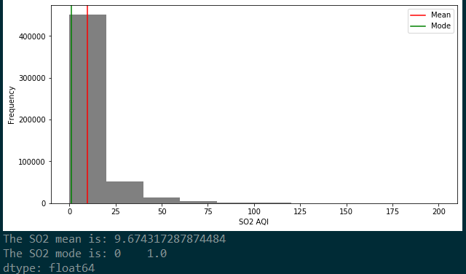
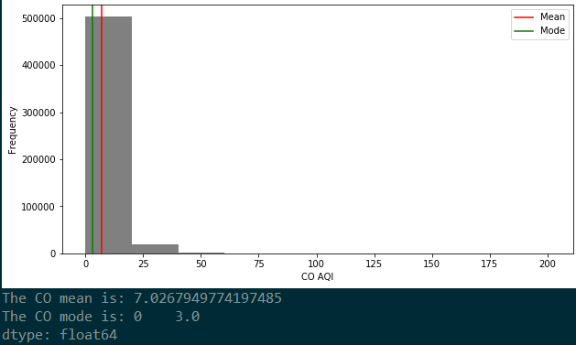
Descriptive Statistics
For the SO2 and CO the numbers are significantly smaller with a similar asymmetric distribution with the Tail and Spread higher at the left(skewed to the left.
SO2 also had many more outliers than CO but not enough to change the spread of the data.

Slide 6
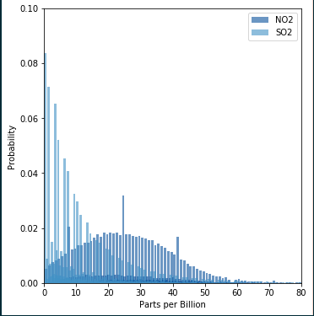
PMF- Comparing two Scenarios
Comparing NO2 and SO2 because their measurements were in billions meanwhile the other pollutants were measured in millions.
NO2 shows a consistent distribution in probability with few outliers and probability less than 0.02, while probability for SO2 is higher reaching 0.08

Slide 7
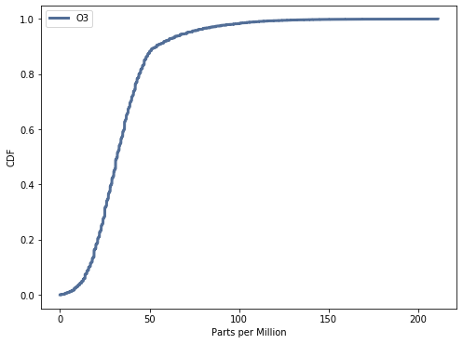
CDF- O3
The variable O3 has a normal CDF distribution.
By visualizing O3 in this format it helps to answer the hypothesis question by demonstrating the increase in O3 higher towards 100-200 parts per million

Slide 8
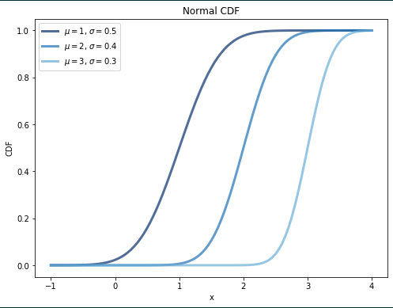
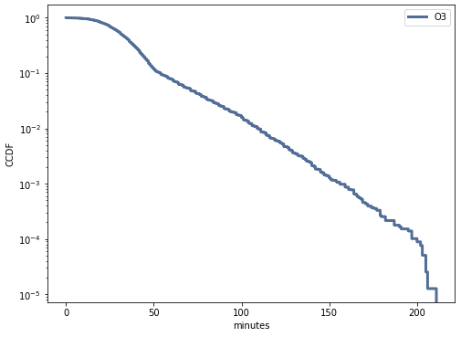
Analytical distribution
This graph demonstrates how O3 has a normal distribution with a range of parameters in it.

Slide 9
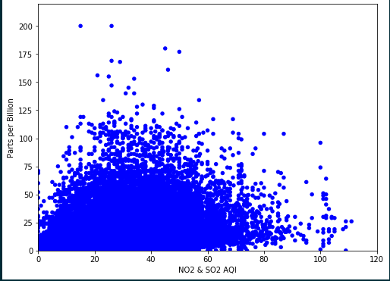
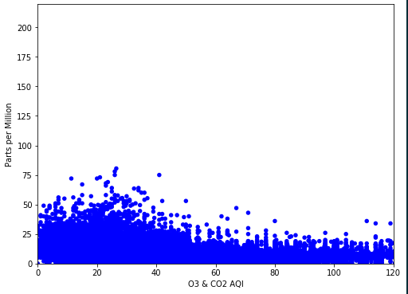
Scatterplots
The following scatterplot shows a visualization of how NO2/SO2 versus O3/CO2 have similar relationship in the amount it generates.
If I were to draw a line of best fit through the scatter plot (using regression analysis: y=mx +b), diagram A would have an upward slopping line from left to right while diagram B would have some sort of a flat line( lateral line)

Slide 10
Conclusion
Visualization (histogram and scatter plot) seem to show more of nitrogen dioxide and Sulphur dioxide
The higher the aqi, the worse the air quality. Indexes above 300 are usually considered hazardous air quality

