Slide 1
SALAMA
NLP-Based Gender-Based Violence
Support Recommendation System
By: Phyllis Njeri Kiarie

Slide 2
The challenge
Why this project matters
Finding help is difficult
Speaking up can be hard
Support information may be spread across different organisations.
Stigma, fear and privacy concerns can discourage disclosure.
Experiences can overlap
Access should offer choice
One person may describe more than one form of violence.
People should be able to explore services without sharing a story.
The guiding question: How can technology make support information easier to find?
SALAMA • CAPSTONE DEMONSTRATION
2

Slide 3
Our solution: Salama
A support-finding tool, not a formal reporting platform
Option 1: Browse services
Option 2: Share an experience
Choose a type of support without writing a narrative.
Describe a fictional example in English or Kiswahili.
Receive relevant referrals
Remain in control
See Nairobi organisations and national helpline contacts.
Users choose what to share and can clear the input field.
Salama provides information; it does not submit cases or contact organisations.
SALAMA • CAPSTONE DEMONSTRATION
3

Slide 4
What we set out to build
Project objectives
Understand narratives
Support two languages
Identify potentially relevant GBV categories from text.
Accept English and Kiswahili experiences.
Connect to support
Make it accessible
Map categories to practical service types.
Build a simple, mobile-friendly web interface.
SALAMA • CAPSTONE DEMONSTRATION
4

Slide 5
The data behind Salama
Two types of data power the system
Narrative examples
Support directory
CRADLE Bench: annotated English-language text used to develop the classifier.
Nairobi County GBV referral information organised into service categories.
General support fallback
National contacts
Additional Nairobi psychosocial support resources.
National GBV and emergency helplines available independently of predictions.
SALAMA • CAPSTONE DEMONSTRATION
5

Slide 6
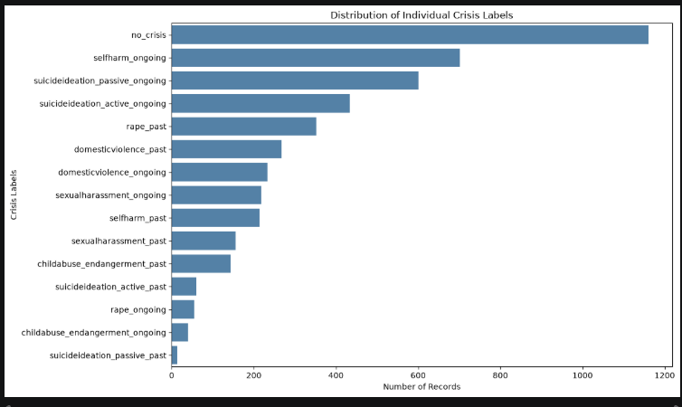
Category Distribution
SALAMA • CAPSTONE DEMONSTRATION
6

Slide 7
Preparing the data
Turning raw information into something models can use
1 Inspect
2 Organise
Review columns, labels, missing values and duplicates.
Prepare text and encode multiple category labels.
3 Separate
4 Structure resources
Use training and evaluation data to assess the model.
Standardise support types and organisation contact records.
SALAMA • CAPSTONE DEMONSTRATION
7

Slide 8
Text Preprocessing
Preparing raw narratives for machine learning
Raw Narratives
↓
Cleaning
↓
Label Encoding
↓
Tokenisation
↓
Chunking (>512 tokens)
↓
Training Dataset
Removed duplicate records.
Checked for missing records.
Cleaned text by removing annotation instructions.
Created binary GBV labels for multi-label classification.
Generated GBV event status labels.
Tokenised text for DistilBERT.
Applied chunking for narratives longer than 512 tokens.
SALAMA • CAPSTONE DEMONSTRATION
8

Slide 9
The Baseline model TF-IDF with Logistic Regression
TF-IDF converts text into numbers by identifying the words that are most important in each narrative. Common words receive low importance, while meaningful words receive higher importance. These numerical features are then used by Logistic Regression to classify the narrative.
Step 1: Term Frequency.(TF)
TF looks at how often a word appears in one narrative.
Step 2: Inverse Document Frequency (IDF)
Now TF-IDF asks:
"Does this word appear in almost every narrative, or is it relatively unique?"
A word gets a high TF-IDF score if it:
appears frequently in the current narrative, and
does not appear in most of the other narratives.
These scores become numbers that represent the narrative.
It gives more importance to words that help distinguish one document from another, making it easier for the model to identify patterns.
SALAMA • CAPSTONE DEMONSTRATION
9

Slide 10
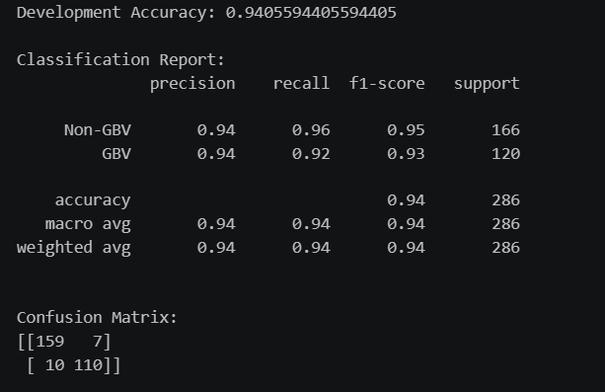
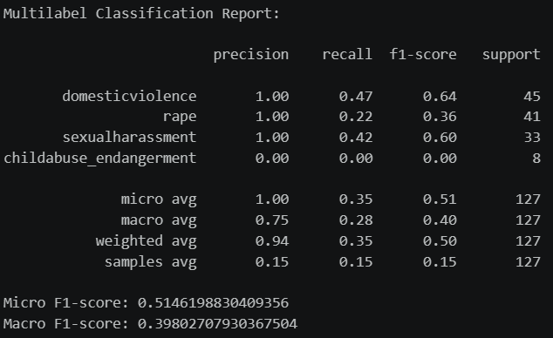
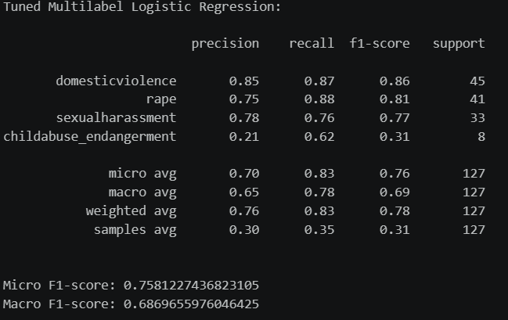
The Baseline model TF-IDF with Logistic Regression
How our model performed
Binary Classification
Multi Label Classification
SALAMA • CAPSTONE DEMONSTRATION
10

Slide 11
DistilBERT
Why DistilBERT?
Unlike TF-IDF, which identifies important words, DistilBERT reads the entire sentence to understand its context and meaning. It converts words into numerical embeddings, analyses how they relate to one another using transformer layers, and then predicts one or more GBV categories based on the overall meaning of the narrative.
Narrative
↓
Tokenisation
↓
Word Embeddings
↓
DistilBERT
(Self-Attention)
↓
Classification Head
↓
GBV Category Predictions
How DistilBERT works:
Splits the input narrative into smaller pieces called tokens.
Converts each token into numerical embeddings.
Uses self-attention to understand the relationship between words and the overall context of the sentence.
Generates a contextual representation of the narrative.
Predicts the probability of each GBV category.
Applies predefined thresholds to determine the final GBV category predictions.
DistilBERT understands meaning.
SALAMA • CAPSTONE DEMONSTRATION
11

Slide 12
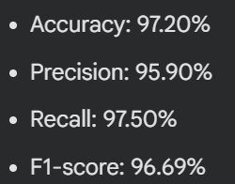
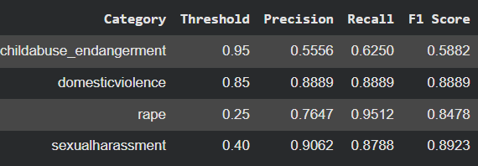
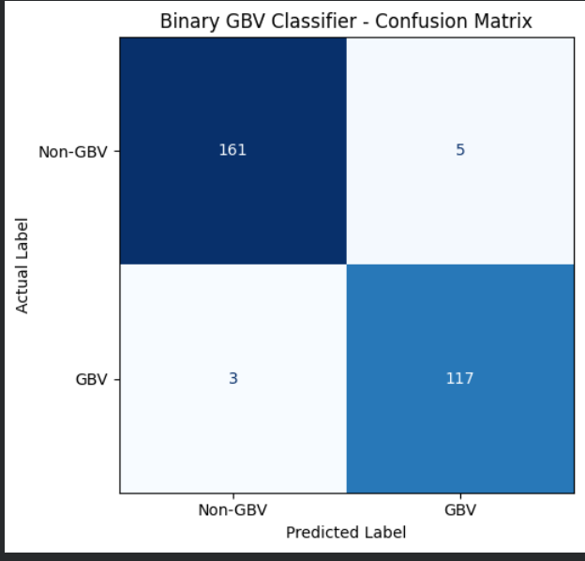
DistilBERT
How the transformer based model performed
Binary Classification
Multi Label Classification
SALAMA • CAPSTONE DEMONSTRATION
12

Slide 13
What Errors does the model make?
The Binary GBV classifier.
For the three false negatives produced:
The first narrative was a brief sexual assault disclosure using sensored abbreviations ‘sa’ when talking about an abortion performed in the past.
For the second one, the narrative contained a brief sexial assault disclosure within a broader discussion of suicidal thoughts, self-harm and mental health challenges. The model may have placed greater emphasis on the dominant mental health-related concerns.
The third narrative described a past rape using censored terminology such as ‘r@pe’ and ‘r*ped’, hence the model may have struggled to recognize these obfuscated expressions.
For the False Positives:
The patterns revealed were, the narratives described experiences of physical abuse, sexual assault or family violence despite being labelled as non-GBV, suggesting possible annotation inconsistencies. They also contained ambiguous reference s to abuse without sufficient context to confirm GBV.
The Multi Label GBV classifier:
Examining the narratives that were misclassified for each category revealed that category specific thresholds affected the models ability to classify some narratives correctly. These thresholds were still maintained for the final DistilBERT model as they achieved a high macro-F1 score, which is our metric for evaluation.
SALAMA • CAPSTONE DEMONSTRATION
13

Slide 14
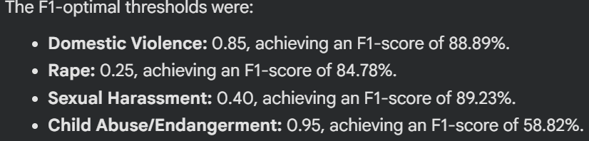
Threshold tuning for Multi-label classification
Instead of simply selecting the highest probability, each GBV category is evaluated independently. We experimented with thresholds to achieve a balance between identifying as many genuine GBV cases as possible while limiting incorrect predictions.
SALAMA • CAPSTONE DEMONSTRATION
14

Slide 15
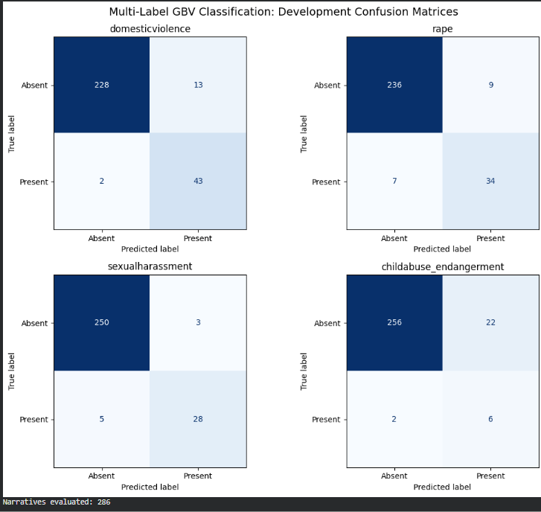
Threshold tuning for Multi-label classification
Instead of simply selecting the highest probability, each GBV category is evaluated independently. We experimented with thresholds to achieve a balance between identifying as many genuine GBV cases as possible while limiting incorrect predictions.
SALAMA • CAPSTONE DEMONSTRATION
15

Slide 16
Did the model learn effectively?
Evaluating results and acknowledging uncertainty
What this tells us
0.784
• We measured performance across the categories.
• The score summarises precision and recall.
• Some cases will still be missed or misclassified.
• Kenyan-context and Kiswahili accuracy need further testing.
Approximate macro F1
on English validation data
A missed label never means an experience is safe or that violence did not occur.
SALAMA • CAPSTONE DEMONSTRATION
16

Slide 17
Training Salama to recognise experiences
Multi-label classification in plain language
What goes in?
What the model learns
A written description of an experience.
Language patterns associated with annotated GBV categories.
Why multi-label?
What comes out?
One experience can involve several forms of harm.
Potentially relevant categories—not a professional assessment.
Model: fine-tuned DistilBERT. Categories: domestic violence, rape, sexual harassment, child abuse/endangerment.
SALAMA • CAPSTONE DEMONSTRATION
17

Slide 18
Making Salama bilingual
English and Kiswahili support
01
02
03
04
Kiswahili narrative
Translation
Classification
Referral
User describes an experience in Kiswahili.
NLLB converts the text into English.
DistilBERT identifies potentially relevant categories.
Salama shows support information in the interface.
Translation can change meaning; this is an important limitation to evaluate.
SALAMA • CAPSTONE DEMONSTRATION
18

Slide 19
From categories to recommendations
The practical link between NLP and support
Domestic violence
Rape
Psychosocial, shelter/security, healthcare and legal services.
Healthcare, psychosocial, legal and shelter/security services.
Sexual harassment
Child abuse/endangerment
Psychosocial, legal and healthcare services.
Shelter/security, healthcare, psychosocial and legal services.
These are transparent, predefined referral rules—not real-time safety assessments.
SALAMA • CAPSTONE DEMONSTRATION
19

Slide 20
Two journeys through Salama
Users can choose the path that works for them
A Browse without disclosure
B Describe an experience
Choose service → Search directory → View contacts
Write → Translate if needed → Classify → Recommend
National helplines remain available whichever route a user takes.
SALAMA • CAPSTONE DEMONSTRATION
20

Slide 21
The finished application
What we built in Streamlit
Easy to navigate
Accessible on phones
English/Kiswahili controls and simple service selection.
Responsive layout tested in a mobile-sized browser view.
Support at a glance
Runs with local models
Organisation cards with contact details and national helplines.
Classification and translation do not require external inference APIs.
Live demonstration: show both browsing and a fictional narrative-based recommendation.
SALAMA • CAPSTONE DEMONSTRATION
21

Slide 22
Challenges and limitations
What we learned along the way
Local relevance
Language accuracy
The classifier was not validated on representative Kenyan narratives.
Translation can miss nuance or change the meaning of text.
Referral coverage
Safety and privacy
Organisation-level resources currently focus on Nairobi.
No validated crisis triage, automatic PII masking or live service verification.
Capstone demonstrations should use fictional narratives—not real disclosures.
SALAMA • CAPSTONE DEMONSTRATION
22

Slide 23
Where Salama can go next
Practical future improvements
Wider reach
Stronger evaluation
Add and regularly verify directories for more Kenyan counties.
Test carefully governed Kenyan English and Kiswahili examples.
Safer workflows
Secure access
Introduce human-reviewed referral and safeguarding processes.
Harden privacy and security before any real-world public use.
SALAMA • CAPSTONE DEMONSTRATION
23

Slide 24
Key takeaway
From language understanding to useful support information
Salama combines NLP, translation and transparent referral rules to help people explore potentially relevant GBV support resources—without requiring disclosure.
Next: a short live demonstration using fictional examples.
SALAMA • CAPSTONE DEMONSTRATION
24

