Slide 1
YouElect- An Online Voting Platform
Phase-I

Slide 2

Our Objective
Our motive is to design an application that makes election conduction and voting a lot easier then it used to be by utilizing the strength of internet.
Also , we look forward to provide deep insights of any election that will be conducted on our platform, along with providing quick results within seconds.

Slide 3
Advantages of the Project
No need to travel miles to cast vote.
Quick evaluation of results.
Ensures authenticity.
User friendly Interface.
Provides trends seen in the election.
Cost effective option as compared to standard election process.
No external manpower needed.
No security issues.
No corruption involved as the whole process will be computerized.
One Person One Vote.

Slide 4

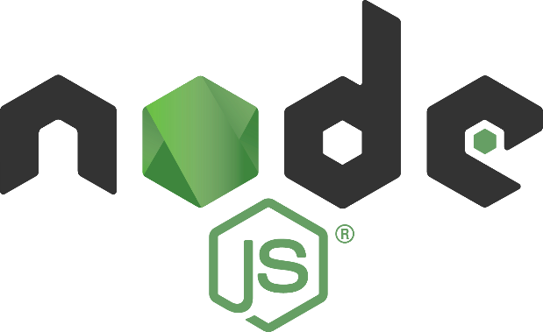
Technologies Used
This application uses the trending technologies currently being used in the industries to deliver a frontend rich and responsive application.
MongoDB Node.js Express EJS Bootstrap

Slide 5
Project Structure
The frontend will be empowered by EJS , providing a dynamic and user friendly interface.
For the server side Node.js along with express will be used making the application quick and highly scalable.
MongoDB will be used as a Database for storing user data and for authentication.
EJS has been used as a templating engine providing dynamic content.

Slide 6
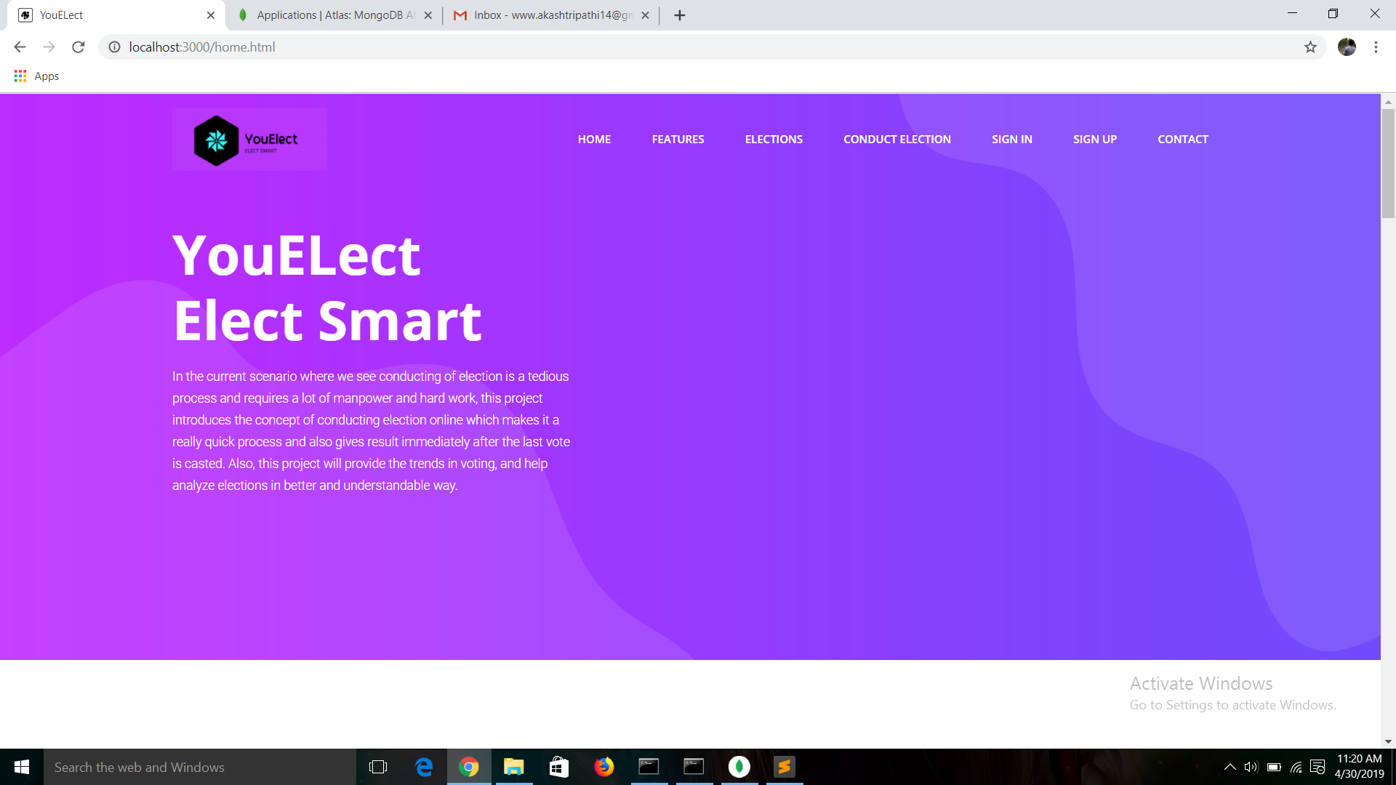
HOME PAGE

Slide 7
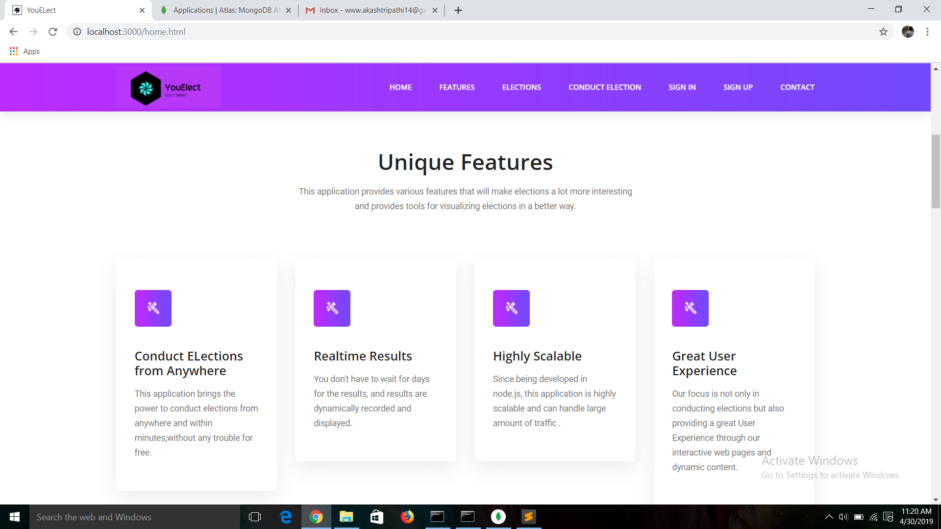

Slide 8
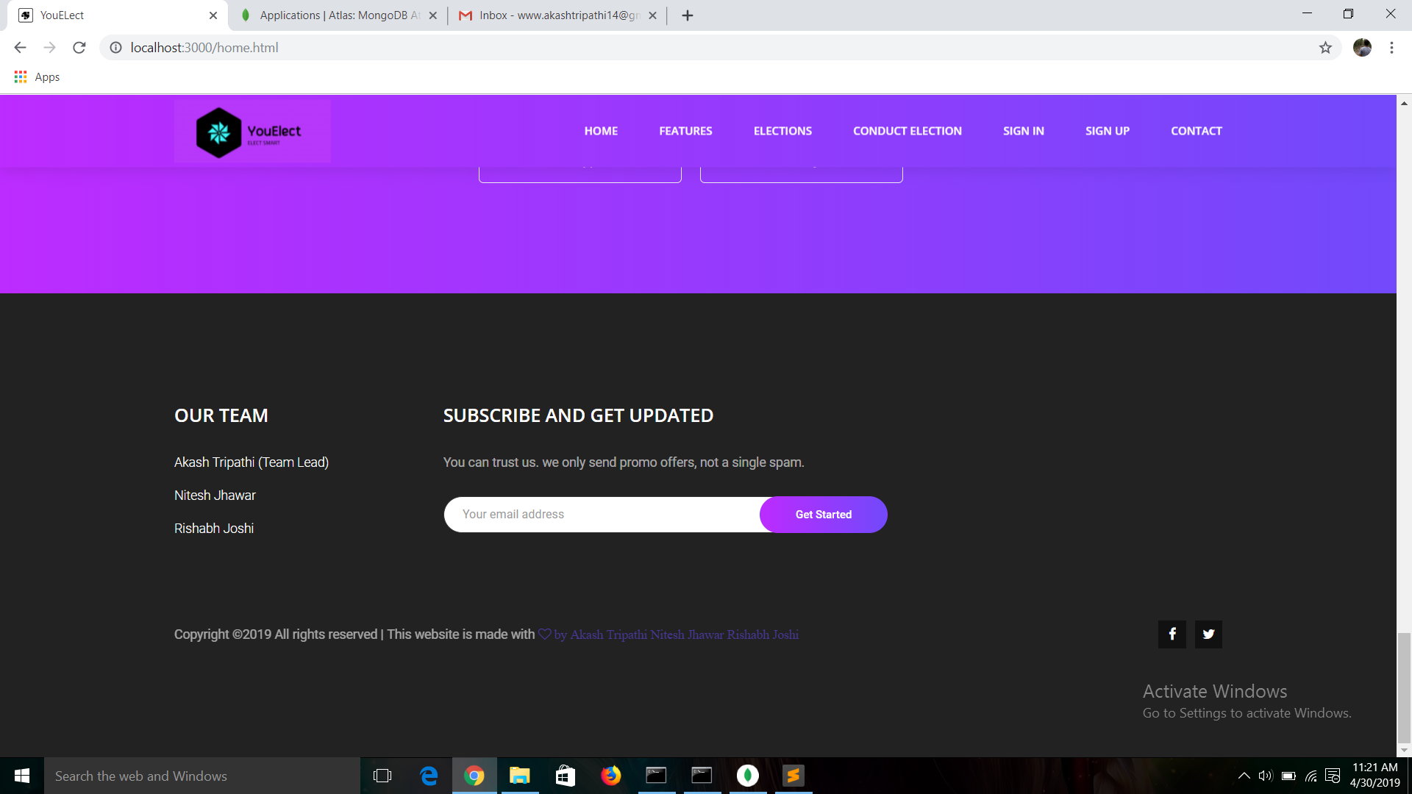

Slide 9
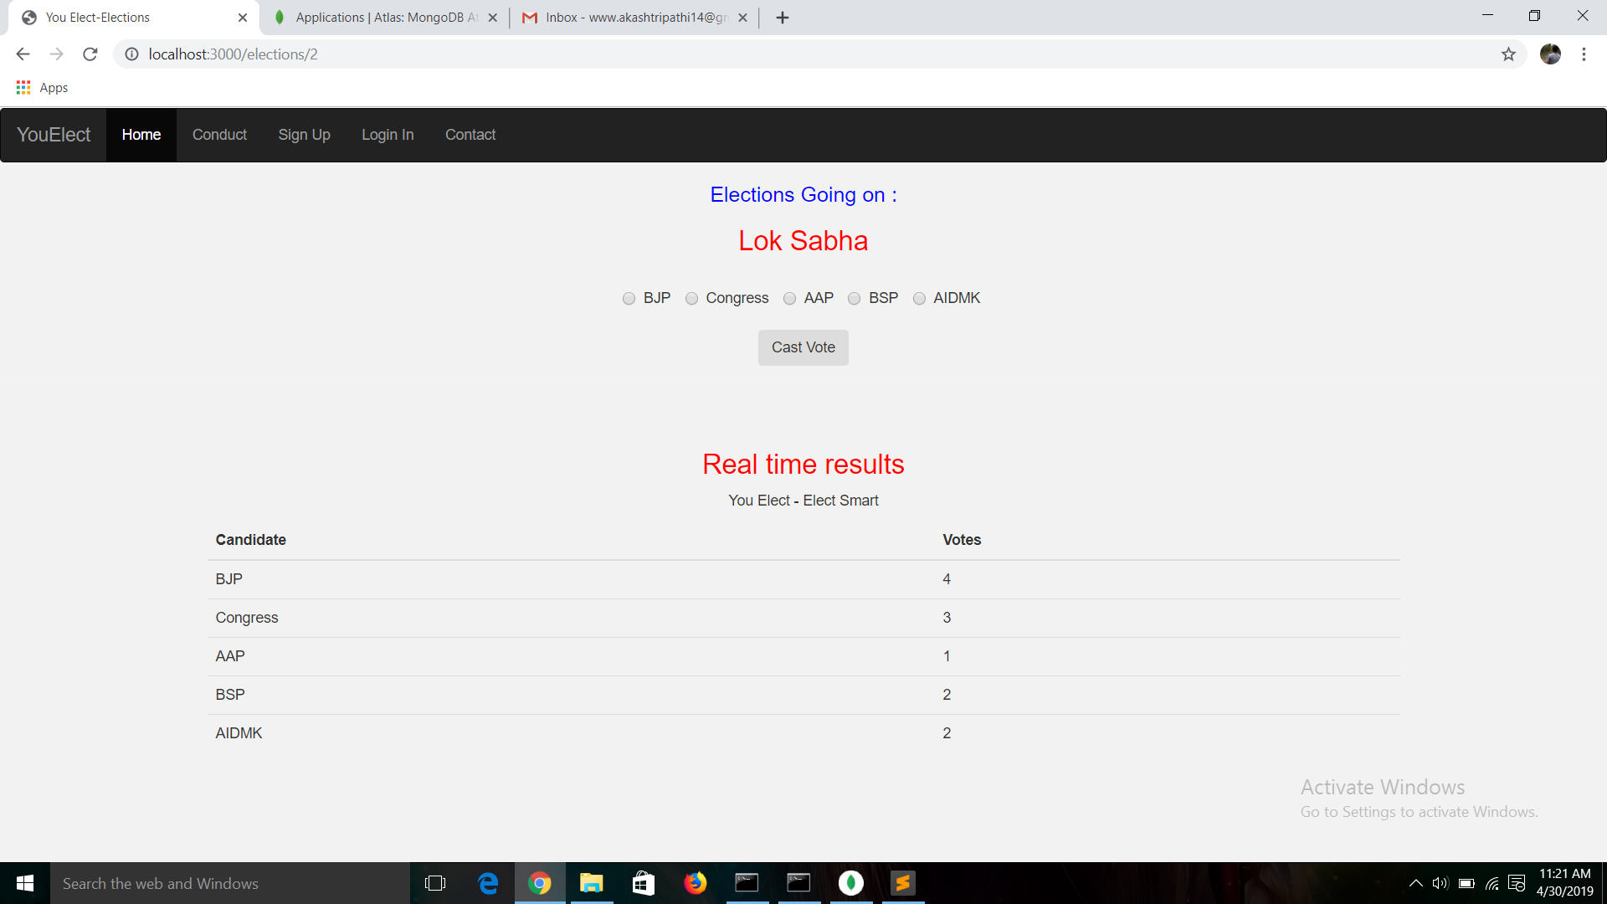

Slide 10
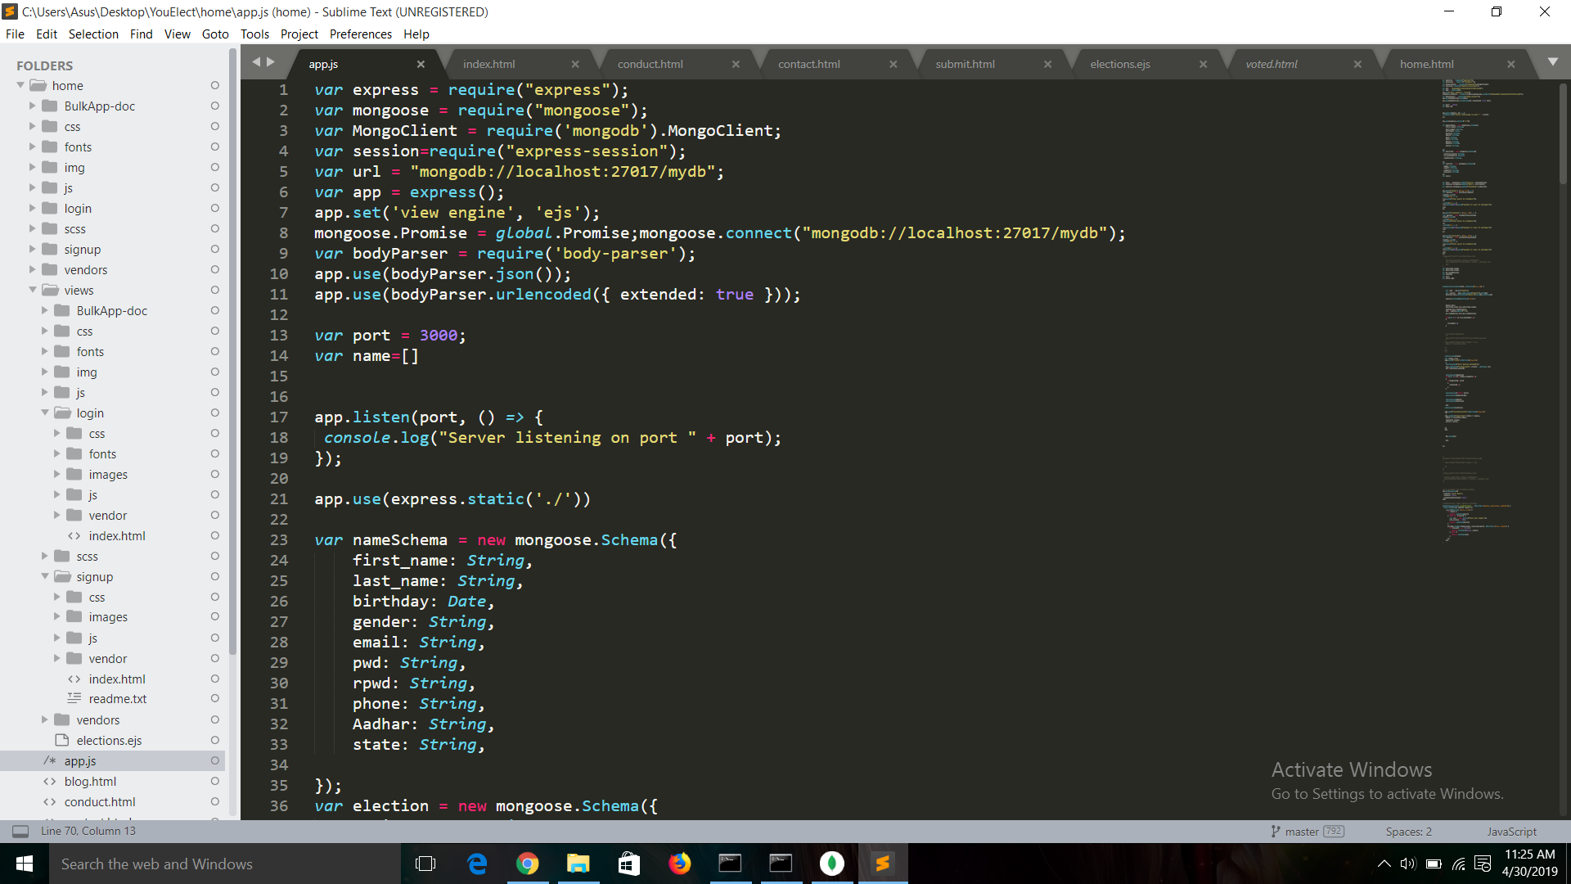
A little Sneak Peek to our code

Slide 11
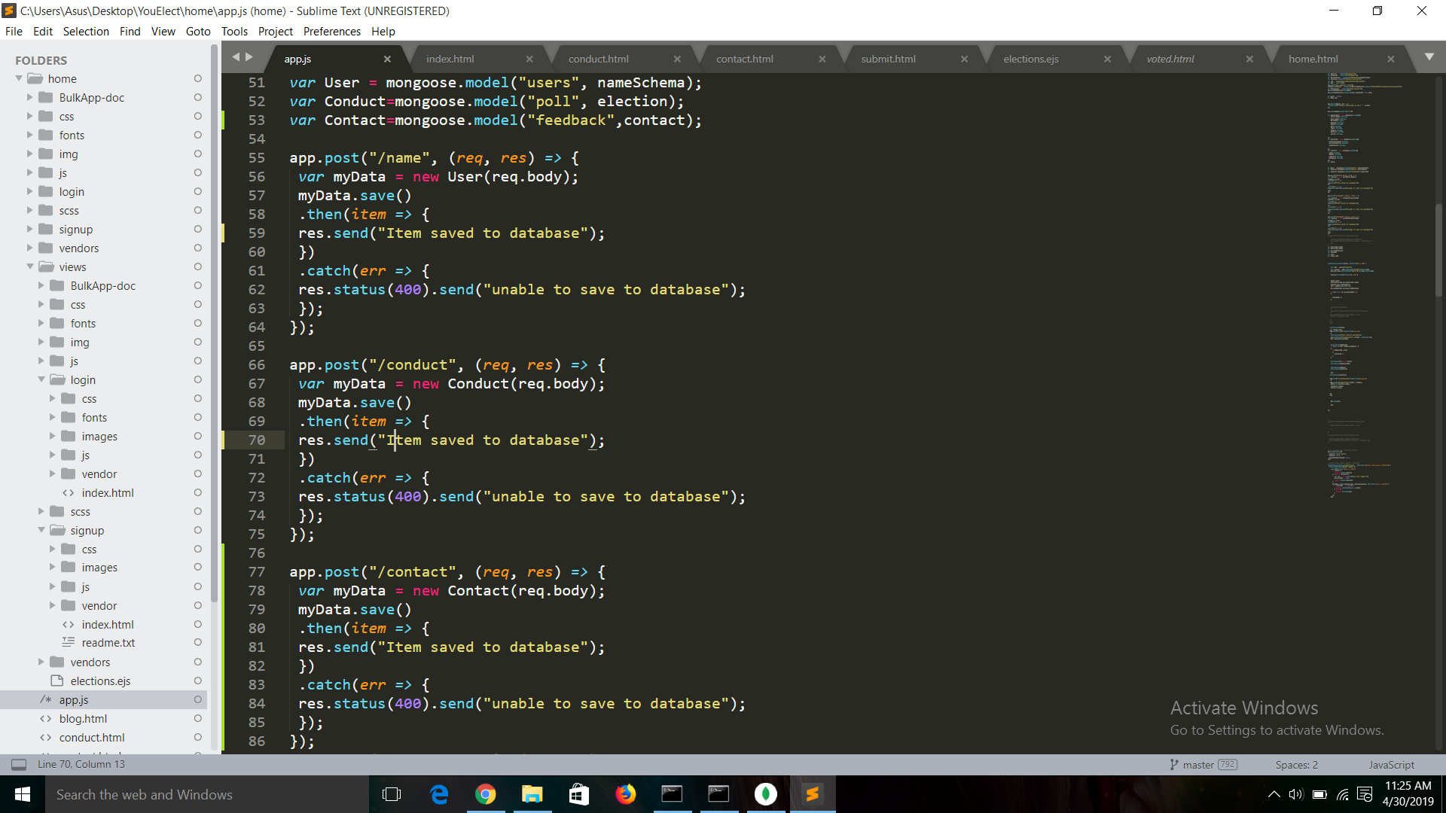

Slide 12
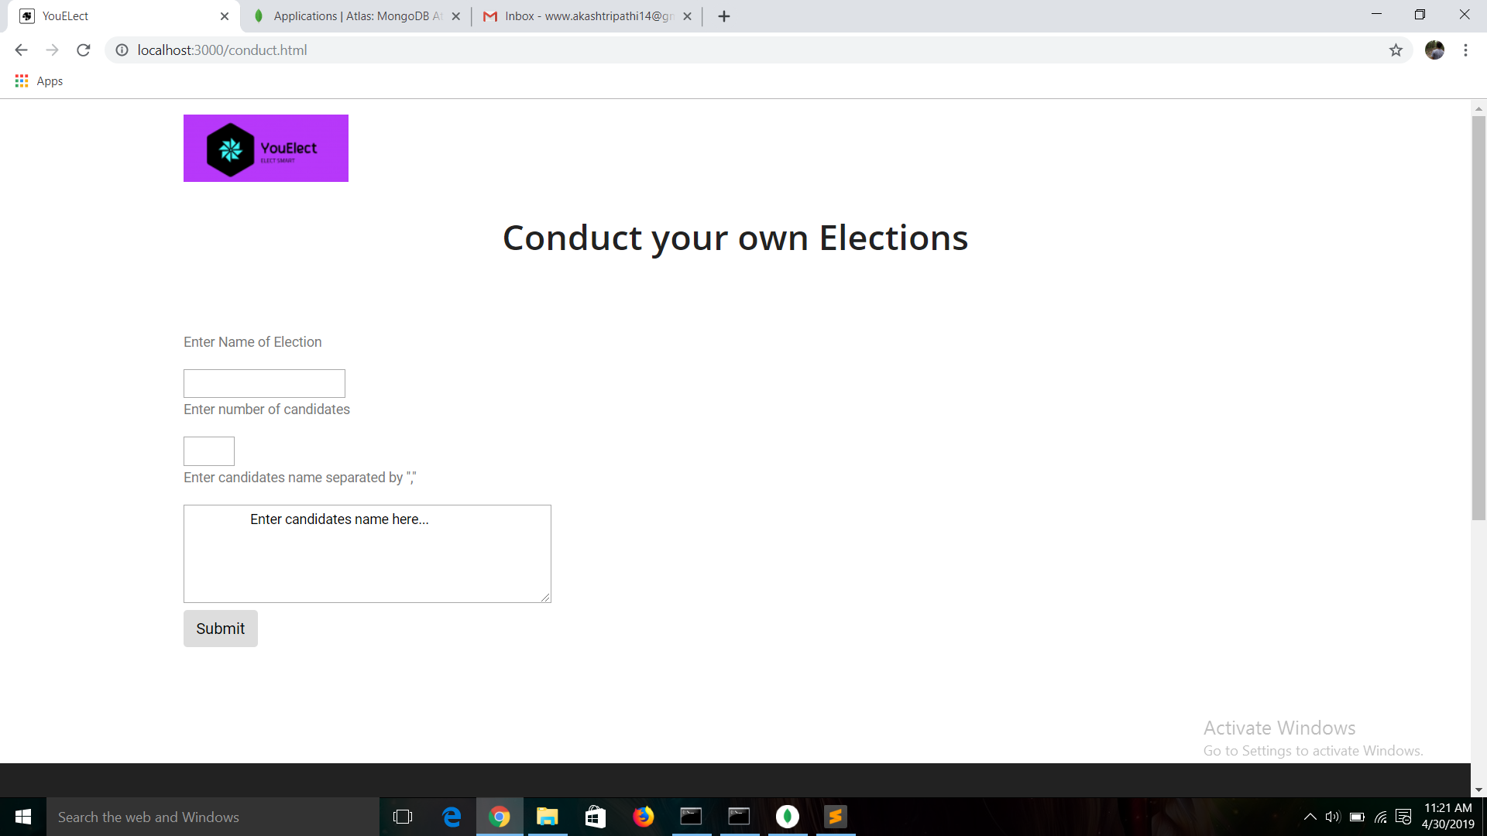

Slide 13
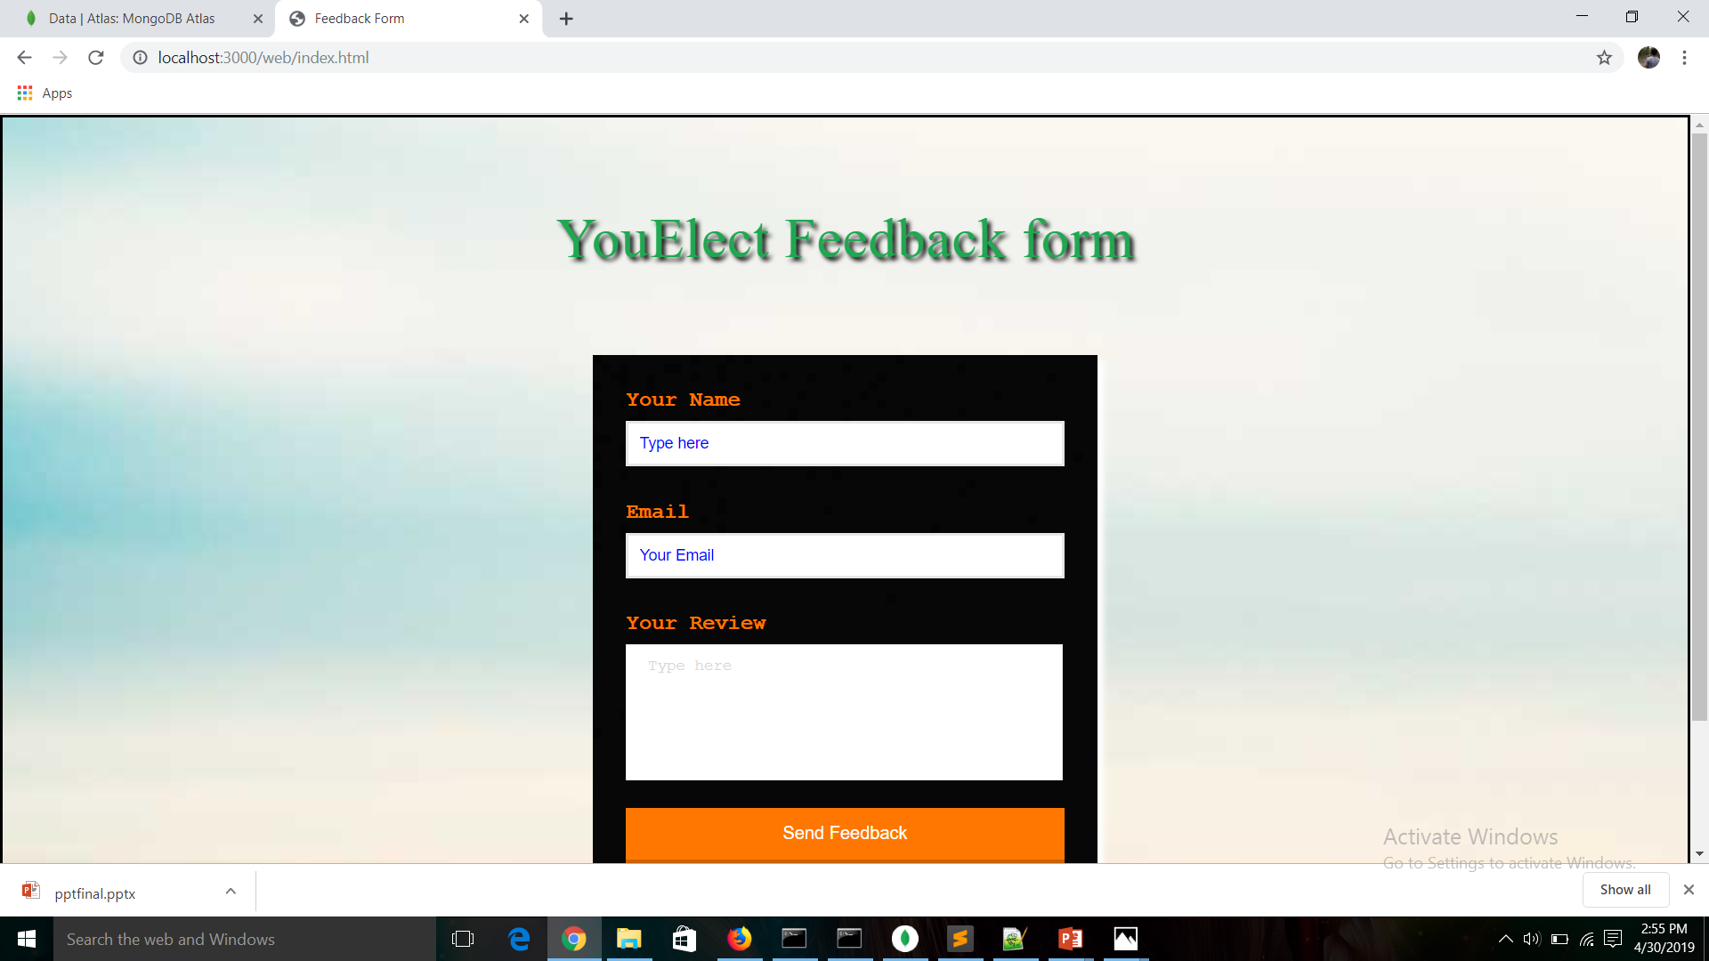

Slide 14
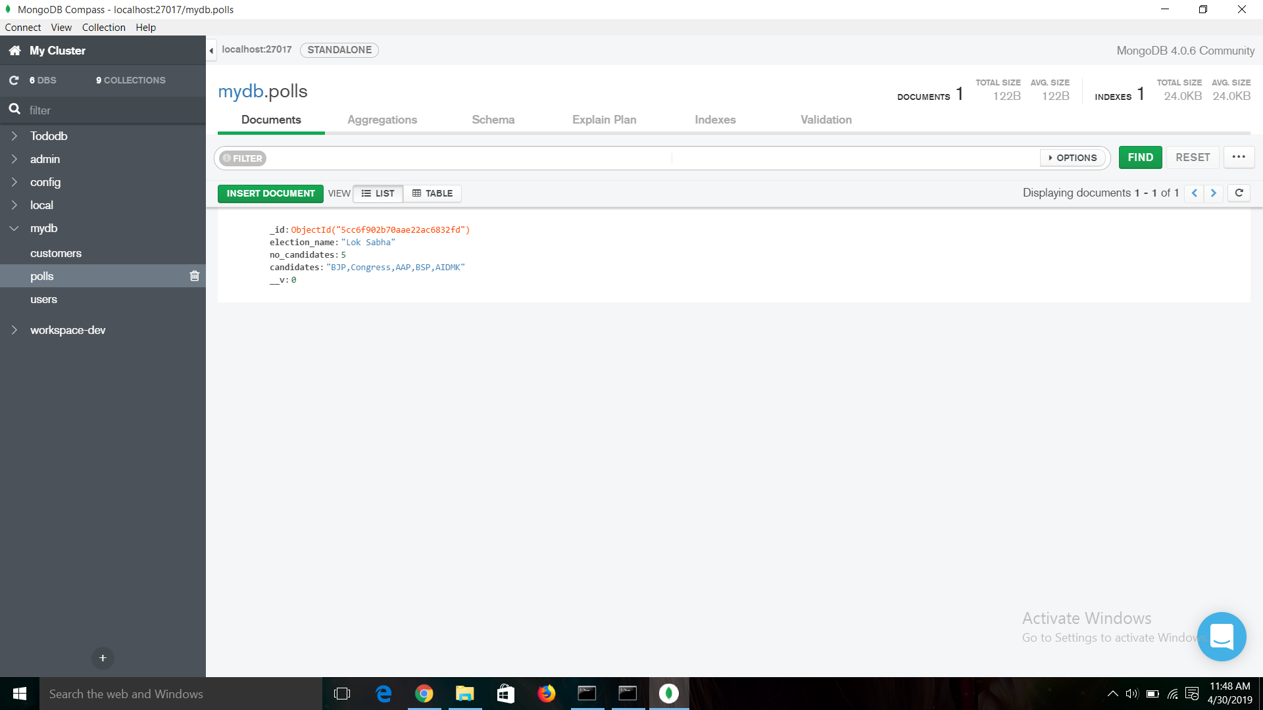

Slide 15
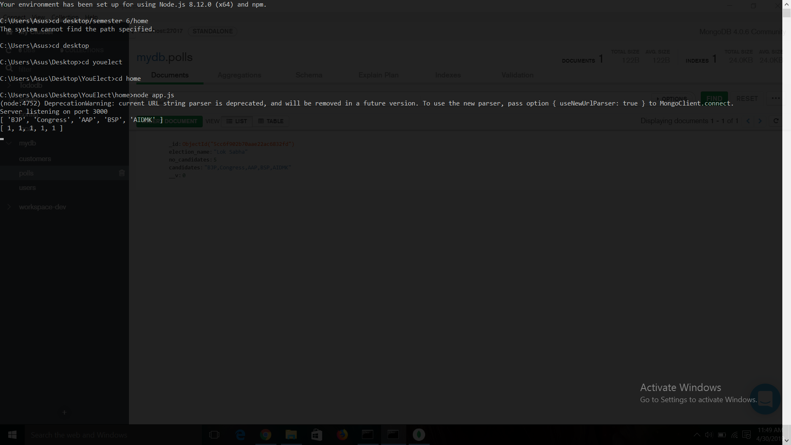

Slide 16
Our Team
Rishabh Joshi Akash Tripathi Nitesh Jhawar (Project Leader)

Slide 17
Thank You

