Slide 1





A probabilistic framework for multi-view feature learning with many-to-many associations via neural networks
http://lamda.nju.edu.cn
Akifumi Okuno¹ ² Tetsuya Hada³ Hidetoshi Shimodaira¹ ²
1 Kyoto University, 2 RIKEN Center, 3 Recruit Technologies Co., Ltd
Presented by Bo-Jian Hou
2018.11.19

Slide 2
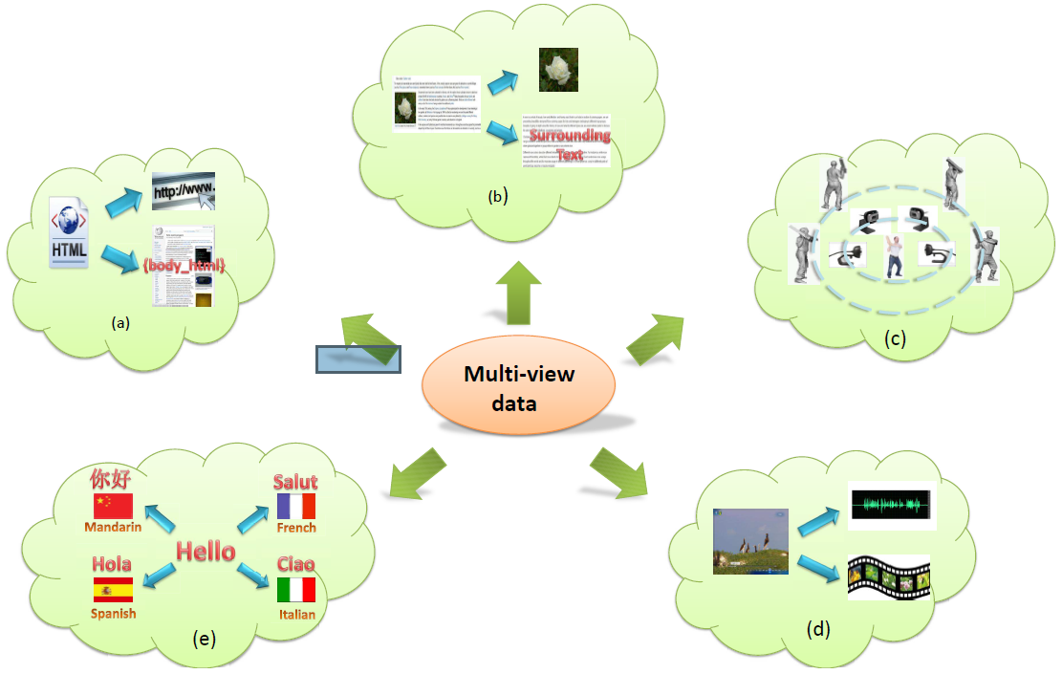
Multi-view Data
a web document can be represented by its url and words on the page,
a web image can be depicted by its surrounding text separate to the visual information,
images of a 3D object taken from different viewpoints,
video clips are combinations of audio signals and visual frames,
multilingual documents have one view in each language.

Slide 3
Goal of This Paper
In this paper, they work on multi-view Feature Learning.
Concretely, the goal is to transform the data vectors from all the views into new vector representations called “feature vectors” in a shared Euclidean subspace.

Slide 4
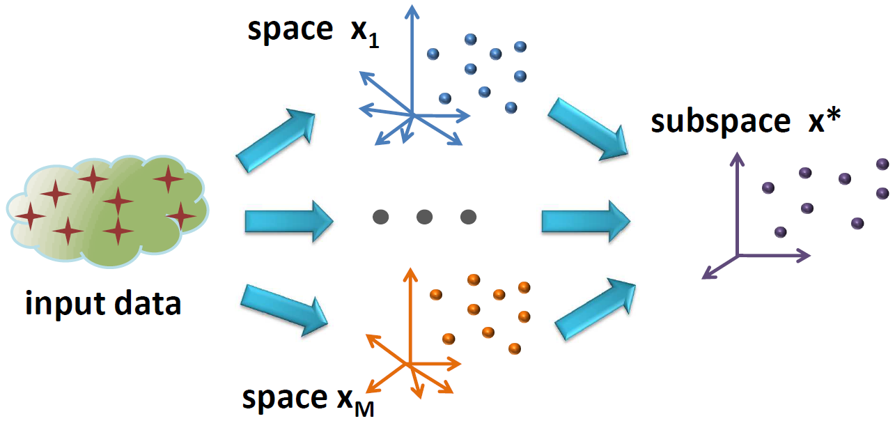
Goal of This Paper

Slide 5







Canonical Correlation Analysis (CCA)
Input multi-view data
Linear transformation matrices
Maximize the sum of inner products
Latent space feature vector
The dimension of latent space

Slide 6
Enhanced CCAs and Their Limitations
The linear transformations of CCA may not capture the underlying structure of real-world datasets.
CCA has been further extended to non-linear settings.
Kernel CCA (Lai and Fyfe, 2000)
Deep CCA (Andrew et al., 2013; Wang et al., 2016, DCCA)
However, these CCA-based approaches are limited to multi-view data vectors with one-to-one correspondence across views.

Slide 7

Many-to-many Associations
Real-world datasets often have more complex association structures among the data vectors.
each image has multiple associated tags as well as each tag has multiple associated images.
Cross-Domain Matching Correlation Analysis (Shimodaira, 2016, CDMCA) are proposed by extending CCA to many-to-many settings.
Linear transformation matrices
Maximize the sum of inner products
However, CDMCA is limited to its linearity.
We need many-to-many correspondence across views and non-linear
transformations simultaneously.

Slide 8








Probabilistic Multi-view Graph Embedding (PMvGE)
Overview of the proposed PMvGE
The whole dataset is interpreted as a large graph with nodes of data vectors and links of the associations.
Observation: many existing approaches to feature learning consider the inner product similarity of feature vectors.
PMvGE transforms data vectors from view by neural networks
so that the function can approximate the weight for .

Slide 9
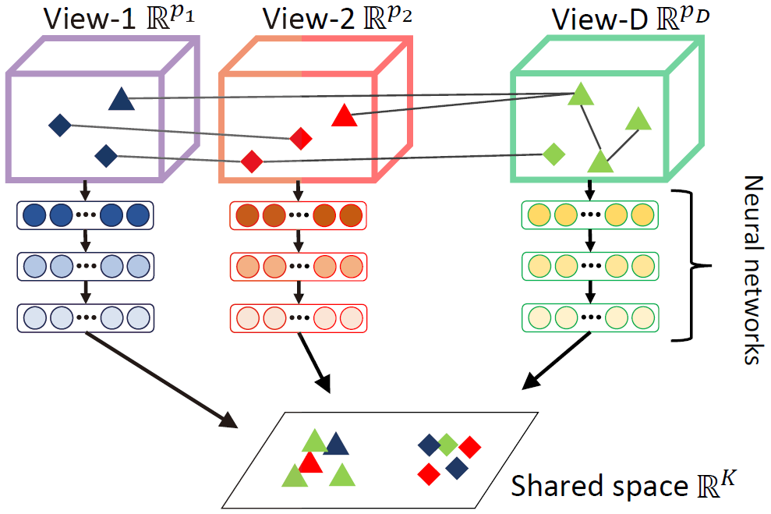
PMvGE-Illustration

Slide 10






PMvGE-Notations
an undirected graph consisting of $n$ nodes
link weights
the number of views
node $v_{i}$ belongs to one of views
the data vector representing the attributes at node $v_{i}$
conditional expected value

Slide 11


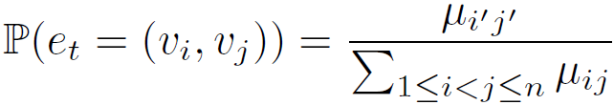

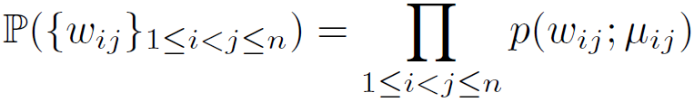

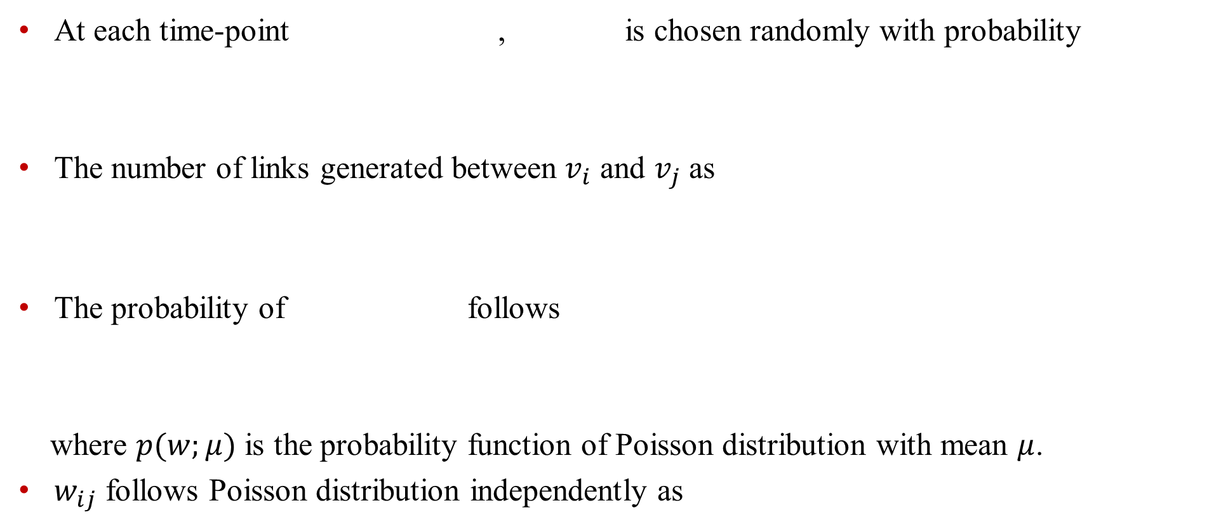
PMvGE-Preliminaries
At each time-point , is chosen randomly with probability
The number of links generated between $v_{i}$ and $v_{j}$ as
The probability of follows
where $p(w;μ)$ is the probability function of Poisson distribution with mean $μ$.
$w_{ij}$ follows Poisson distribution independently as

Slide 12
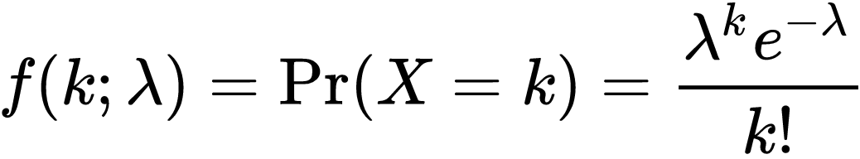
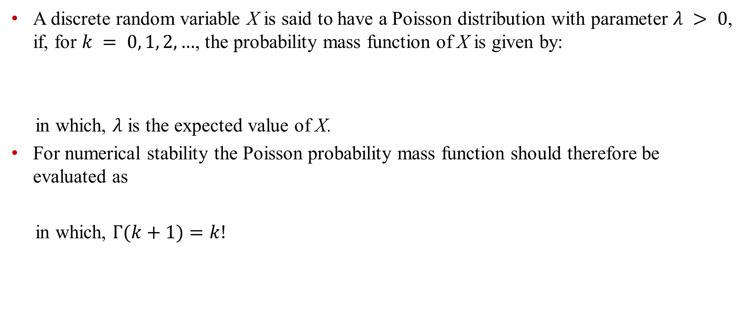
Poisson Distribution
A discrete random variable X is said to have a Poisson distribution with parameter $λ > 0$, if, for $k = 0, 1, 2, …$, the probability mass function of X is given by:
in which, $λ$ is the expected value of X.
For numerical stability the Poisson probability mass function should therefore be evaluated as
in which, $Γ(k+1)=k!$

Slide 13





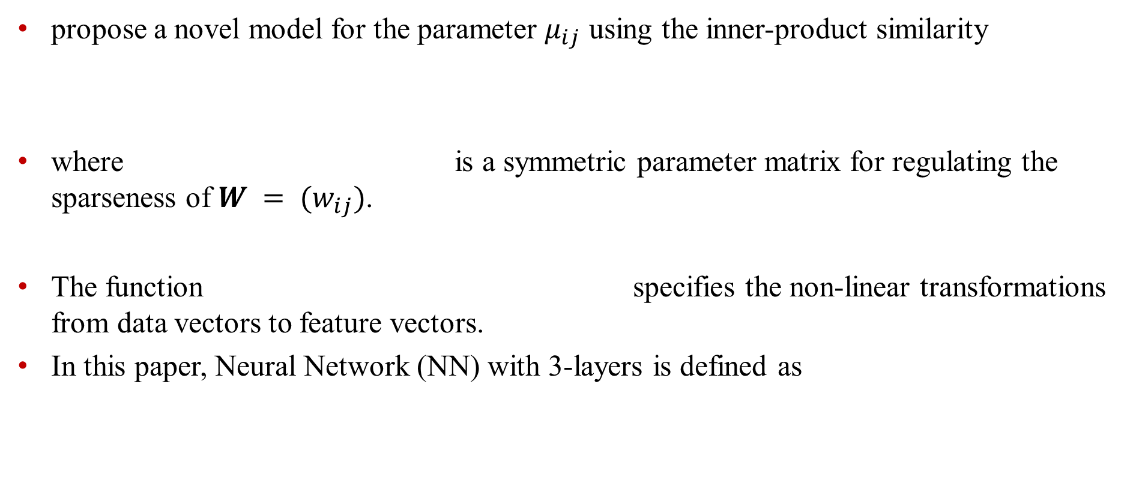
PMvGE
propose a novel model for the parameter $μ_{ij}$ using the inner-product similarity
where is a symmetric parameter matrix for regulating the sparseness of $W = (w_{ij})$.
The function specifies the non-linear transformations from data vectors to feature vectors.
In this paper, Neural Network (NN) with 3-layers is defined as
for me, it is only an extra parameter to tune

Slide 14



PMvGE-Maximum Likelihood Estimator
Likelihood：
alternatively optimize the two parameters $α$ and $ψ$

Slide 15
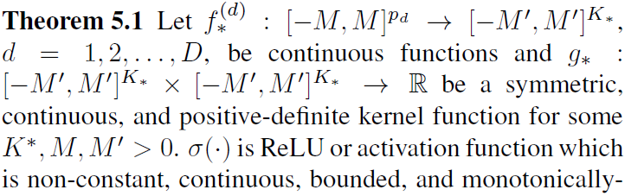


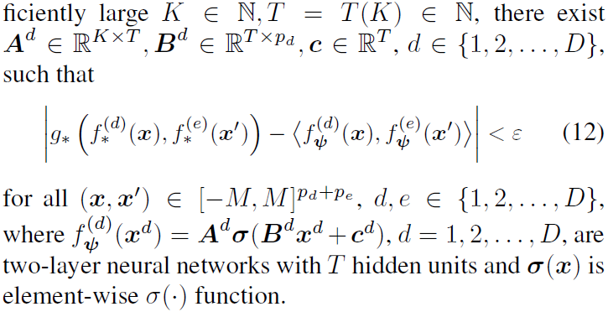



PMvGE Learns Arbitrary Similarity Measure
Goal:
Inner product of NNs approximates a wide class of similarity measures across views
Idea:

Slide 16







MLE converges to the true parameter value
Let denote the vector of free parameters in
maximizes and is the true parameter
They claim that converges to the true parameter
Note that there are rotational degrees of freedom where is orthogonal
They consider the set of equivalent parameters

Slide 17
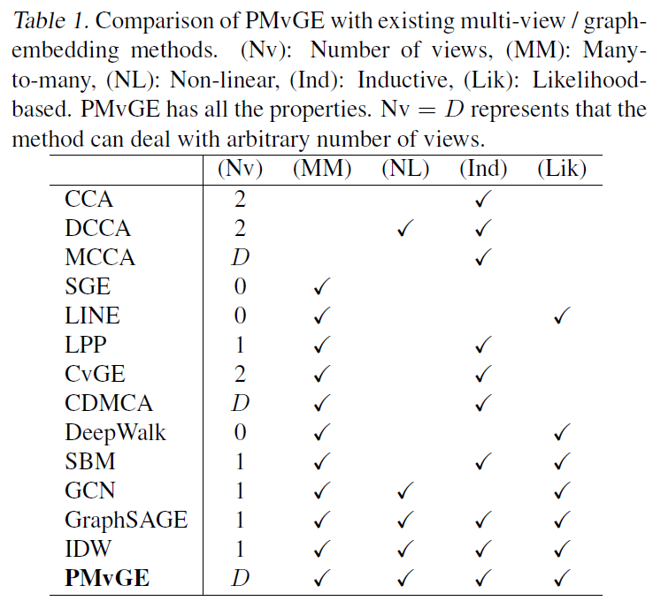
Comparison

Slide 18
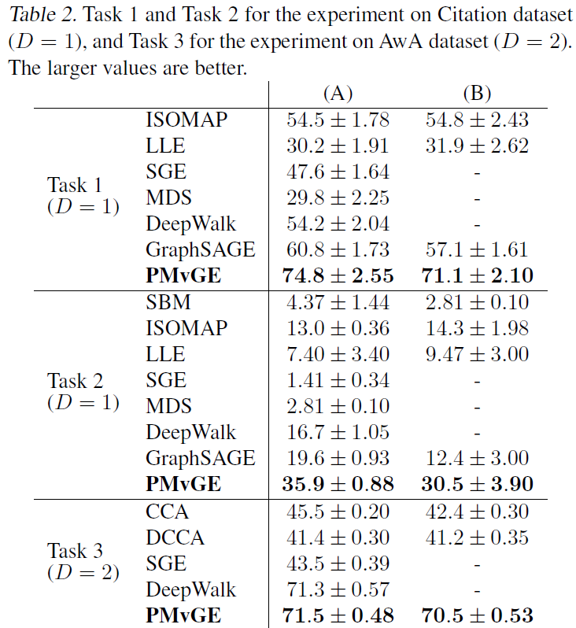
Experiments
Transductive
Inductive
Label classification
Clustering
Link prediction

Slide 19
Conclusion
This paper attempts to do multi-view feature learning with many-to-many associations.
They uses neural networks to implement the non-linear transformation.
They use MLP with Poisson distribution as objective to optimize to obtain solutions.
They provide theoretical analysis where PMvGE can learns arbitrary similarity measure.
They provide a guarantee that the iterative algorithm can converge.
Experiments show that they outperform other baseline methods.
My Comments
Pros:
Cons:
A general paradigm that incorporates all scenarios
No time complexity provided and seems time consuming
Theoretical guarantee provided
May be used in feature changing problem
Q&A

