Slide 1

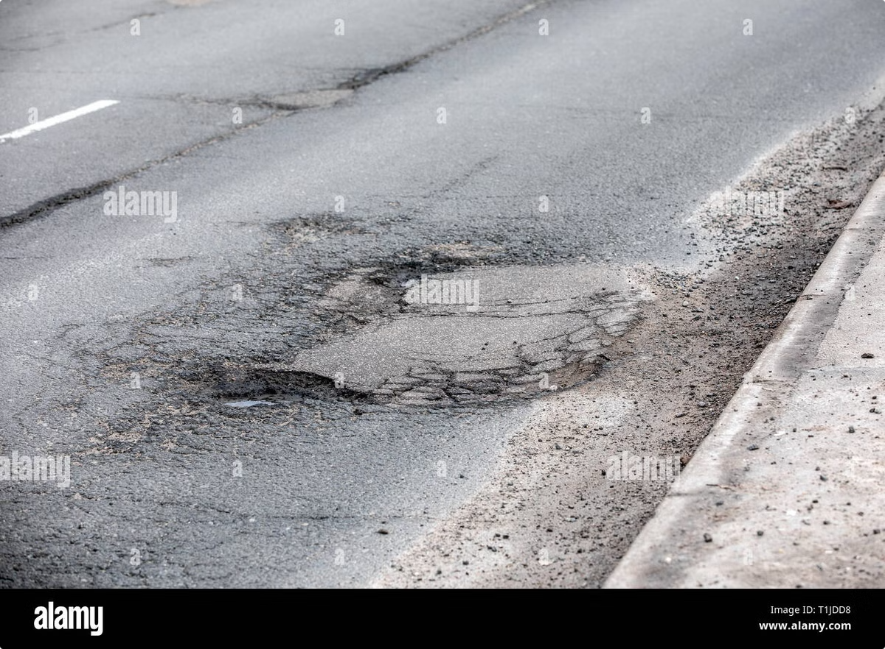
Revolutionizing Road Maintenance: Real-Time Pothole Detection
Our nation's roads are deteriorating, with significant portions in poor condition. Potholes contribute to accidents and vehicle damage, costing millions annually. This presentation introduces a cutting-edge solution leveraging AI for real-time pothole detection, paving the way for more efficient and proactive road maintenance.
by Team 227: AlgoMinds

Slide 2

Solution Overview: Real-Time Pothole Detection
Automated Detection
Data Analysis
Leveraging advanced machine learning algorithms, our system automatically identifies potholes from images or videos captured by various sources.
The system analyzes the visual data to precisely locate and assess the severity of each pothole, providing crucial data for prioritization of repairs.
Human Oversight
Enhanced Efficiency
While automated, the system allows for human review and intervention to ensure accuracy and address edge cases, guaranteeing high-quality results.
Real-time data enables proactive maintenance, reducing response times, improving road safety, and minimizing costs associated with pothole damage.

Slide 3
Dataset Collection and Preparation
Data Source
Data Cleaning
The foundation of our model is a robust dataset sourced from Kaggle, offering a large, pre-existing collection of pothole images and videos. This accelerates the development process and ensures a representative sample of diverse pothole conditions.
Rigorous cleaning was essential. We addressed issues like missing data, noise reduction, outlier removal, and inconsistency in image quality. This ensured data accuracy.
Data Augmentation
Data Annotation
To enhance model robustness, we augmented the dataset using various techniques, including image rotation, scaling, and brightness adjustments. This increased the training data's diversity and improved generalization.
Images were precisely labeled and annotated using RoboFlow, a platform designed for efficient dataset preparation. This meticulous annotation ensures high-quality training data for accurate pothole detection.

Slide 4
Data Processing and Augmentation
Data Cleaning
Data Transformation
This crucial step involved meticulous removal of irrelevant data points, such as images with poor quality or insufficient pothole visibility. We also handled missing values using imputation techniques and employed advanced filtering to eliminate noise and outliers, ensuring data accuracy and reliability.
Images were resized to a consistent format (224x224 pixels) for efficient processing by the CNN. Pixel values were normalized to a range of 0-1, improving model performance and training stability. Data format conversions ensured compatibility with the chosen deep learning framework (TensorFlow/Keras). These steps standardized the data for optimal model training.

Slide 5





Model Architecture: Convolutional Neural Network (CNN)
Input Layer
1
Raw image data.
2
Convolutional Layers
Feature extraction.
3
Pooling Layers
Dimensionality reduction.
4
Fully Connected Layers
Classification.
5
Output Layer
Pothole/No Pothole.
Our model employs a Convolutional Neural Network (CNN), a deep learning architecture ideally suited for image processing tasks. The CNN's hierarchical structure, composed of convolutional and pooling layers, effectively extracts relevant features from input images. These features are then fed into fully connected layers for final classification, distinguishing between potholes and non-potholes with high accuracy.

Slide 6

Model Performance Results
96%
95%
Accuracy
Precision
Correctly identified potholes and non-potholes.
Minimizes false positives.
97%
61%
Recall
F1-Score
Minimizes false negatives.
Harmonic mean of precision and recall.
The model demonstrates high accuracy, precision, and recall, indicating its effectiveness in identifying potholes. However, the F1-score suggests a potential imbalance in the dataset or the need for further optimization to improve the model’s ability to accurately identify potholes while minimizing false positives.

Slide 7
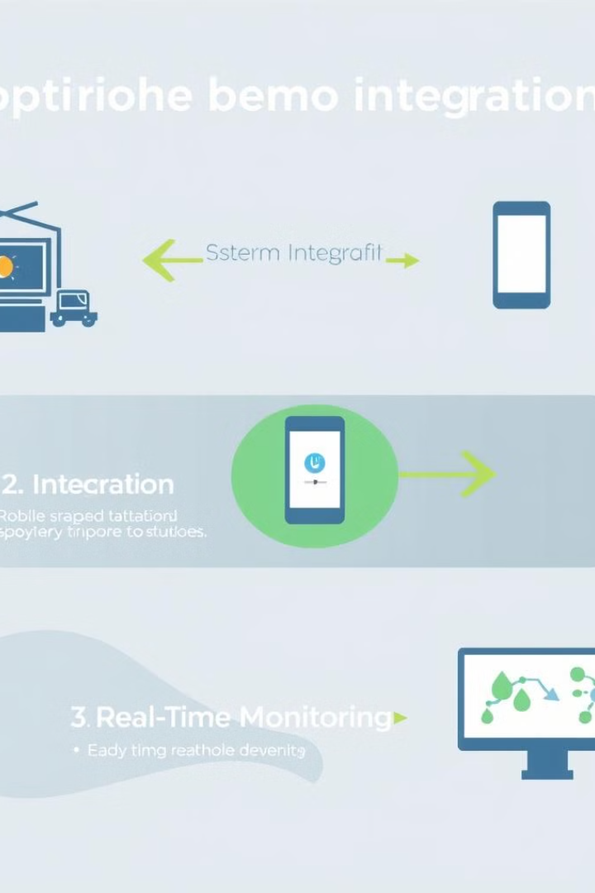
Deployment and Integration Strategies
1
System Integration
Seamlessly integrates with existing road maintenance systems, streamlining workflows and centralizing pothole data.
2
Mobile App Integration
Citizen reporting capabilities via a user-friendly mobile app allow for rapid pothole identification and efficient response.
3
Real-Time Monitoring
Real-time dashboards provide up-to-the-minute insights into pothole locations and repair progress, enabling proactive maintenance.
Our solution offers a variety of integration options. Data can be fed into existing systems, providing road maintenance teams with actionable, real-time insights. This integration ensures efficient allocation of resources and timely repairs, improving overall road safety and public satisfaction.

Slide 8
Deployment and Integration Strategies
System Integration
1
Seamlessly integrates with existing road maintenance systems.
Mobile App
2
Citizen reporting via a user-friendly mobile app.
Real-Time Monitoring
3
Dashboards provide real-time insights into pothole locations and repair progress.
Our solution offers flexible integration options. Data feeds into existing systems, offering real-time insights to road maintenance teams. This ensures efficient resource allocation and timely repairs, boosting road safety and public satisfaction.

