Slide 1
Bright Coffee Shop Sales Analysis

Slide 2
Objective & Data Overview
Objective: Identifying Sales trend of all products.
Identify top products.
Best performing outlet.
peak times of sales.
actionable recommendations to increase revenue.

Slide 3
Key Metrics
Total Revenue: R698,812.33
Total Units Sold: 214,470
Average Sale Value: R4.69

Slide 4
INTRODUCTION
The presentation if designed to make analysis of Bright Light Coffee Shop.
We analyze sales Revenue performance from January to June (6 Months)
We investigate which outlets are preforming well.
Which products are well performing.
Which times are the most are more profitable
We compare weekends and weekdays sales.
We make analysis and recommendations on steps to improve revenue over time.

Slide 5
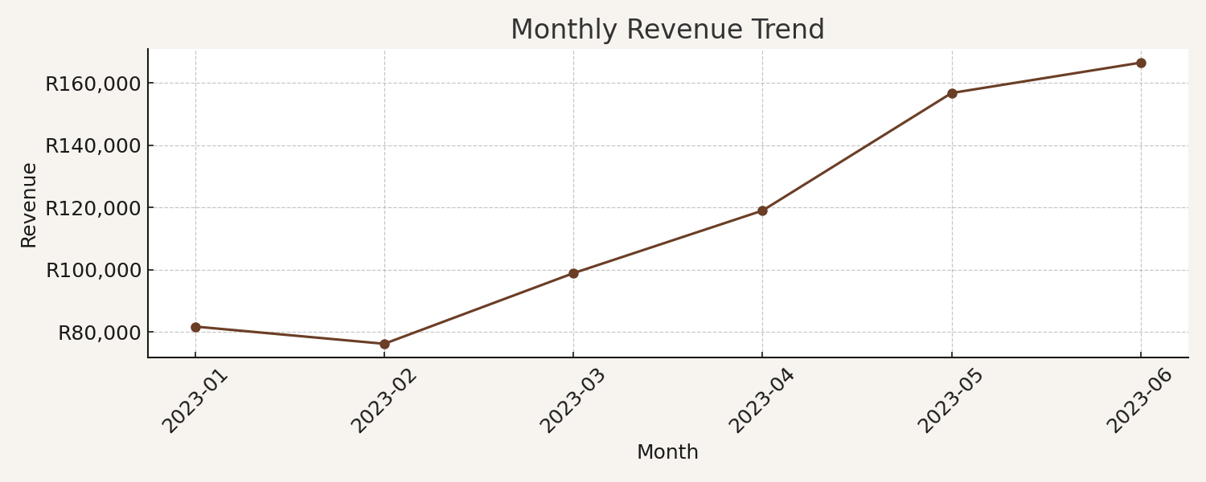
Revenue generation
The revenue graph above shows performance of the organization over period of Six months. It shows a low start of R80 000 from January, followed by deep in February. March starts to show improvement and gradually increases till June. Details will be explained below.

Slide 6
Revenue by Location
Store Locations | Sum of REVENUE
Astoria | R232 243,91
Hell's Kitchen | R236 511,17
Lower Manhattan | R230 057,25
Grand Total | R698 812,33
The pie chart show that Hells Kitchen is leading, followed by Astoria outlet and lastly Lower Manhattan in revenue generation. All out lets operate same hours. Hells Kitchen generates 38% of revenue, followed by Astoria at 33,2% and lastly Low Manhattan at 33 % of total revenue.

Slide 7
Total revenue of all locations
Revenue Per location for Six Months | Sum of REVENUE
Astoria | R232 243,91
Jan | R27 313,66
Feb | R25 105,34
Mar | R32 835,43
Apr | R39 477,61
May | R52 428,76
Jun | R55 083,11
Hell's Kitchen | R236 511,17
Jan | R27 820,65
Feb | R25 719,80
Mar | R33 110,57
Apr | R40 304,14
May | R52 598,93
Jun | R56 957,08
Lower Manhattan | R230 057,25
Jan | R26 543,43
Feb | R25 320,05
Mar | R32 888,68
Apr | R39 159,33
May | R51 700,07
Jun | R54 445,69
Grand Total | R698 812,33
All stores shows improvement in sales as the year progress. How ever Lover Manhattan is lagging behind in growth as a result it registers the lowest revenue.

Slide 8
Top 10 Product Details by Revenue
Types of Products Sold | Sum of REVENUE
Bakery | 8231564%
Branded | 13607
Coffee | 269952,45
Coffee beans | 40085,25
Drinking Chocolate | 72416
Flavours | 8408,8
Loose Tea | 11213,6
Packaged Chocolate | 4407,64
Tea | 196405,95
Grand Total | 698812,33
These are the top selling products, With Packages Chocolate been the lowest and Coffee being highest. This could the price facts. Coffee is cheaper and so more demand and Packages chocolate may be viewed as luxury in all locations. As the months gets colder more customers are gonna demand coffee as oppose to Packaged Chocolate.

Slide 9
Weekend vs Weekday Sales
Weekday total revenue for all shops show that Mornings have a highest profit, followed by Afternoon and lastly Evenings.
Sales Per Location in Different Time Buckets | Sum of HOUR_OF_DAY
AFTERNOON | R622 669,00
Astoria | R241 355,00
Hell's Kitchen | R182 532,00
Lower Manhattan | R198 782,00
EVENING | R411 107,00
Astoria | R187 592,00
Hell's Kitchen | R151 029,00
Lower Manhattan | R72 486,00
MORNING | R712 444,00
Astoria | R204 170,00
Hell's Kitchen | R258 412,00
Lower Manhattan | R249 862,00

Slide 10
Weekends sales
Sales Per Location in Different Time Buckets | Sum of HOUR_OF_DAY
AFTERNOON | R622 669,00
Astoria | R241 355,00
Hell's Kitchen | R182 532,00
Lower Manhattan | R198 782,00
EVENING | R411 107,00
Astoria | R187 592,00
Hell's Kitchen | R151 029,00
Lower Manhattan | R72 486,00
MORNING | R712 444,00
Astoria | R204 170,00
Hell's Kitchen | R258 412,00
Lower Manhattan | R249 862,00
With the Average price of all products being R4.69. Minimum price being 0.80 cents for Sugar free syrup and maximum price being R45 for Premium Beans. Total Units Sold: 214,470

Slide 11
Key FINDINGS
• Morning hours (peak) drive most revenue FROM 7am-10am and afternoon shows decline, As shown in the data above by Hells kitchen.
Coffee, Cappucino, Latte, and Americano drive the majority of total revenue.
Weekends transitions have higher average order values.
Weekends generate steady revenue driven by morning customers.
Less profitable in Manhattan Outlet. Staff must be stock up and be prepared for the morning rush accordingly.
• Top product types contribute majority of revenue such as Coffee, we might consider promoting complementary items
• Weekends show higher average basket sizes — target weekend promotions.
• Monitor low-margin high-volume items for pricing to build market share.
Create new combo’s based on customer

Slide 12
Recommendations & Next Steps
1. Increase inventory for top 5 selling items before morning peak.
2. Introduce bundle/upsell promotions during slow afternoon hours.
3. Develop a summer menu to continue with building market share.
4. Manhattan needs more support as its in the business district, has potential of more revenue.
4. Test weekend loyalty offers to increase repeat visits.

