Slide 1
METAL-INDUCED ENERGY TRANSFER ON SLB – Jurkat cell system
Membrane topography of
Jurkat cells on CD58
CELLS
17, two preparations
CALIBRATION
τ0 2.20 ns, qy 0.227
STAGE
4×4 sliding TCSPC
Height maps of 17 cells on CD58-functionalised supported bilayers over gold, and a test of whether close membrane contacts coincide with CD58 clusters.
ACQUIRED
13 Aug 2026
Notes:
MIET height maps of Jurkat T cells on CD58 bilayers over a 15 nm gold film. Three findings at three confidence levels. All numbers from the h2_rnd_t220 calibration variant.

Slide 2
THE MEASUREMENT
Lifetime becomes height
Gold quenches over the first ~100 nm
water n 1.33
Lifetime falls steeply with distance to the metal. Inverting that dependence gives a height per pixel.
cell membrane
z
Two dyes, one scan
MemGlow on the membrane in the 640 nm window, CD58–Atto488 on the bilayer in the 485 nm window. Perfectly registered — same pixels, no alignment step.
bilayer + CD58
SiO2 20 nm
Ti 2 nm
Anchored on the bilayer
Au 15 nm
The uniformly labelled SLB, about 4 nm above the silica, fixes the quantum yield and free-space lifetime.
Ti 2 nm
glass n 1.52
Thicknesses labelled, not to scale.
Notes:
Layer stack: glass / 2 nm Ti / 15 nm Au / 2 nm Ti / 20 nm SiO2 / water. Random dipole orientation assumed, f = 1/3.

Slide 3
FINDING 1 · EXPLORATORY
Room-temperature cells flatten in the middle.
Cold-prepared cells do the opposite.
−21.6 nm
RT core − rim, mean. 6 of 6 negative.
+22.0 nm
4 °C core − rim, mean. 2 of 11 negative.
p = 0.0023
Fisher exact, one-sided, on the sign.
Core = beyond 55 % of the way in from the footprint edge; rim = outer 20 %. Metric chosen after seeing the maps, and the 4 °C maps invert far fewer pixels — hence exploratory.
Notes:
Restricting to the six cold cells above 30 % inversion keeps the direction but weakens it to p = 0.030. RT cells also spread over about 65 % more area, 89 vs 54 square microns.

Slide 4
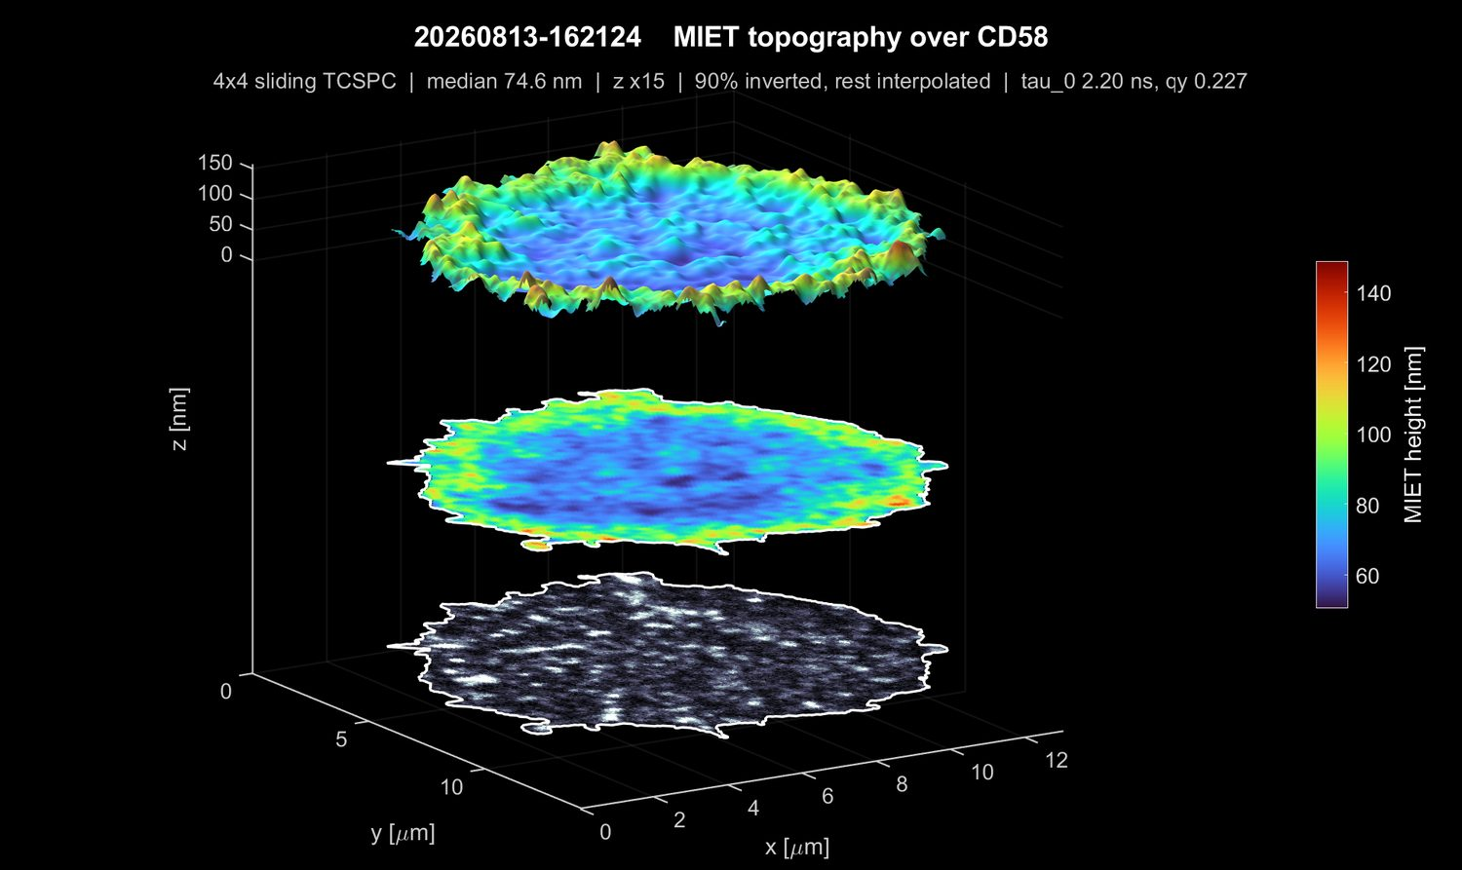
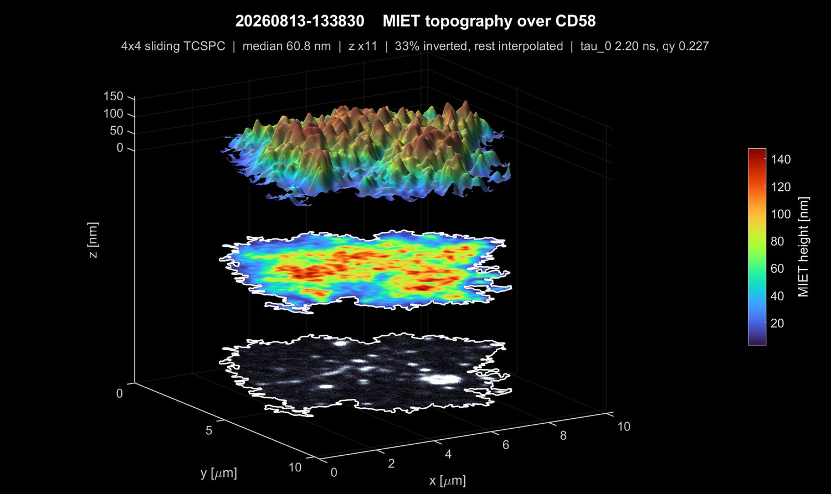
EXAMPLES
The two geometries
ROOM TEMPERATURE · 162124
PREPARED AT 4 °C · 133830
Core 67 nm against a rim at 80 nm, dipping to 54 nm at its lowest decile. The best-conditioned map in the set — 90 % of pixels invert. No pixel reaches the 30 nm contact threshold.
The inverse — a rugged interior near 65 nm falling to 18 nm at the rim. Only 33 % of pixels invert, so the surface is partly interpolated, as stated on the figure.
Notes:
Each figure stacks three registered layers: height surface in relief, the same height map as a flat projection, and the CD58 image of the bilayer at the bottom. One shared footprint outline.

Slide 5
FINDING 2 · ROBUST
Membrane closer than 30 nm is rare.
Thirteen of seventeen cells have none at all.
Here we use one fixed height threshold
4
PREPARED AT 4 °C
Contact is a physical claim, so the cut stays a number in nanometres, identical for every cell and printed on every figure.
A per-cell adaptive cut would have produced regions in all seventeen, which would turn an absence of contact point into a dataset.
133049
133830
151013
ROOM TEMPERATURE
of 17 cells
carry any contact region
164910
filled = contact regions found
Every region found sits within a few pixels of the footprint edge — at 30 nm this finds the lamellipodial rim, not interior contacts.
Notes:
Three of the four contact-bearing cells are cold-prepared. Three have unusually low median heights at 19, 28 and 56 nm against about 74 nm across the set; the fourth contributes a single region covering 0.4 % of its footprint.

Slide 6
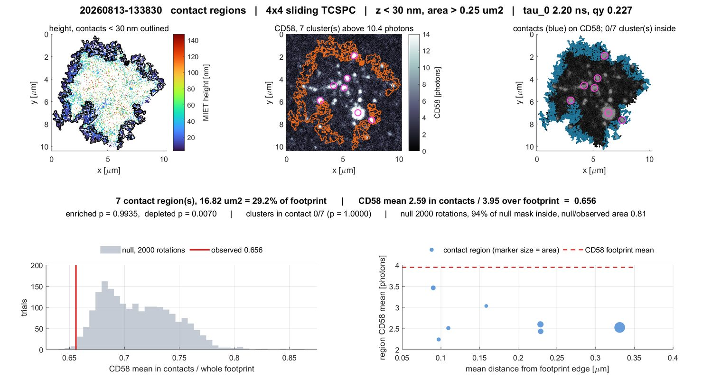
FINDING 3 · NEGATIVE
No cell shows CD58 enriched at its contacts.
0 of 4
contact-bearing cells enriched. p ≥ 0.25 throughout.
1 of 12
CD58 clusters inside a contact. About 3 expected by area.
Why the depletion cannot be read
The cell body sits above the bilayer and attenuates the 485 nm path, so CD58 counts fall wherever the membrane is closer. That artefact produces depletion and only depletion — which is why the absent enrichment is trustworthy and the depletion is not.
Cell 133830. Seven contact regions form a rim annulus and all seven CD58 clusters sit inside it, in the interior. The histogram is the rotation null.
Notes:
Null: each region rotated about the footprint centroid through a random admissible angle, 2000 trials, CD58 held fixed. Statistic normalised by the whole-footprint mean, because independently rotated regions can overlap and a mask-complement denominator biases the null. 133830 depletion p = 0.0070.

Slide 7
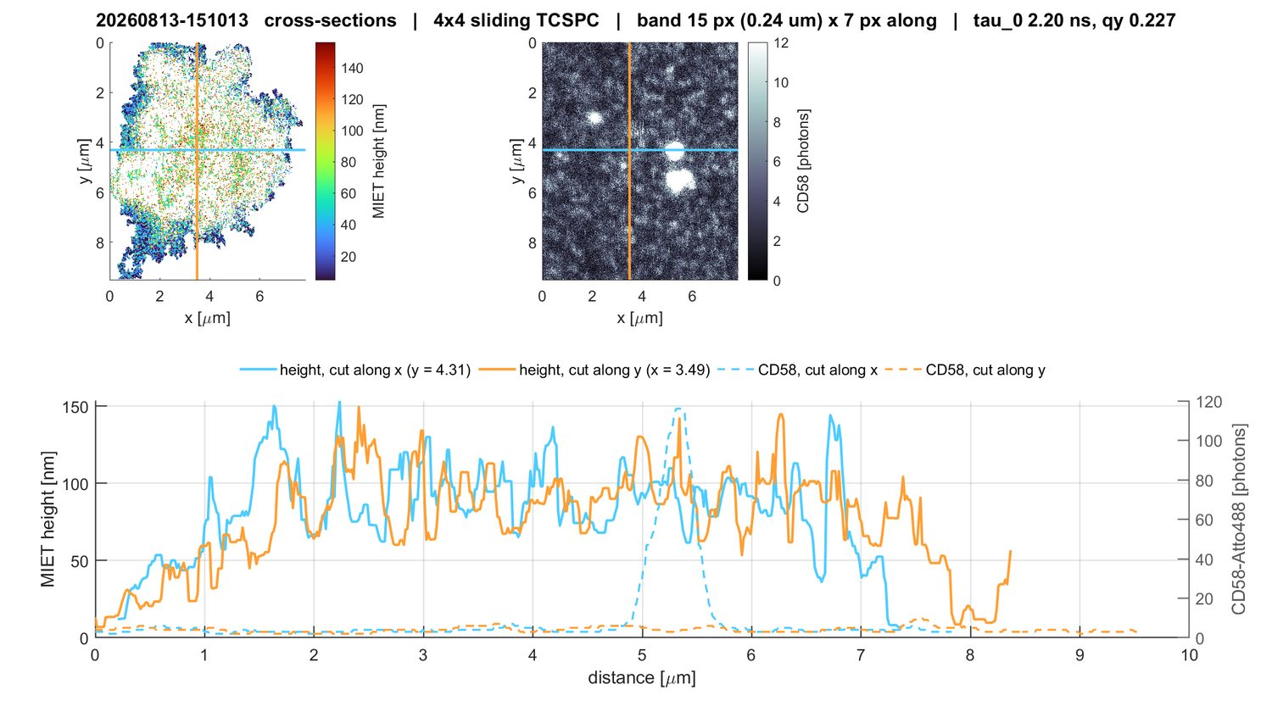
Higher heights are noisier
Medians, not means
dz/dτ reaches several hundred nm per ns near τ0, so the noise is heavy-tailed.
Cell 151013. Height on the left axis, CD58 on the right; one cut along x and one along y.
Notes:
51 cross-section figures on disk, one per cell per binning. Band and along-cut statistics are medians because the calibration flattens near tau_0.

Slide 8
EVERY CELL
All 17 cells, 4×4 sliding stage
Prep | Acquisition | Inv % | Area μm² | Median nm | Core nm | Rim nm | Δ nm | Contact regions | Clusters in contact
RT | 155036 | 64 | 56 | 78 | 72 | 86 | −13 | – | 0 / 4
RT | 155849 | 80 | 95 | 74 | 74 | 91 | −17 | – | 0 / 11
RT | 160712 | 76 | 72 | 69 | 64 | 100 | −35 | – | 0 / 0
RT | 162124 | 90 | 122 | 68 | 67 | 80 | −12 | – | 0 / 13
RT | 164117 | 70 | 74 | 82 | 72 | 102 | −30 | – | 0 / 5
RT | 164910 | 64 | 117 | 80 | 73 | 94 | −22 | 1 | 0 / 0
4 °C | 132419 | 8 | 43 | 87 | 111 | 66 | +45 | – | 0 / 1
4 °C | 133049 | 28 | 59 | 19 | 50 | 10 | +40 | 4 | 1 / 2
4 °C | 133830 | 33 | 58 | 28 | 65 | 18 | +46 | 7 | 0 / 7
4 °C | 134759 | 9 | 45 | 70 | 70 | 61 | +9 | – | 0 / 5
4 °C | 135856 | 55 | 56 | 97 | 88 | 134 | −46 | – | 0 / 1
4 °C | 141031 | 24 | 38 | 97 | 97 | 91 | +6 | – | 0 / 8
4 °C | 142754 | 28 | 59 | 85 | 104 | 62 | +42 | – | 0 / 7
4 °C | 143434 | 45 | 51 | 73 | 90 | 52 | +38 | – | 0 / 8
4 °C | 144242 | 47 | 72 | 97 | 90 | 103 | −12 | – | 0 / 5
4 °C | 145800 | 31 | 66 | 92 | 96 | 76 | +21 | – | 0 / 12
4 °C | 151013 | 43 | 47 | 56 | 89 | 37 | +52 | 5 | 0 / 3
Δ = core − rim. “Inv %” is the share of footprint pixels whose lifetime fell inside the invertible window; the rest carry no height. “4 °C” denotes samples prepared cold and measured at room temperature.
Notes:
Full per-cell table, also written as one CSV per preparation next to the figures.

