Slide 1

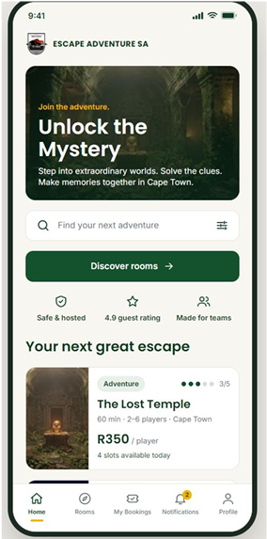
ADVENTURE
ESCAPE
Website Project Presentation
Work Integrated Learning • Group Project
Presented by: [Konanani Nkateko Fhumulani]
Course / Class: [XHAW5112] | Date: [27/10/2026]
EXPLORE • SOLVE • ESCAPE

Slide 2
Introducing the idea behind our Adventure Escape website
01 | PROJECT OVERVIEW
Adventure Escape is a website concept designed to bring the excitement of escape-room challenges and adventure experiences online.
THE IDEA
THE AUDIENCE
THE PURPOSE
Create an engaging place where visitors can discover adventure challenges and learn how to take part.
Friends, families, students, and groups looking for a fun activity or team-building experience.
Present information clearly and make it easy for users to explore activities and contact the team.

Slide 3
Why an Adventure Escape website can be useful
02 | THE NEED WE ADDRESS
People need a simple way to discover exciting group activities.
Important details—such as the experience, rules, and how to enquire—should be easy to find.
1
2
A well-organised website helps visitors understand the concept before making contact.
The website can make the adventure feel exciting through clear content and visual design.
3
4

Slide 4
What we want our website to achieve
03 | PROJECT GOALS
01
02
03
04
INFORM
ENGAGE
GUIDE
CONNECT
Explain the Adventure Escape concept, activities, and visitor expectations.
Use an adventurous look and clear calls to action to keep visitors interested.
Help users move between pages and find the information they need.
Give visitors a clear way to ask questions or enquire about an experience.

Slide 5
Designing with the visitor in mind
04 | TARGET USERS
1
2
3
ADVENTURE SEEKERS
FRIENDS & FAMILIES
TEAM GROUPS
People who enjoy puzzles, challenges, mystery, and trying something new.
Groups looking for an entertaining activity to enjoy together.
Students or colleagues interested in teamwork and problem-solving.
Our design should be clear, easy to navigate, and suitable for users with different levels of web experience.

Slide 6
A simple structure for the user journey
05 | WEBSITE PAGES
HOME / LANDING PAGE
ADVENTURES PAGE
CONTACT / BOOKING
Welcoming headline
Short introduction
Adventure-themed image
Main call-to-action button
Available challenges
Short descriptions
Difficulty or theme details
What visitors can expect
Contact information
Enquiry form or details
Group enquiry option
Clear next steps

Slide 7
Features that support a useful visitor experience
06 | KEY WEBSITE FEATURES
01
02
03
Navigation menu that links the main pages together.
Adventure-themed headings, images, and colours.
Readable text with a clear visual hierarchy.
04
05
06
Buttons or links that guide visitors to the next step.
Responsive layout principles so the website can work on different screen sizes.
Contact or enquiry information that is easy to locate.

Slide 8
Making the website easy and enjoyable to use
07 | DESIGN AND USER EXPERIENCE
VISUAL STYLE
EASY NAVIGATION
Adventure-inspired imagery, strong contrast, and consistent colours.
Consistent menus, descriptive links, and a clear path between pages.
ACCESSIBILITY
USER-CENTRED THINKING
Readable font sizes, meaningful image descriptions where appropriate, and clear labels.
Consider what visitors need to know and reduce unnecessary steps.

Slide 9
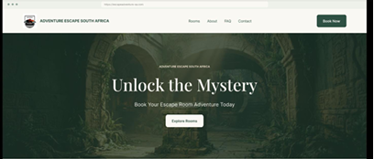
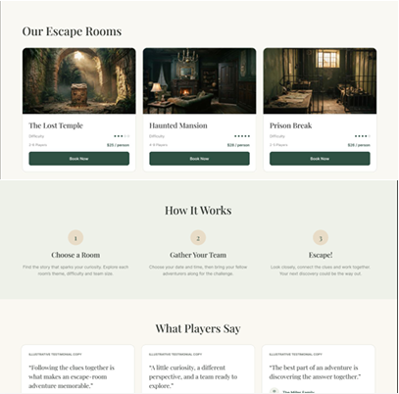
Figma website design: home page
WEBSITE DESIGN
The future or final view with HTML, CSS and JS
Rooms, how it works, player stories
Hero with the “Unlock the Mystery” headline, a clear “Explore Rooms” call to action and a “Book Now” button in the navigation bar.
Room cards, a three-step “How It Works” and testimonials.

Slide 10
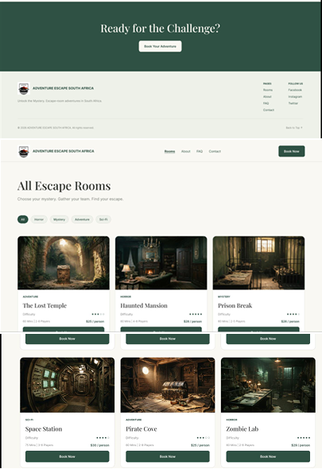
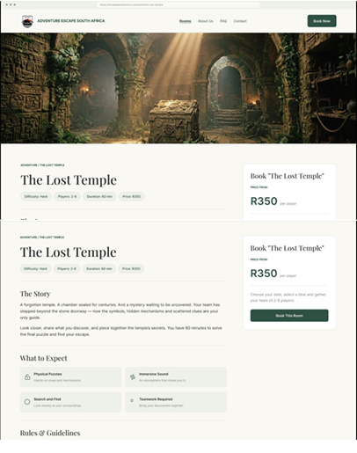
Rooms listing and room details
WEBSITE DESIGN
WHAT VISITORS SEE
Filter rooms by category: All, Horror, Mystery, Adventure, Sci-Fi
Room cards show difficulty, duration, players and price
Room page: story, what to expect, rules and guidelines
Booking panel with price from R350 per player
All Escape Rooms • The Lost Temple

Slide 11
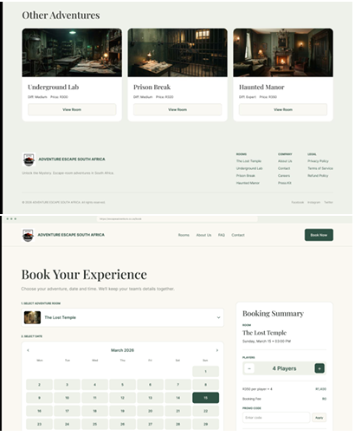
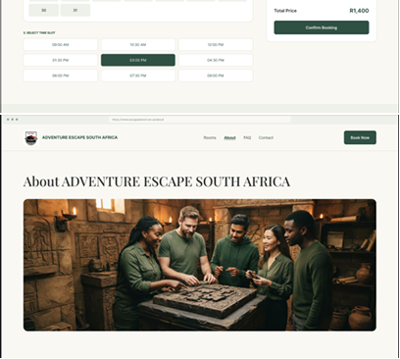
Booking and About pages
WEBSITE DESIGN
Book Your Experience
Booking summary and About page

Slide 12

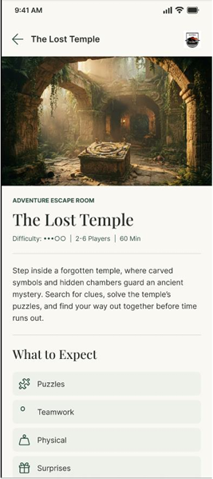
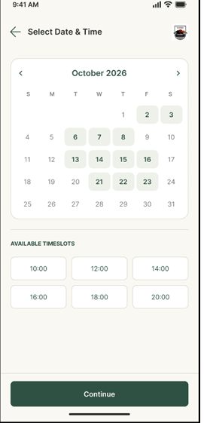
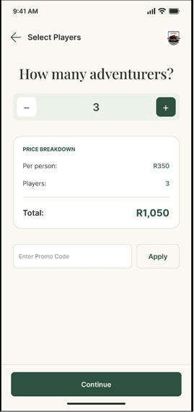
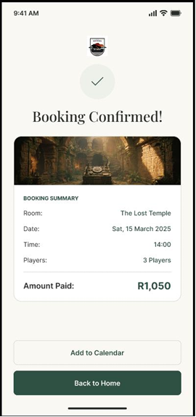
Mobile app: the booking flow
MOBILE APP DESIGN
Splash
Room details
Date & time
Players
Confirmed

Slide 13
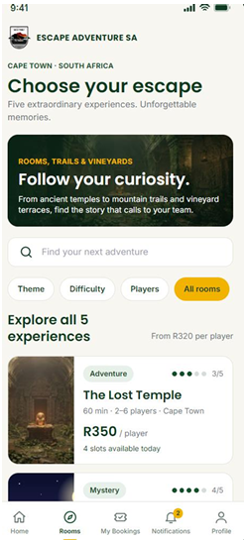
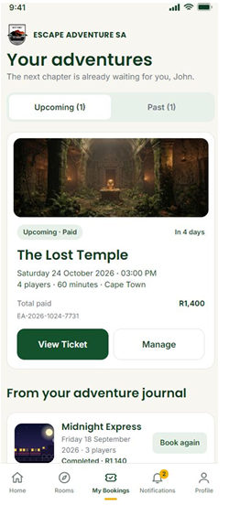
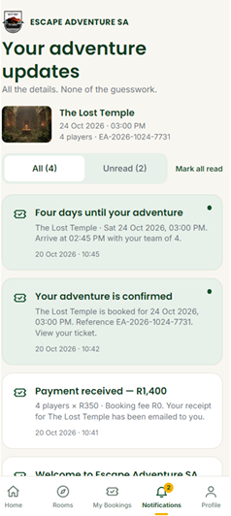
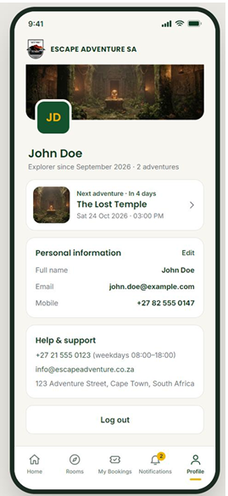
Mobile app: browse, track and manage
MOBILE APP DESIGN
Home
Rooms
My bookings
Notifications
Profile

Slide 14
The tools behind our website
08 | TOOLS AND TECHNOLOGIES
HTML
CSS
JAVASCRIPT
Provides the structure and content of the web pages.
Controls the layout, colours, spacing, and visual presentation.
Can add interactive behaviour, such as menus or form feedback, if used.
Other tools (if used): Visual Studio Code • Figma • GitHub

Slide 15
A practical workflow for a group website project
09 | OUR DEVELOPMENT PROCESS
1
2
3
4
5
PLAN
DESIGN
BUILD
TEST
IMPROVE
Agree on the purpose, audience, and pages.
Sketch a wireframe and decide on layout.
Create the pages and style the website.
Check links, layout, text, and usability.
Use feedback to fix issues and refine the result.

Slide 16
How teamwork supports the project
10 | GROUP COLLABORATION
Share responsibilities for research, design, coding, content, and testing.
Communicate regularly and agree on deadlines.
Use shared files or version control to keep work organised, if available.
Review each other’s work and provide constructive feedback.
Make sure every member understands the final website and can explain their contribution.
Group members and roles: [Add each member’s name and contribution]

Slide 17
What we ran into and what we learned
11 | CHALLENGES AND LESSONS LEARNED
POSSIBLE CHALLENGES
WHAT WE LEARNED
Linking pages correctly
Keeping layouts consistent
Working to shared deadlines
Fixing display or coding errors
Planning before coding saves time
Testing catches issues early
Communication improves teamwork
User feedback helps us improve

Slide 18
An adventure starts
with a great experience.
12 | CONCLUSION
Our Adventure Escape website aims to present an exciting concept through clear information, engaging design, and simple navigation.
THANK YOU
Questions?

