Slide 1
Unwrapping Valentine's Day:
A Data-Driven Look into Love & Spending
By Team HeartCode ❤️ (Group 11) | April 2025

Slide 2
Business Question
How do age and gender influence spending patterns on Valentine's Day gift categories over time?
Why this matters:
Helps brands personalize campaigns
Reveals shifting consumer behavior over time

Slide 3
Data Sources
historical_spending.csv: Yearly spend by category (2010–2022)
gifts_gender.csv: Spend distribution by gender
gifts_age.csv: Spend distribution by age group

Slide 4
Methodology
Data Cleaning & Reshaping: Unpivoted category columns
Dimensional Model: YearTable, CategoryTable, GenderTable, AgeGroupTable
Tools: Power BI, DAX, Power Query
Key Metrics: Total Spend, YoY Growth %, Category Breakdown

Slide 5
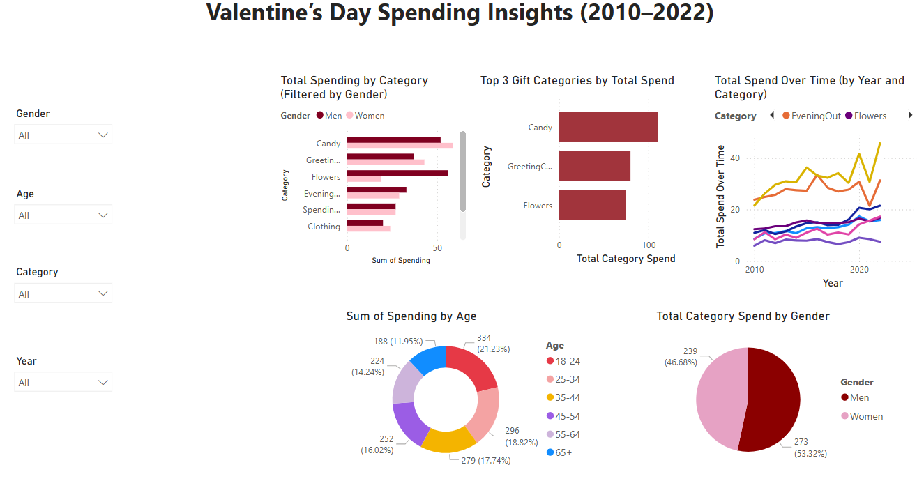

Slide 6
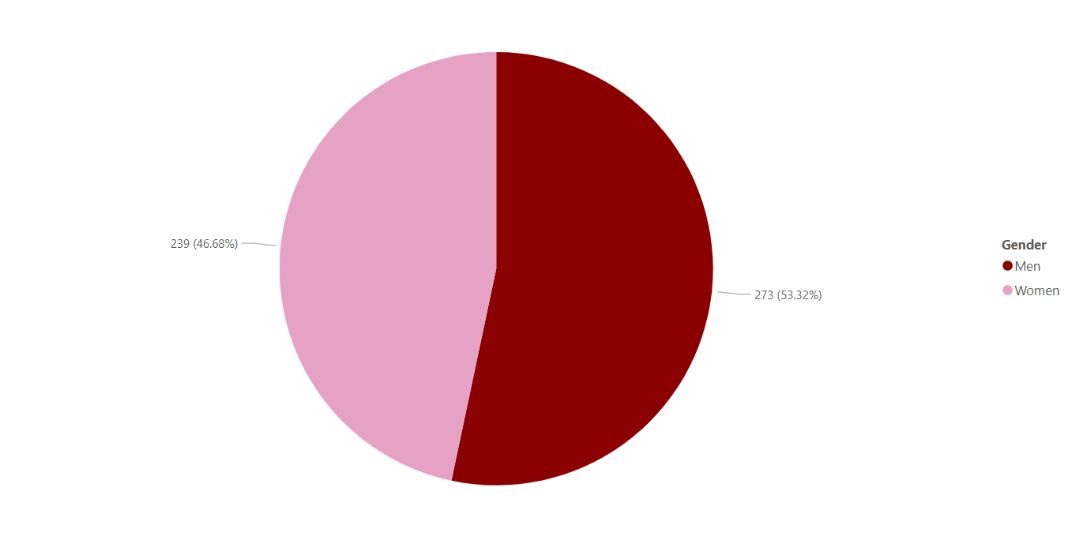
Total Spend by Gender
While both genders are actively involved in Valentine’s gifting, men account for the majority share of total spend(53.3%).
This is consistent with traditional buying roles where men often purchase high-value items like jewelry, flowers, or plan evenings out.

Slide 7
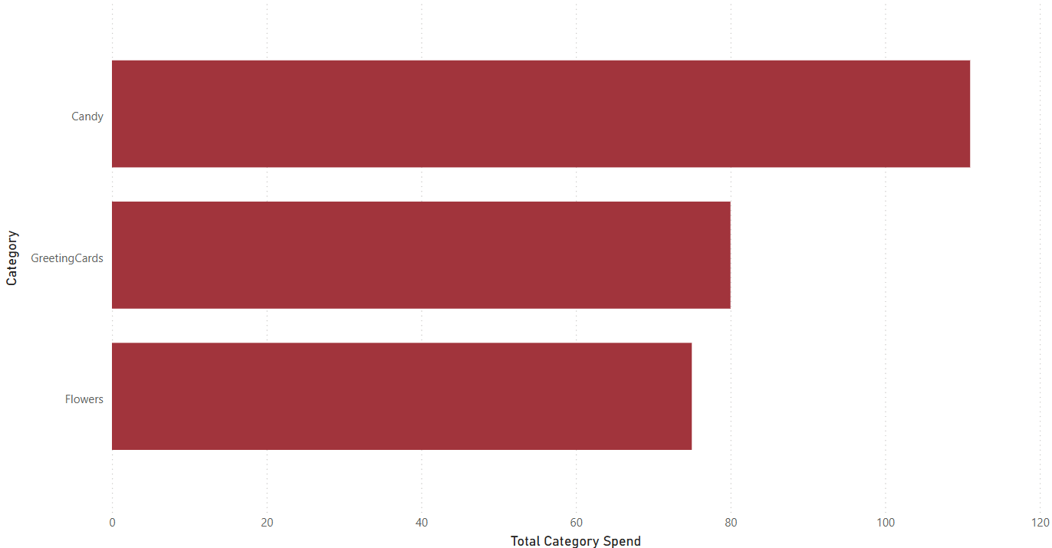
Top 3 Categories of Gifts
Candy is king
Cards have lasting power
Flowers remain iconic

Slide 8
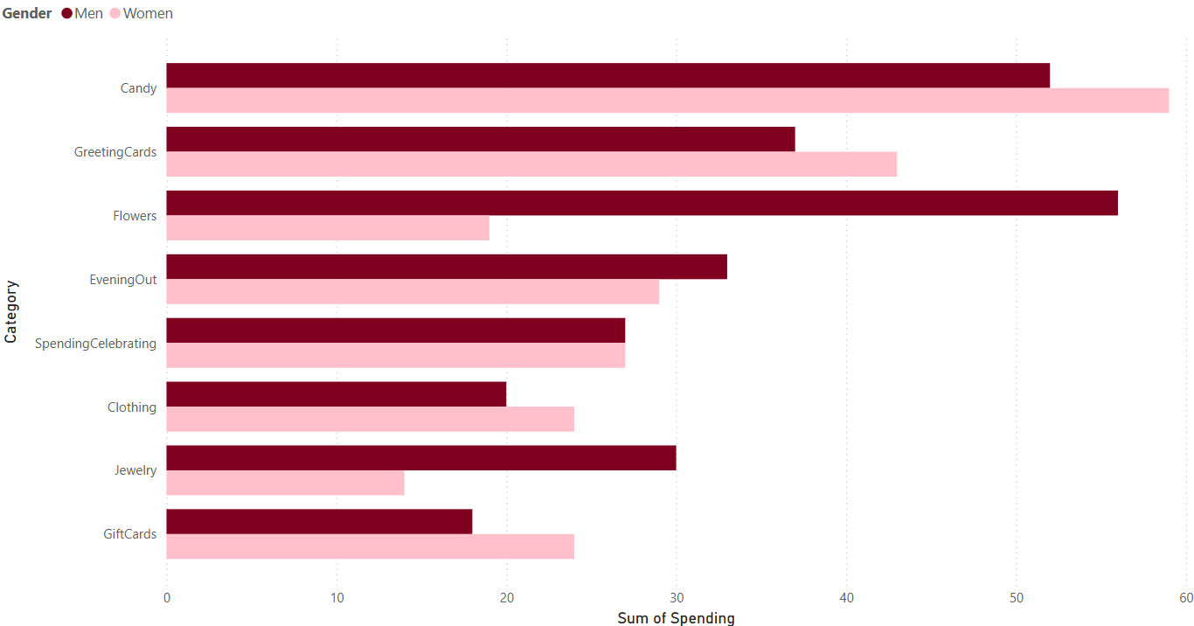
Gender-Based Spending
• Women spend more on Candy ,Cards and Experiences such as evening out
• Men on Flowers, Candy, Jewelry and Cards.
Tailor campaigns can be made based on gender preferences
Joint packages or couple promotions might appeal to many.

Slide 9
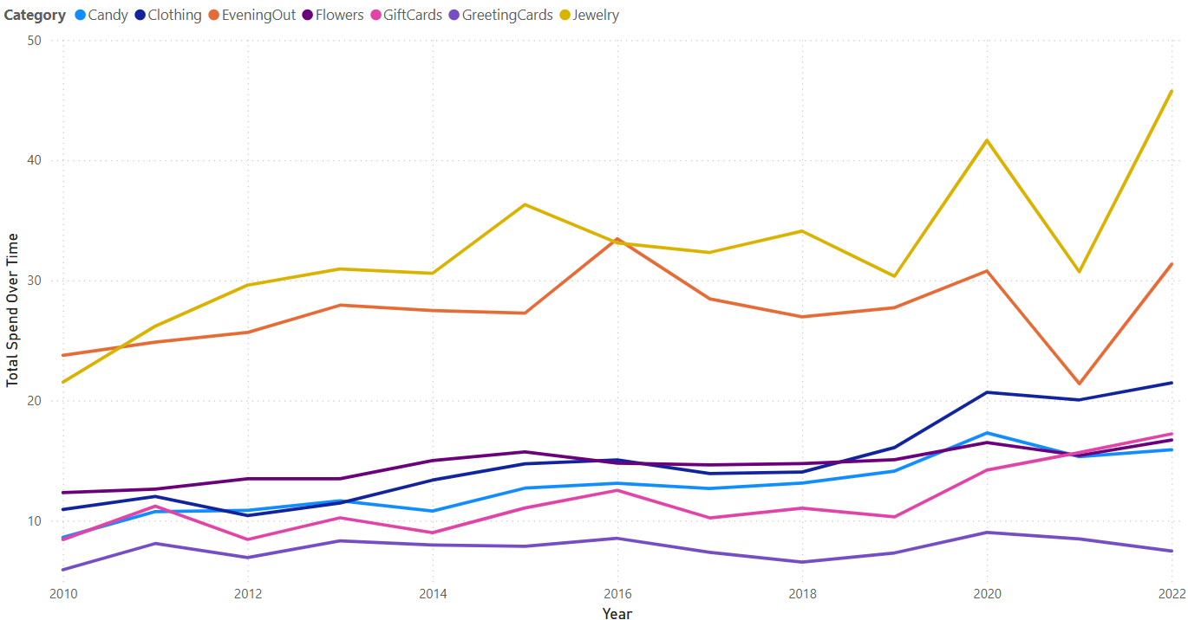
Spending Trends Over Time
• Jewelry and Flowers lead in total spend
• Gift Cards and Experiences are rising
Opportunity to promote digital and experiential gifts

Slide 10
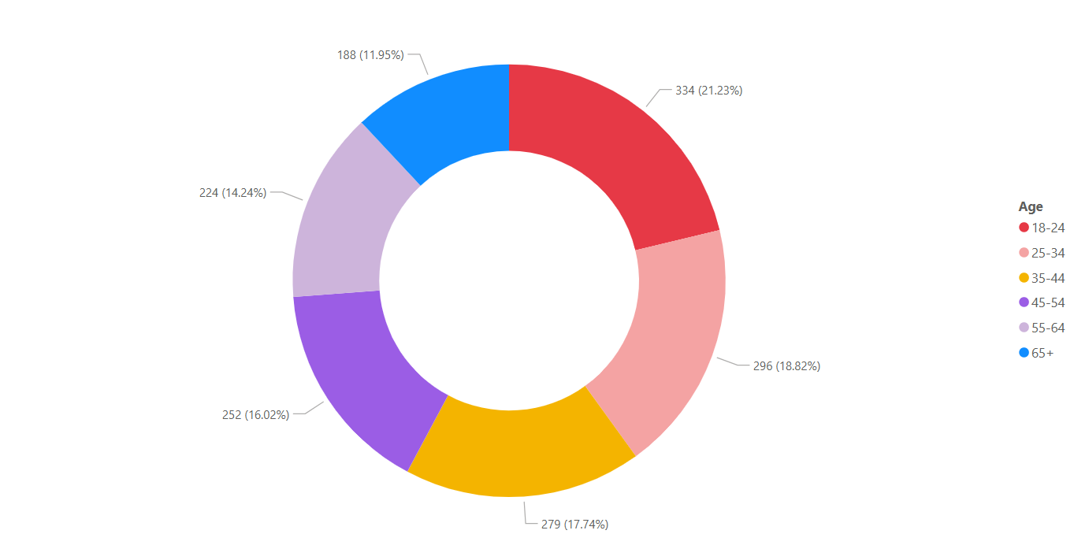
Age Group Preferences
The 18–34 age range accounts for 40% of total Valentine's Day gift spending
Younger adults are key drivers of seasonal consumer behavior
Older segments still participate, but with decreasing intensity

Slide 11
Gaps & Opportunities
Limitations:
No location or sentiment data
Future Potential:
Integrate Google Trends / social sentiment
Expand to geo-based insights

Slide 12
Conclusion
Valentine spending is shaped by age and gender
Experiences and gift cards are rising in popularity
Businesses can leverage these insights for smarter, targeted campaigns

Slide 13
Thank You / Q&A
Thank you! We’d love to hear your questions or thoughts.
Team HeartCode ❤️

