Slide 1
AliExpress Supplier Data

Slide 2
AGENDA
1) Abstract/ Data Setting
2) Interactive Visualization
3) Stagnant Visualizations
4) Data Analysis
5) Summary

Slide 3
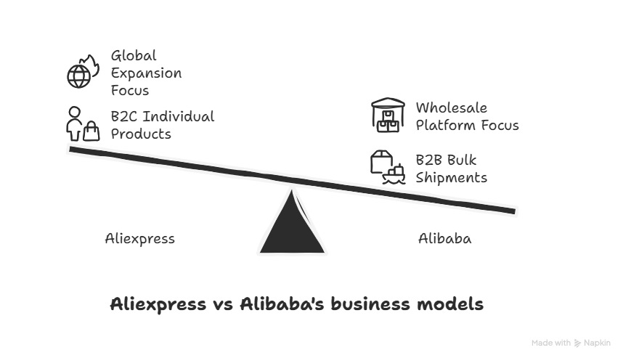
ABSTRACT
AliExpress is a Chinese e-commerce, wholesale company. Comparable to E-Bay, and DhGate. Incredibly, AliExpress has surpassed 10,000 sellers, the company has also developed initiatives and targeted marketing towards global expansion. Diversification of merchant location's of course increases the efficiency of supply chains and promotes more convenience in the primarily B2C model that the company operates. A key distinction, Alibaba is not congruent with AliExpress, although the 2 are grouped into the same conglomerate, Alibaba is primarily a B2B wholesale platform offering bulk shipments, whereas AliExpress offers individualized products to the consumer similar to Temu. For purposes of research and visualization I chose to use readily available AliExpress data. Generally, I would consider lead time and risk (defect) rates to garner a better understanding of supplier trends.
Bulk purchasing is often impractical for small businesses, while platforms like AliExpress may lack the customization or quality standards these businesses require. A notable social trend shaping the pet industry—especially among passionate small business owners and consumers—is the increasing "humanization of pets." As pets are treated more like family members, particularly in suburban markets, there is growing demand for boutique items, wellness-focused products, and curated pet experiences.
The goal of my analysis is to provide stakeholders with necessary, yet concise information to make simpler retail procurement decisions. With over 1990 products from different suppliers to choose from within this chosen dataset, a small business may feel overwhelmed, especially because of the global scale. I have identified the top 10% of suppliers through a scorecard with weighted criteria, and I have done a statistical analysis in Excel of only 5-star suppliers and selected the best to ensure a safe and reliable supply chain

Slide 4
Interactive Visualization power bi

Slide 5
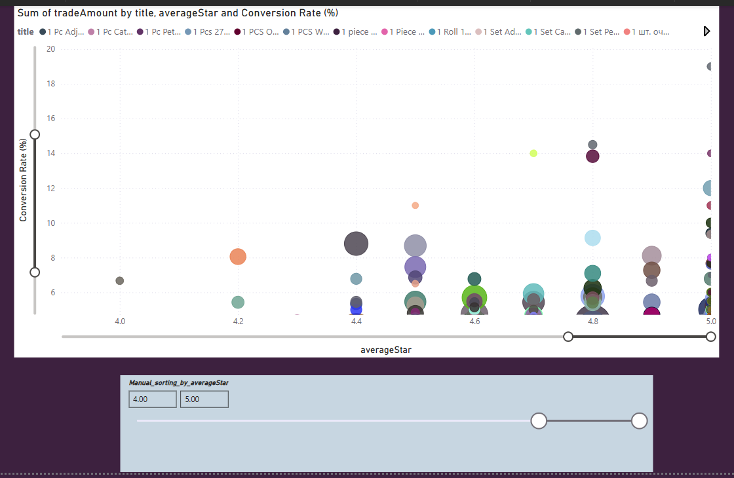
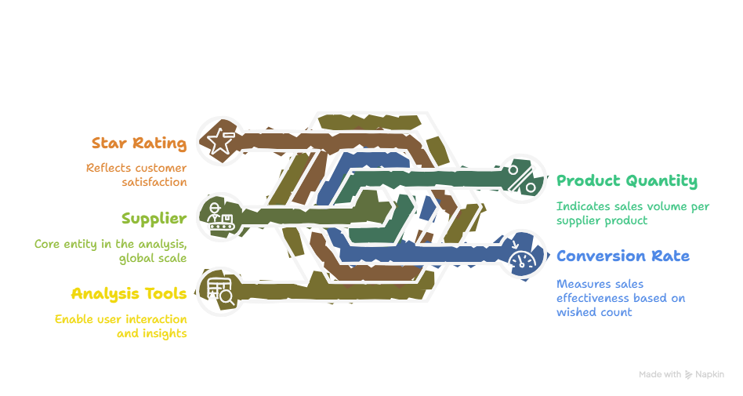
Dual sliders allow the user to adjust the conversion rate % and average star rating to analyze specific supplier product subgroups. Each bubble corresponds to a supplier and is interactive. The size of each bubble indicates the quantity of product sold per supplier. The ‘title’ of the product can be examined by clicking on each bubble.

Slide 6
Stagnant Visualizations Excel

Slide 7
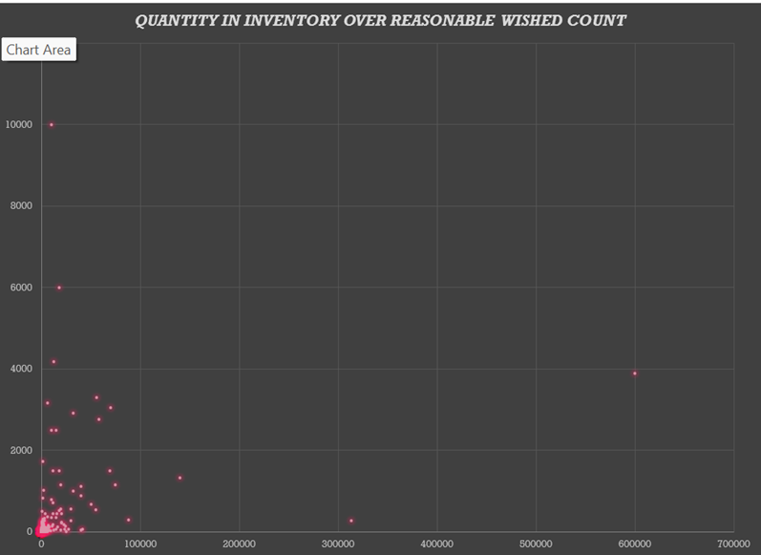
Visualization 1

Slide 8
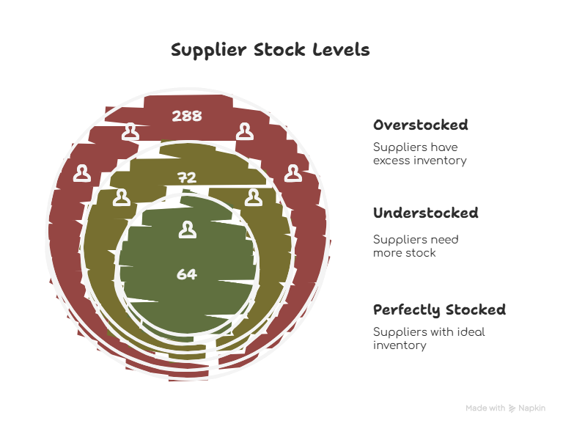
Depicts the coverage ratio of all our ‘5 star’ products (filtered in excel)
The trendline and R squared equation is depicted on the worked excel case file, the Rsq= 0.11, which signifies an extremely insignificant relationship between quantity in inventory and reasonable wished count, secondhand factors must influence quantity in inventory
Suppliers should not consider wished count as an accurate demand forecast to stock inventory
Significant outliers are depicted, generally our group of suppliers is overstocked, with 288 suppliers being overstocked, and 72 understocked

Slide 9
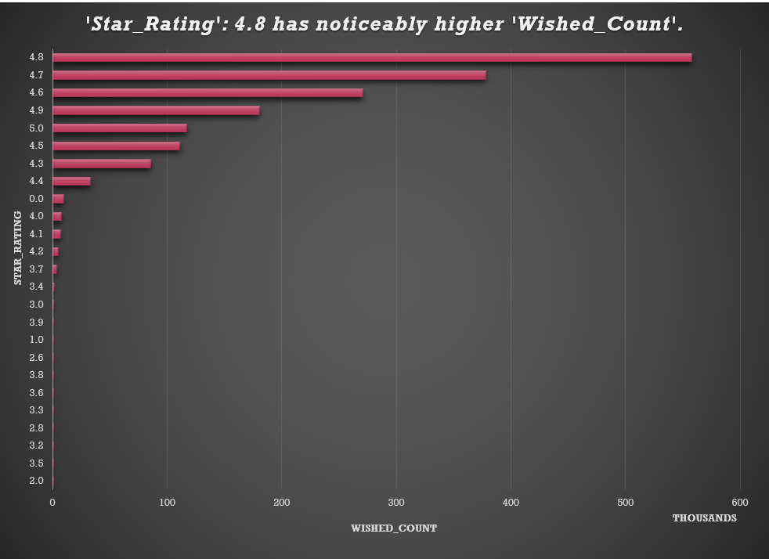
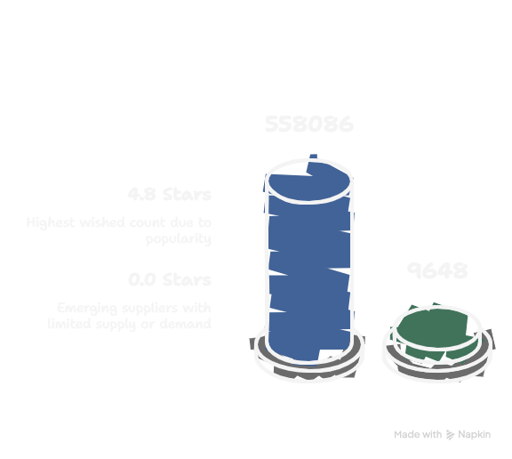
Visualization 2
Star Rating as a determinant of Wished Count, an intuitive relationship
Unintuitively, the 4.8 star rated suppliers are the suppliers with the highest average wished count of 558.086
Consider that supplier products with higher star ratings most likely also have backlogs due to their popularity and higher wished counts
The 0.0-star rating has a small, but significant amount of wished cart placements, this is due to the emerging nature of these suppliers- initial interest with limited supply

Slide 10
DATA ANALYSIS Excel & Python

Slide 11

Criteria for scorecard Ordered by weight In ‘Final Score’
Quantity of product sold / Wished count – 25% weight
Quantity sold / Current Quantity of product in inventory – 35% weight
Star Rating
0-5 integer value – 40% weight
Turnover Ratio
Conversion Rate

Slide 12
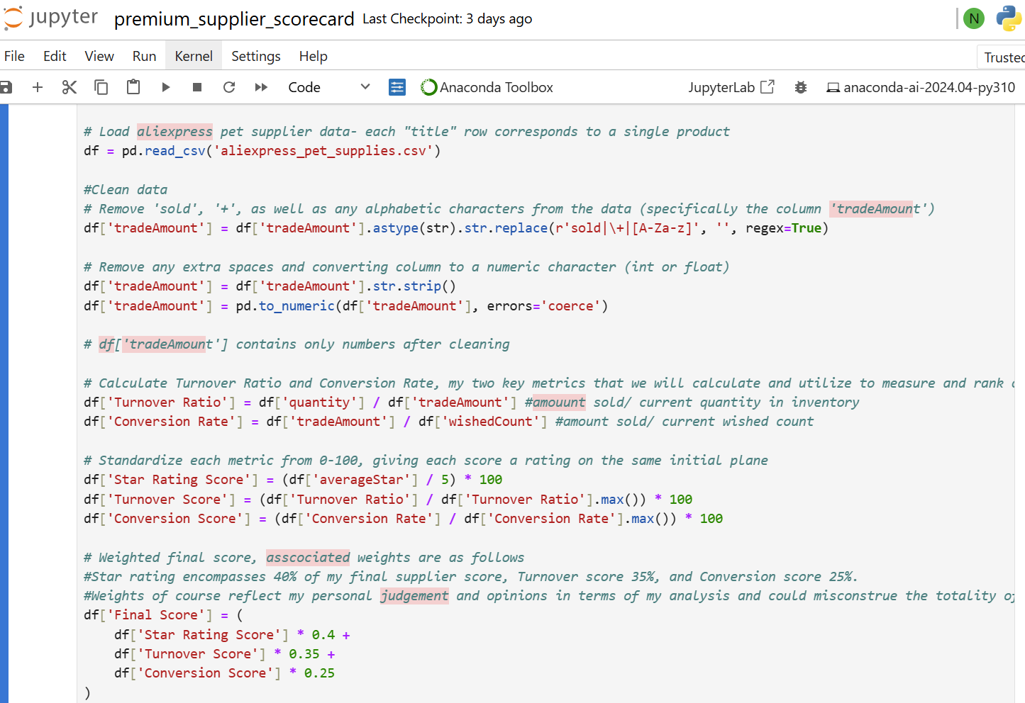
SUPPLIER SCORECARD
Clean Data
Adjusting raw data, Removing “sold” and “+” from ‘tradeAmount’ column, converting all columns to integer, removing rows with 0 product sold that may dilute the scorecard
Create Scoring Criteria
Calculating Turnover Ratio, and Conversion Rate, Standardize scores, Applying predetermined weights to my 3 criteria (which also includes star rating)
Filter and Sort products
Setting a threshold of 0.9, selecting and displaying top 10% of suppliers based on ‘Final Score’, Sort premium supplier products in descending order
Output Results
scorecard_output

Slide 13
Final Summary
30 top supplier products listed in red, my top 6 safest selections include…
Simulation Bird Interactive Cat Toys Electric Hanging Eagle Flying Bird Cat Play Cat Stick Scratch Rope Pet Toys (2000 sold)
20KG Pet Cat Hammock Hanging Cat Bed Bearing Comfortable Cat Sunny Window Seat Mount Kitten Climbing Frame Pet Accessories (1000 sold)
Pet Cat Toys Funny Stick Kitten Self -hi Elastic Rope Dragonfly Shape Feather Bell Teasing Stick Hanging Swing Thousands (2000 sold)
Cat toy Cute octopus plush toy bite resistant teeth interactive play pet supplies (5000 sold)
2 Modes Smart Cat Toy Automatic Moving Remote Controlled Toy Car for Cats Dogs Interactive Playing Kitten Training Pet Supplies (2000 sold)
Night Reflection Dog Pet Towing Rope 1.2/1.5/1.8m Guard Rope Pet Walking Training Leash Cats Dogs Harness Collar Lead Strap (2000 sold)
Enter these text queries into AliExpress to analyze price distributions and make purchase decisions

